Slide 1
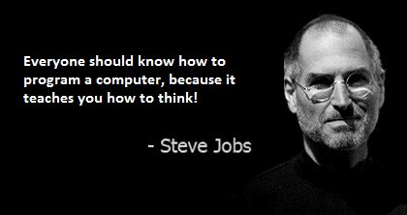

Slide 2
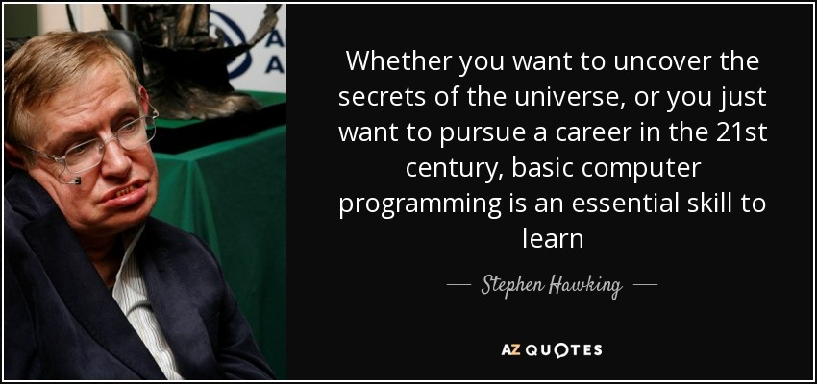

Slide 3
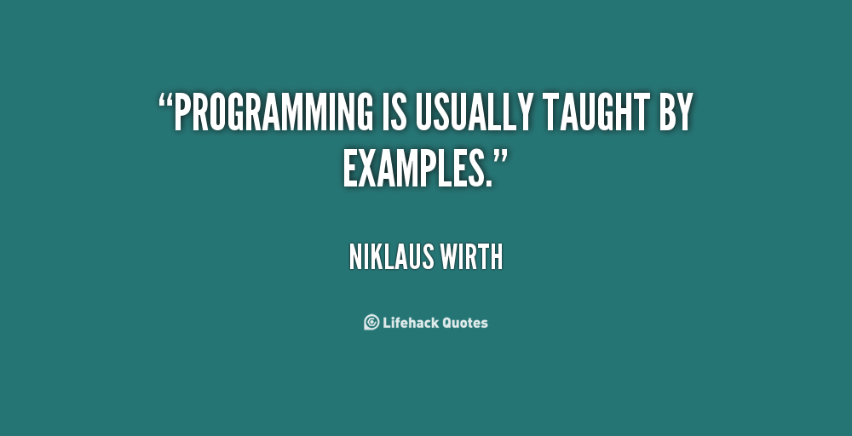

Slide 4


GitHub Inc. is a web-based hosting service for version control using Git. It is mostly used for computer code. It offers all of the distributed version control and source code management functionality of Git as well as adding its own features

Slide 5

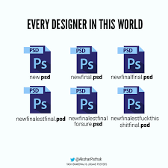
WHAT IS VERSION CONTROL?
A system that keep records of your changes.
Allows for collaborative development
Allows you to made what changes and when.
Allows you to revert any changes and go back to previous state

Slide 6
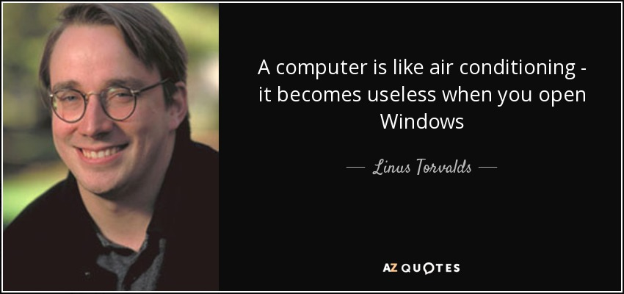
WHAT IS GIT?
GIT IS A PROTOCOL CREATED BY LINUS TORVALDS
STARTED IN 2005
TO AID IN LINUX KERNEL DEVELOPMENT

Slide 7
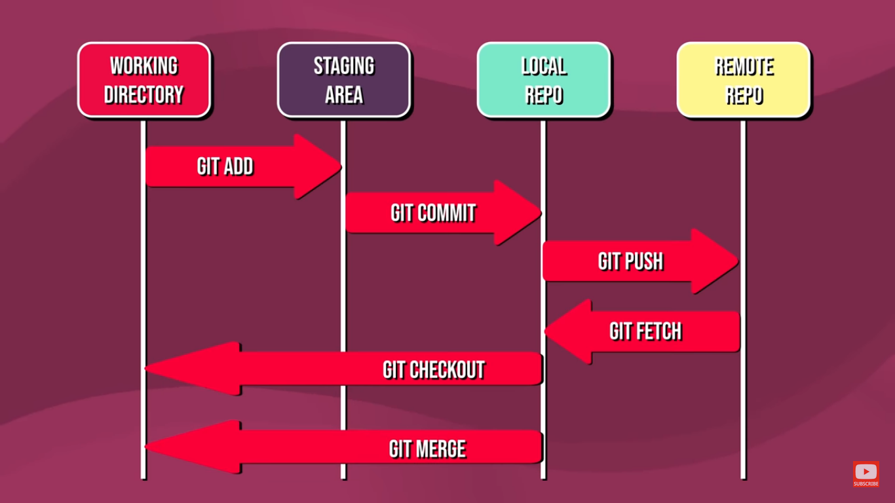
HOW IT WORKS?

Slide 8
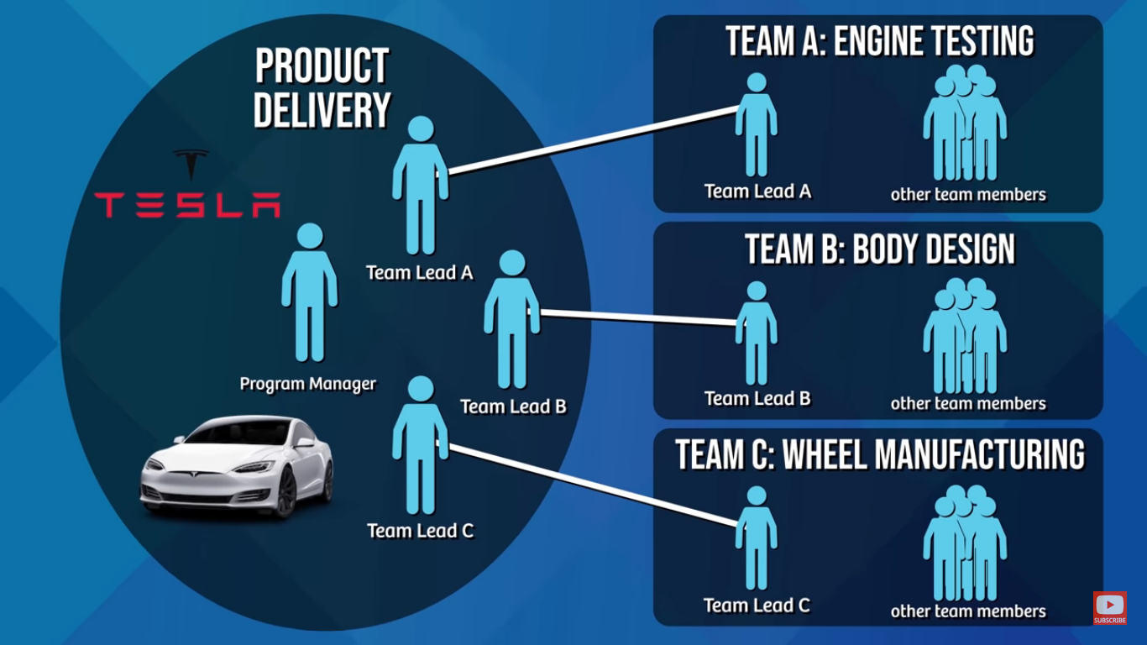

Slide 9
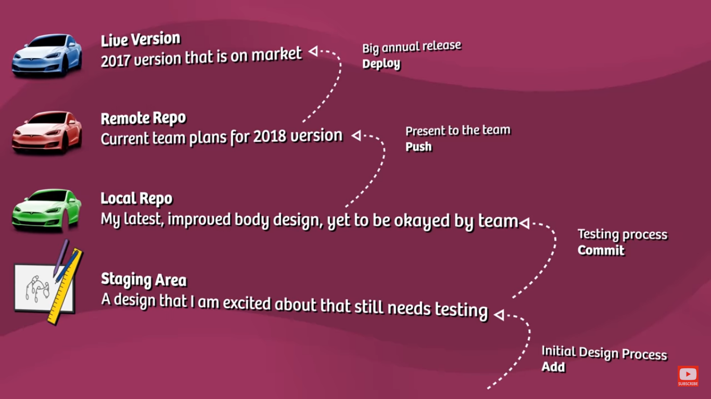

Slide 10
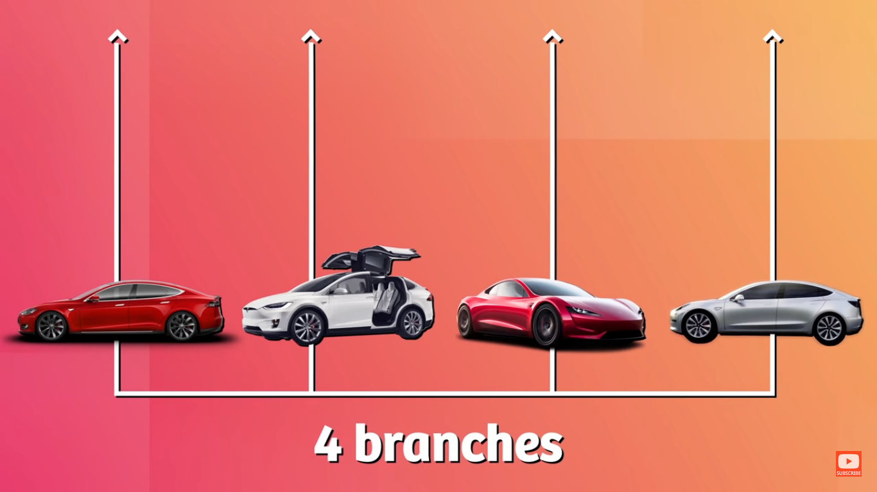

Slide 11
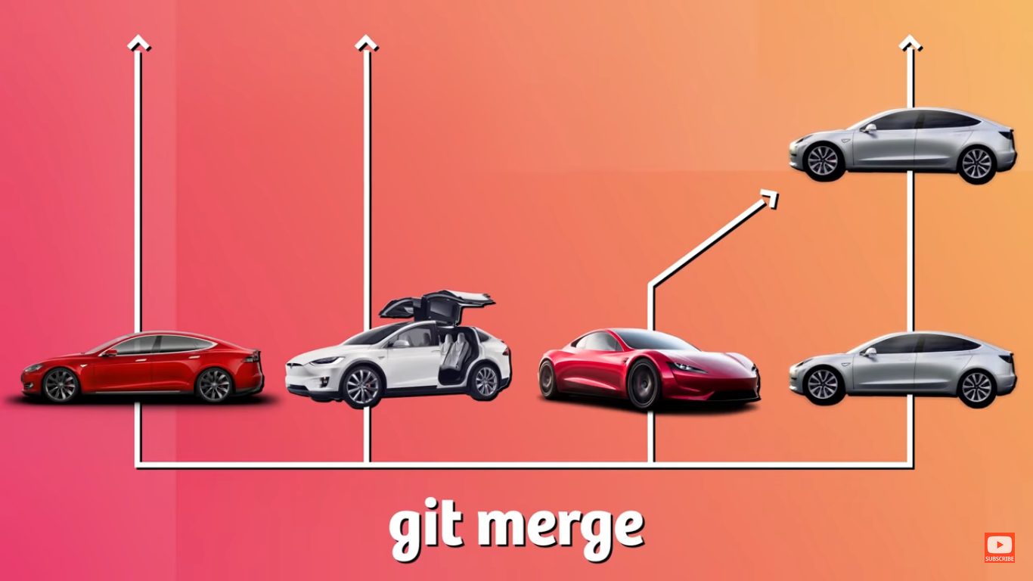

Slide 12
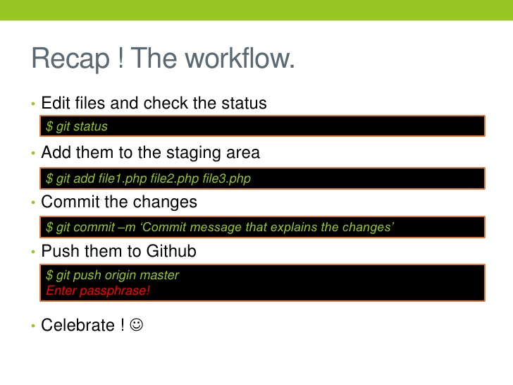
GIT COMMANDS

Slide 13


bit.ly/rvgslack

Slide 14


