Slide 1
Graphs of Kinematics overgrind( raB`bDa`Laha )

Slide 2
Types of Graphs in Kinematics
-> The First Equation
-> The Second Equation
-> The Acceleration-Position Graph Variate
-> Sign of Acceleration from Position-Time Graph
-> The Average-Velocity / Instantaneous Velocity , Equal Case
-> The Velocity-Displacement Case
-> Motion Under Free Fall due to Gravity
-> Projectile Motion
&&
==> The Other Types

Slide 3
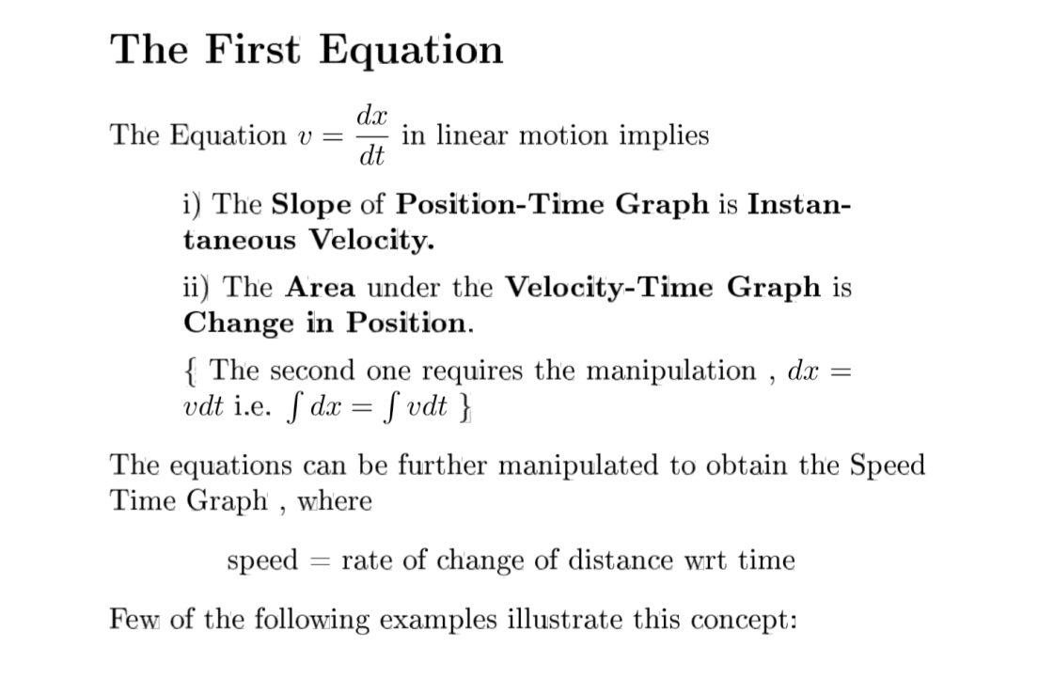

Slide 4
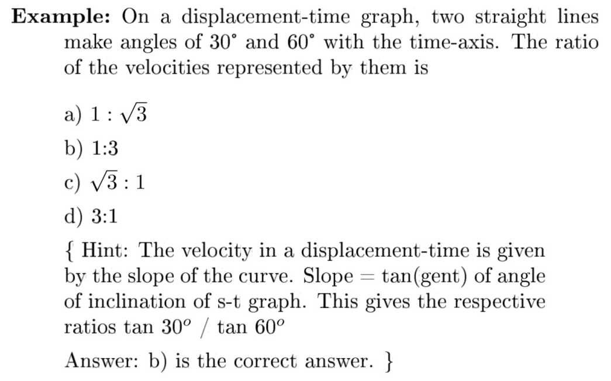

Slide 5
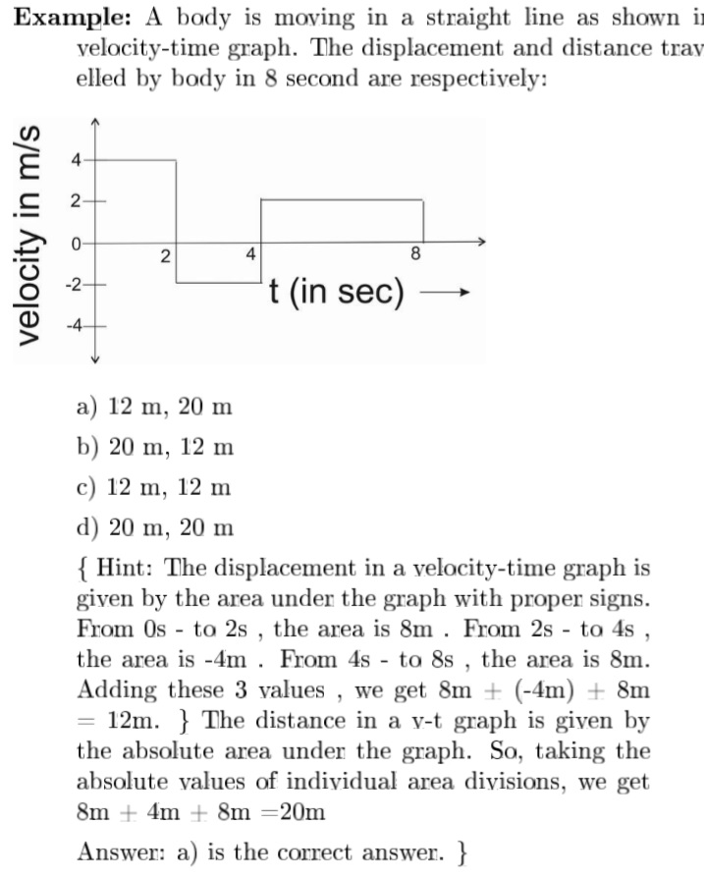

Slide 6
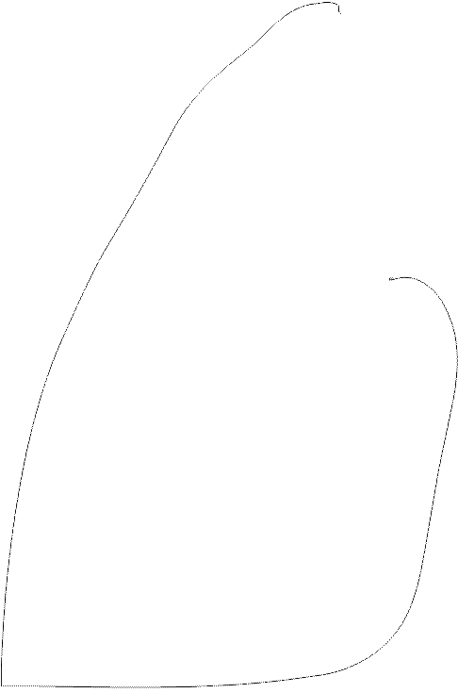
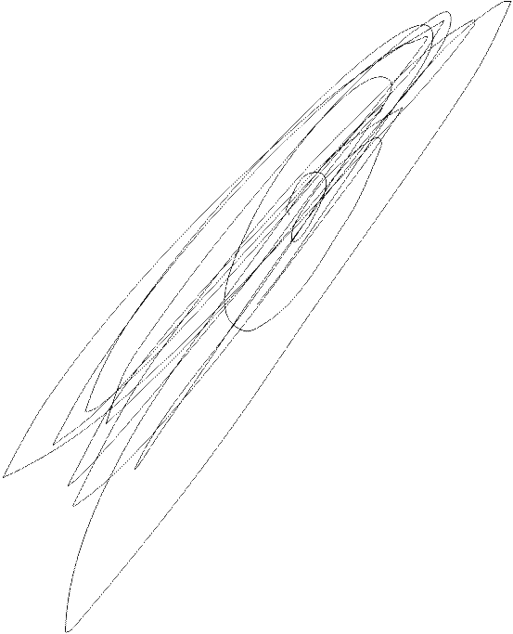
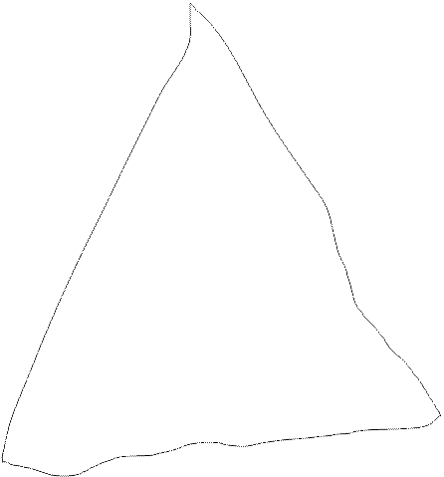
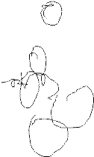
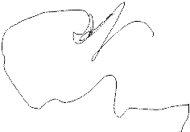
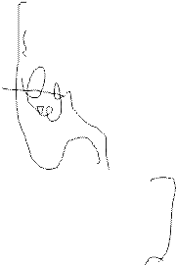
Graphics Created by HN_Kisna_
[ A rocket on a distant planet visiting a man ]

Slide 7
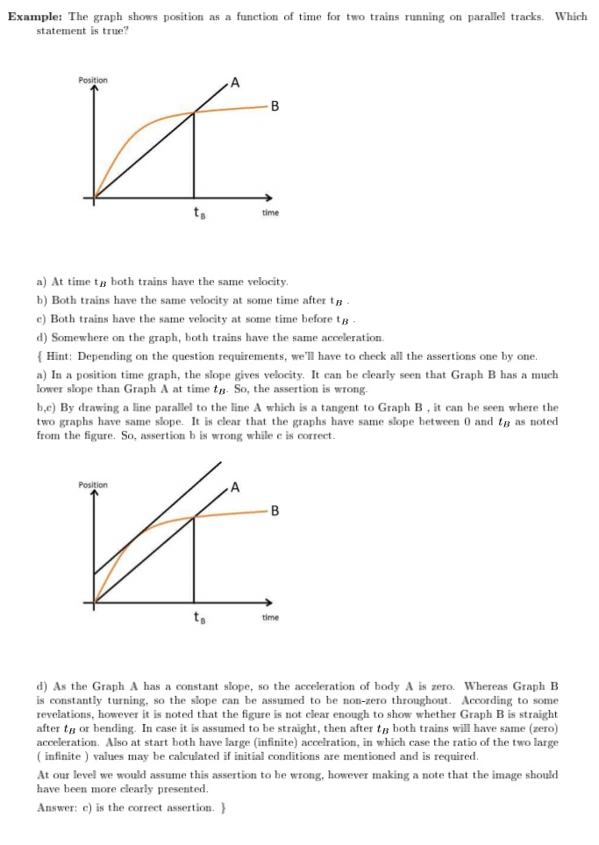

Slide 8
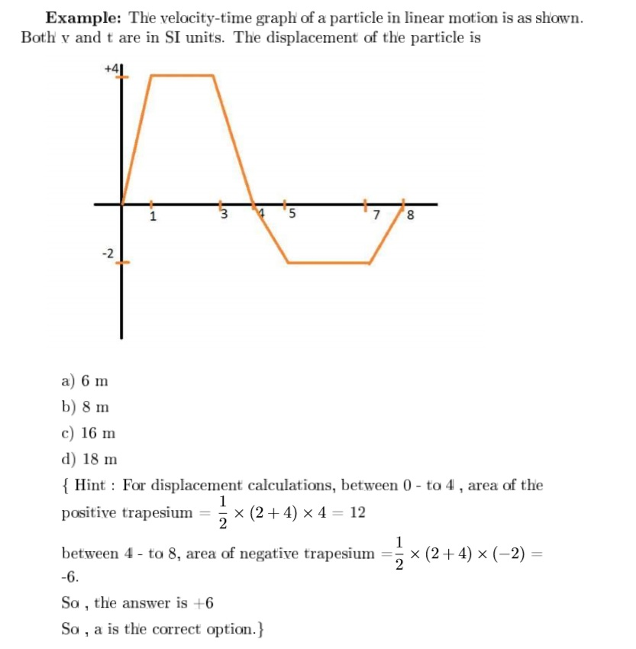

Slide 9
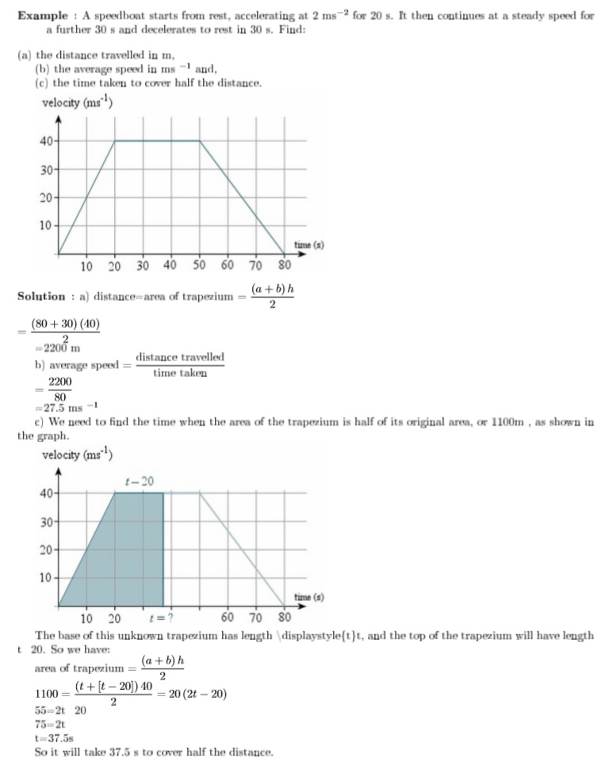

Slide 10
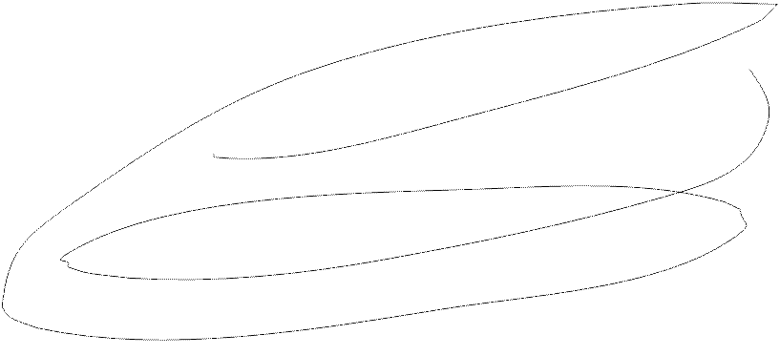
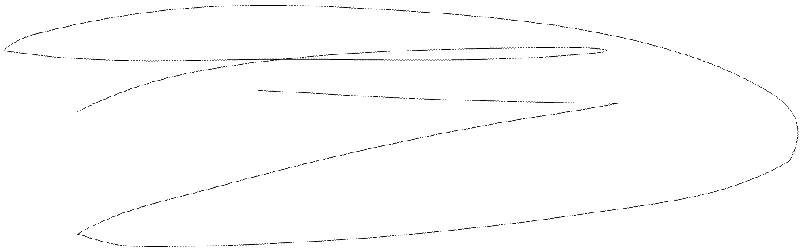
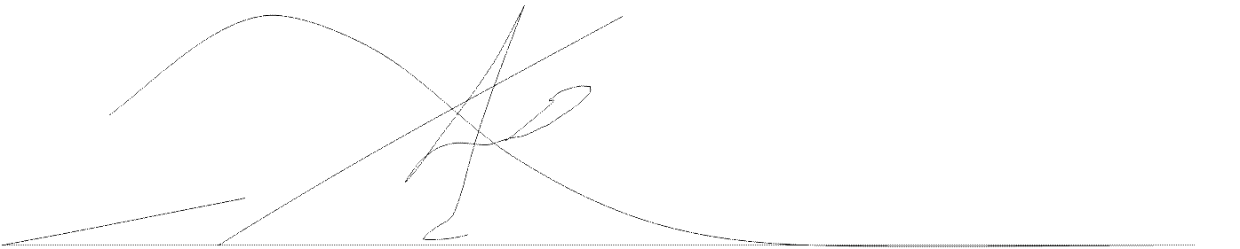
Spades Ace – Graphics created by HN_Kisna_

Slide 11
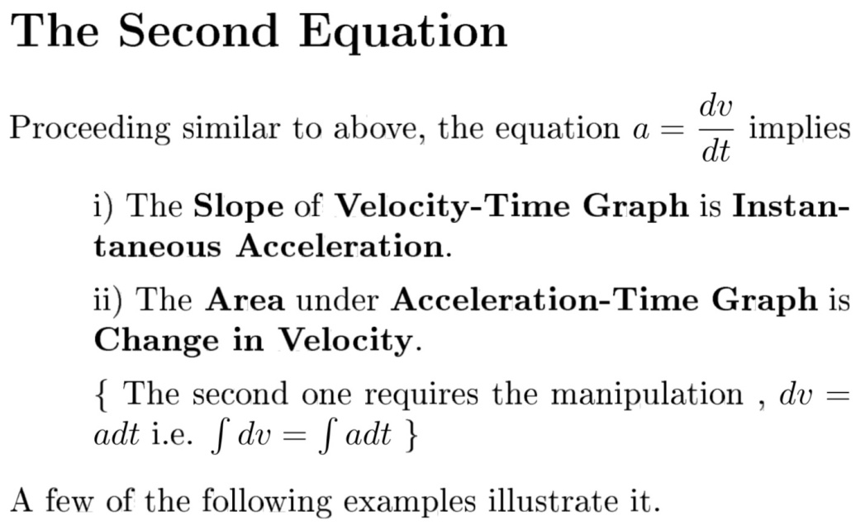

Slide 12
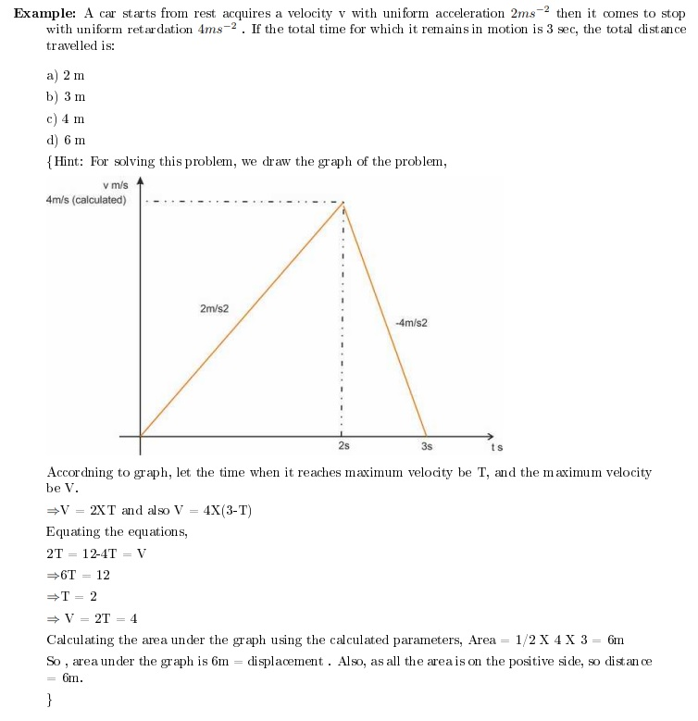

Slide 13
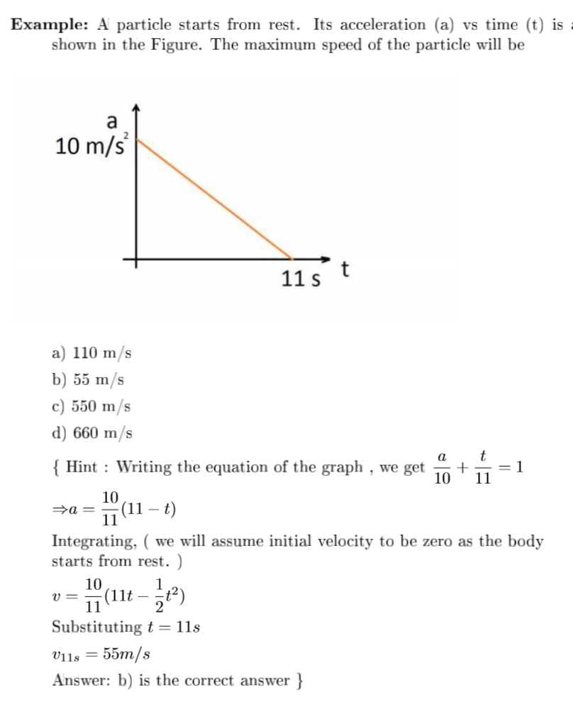

Slide 14
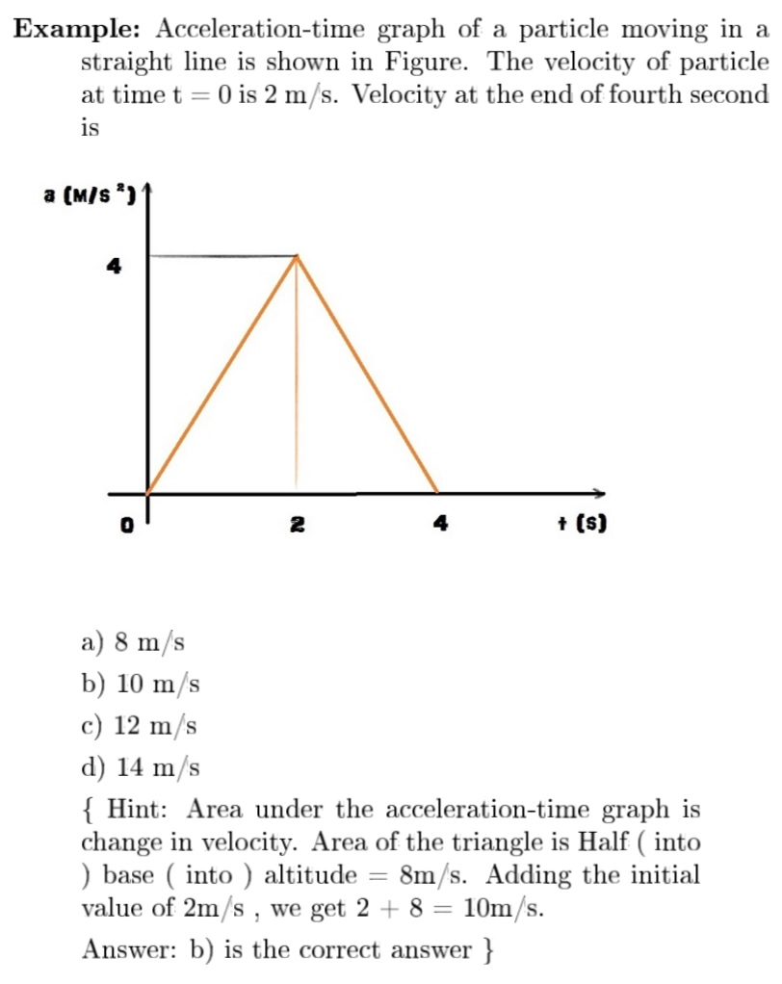

Slide 15
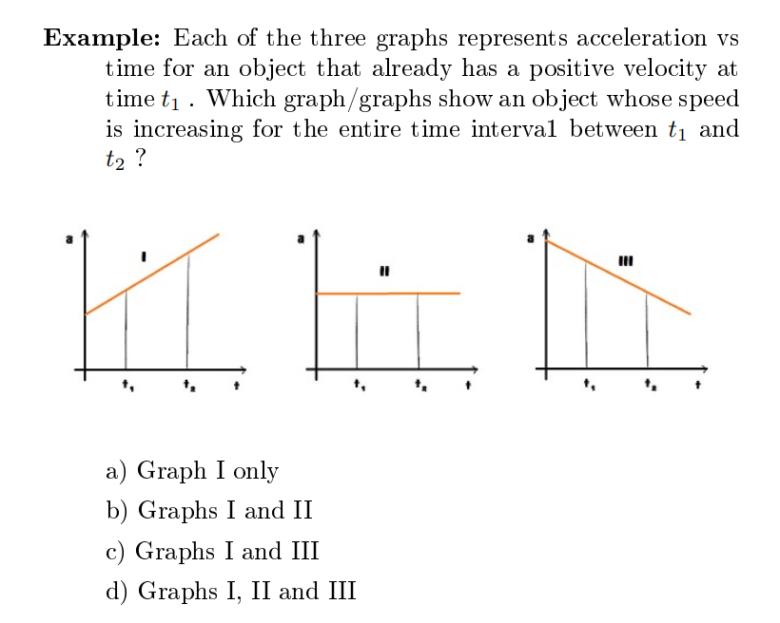

Slide 16
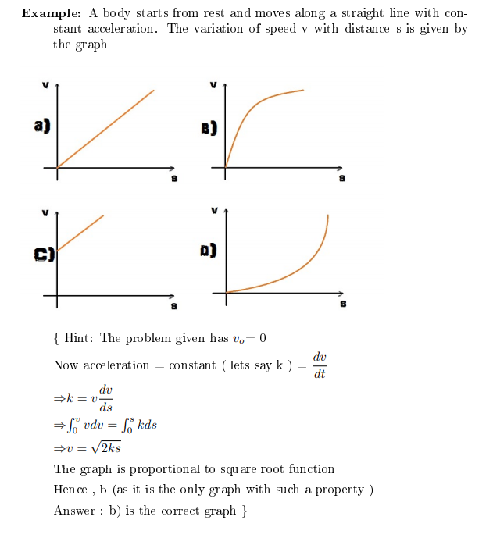

Slide 17
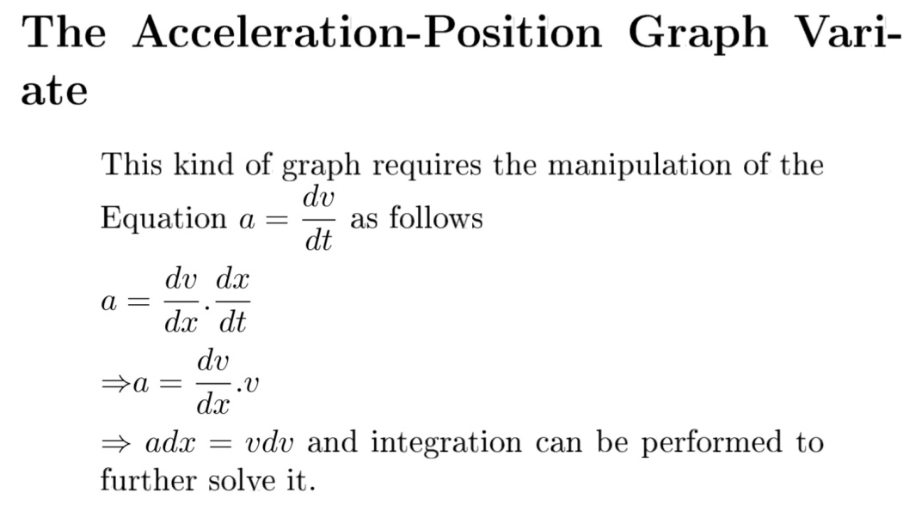

Slide 18
