Slide 1
Credit Card Financial & Customer Analytics
DASHBOARD
Weekly Transaction & Customer Analysis | PostgreSQL · Power BI · DAX
$55M
$7.8M
$576M
3.19/5
Total Revenue
Total Interest
Total Income
Avg Satisfaction
Data Analyst Portfolio Project · GitHub Ready

Slide 2
PROJECT OVERVIEW
🎯 Objective
⚙️ Tech Stack
Build a full-stack Credit Card Analytics solution to help business stakeholders monitor revenue, customer behaviour, and transaction patterns on a weekly basis. Two Power BI dashboards were created:
Credit Card Transaction Report – card & spend-level metrics
Credit Card Customer Report – demographic & income-level metrics
This project demonstrates end-to-end data analyst skills: SQL ingestion → data modelling → DAX engineering → visual storytelling.
PostgreSQL
Raw CSV ingestion via COPY command; schema design with 2 normalized tables
Power BI
Two interactive dashboards with slicers, KPI cards & charts
DAX
Revenue formula, Age Group & Income Group calculated columns; WEEKNUM measure
CSV Files
cc_add.csv (transactions) and cust_add.csv (customer demographics)

Slide 3
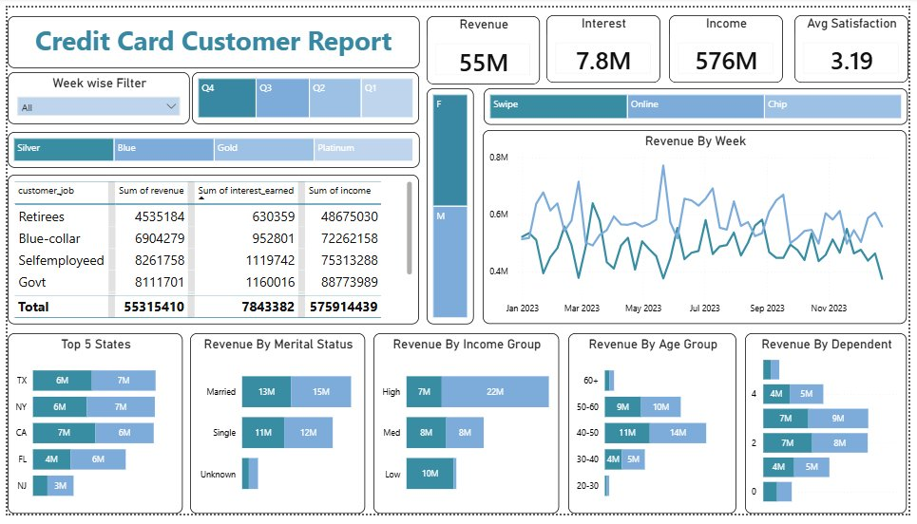
DASHBOARD 1 — Credit Card Customer Report (All Customers)
Source: Power BI · Credit Card Customer Report · Full dataset (All weeks, All genders)

Slide 4
CUSTOMER DASHBOARD — KEY INSIGHTS
💰 Revenue Dominated by Blue-Collar & Govt
📍 TX, NY, CA Lead with ~$6-7M Each
Blue-collar ($6.9M) and Govt ($8.1M) job categories drive the most revenue. Despite lower income brackets, high transaction frequency makes these segments the backbone of card revenue.
The top 3 states each generate $6-7M in revenue. Geographic concentration suggests opportunity for targeted marketing and premium card upsell in these regions.
💍 Married Customers Generate More Revenue
📊 40-50 Age Group is the Sweet Spot
Married segment: $13M vs Singles: $11M. Higher household spending needs and joint financial obligations push married customers toward higher card utilization.
The 40-50 age cohort ($11M female + $14M male) outperforms all others. This group balances high income, stable employment, and established spending habits — ideal for premium card offers.
👨‍👩‍👧‍👦 2-Dependent Households Spend the Most
😊 Satisfaction Score Stable at 3.19-3.20
Customers with 2 dependents generate the highest revenue tier. Family financial obligations increase card usage for groceries, fuel, education, and EMI payments.
Near-identical satisfaction across gender segments (3.19 vs 3.20) suggests service parity — positive for retention, but headroom exists to push score above 4.0 through targeted benefits.

Slide 5
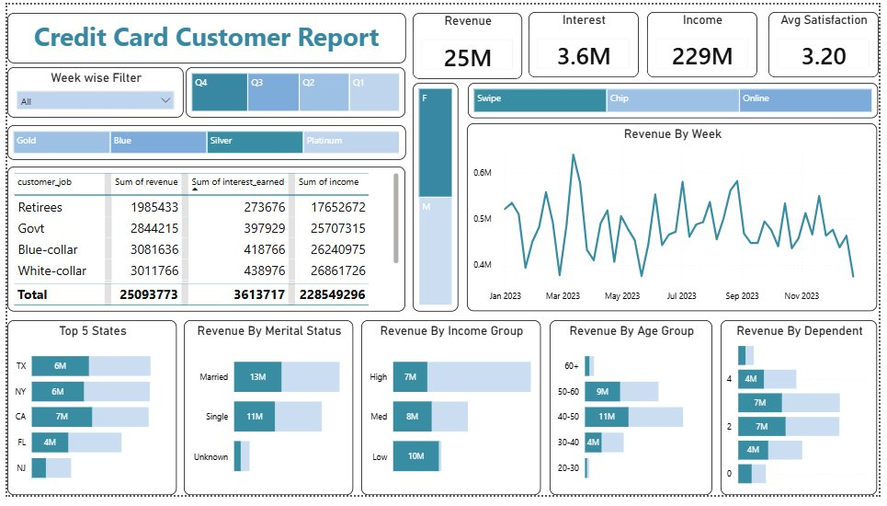
DASHBOARD 1 — Gender Comparison: Female vs Male Customer Segments
🚺 Female Segment
🚹 Male Segment
METRIC
🚺 FEMALE
🚹 MALE
Revenue
$25M
$55M
Interest Earned
$3.6M
$7.8M
Total Income
$229M
$576M
Avg Satisfaction
3.20
3.19

Slide 6
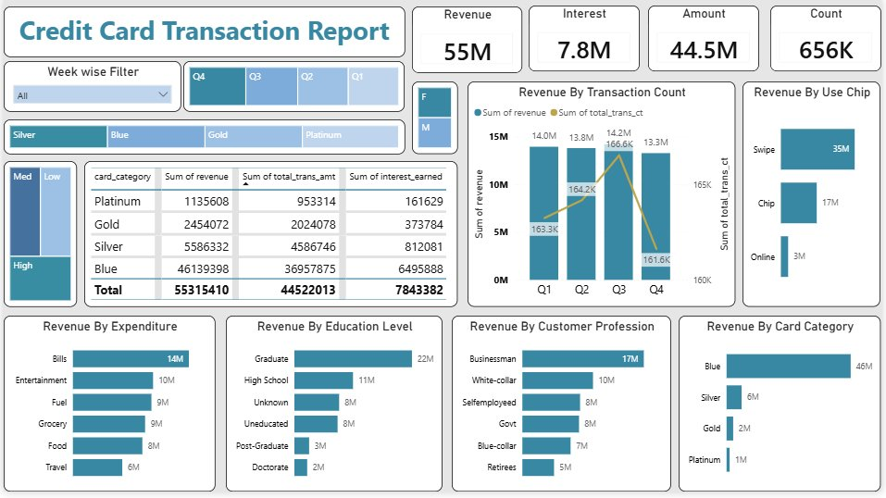
DASHBOARD 2 — Credit Card Transaction Report (Full Dataset · All Cards)
Source: Power BI · Credit Card Transaction Report · Full dataset (All card categories, All weeks)

Slide 7
TRANSACTION DASHBOARD — KEY INSIGHTS
💳 Blue Card Dominates at $46M Revenue
💼 Businessmen Lead by Profession ($17M)
Blue card holders generate 84% of total revenue ($46M of $55M). This entry-level card has the widest user base, making it the single most important product segment to monitor and grow.
Business owners generate $17M in revenue — almost double White-collar ($10M). High-spend, low-risk profile makes this segment ideal for premium card migration and rewards upsell.
📚 Graduate Customers Spend the Most ($22M)
🏷️ Bills & Food are Top Spend Categories
Graduates contribute $22M, nearly double High School ($11M). Education level strongly predicts credit capacity and spending sophistication. Targeting post-grads for premium tiers makes strategic sense.
Bills ($14M) and Food ($8M) are non-discretionary categories that dominate spend. These are 'sticky' expenditures that drive consistent transaction activity and revolving balance.
📱 Swipe Transactions Drive 64% of Revenue
📈 Q3 Peak: Highest Revenue & Transaction Count
Swipe ($35M) massively outperforms Chip ($17M) and Online ($3M). Low online adoption suggests an opportunity to push digital channels with cashback incentives.
Q3 shows the highest revenue ($14.2M) and transaction count (166.6K). Summer spending on travel, entertainment, and back-to-school drives the seasonal spike — timing campaigns to Q3 maximizes ROI.

Slide 8
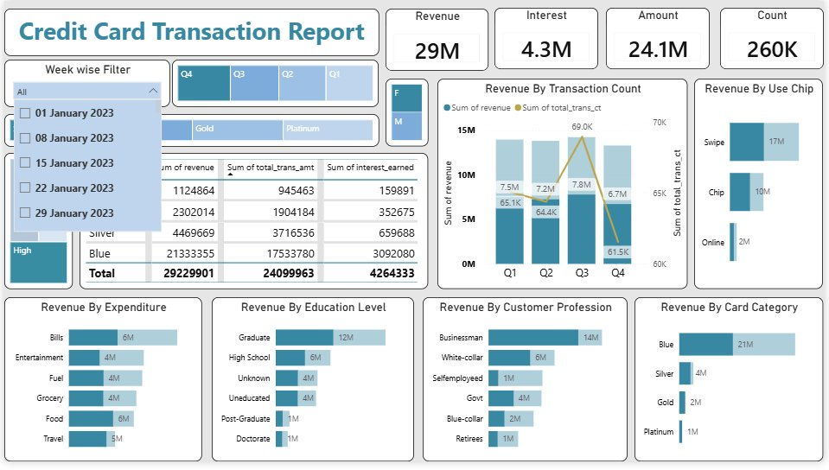
DASHBOARD 2 — Weekly Drill-Down Filter in Action (Jan 2023 Sample)
Weeks Available
Jan Revenue Snapshot
Jan Transaction Count
01 Jan – 29 Jan 2023
(weekly slicing)
$29M total
$4.3M interest
260K transactions
$24.1M amount

Slide 9
DATA PIPELINE & SCHEMA DESIGN
01
02
03
04
05
→
→
→
→
CSV Files
PostgreSQL
Power BI
Connect
DAX
Measures
Dashboard
cc_add.csv
cust_add.csv
CREATE TABLE
COPY command
Native PG
connector
Revenue, Groups
WEEKNUM
2 Reports
Published
📋 TABLE 1: cc_details (Transactions)
📋 TABLE 2: cc_customers (Demographics)
client_num (PK/FK)
card_category
annual_fees
activation_30_days
customer_acq_cost
credit_limit
total_revolving_bal
total_trans_amt
total_trans_ct
avg_utilization_ratio
interest_earned
delinquent_acc
use_chip, exp_type
Client_Num (PK/JOIN)
Customer_Age → age_group
Gender, Marital_Status
Education_Level
Customer_Job
Income → income_group
Dependent_Count
state_cd, Zipcode
Car_Owner, House_Owner
Personal_loan
contact
Cust_Satisfaction_Score

Slide 10
DAX TRANSFORMATIONS (Power BI Calculated Columns & Measures)
Revenue Measure
Age Group Column
Income Group Column
Week Number Measure
revenue =
annual_fees
+ interest_earned
+ total_trans_amt
age_group = SWITCH(TRUE(),
age < 30, "20-30",
age < 40, "30-40",
age < 50, "40-50",
age < 60, "50-60",
"60+")
income_group = SWITCH(
TRUE(),
income < 35000, "Low",
income < 70000, "Med",
income >= 70000, "High"
)
week_num2 = WEEKNUM(
cc_details
[week_start_date]
.[Date]
)
💡 Business Insight
💡 Business Insight
💡 Business Insight
💡 Business Insight
Unifies 3 income streams into 1 KPI:
Fee income + Interest income + Spend volume.
Critical for weekly P&L monitoring.
Buckets 10,000+ customers into 5 cohorts.
Enables cohort analysis and targeted
product/limit strategy per age band.
Three-tier segmentation for credit
risk assessment and personalised
limit & offer recommendations.
Maps weekly dates to ISO week numbers.
Powers the Week-wise filter slicer for
granular trend tracking across 52 weeks.

Slide 11
END-TO-END ANALYST WORKFLOW
01
Requirements & Data Sourcing
Identified business need: stakeholders needed weekly visibility into credit card revenue, customer demographics, and spend patterns. Sourced raw CSVs: cc_add.csv (transaction-level) and cust_add.csv (customer-level).
02
PostgreSQL Schema Design & Ingestion
Designed 2 normalized tables (cc_details & cc_customers) with correct data types. Used PostgreSQL's COPY command for bulk ingestion. Validated data integrity with SELECT * queries. Tables joined via client_num.
03
Power BI Connection & Data Modelling
Connected Power BI Desktop to PostgreSQL via native connector. Created table relationships. Defined data model structure to support cross-table filtering across card categories, customer demographics, and time.
04
DAX Engineering
Built 4 calculated columns/measures: Revenue (3-stream aggregation), Age Group (5 cohorts via SWITCH), Income Group (3 tiers), and Week Number (WEEKNUM for the time-slicer). Validated outputs against source data.
05
Dashboard Design & Visualisation
Designed 2 dashboards: (1) Transaction Report — card-level, spend-category, and profession-level views; (2) Customer Report — demographic, geographic, and satisfaction views. Both feature Week-wise & Quarter slicers for interactivity.

Slide 12
STRATEGIC RECOMMENDATIONS FOR STAKEHOLDERS
🎯
💼
📍
Target 40-50 Age Cohort
Upsell to Businessmen
Geographic Deep-Dive
Highest-revenue age band. Offer premium Blue→Gold/Platinum upgrade campaigns with reward multipliers on Bills and Travel.
$17M revenue already. This segment has capacity for higher limits and Platinum card benefits — lowest churn risk.
TX, NY, CA already dominant. Investigate NJ ($3M) underperformance — is it market size or product-market fit?
📱
⚠️
🔄
Push Online Transactions
Monitor Delinquency Closely
Q3 Campaign Planning
Online contributes only $3M vs Swipe $35M. Launch cashback incentives for online spend to improve digital adoption.
Low-income customers with high utilization ratios (>70%) are most at risk. Weekly delinquent_acc flag monitoring can reduce write-offs.
Q3 is the annual revenue peak. Align marketing spend, credit limit reviews, and product launches to maximise seasonal uplift.

Slide 13
Thank You
Credit Card Financial & Customer Analytics Dashboard · PostgreSQL · Power BI · DAX
🐙 GitHub:
https://github.com/rajatkumar-analytics/Credit-Card-Financial-Customer-Analytics-Dashboard

