Slide 1
MODULE 6 / CASE STUDIES & PRACTITIONER PERSPECTIVES
AI / ML IN BANKING & FINANCE
From prediction to decisions — returns, defaults, lending, macro, markets and mortgages
Predicting Returns
Loan Defaults
Credit Scoring
Macro Forecasting
Market Risk
Mortgage Prepayment
Practitioner View
Business-school depth • Consulting-style structure • Banking practitioner lens
Illustrative calculations are explicitly labelled; real-world regulatory context is sourced from BIS / FSB materials.
MODULE 6 • CASE STUDIES & PRACTITIONER PERSPECTIVES
01

Slide 2
EXECUTIVE MAP
The module is one decision system — not seven disconnected models
The common thread is simple: convert messy information into a decision, then control the downside.
DATA
MODEL
DECISION
CONTROL
VALUE
Customer • market • macro • loan • behavioural
Prediction • classification • ranking • hazard
Approve • price • hedge • provision • allocate
Limits • overrides • monitoring • governance
RAROC • loss avoidance • liquidity • growth
WHAT
WHY
HOW
SO WHAT
What is being predicted?
Why does it matter?
How do we operationalise it?
What changes tomorrow?
Return / default / prepayment / volatility
Revenue, loss, capital, liquidity
Features → model → threshold → action
Pricing, approval, hedging, provisioning
7
4
2
1
use cases → one operating model
decision lenses
deep case studies
governance spine
MODULE 6 • CASE STUDIES & PRACTITIONER PERSPECTIVES
02

Slide 3
WHAT → WHY → HOW → SO WHAT
A practical AI/ML architecture for financial decisions
FROM SIGNAL → SCORE → ACTION
MODEL CHOICE IS A BUSINESS DECISION
01
Signal design
Define target, horizon, unit of observation and economic outcome.
Linear / logistic
Best when transparency, stability and policy interpretation dominate.
02
Feature engineering
Turn raw events into stable, leakage-safe predictors.
Tree ensembles
03
Model estimation
Choose model complexity that earns its keep.
Useful for non-linearity, interactions and heterogeneous risk.
04
Decision layer
Translate probability/forecast into a threshold, price or limit.
Deep / advanced ML
Use when signal complexity justifies validation and governance burden.
05
Monitoring
Watch drift, stability, overrides, outcomes and unintended effects.
Rule of thumb: the best model is not the model with the highest AUC — it is the model with the highest sustainable decision value.
MODULE 6 • CASE STUDIES & PRACTITIONER PERSPECTIVES
BIS / FSB: AI benefits and model-risk / governance considerations
03

Slide 4
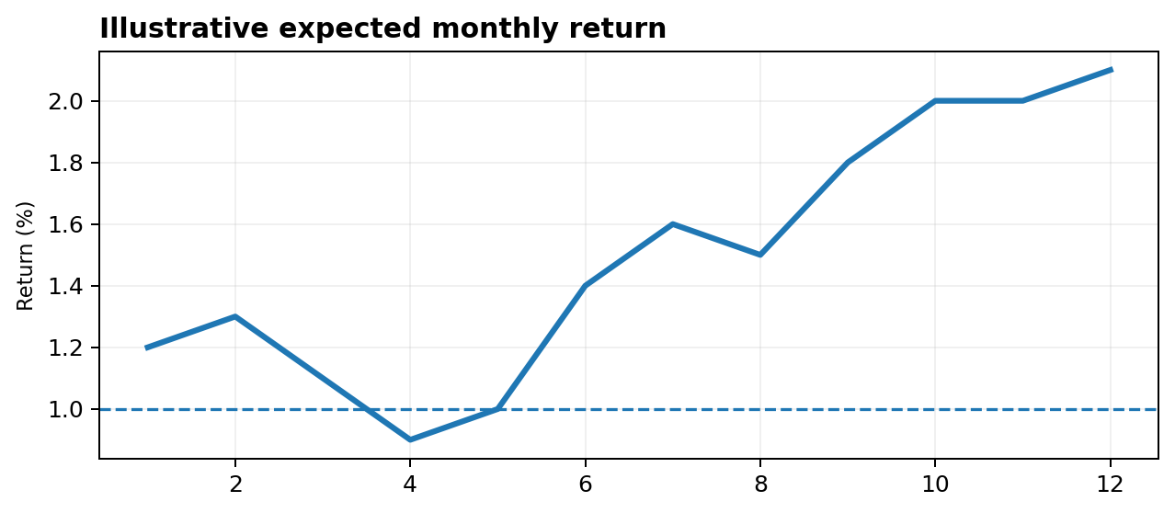
USE CASE 01
Predicting returns: forecast the distribution, not just the point estimate
Business question: where should capital be allocated when expected return and uncertainty move together?
HOW
Target: next-month return or excess return.
Features: price momentum, volatility, liquidity, macro regime, sector factors.
Models: linear factors → gradient boosting → sequence models.
Evaluate: MAE/RMSE + directional accuracy + economic back-test.
NUMERICAL EXAMPLE
Forecast = 1.8% | volatility = 4.0%
If a mandate requires return > 1.0% and volatility < 5.0%, the signal passes. If risk-adjusted return is the objective, compare Sharpe-like signal: 1.8 / 4.0 = 0.45.
SO WHAT
Prediction becomes useful only after portfolio constraints, transaction costs and downside scenarios are applied.
MODULE 6 • CASE STUDIES & PRACTITIONER PERSPECTIVES
04

Slide 5
USE CASE 02
Classifying loan defaults: the model is only half the credit decision
A PD classifier converts borrower information into a probability — the bank still has to decide what to do with it.
Applicant data
PD model
Threshold
Economic layer
Income • DPD • utilisation • bureau • vintage
Logistic / tree / boosting
Approve / refer / decline
LGD × EAD × PD
Illustrative validation set: 10,000 loans
Actual GOOD
Actual BAD
71.4%
76.9%
3.7%
90%
precision
recall
bad rate
capture
Pred GOOD
8,300
300
RED FLAGS
Pred BAD
400
1,000
Target leakage: using information created after the decision date.
Imbalanced classes: accuracy can look impressive while missing bads.
Probability ≠ action: threshold must reflect loss, capital and appetite.
MODULE 6 • CASE STUDIES & PRACTITIONER PERSPECTIVES
05

Slide 6
USE CASE 03
Credit scoring & lending decisions: move from score to economics
The CRO does not approve an application because AUC is high. The CRO approves when risk-adjusted economics are acceptable.
Illustrative scorecard policy
STEP-BY-STEP ECONOMICS
750+
Approve / best pricing
Illustrative loan: EAD = ₹10M
PD
2.5%
700–749
Approve / standard
LGD
40%
650–699
Refer / tighter terms
Expected Loss
₹10M × 2.5% × 40% = ₹0.10M
Interest income
₹0.65M
<650
Decline / manual review
Operating + funding cost
₹0.22M
Risk-adjusted contribution
₹0.65M − ₹0.22M − ₹0.10M = ₹0.33M
SO WHAT → The score is a gate; the economics determine the appetite.
MRM / Model Risk question: is the PD calibrated and stable enough to support pricing, provisioning and capital decisions?
MODULE 6 • CASE STUDIES & PRACTITIONER PERSPECTIVES
06

Slide 7
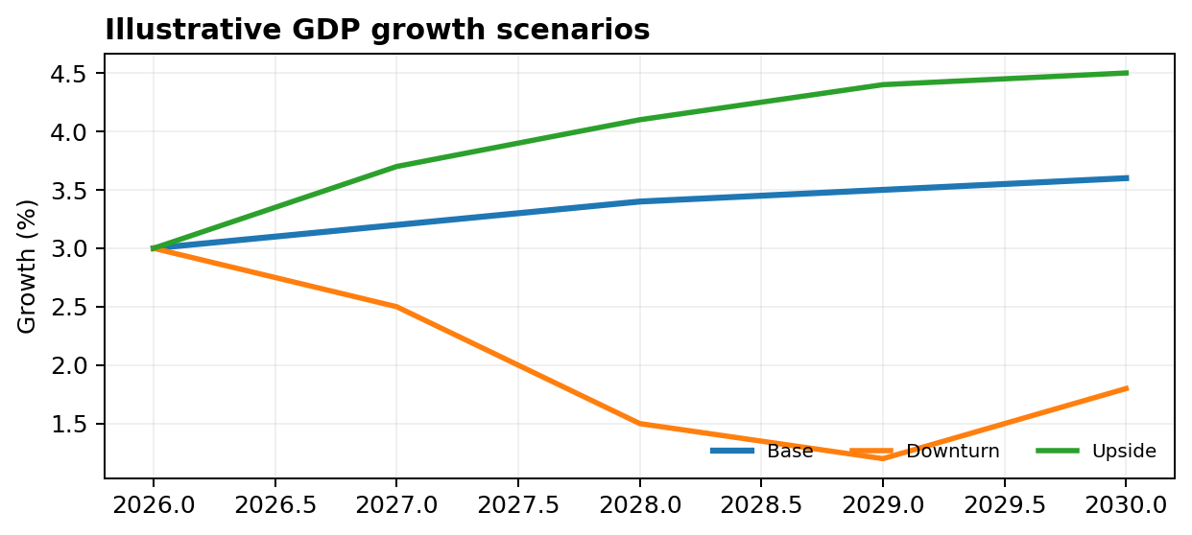
USE CASE 04
Macroeconomic forecasting: connect scenarios to portfolio outcomes
Macro forecasting is valuable when it changes the timing or severity of a credit, liquidity or capital decision.
MACRO → PORTFOLIO TRANSMISSION
GDP / unemployment
→
PD migration
Rates / inflation
→
DSCR & affordability
FX / commodity
→
Corporate cash flow
Property prices
→
LGD / collateral
DECISION EXAMPLE
Downturn scenario: unemployment +2pp
If portfolio PD rises from 2.5% → 4.0% on ₹1B EAD at 40% LGD, expected loss increases from ₹10M → ₹16M: +₹6M.
MODULE 6 • CASE STUDIES & PRACTITIONER PERSPECTIVES
Illustrative scenario; BIS notes AI can support economic forecasting and policy analysis
07

Slide 8
USE CASE 05
Market risk management: forecast volatility, then stress the system
The failure mode is not 'the model was wrong' — it is relying on a single number when the regime changes.
Daily risk signal
Volatility / correlation / liquidity
NUMERICAL EXAMPLE
1-day 99% VaR (illustrative)
Portfolio = ₹500M
VaR / ES
Normal-period loss estimate
Daily volatility = 1.6%
99% z ≈ 2.33
Stress testing
Rates, spreads, FX, equity shocks
VaR ≈ ₹500M × 1.6% × 2.33 = ₹18.64M
Limits & actions
Reduce risk / hedge / raise liquidity
Stress: volatility doubles to 3.2%
A simplistic normal VaR would rise to ≈ ₹37.28M — but correlation/liquidity shocks can make realised losses larger.
MRM RED FLAG → regime change + model concentration
MODULE 6 • CASE STUDIES & PRACTITIONER PERSPECTIVES
08

Slide 9
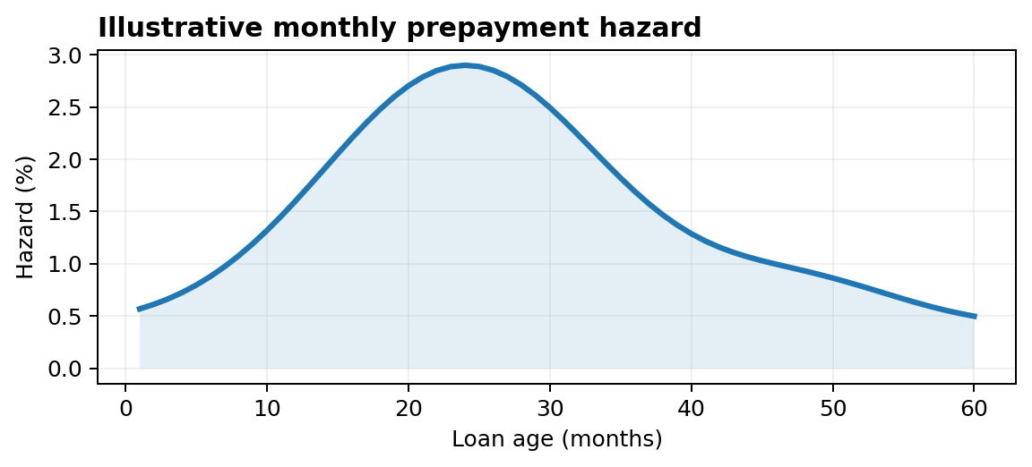
USE CASE 06
Mortgage prepayment modeling: a borrower can default less — and still hurt the bank
Prepayment is an option embedded in the loan. Modeling it is an ALM, duration and profitability problem — not just a forecasting exercise.
HOW
Model the probability of prepayment in each period, conditional on survival.
Key drivers: rate incentive, seasoning, borrower type, balance, geography, macro regime.
Use survival / hazard methods rather than treating prepayment as a one-off binary event.
NUMERICAL EXAMPLE
₹100M pool × 8% expected annual prepayment = ₹8M principal returned earlier than planned.
If reinvestment yield falls by 150 bps, the economics of early principal return can deteriorate materially. This is the bridge from model output → NII / duration / hedge decisions.
MODULE 6 • CASE STUDIES & PRACTITIONER PERSPECTIVES
09

Slide 10
DETAILED CASE STUDY • ILLUSTRATIVE DATA
Case study 1 — Retail lender: reducing bad approvals without strangling growth
Illustrative bank portfolio: 100,000 applications • 3.0% observed default rate • decision horizon = 12 months
Metric
Legacy policy
ML-assisted policy
Decision impact
WHAT CHANGED?
Approval rate
62%
65%
+3pp growth
Better segmentation
High-risk applicants moved to manual review.
Bad rate of approvals
4.1%
3.4%
−70 bps
Bad loans
2,542
2,210
−332
Better calibration
PD bands aligned to realised default rates.
Expected loss / bad
₹0.40M
₹0.40M
same assumption
Annual EL avoided
—
₹132.8M
economic upside
Policy optimisation
Threshold chosen using loss + growth economics.
Calculation: 332 fewer bad loans × ₹0.40M = ₹132.8M annual expected-loss avoidance.
Key caution: illustrative economics assume constant LGD and no adverse selection; a production study would include pricing, utilisation and vintage effects.
MODULE 6 • CASE STUDIES & PRACTITIONER PERSPECTIVES
10

Slide 11
DETAILED CASE STUDY • ILLUSTRATIVE DATA
Case study 2 — Mortgage portfolio: prepayment + ALM
Objective: quantify how a prepayment model can change hedge sizing, NII expectations and liquidity planning.
Scenario
Prepay rate
Principal returned early
Reinvestment yield
Illustrative NII impact
ALM TRANSMISSION
Base
8%
₹80M
6.0%
Neutral
Prepayment speed
→
Asset duration
Fast prepay
12%
₹120M
4.5%
Negative
Asset duration
→
Rate sensitivity
Slow prepay
5%
₹50M
6.5%
Positive / duration longer
Rate sensitivity
→
Hedge ratio
PRACTITIONER INSIGHT
Hedge ratio
→
NII / EVE
A prepayment model is valuable because it changes a balance-sheet decision. The model is not the end product; hedge and funding actions are.
Illustrative data only; production models require loan-level history, rate curves, servicing behaviour and validation.
MODULE 6 • CASE STUDIES & PRACTITIONER PERSPECTIVES
11

Slide 12
PRACTITIONER PERSPECTIVES
Four practitioners — one model, four definitions of 'good'
A technically excellent model can still fail if it is unusable for the person who owns the decision.
CREDIT ANALYST
DATA SCIENTIST
MRM PROFESSIONAL
CFO / CRO
Can I explain the risk?
Does it predict?
Can I challenge it?
Does it create value safely?
Segment • borrower story • overrides
Feature quality • lift • calibration
Validation • stability • governance
P&L • capital • liquidity • appetite
SUCCESS TEST
SUCCESS TEST
SUCCESS TEST
SUCCESS TEST
Clear rationale
Stable lift
Defensible evidence
Economic value
Executive principle: optimise for decision quality, not model complexity.
MODULE 6 • CASE STUDIES & PRACTITIONER PERSPECTIVES
12

Slide 13
MODEL RISK / CONTROLS
Risk, governance & red flags: where sophisticated models fail
The most dangerous failure is a model that looks strong in development, survives validation, and fails silently in production.
DATA
Leakage • stale data • bias • weak lineage
Prevent with point-in-time datasets + data controls
MODEL
Drift • overfit • poor calibration • instability
Monitor performance by segment / vintage / regime
DECISION
Bad threshold • no override discipline • incentive mismatch
Tie thresholds to loss, capital and appetite
TECH
Cloud / vendor dependency • cyber • outage
Fallbacks, access controls, resilience testing
GOVERNANCE
Opaque rationale • weak documentation • no owner
Model inventory, validation, change control
BIS / FSB emphasis: explainability, data quality, model risk, third-party concentration and operational resilience matter alongside model performance.
MODULE 6 • CASE STUDIES & PRACTITIONER PERSPECTIVES
BIS / FSB AI & financial stability materials
13

Slide 14
CLOSE
Executive playbook — six questions before putting AI into production
What decision changes?
Who challenges it?
01
If no decision changes, do not industrialise the model.
04
Independent validation + accountable business owner.
What is the economic objective?
How is it monitored?
02
Growth, loss, capital, liquidity or a combination.
05
Performance, calibration, stability, overrides and outcomes.
What can break?
What is the fallback?
03
Data, drift, regime change, bias, vendor and cyber risks.
06
Human review / challenger model / policy stop / limit trigger.
FINAL TAKEAWAY → AI creates value in banking when prediction is tightly coupled to economics, controls and accountable decisions.
MODULE 6 • CASE STUDIES & PRACTITIONER PERSPECTIVES
Sources: BIS / FSB materials on AI in financial services
14

Slide 15
REFERENCES
Selected source base & assumptions
Regulatory / industry context
Deck assumptions
BIS / FSI — Financial stability implications of artificial intelligence (Executive Summary, 2025).
All numeric examples and case-study data are illustrative unless explicitly identified as industry/regulatory context.
BIS — Artificial intelligence and financial stability / banking supervision materials (2024–2026).
Production deployment would require point-in-time data, independent validation, calibration, stress testing and governance.
BCBS — Newsletter on artificial intelligence and machine learning (2022): explainability, governance and resilience.
Model performance should be evaluated jointly with economic value, stability and decision outcomes.
Recommended teaching flow
Concept → worked example → case study → practitioner challenge → executive takeaway
MODULE 6 • CASE STUDIES & PRACTITIONER PERSPECTIVES
15

