Slide 1

Stock Market Big Data Analytics

Slide 2
Introduction
Stock trading is a big deal in finance, and predicting where stock prices are headed is like trying to see into the future. However, due to the complexity and unpredictability of the stock market, making accurate predictions has always been a challenge. In our Big Data Analysis (BDA) assignment, we tackled this challenge by examining the 'AMEX, NYSE, NASDAQ stock histories' dataset, leveraging PySpark for efficient data handling. Our focus was on three major tech giants – Apple, Facebook, and Microsoft – analyzing their stock market trends through Exploratory Data Analysis (EDA). Finally, we picked the Apple’s stock market dataset to construct a predictive model using Recurrent Neural Networks (RNN), particularly the Long-Short Term Memory model (LSTM). To get the accuracy of our predictions, we employed key evaluation metrics, including Root Mean Squared Error (RMSE), Mean Absolute Percentage Error (MAPE), and R-squared (R2).

Slide 3


Slide 4
Pyspark
PySpark, the Python API for Apache Spark, empowers users to conduct real-time, large-scale data processing in a distributed environment using Python. It offers a PySpark shell for interactive data analysis, blending Python's user-friendly nature with the robust capabilities of Apache Spark. This integration allows seamless processing and analysis of data at any scale, making it accessible to those well-versed in Python. PySpark encompasses the full spectrum of Spark features, including Spark SQL, DataFrames, Structured Streaming, Machine Learning (MLlib), and Spark Core (Apache Spark, 2023).

Slide 5
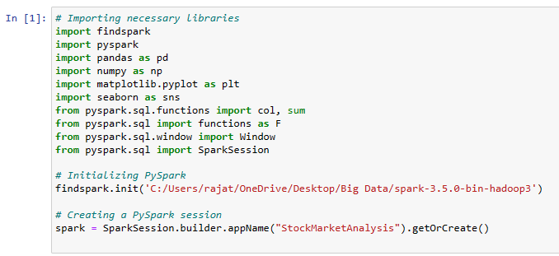
Setting up a pyspark session
The provided code is setting up a PySpark session and importing essential libraries for a stock market analysis.

Slide 6

DataSet

Slide 7
Data Source
The dataset, sourced from www.kaggle.com, which includes the stock data of 6,335 companies in past 5 years from Jan 2015 to July 2020. The stock information is aggregated from AMEX, NASDAQ and NYSE markets. The dataset consists of 8 columns and 6,852,038 rows.
Feature Description
Date: Spanning from 2015 to 2020, the date column signifies the date of each transaction and is stored as a date data type.
Open: The opening price, denoting the initial transaction price per share after the market opening in USD, is stored as a floating-point number.
High: Reflecting the highest transaction price during the trading date in USD, the high column contains floating-point data.
Low: Indicating the lowest transaction price for the trading date in USD, the low column holds floating-point values.
Close: The closing price, representing the transaction price of the last trade during the trading date in USD, is stored as a floating-point number.
Close Adjusted: The adjusted closing price for the trading date is the volume-weighted average price, including the last trade of all trades one minute before the last trade of the security on the same date. This data is stored as a floating-point number.
Volume: Representing the number of transactions between buyers and sellers of the stock on a given trading date, the volume column is of integer type.
Symbol: Representing the unique identifier for a stock, the symbol is a string-based data type.

Slide 8

Exploratory Data Analysis

Slide 9
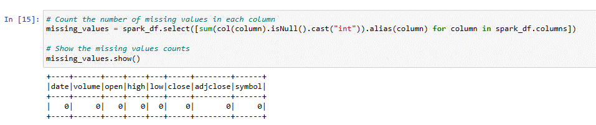
Data preprocessing
The provided code is for checking the missing values in the data set. According to the result, there is no missing values in the dataset.

Slide 10
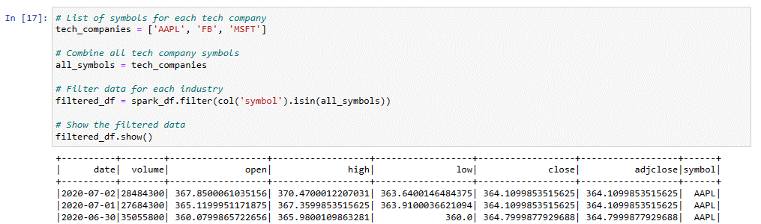
Filtering three Major tech companies dataset
The provided code is for filtering the dataset for 3 major tech companies: Apple, Facebook and Microsoft. We will compare the stock data for all 3 companies and how these companies stock have performed from 2015 to 2020.

Slide 11
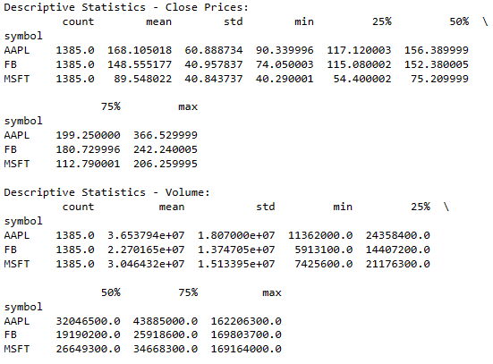
Descriptive Analysis
Close Prices:
Apple has the highest average close price, followed by Facebook and Microsoft.
Apple has the highest volatility (standard deviation) in close prices.
All three companies experienced significant growth in their maximum close prices.
Volume:
Apple has the highest average volume of shares traded, followed by Microsoft and Facebook.
Apple has the highest volume volatility (standard deviation).

Slide 12
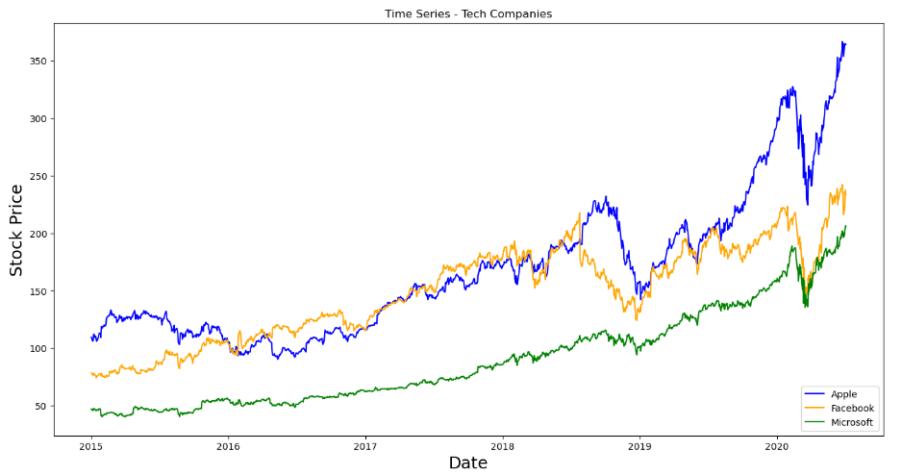
Time Series Analysis
According to the above graph, a clear trend emerges in the stock prices of Apple, Facebook, and Microsoft from 2015 to 2020. Initially, Apple exhibited a consistently high stock price, followed by Facebook and then Microsoft. Notably, in 2016, Facebook surpassed Apple, maintaining the top position until mid-2018. Although there were occasional dips below Apple, Facebook mostly remained above it. However, post-mid-2018, Facebook's stock declined relative to Apple. In mid-2019, it attempted a resurgence but faced a substantial downturn, touching Microsoft's stock levels in the early months of 2020. Subsequently, Apple's stock surged significantly, consistently securing the leading position, with Facebook in second place and Microsoft consistently trailing. Despite variations, all three companies experienced substantial stock growth from 2015 to 2020. Apple's stock, starting just above 100, reached an impressive 350 by the end. Similarly, Facebook, initially below 100, climbed to around 200, and Microsoft, starting near 50, reached approximately 150.

Slide 13
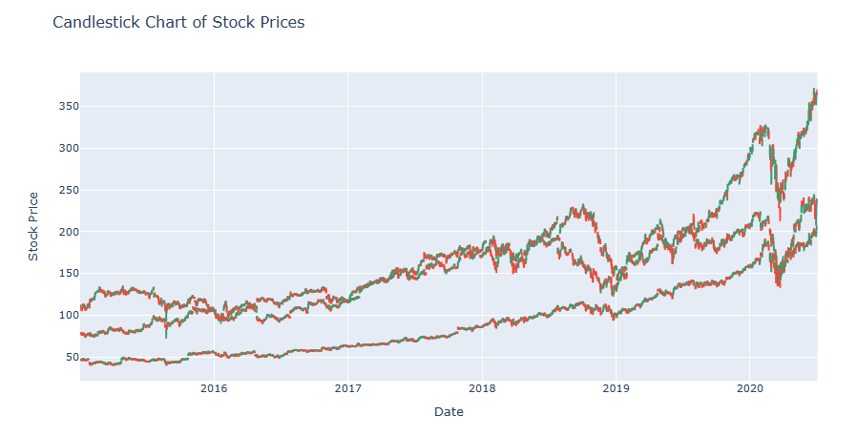
Candlestick chart
In the displayed candlestick chart, the green lines represent an upward trend in the stock value for the respective day, indicating a positive movement. Conversely, the red lines signify a decrease, indicating a downward trend or a drop in the stock value. Candlestick charts provide a visual representation of daily price movements, with each candlestick encapsulating the opening, closing, high, and low prices for a specific trading day. The color coding, such as green for upward movements and red for downward movements, aids in easily interpreting the daily trends and price changes.

Slide 14
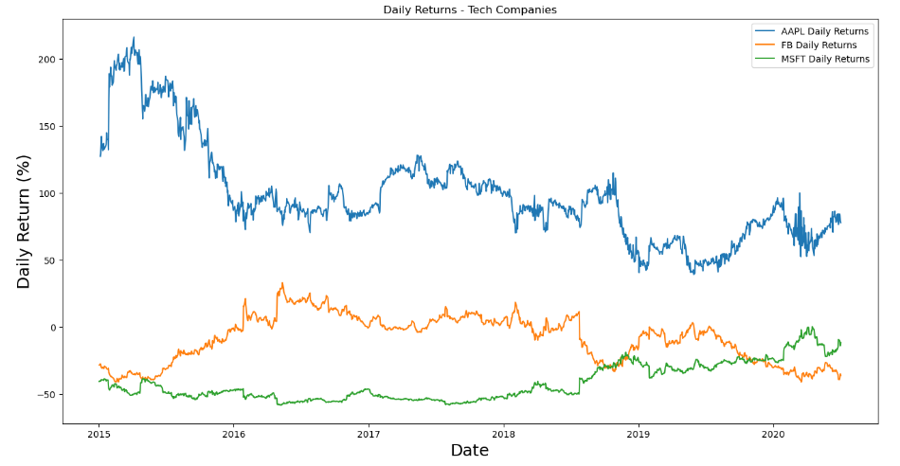
Daily return Analysis
From the above graph, it's evident that Apple's stock has consistently outperformed its competitors. Apple exhibited a remarkable daily return percentage, exceeding 150% in 2015, gradually declining over the years, with a drop to 100% observed towards the end of 2020. In contrast, both Facebook and Microsoft experienced negative daily return percentages. Although Facebook slightly achieved positive daily returns in 2016, it subsequently faced a downturn, falling below Microsoft in mid-2018 and maintaining the third position until the end of 2020.

Slide 15
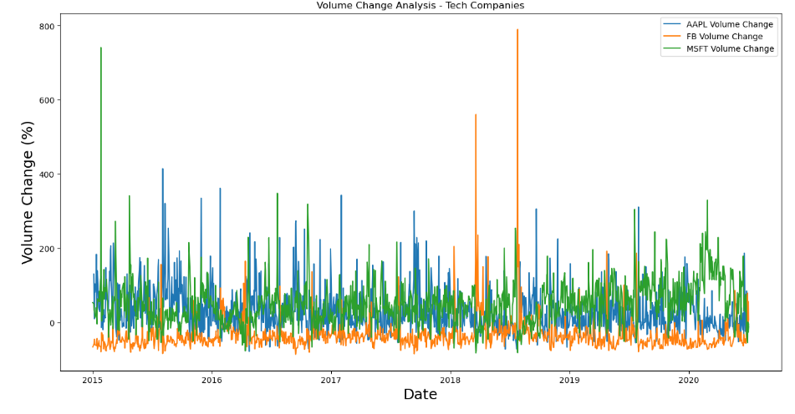
Volume Change Analysis
In the displayed chart, it is evident that the percentage change in volume for Microsoft and Apple exhibits a generally consistent and high trend throughout the period spanning 2015 to 2020. On the other hand, Facebook's volume change percentage, while somewhat lower for the majority of the timeframe, experienced significant fluctuations, notably displaying a notable surge in mid-2018. Volume change percentage is a metric that reflects the relative increase or decrease in trading activity for a specific stock. Higher volume change percentages often indicate heightened market activity, potentially driven by significant events or shifts in investor sentiment. The observed patterns in volume change provide insights into the dynamics of market participation and the relative trading intensity for each company's stock.

Slide 16
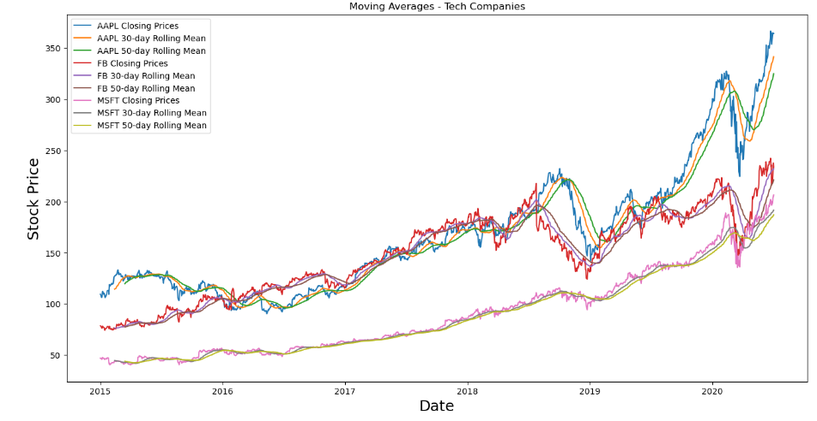
Moving Averages
Moving averages are statistical tools used in stock market analysis to smooth out price data and identify trends. In the context of the provided graphs, the closing prices of three tech companies (Apple, Facebook, Microsoft) are plotted alongside their 30-day and 50-day rolling averages. These moving averages help reduce short-term fluctuations, allowing analysts to discern overall trends more clearly. An upward-sloping moving average indicates an uptrend, while a downward slope suggests a downtrend. Moving averages also serve as dynamic support or resistance levels and are valuable for detecting potential trend reversals, especially when shorter-term averages cross above or below longer-term ones. Investors often use moving averages to inform trading decisions and assess the strength and direction of stock price movements.

Slide 17
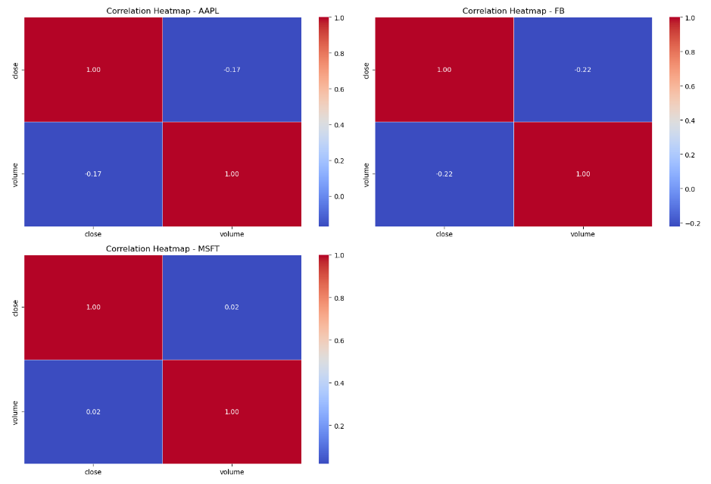
Correlation Analysis
The positive correlation between volume and close price for Microsoft suggests a tendency for these two variables to move in the same direction. When the trading volume increases, there is a slight tendency for the close price of Microsoft stock to increase as well. On the other hand, the negative correlations for Apple and Facebook indicate an inverse relationship between volume and close price. In these cases, when the trading volume rises, the close prices for Apple and Facebook stocks tend to decrease, and vice versa. These correlations provide insights into how changes in trading activity may be associated with price movements, and they can be influenced by various factors, including market dynamics, investor sentiment, and external events affecting each company differently.

Slide 18

RNN – Long short term memory(LSTM)

Slide 19
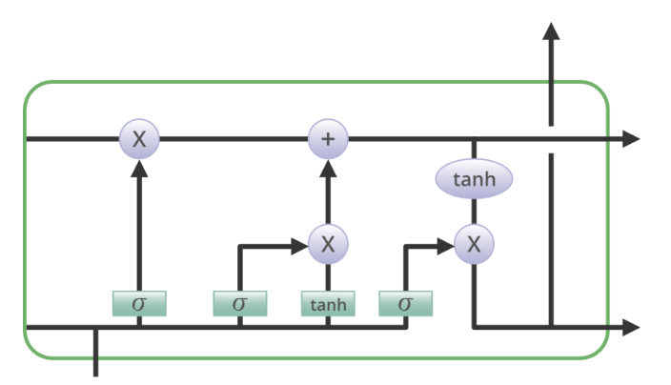
RNN-Long short term memory model
Long Short-Term Memory (LSTM) represents an enhanced version of recurrent neural networks, designed by Hochreiter & Schmidhuber. Primarily tailored for sequence prediction tasks, LSTM excels in capturing and learning long-term dependencies, making it particularly effective for applications involving time series and sequential data. The conventional recurrent neural network (RNN) is often challenged in learning extended dependencies due to its single hidden state passed through time. LSTM addresses this limitation by introducing a memory cell capable of retaining information over an extended duration. This characteristic makes LSTM networks well-suited for intricate tasks such as machine translation, speech recognition, and time series forecasting. The three gates—input, forget, and output—govern the memory cell's operations, facilitating the selective addition, removal, and output of information. This selective control empowers LSTM networks to effectively manage and learn long-term dependencies in sequential data GeeksforGeeks. (2023).

Slide 20
Steps involved in building lstm model
Importing essential libraries to process and building our LSTM model.
Preprocessing of Apple dataset
To enhance model performance, we normalize our data using the min-max scaler.
Splitting data into training and testing.
Initializing the model.
Training our model.
Perform prediction and analyzing results.

Slide 21
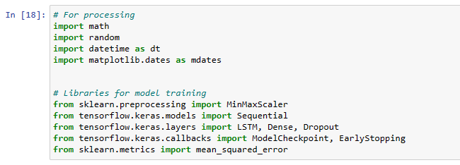
Step 1: importing essential libraries
The provided code is to import essential libraries for building and predicting stock analysis through LSTM model.

Slide 22
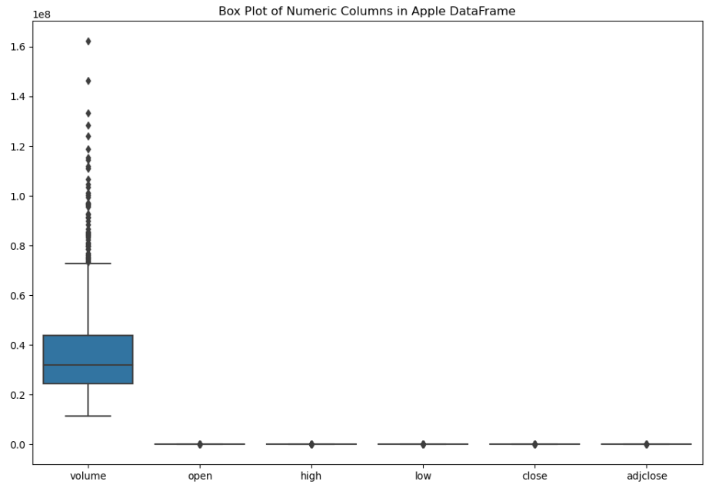
Step 2: preprocessing of apple data
Based on the boxplot displayed above, it is evident that outliers are observed exclusively in the volume column. Since our modeling focus is on the close column, which does not exhibit outliers, we can proceed with building our model using the relevant data.

Slide 23
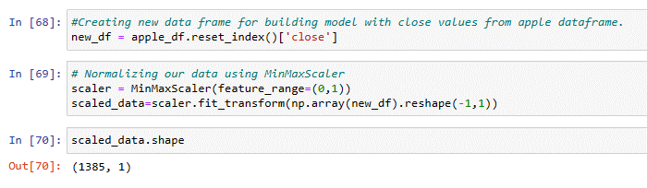
Step 3: Normalizing Data
The provided code is to create new data frame from filtering close values and then normalizing it with min-max scaler.

Slide 24
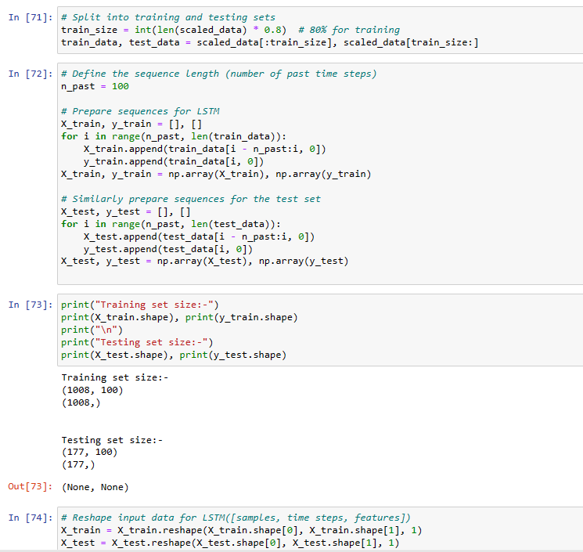
Step 4: Splitting data into training and testing
Data Splitting: The scaled_data, which represents the normalized stock prices, is split into training and testing sets. The training set constitutes 80% of the data.
Sequence Preparation for Training: Sequences of data are created for the LSTM model. For each entry in the training set, it collects the previous n_past time steps (past stock prices) as input features (X_train) and the corresponding next time step as the target variable (y_train). This is done to create a supervised learning problem where the model learns to predict the next stock price based on a sequence of past prices.
Sequence Preparation for Testing: Similar to the training set, sequences are prepared for the test set (X_test and y_test). This ensures that the model can be evaluated on unseen data.
Reshaping for LSTM Input: The input data (X_train and X_test) is reshaped to match the LSTM model's input shape, which expects a three-dimensional array in the form [samples, time steps, features]. In this context, samples are the number of sequences, time steps are the past data points considered, and features are the attributes used for prediction (in this case, just the closing stock price).

Slide 25
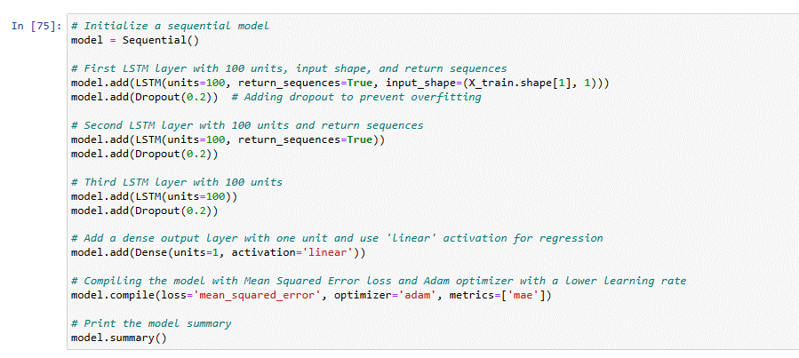
Step 5: initializing Model
This code sets up the architecture for an LSTM (Long Short-Term Memory) neural network model for stock price prediction using the Keras library.
In Keras, the sequential model represents a linear stack of layers, where you can simply add one layer at a time.
The LSTM layer is a type of recurrent neural network (RNN) layer designed to capture temporal dependencies in sequential data. The units parameter sets the number of memory units (neurons) in the layer. The return_sequences=True indicates that the layer should return the full sequence of outputs, which is important when stacking multiple LSTM layers.
The Dropout layer is added to prevent overfitting. It randomly sets a fraction of input units to zero at each update during training, which helps prevent overfitting. Similar blocks of code add two more LSTM layers with dropout for the model.
A dense layer with one unit is added, and 'linear' activation is used. Since this is a regression task (predicting a continuous value), a linear activation is appropriate.
The loss parameter specifies the loss function to be minimized during training, and in this case, it is mean squared error, which is suitable for regression problems. The optimizer parameter sets the optimization algorithm, and 'adam' is a popular choice for its adaptive learning rates.
In summary, this code sets up a sequential LSTM model with dropout layers for stock price prediction and compiles it for training. The model is designed to take sequences of past stock prices as input and predict the next stock price.

Slide 26
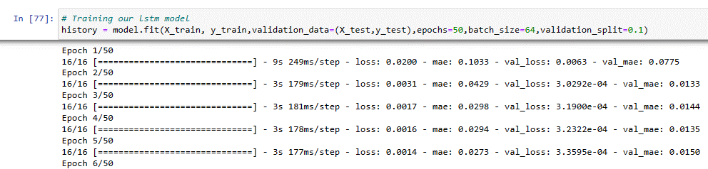
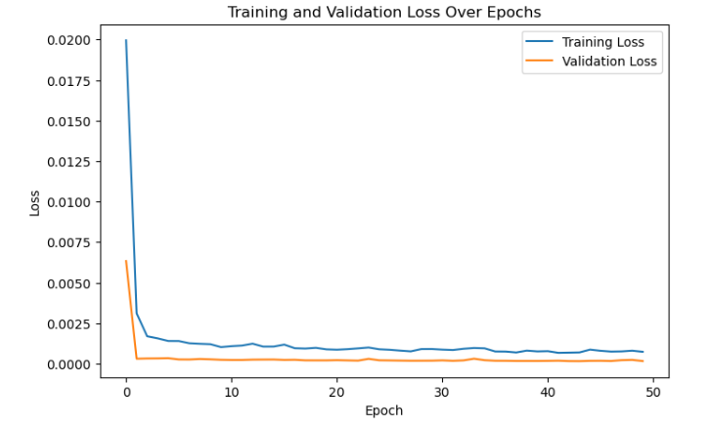
Step 6: Training Model
validation_data=(X_test, y_test): The validation dataset, which is used to evaluate the model's performance on data it hasn't seen during training.
epochs=50: The number of times the entire training dataset is passed forward and backward through the neural network. In this case, the training process will iterate 50 times over the entire dataset.
batch_size=64: The number of samples processed before the model is updated. It is a hyperparameter that influences the convergence of the model during training.
validation_split=0.1: It specifies the fraction of the training data to be used as validation data during training. In this case, 10% of the training data is used for validation.
During training, the model adjusts its weights based on the comparison between its predictions and the actual target values. The training process aims to minimize the mean squared error loss function. The history variable stores information about the training process, such as loss values and metrics, which can be used for later analysis or visualization.
This code essentially initiates the training of the LSTM model with the specified parameters, and the model learns to make predictions on stock prices as it iterates through the training data. The validation data help monitor the model's performance on unseen data to check for overfitting and assess generalization.

Slide 27
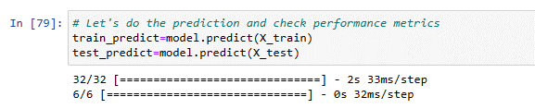
Step 6: Testing Model
This code snippet performs predictions using the trained LSTM model on both the training set (X_train) and the test set (X_test). The predictions are obtained after the model has been trained on historical stock price data. These predictions represent the model's estimations of the stock prices corresponding to the input sequences. After obtaining these predictions, we can evaluate the model's performance by comparing these predicted values with the actual stock prices from the training and test sets.

Slide 28
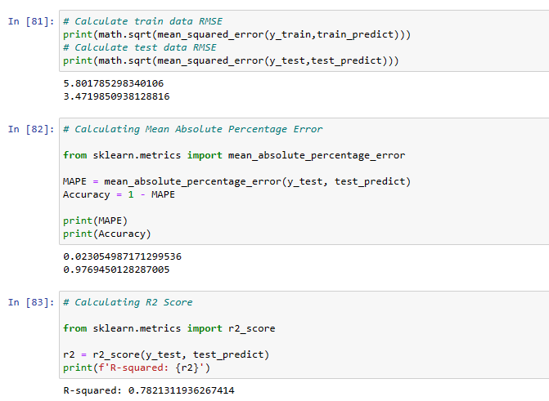
Step 7: Analyzing Result
Root Mean Square Error(RMSE): The RMSE for the training data is approximately 5.80. The RMSE for the test data is approximately 3.47. RMSE is a measure of the average deviation between predicted values and actual values. A lower RMSE indicates better model performance, as it signifies smaller prediction errors.
Mean Absolute Percentage Error(MAPE): The MAPE is approximately 0.0230, indicating that, on average, the model's predictions have an absolute percentage error of about 2.30%. The accuracy is approximately 0.976, which means the model has an accuracy of around 97.6%. These metrics help assess the reliability of the LSTM model in predicting stock prices, with lower MAPE and higher accuracy values being desirable for better performance.
R2 Score: The R-squared value is approximately 0.78, which is very close to 1.0. A high R-squared value indicates that the model explains a significant proportion of the variability in the actual stock prices, suggesting that the model's predictions align well with the observed data. In summary, the high R-squared score suggests that the LSTM model performs well in explaining and predicting the variation in stock prices based on the given features.

Slide 29
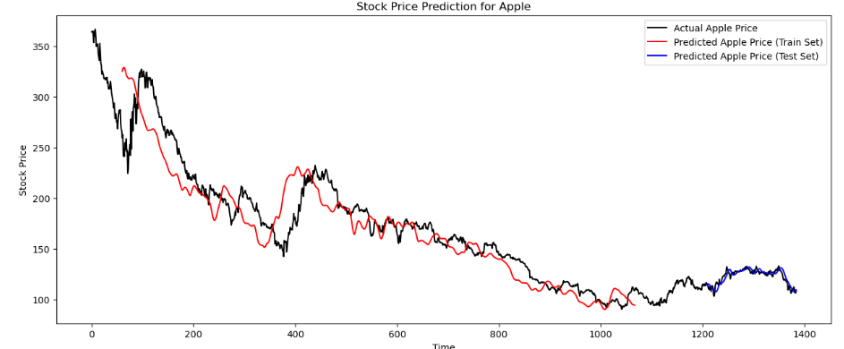
Visualization Result
According to the above visualization, we can clearly see the stock price prediction results for Apple. The training predictions are plotted in red, while the test predictions are plotted in blue, overlaid on the actual Apple stock prices shown in black. The result is a comprehensive visualization that allows for the comparison of predicted and actual stock prices over time, enabling an assessment of the model's performance in capturing the underlying patterns and trends in the stock price data. The plot provides a clear representation of how well the model aligns with the actual stock prices for both the training and test sets.

Slide 30
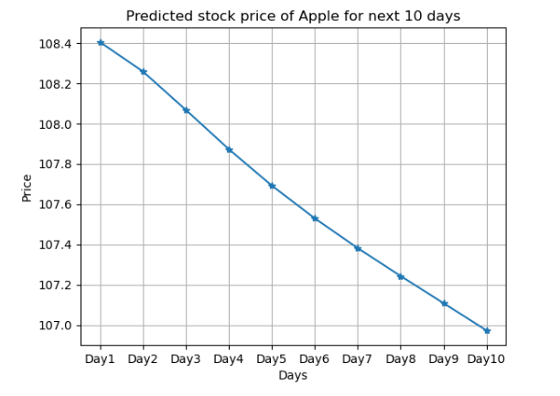
Predicting stock price for next 10 days
According to the above graph, we can predict the stock prices of Apple for the next 10 days using the LSTM model.

Slide 31
References
Apache Spark. (2023). Pyspark Overview. Apache. https://spark.apache.org/docs/latest/api/python/index.html
GeeksforGeeks. (2023). Deep Learning | Introduction to Long Short Term Memory. geeksforgeeks. https://www.geeksforgeeks.org/deep-learning-introduction-to-long-short-term-memory/

Slide 32

Thank you

