Slide 1

Application of Face recognition using ML in Employee Emotion Detection
Under the Guidance of
Dr. Seema Maitrey
Submitted by
Rajat Maurya 1900290100116
Rajat Maurya 1900290100115
Jatin Jain 1900290100076

Slide 2
Face recognition system
Face recognition system is to recognize the face of a human being from an image or video stream with high accuracy in a shorter time.
Face recognition systems have seen wider uses in recent times on smartphones and other forms of technology, such as robotics.
Although the accuracy of facial recognition systems as biometric technology is lower than iris recognition and fingerprint recognition, it is widely adopted due to its contactless process.

Slide 3
Detailed Methodology
It first recognizes and extract unique features of the face like nose, eyes, eyebrows, lips, jaw, nose length, nose width, cheek, etc, and then compares it with the images in the database.
When we match two faces then their unique features get matched.
Accuracy of the recognition is depending on the following factors
Lightning condition (the bad lightning condition can decrease the accuracy)
Face positioning
Makeup
Hairstyle
Accessories (like glass)

Slide 4
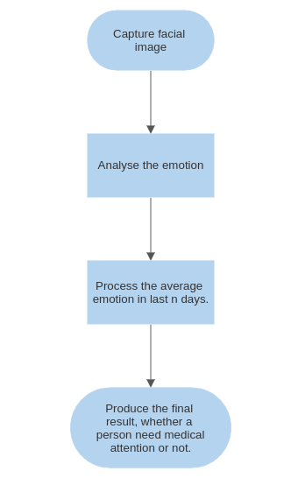
Implementation flow

Slide 5
Other Applications of the face recognition
Criminal identification
Suvillance
Emotion detection
Tracking attendance
Defense services
Bank services (like atm)
Online payment
Airport service

Slide 6
There are different types of face recognition algorithms.
Eigenfaces (1991)
Fisherfaces (1997)
CNN

Slide 7
Convolutional Neural Networks
Convolutional Neural Networks (CNNs): CNNs are a class of deep learning algorithms specifically designed for analyzing visual data, such as images and videos. They are inspired by the organization and functionality of the human visual cortex and have revolutionized computer vision tasks.
Convolutional Layers: CNNs consist of multiple layers, with convolutional layers being the core component. These layers apply filters (kernels) to input data, allowing the network to detect various features and patterns in the data. Convolutional layers help capture local spatial dependencies and enable translation invariance.

Slide 8
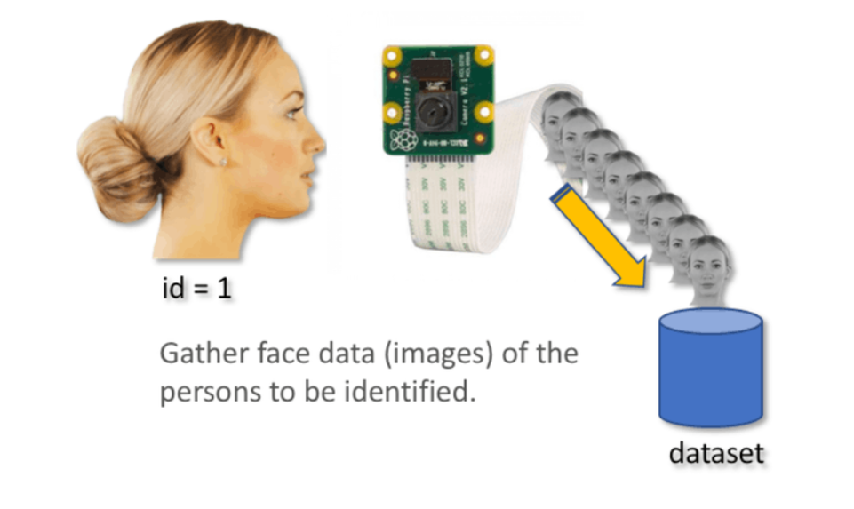
List of activities carried out to complete the project
We first capture faces of different people and
store them with different folders of their names.
Now we have to train the model based on their
faces stored in different folders.
After the training of the model our face detection model is ready to detect the faces.
Now we can use it to detect faces from the video stream like our webcam.

Slide 9
Steps carried out
Capturing Photos: Implement a system to capture photos of employees at regular intervals, such as every 15 minutes, during their workday.
Facial Feature Detection: Utilize facial recognition algorithms to detect and analyze various facial features in the captured images.
Emotion Analysis: Apply machine learning techniques to analyze the detected facial features and determine the emotional state of each employee in the captured photos.
Reporting and Action: Compile and organize the emotional data obtained from each employee and generate reports for managers and HR teams.

Slide 10
Places/Labs/Equipment and Tools used
Python used as a programming language
OpenCV
NumPy

Slide 11
References/links
https://www.youtube.com/watch?v=5r6ldRG9FWk
https://towardsdatascience.com/face-recognition-how-lbph-works-90ec258c3d6b
https://en.wikipedia.org/wiki/Facial_recognition_system

