Slide 1
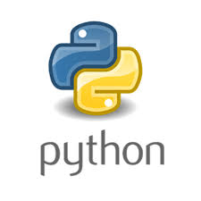
PYTHON – CRASH COURSE
- Raj Prajapati
Python is an interpreted, high-level, general-purpose programming language.

Slide 2

Who Made Python and When ??
Created by Guido van Rossum and first released in 1991, Python's design philosophy emphasizes code readability with its notable use of significant white-space.
Dev started in 1989.

Slide 3
Applications for Python
Web and Internet Development : Frameworks such as Django and Pyramid.
Education : Python is a superb language for teaching programming.
Scientific and Numeric : SciPy, Pandas, Ipython.
Desktop GUIs : Kivy, for writing multitouch applications.
Software Development : Roundup or Trac for bug tracking and project management.
Business Applications : Tryton is a three-tier high-level general purpose application platform.

Slide 4
Companies Using Python
Google : For Better Search Results.
Netflix : Recommending shows to users.
DropBox : Server Client Application in Python.
Bit-Torrent : File Transfer between peer to peer
NASA : Mathematical modeling and Calculation

Slide 5
Topics
Data Type
Arithmetic Operations
Variables
Numeric Data Types
String Data Types
Booleans
Methods
List
Slicing
Membership Operators
Mutability I
Mutability II
Common Function & Methods
Tuples
Sets
Dictionaries
Compounded Data Structures

Slide 6
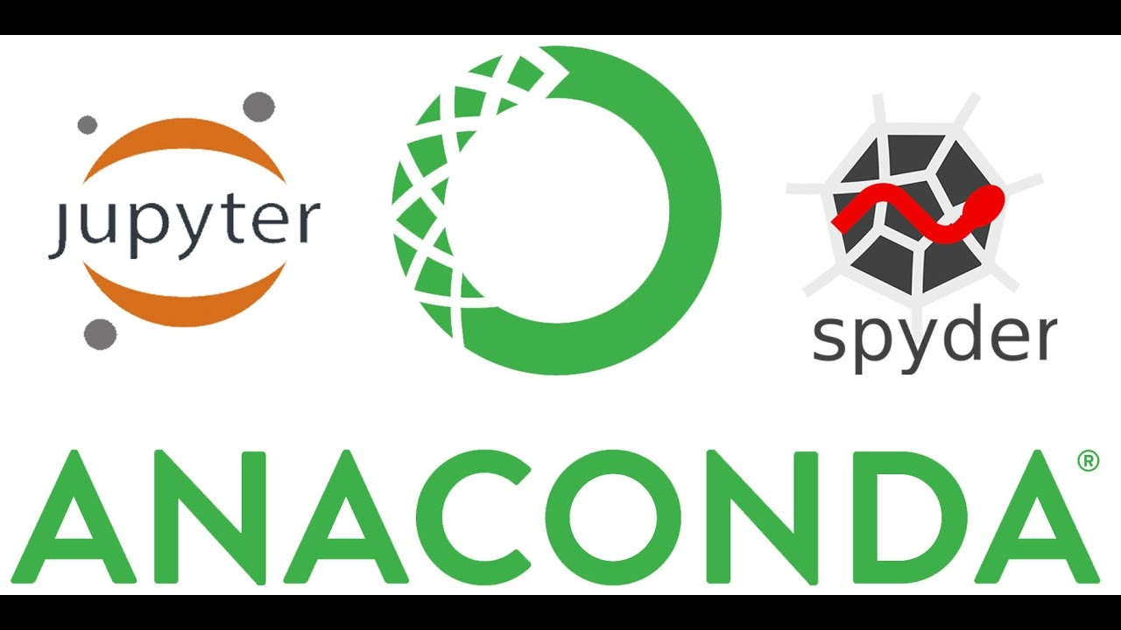
ANACONDA – A Python Distribution

Slide 7
ANACONDA
Anaconda is a free and open-source distribution of the Python and R
programming languages for scientific computing (data science, machine
learning applications, large-scale data processing, predictive analytics,
etc.), that aims to simplify package management and deployment. The
distribution includes data-science packages suitable for Windows, Linux,
and macOS.

Slide 8
Downloading Anaconda
Downloading Link :
  https://www.anaconda.com/products/individual
Anaconda Package List :
  https://docs.anaconda.com/anaconda/packages/pkg-docs/

Slide 9
Jupyter Notebook
Project Jupyter exists to develop open-source software, open-standards, and services for interactive computing across dozens of programming languages.
Its Web based interface with Live Code and Visualization for various Programming Languages

Slide 10
Various IDE’s Supporting Python Dev
List is available at :
  - https://wiki.python.org/moin/IntegratedDevelopmentEnvironments
  But we will work with Jupyter Notebook
  Lets see what is
    anaconda, Jupyter notebook, powershell, environment etc
  Lets Do Some Practical. !!

Slide 11
Creating Env
Creating Env :
conda create --prefix <Location> <Package>
conda create --prefix C:\Users\raj\Desktop\Test python=3.7
Checking Env :
conda list env
Activating Env :
conda activate C:\Users\raj\Desktop\Test
Manage Env :
- https://docs.conda.io/projects/conda/en/latest/user-guide/tasks/manage-environments.html

