Slide 1
Indexing and Searching for hot topics
Rajat Narang [rnarang]
Shreya More [ssmore]
Udit Misra [umisra]

Slide 2

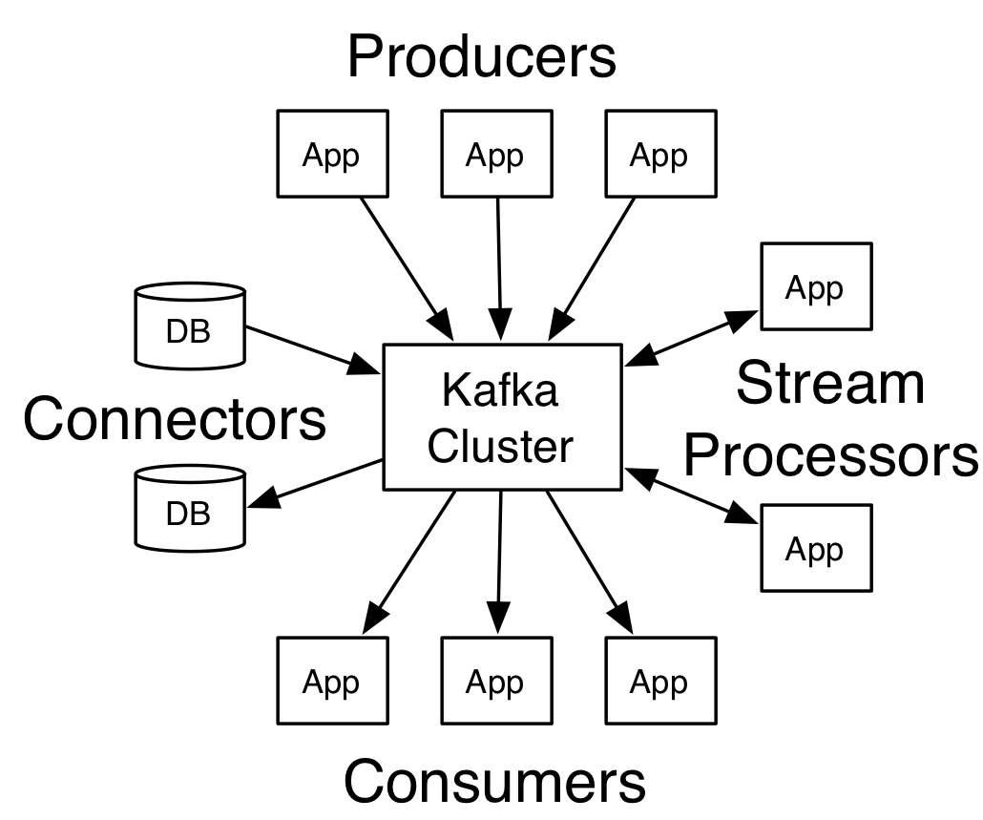
Kafka And Tweepy
Tweepy: An easy-to-use Python library for accessing the twitter API
Kakfa: Distributed queuing service to buffer the tweets before processing

Slide 3
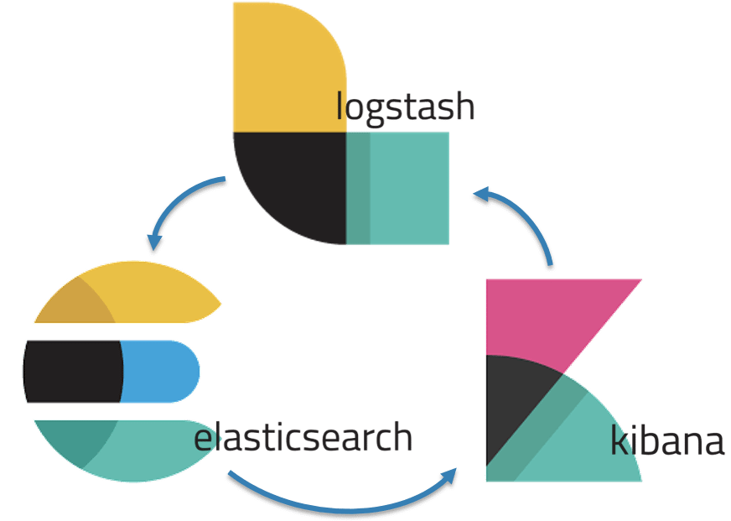
ELK Stack
ElasticSearch: Elasticsearch is a distributed, RESTful search and analytics engine capable of solving a growing number of use cases Logstash: Logstash is an open source, server-side data processing pipeline that ingests data from a multitude of sources simultaneously, transforms it, and then sends it to your favorite “stash.” Kibana: Kibana lets you visualize your Elasticsearch data and navigate the Elastic Stack

Slide 4
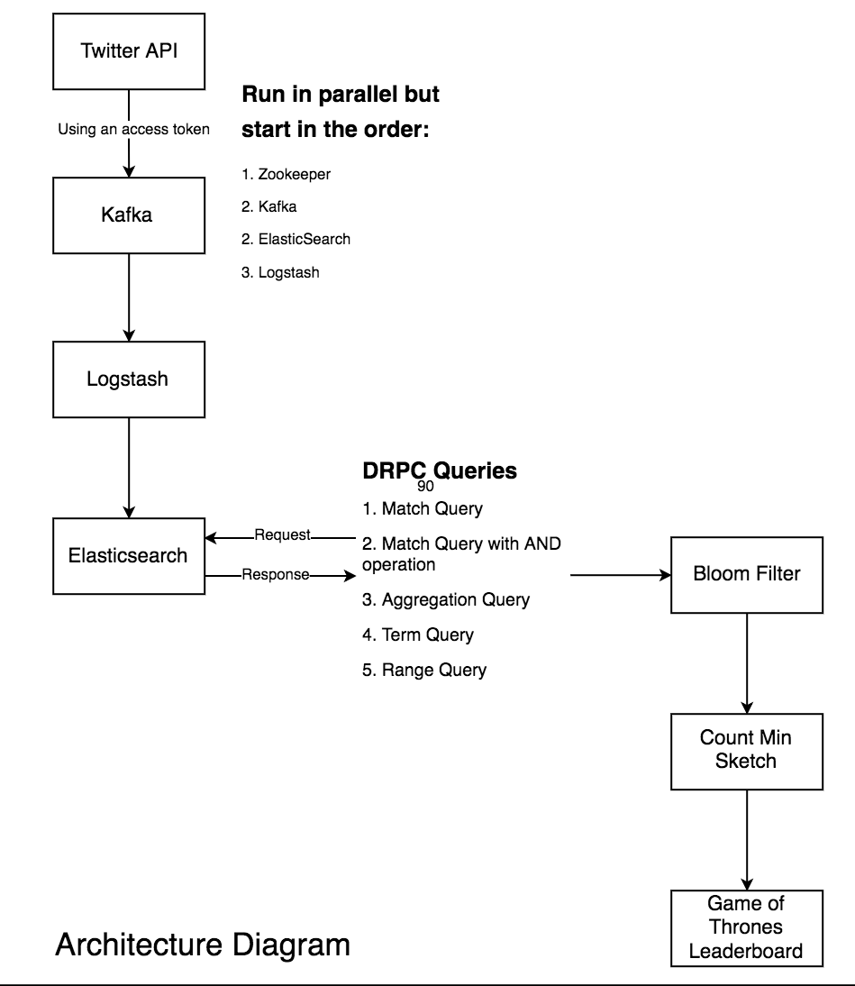
Project Architecture

Slide 5
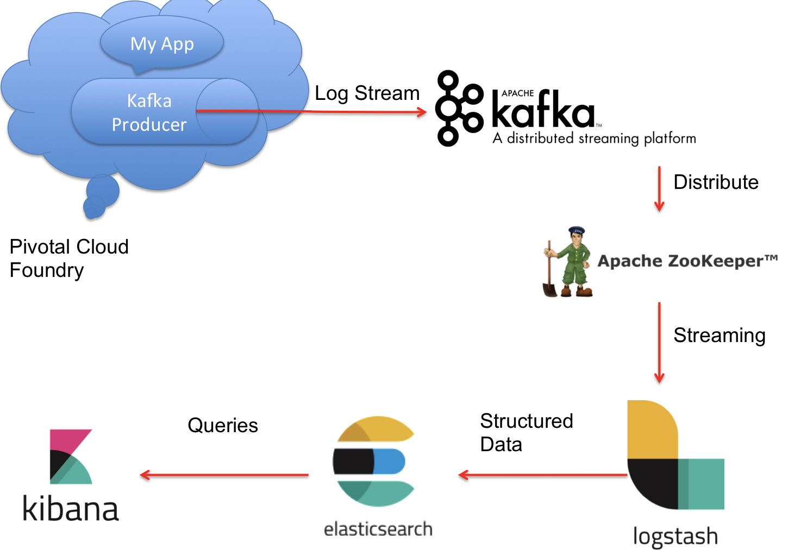
Connection between Kafka & ES
Pipeline:
Extract data using tweepy and push to kafka
Using Logstash transfer data from kafka to elasticsearch
Using Kibana run DRPC queries and visualize data

Slide 6
Count Min Sketches & Bloom Filters
Sub linear space data structures
Summarize data streams
Probabilistic nature
CMS are a refinement of BF

Slide 7
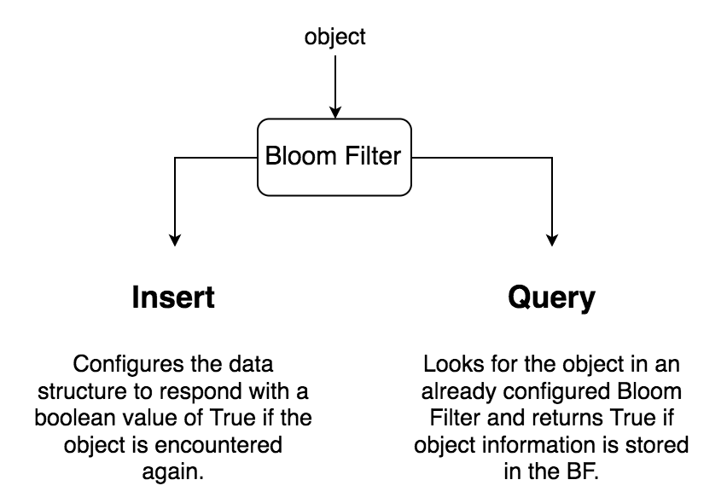
Bloom Filters Design
Allows False Positives but not False Negatives
The output a Bloom Filter gives is whether an input object has already been registered in it.
BF supports insert and query operations
It works by using k independent hash functions <h1, h2, …, hk> that map to indices in the range of 1 to m.

Slide 8
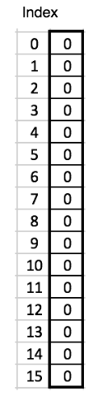
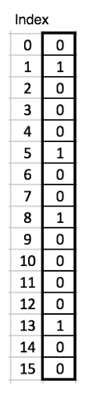
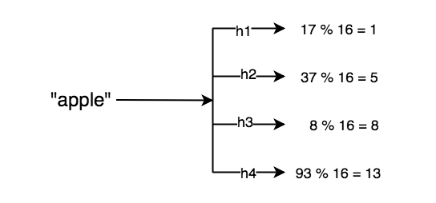
Bloom Filters Insert
We initialise an array of n bits to zero and use k independent hash functions.
Assume we are working with a bloom filter of size 16 with 4 hash functions.
O(k) complexity

Slide 9
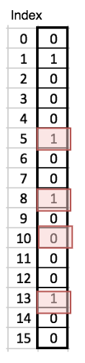
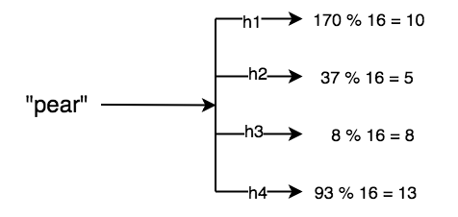
Bloom Filters Query
Perform AND operation on all indices found through hash functions.
"pear" was not contained in the Bloom Filter in which we had inserted "apple".
1 and 1 and 0 and 1 = 0
O(k) complexity

Slide 10


Bloom Filter Equations
Where,
n = number of items in set
m = number of bits in filter
k = number of hash functions
p = probability of a false positive
We generally fix values of n and p to determine the values of m and k

Slide 11
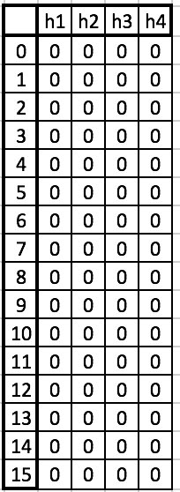
Count Min Sketches
k hash functions
An extension to Bloom Filters
Acts as a frequency table of objects in a data stream
Instead of an array of length m, CMS maintains a 2-dimensional data structure (mxk)
The hash functions can deliver any value less than m. So every hash function and a value under m, map to a cell in the CMS
m rows

Slide 12
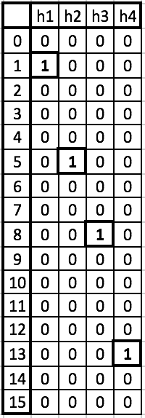
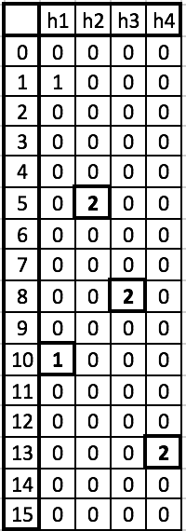
CMS Example

Slide 13
Top K Heavy Hitters
Heavy hitters problem:
Given a stream of length T and a parameter k, in a single pass over the stream we want to find any elements that appear at least T/k times.
Top k:
Find the top k frequently occurring items in the data stream

Slide 14
Game of Thrones Leaderboard
Built a Bloom Filter based on 31 popular characters from Game of Thrones.
Tweets checked for these names
If present in the Bloom Filter, the name is added to a CMS that backs up the leaderboard
Leaderboard: [(27, 'samwell'), (41, 'bran'), (60, 'got\xe2\x80\xa6'), (86, 'cersei'), (176, 'jon')]

Slide 15
Conclusion
We successfully built a pipeline to stream tweets from Twitter's API through Kafka, Logstash and index it in Elasticsearch.
Results were obtained using CMS and BF by performing top k Heavy Hitters on their result.
All top characters stayed at relatively same positions, even though their frequencies changed over time. The change was not found to be very drastic.
We did not expect the leaderboard to change constantly. However, fluctuations were noticed after the release of a new episode.

