Slide 1

DATA VISULAIZATION AND DASHBOARDS USING TABLEAU
BY Rajat Parmar

Slide 2
AGENDA
-Introduction
-Data analysis
-Data visualization
-Dashboard
-Challenges

Slide 3
Introduction
- Given 5 datasets
-Information given on HPI(housing price index), CPI(consumer price index), Office price index and prices for houses ie. Single storey, two storey, townhouse etc. in different locations across Canada.
-Years from 1979-2020

Slide 4
DATA ANALYSIS
-Search for duplicate rows
-Check for null values
-Check data types
-Remove unwanted rows and columns
-Adding zero to numeric null values

Slide 5
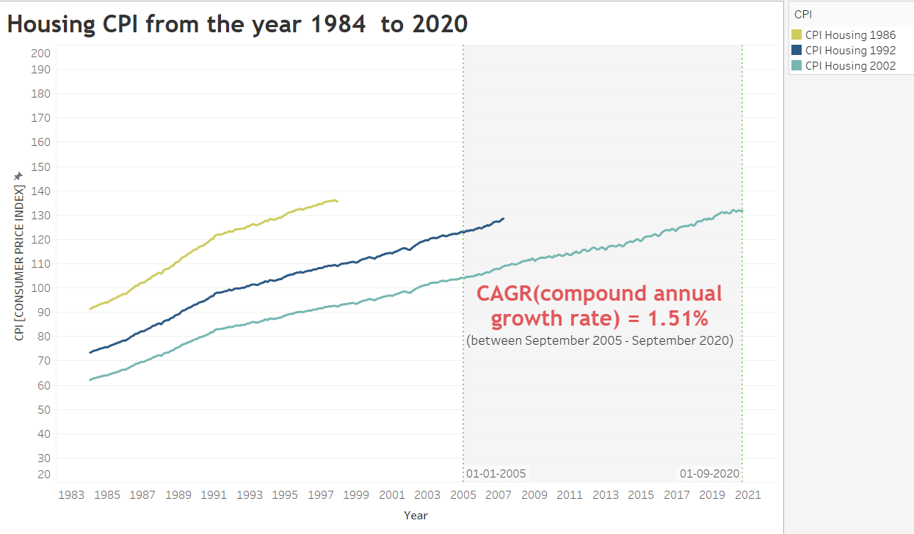
DATA VISUALIZATION
Data ends for 1986 and 1992 indexes will use data index from 2020

Slide 6
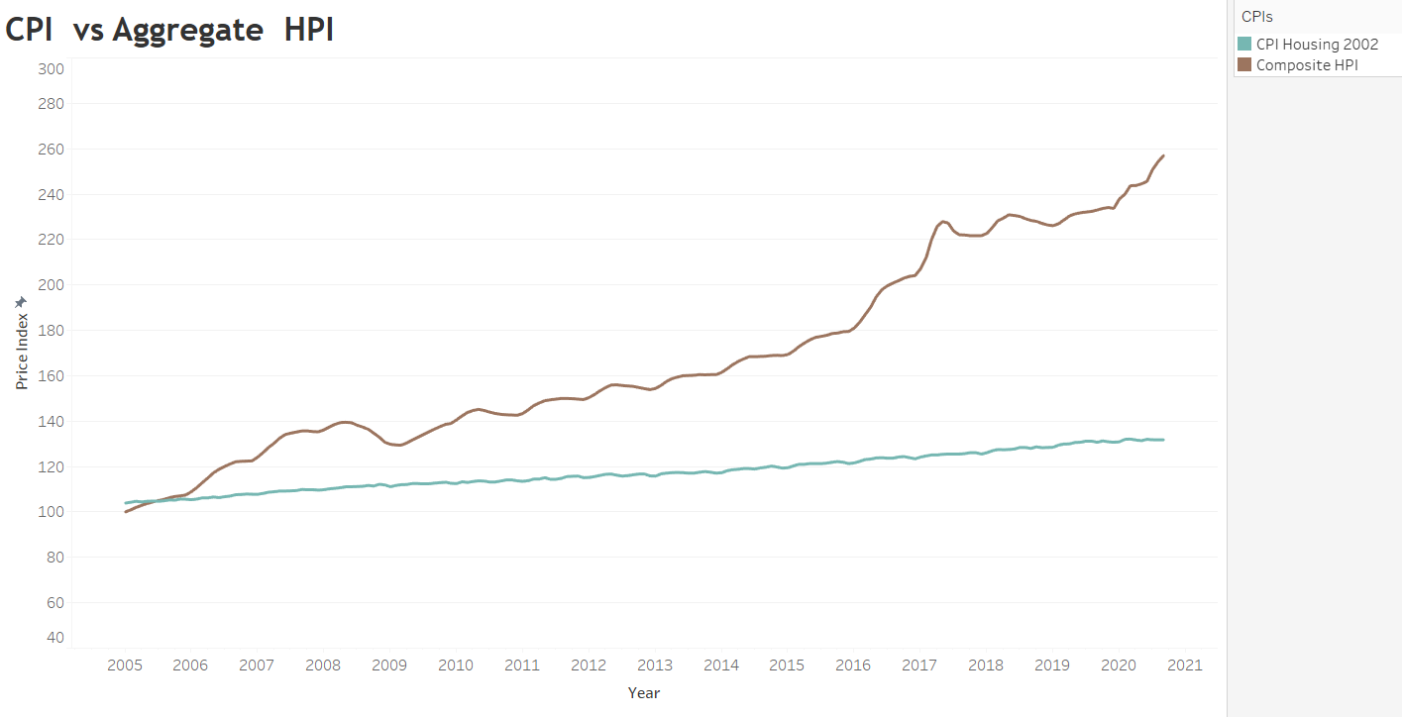
TREND COMPARISON
Difference is 125.1 (sept 2020)

Slide 7
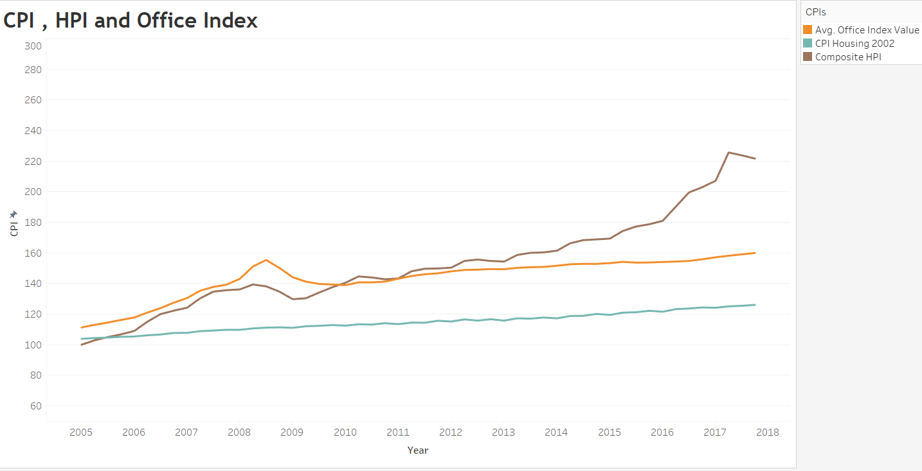
Office CPI Year over Year trend similar to the Housing CPI The Composite HPI is growing much faster than the Office CPI

Slide 8
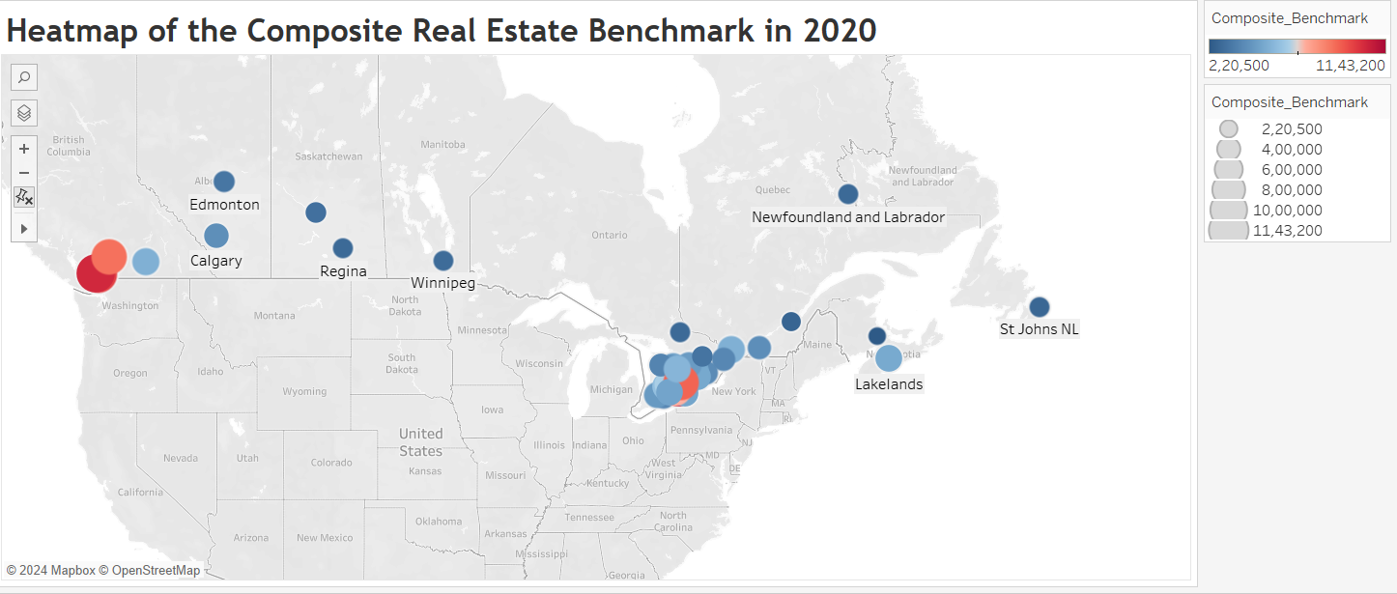
The highest cost real estate was located in the surrounding areas of Toronto and Vancouver. The lowest cost real estate was located in the maritimes.

Slide 9
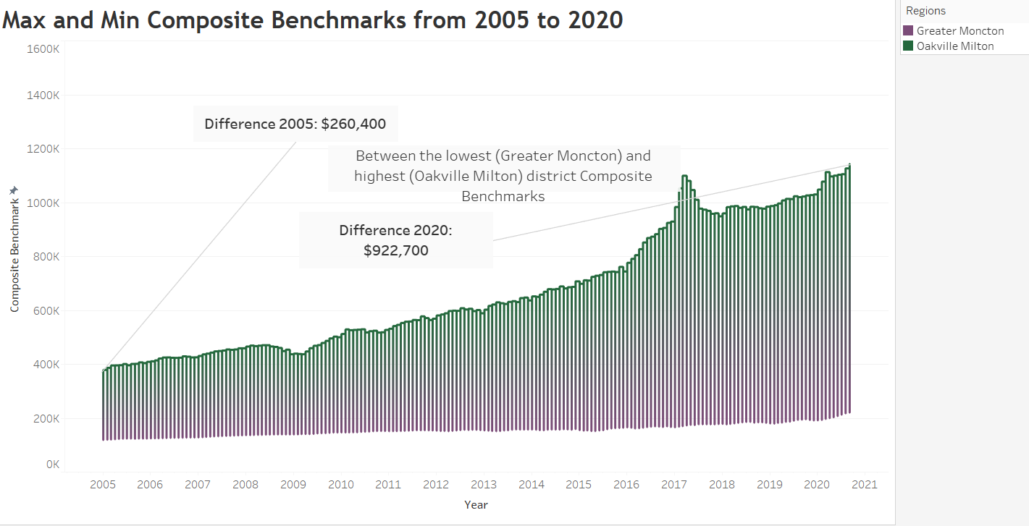

Slide 10
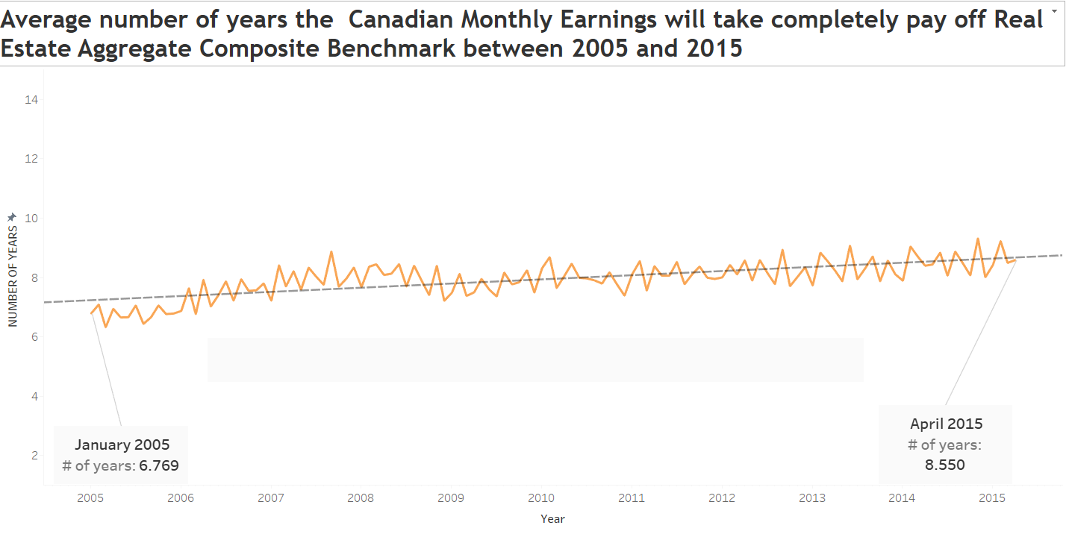
The change in earnings across Canada is being outpaced by the change in benchmark price across all real estate. It will continue to take longer for Canadians to pay off their real estate. Considering this trend, Canadians would have spent more of their income in 2014 than in 2001

Slide 11
CHALLENGES
-Data cleaning
-Visualization challenges
-Understanding the data and sorting it
-Geographical coordinates had to be given to create heatmap.

