Slide 1



Fault Diagnosis related to an IIoT Based Development of an Active Damped Boring Bar using a case study on bearing data
RAJAT RAI
Third Year and Sixth Semester (B.Tech. Mechanical Engineering)
Indian Institute Of Technology (Indian School Of Mines) Dhanbad
Conducted by
Sponsored by
December 2021 – February 2022

Slide 2
ABSTRACT
In Boring process casted, forged or extruded holes in components are finished with a boring bar having cutting tool insert at its frontend. Dynamic and static deflections are always there in the boring bar due to its slenderness. The generating force for chatter is supplied by the cutting process itself, so it creates problems in achieving desired productivity and also reduces the life of boring bar and cutting tools. As part of this Internship, the focus is to provide fault diagnosis for the Boring process to avoid unnecessary costs and squandering of time due to sudden failure of boring bar and cutting tools to ensure that the best quality product is maintained.
The main objective of method proposed here is to diagnose the machine and its parts by monitoring vibration, to predict defects. A reference Bearing data is considered for the purpose from NASA repository for training some best available machine learning models. As a result of this, it has been possible to predict faults and location of faults, to the best of our ability based on the data taken for study.

Slide 3
Key Learnings
Got a chance to test and hone my machine learning and python skills
Understood how machine learning can be used in mechanical engineering field
Because of frequent meetings being held got a chance to improvise my presentational and communication skills

Slide 4
Outcomes
Built a diagnostic, condition monitoring and predictive maintenance framework using best available machine learning models and implemented all these using Python programming language, based on bearing data available in NASA repository, further refinement may be necessary to accommodate the boring data.

Slide 5
Introduction
All our problems related to boring bar starts with chatter. Chatter is a self-excited vibration caused by variation in chip thickness resulting from a time delay between current cut and preceding cut.
Chatter vibration in machining processes limits accuracy and productivity of boring processes.
Chatter vibration brings about following unwanted effects :
1. Mechanical faults and failure of cutting tools and supporting structure
2. Poor surface finish and accuracy of finished product
In a boring process, the long cantilever boring bar makes it vulnerable to chatter, due to its low dynamic stiffness. The tool or boring bar will need to be replaced at some point during the operation to prevent adverse effects of the chatter vibration on the workpiece. In this case, condition monitoring and predictive maintenance allows us to predict when to replace the tool or boring bar so that we can get the most benefit in terms of time, cost, and quality.

Slide 6
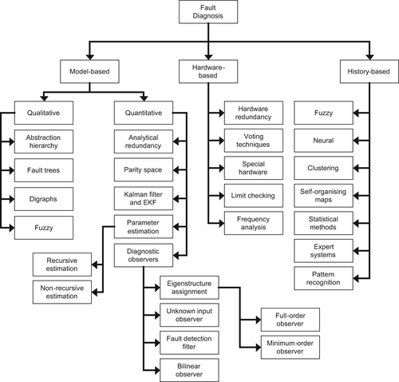
In the case study carried out during this internship I used
History based fault diagnosis method that specially consists of Classification techniques and statistics based machine learning Models.
In fault diagnosis literature, one can find a huge overlap between model-based fault diagnosis and history-based fault diagnosis. Model-based fault diagnosis methods usually deploy a model developed based on some fundamental understanding of the physics of the process. History-based fault diagnosis methods do not deploy a mathematical model of the physics of the process, but a model derived from known and measured input and output process data. The fundamental idea of history-based fault diagnosis is to generate a model of the process, which mathematically relates measured inputs to measured outputs, and then use this model against the real process to generate residual.

Slide 7
Objective of the case study
To build a health condition monitoring and fault diagnosis framework using Python programming language, best available machine learning models and statistical methods based on Bearing data available on NASA repository.
Scope of the case study
The main focus of this case study will be on implementing fault diagnosis methods using best machine learning models using the bearing data available on NASA repository. Real life physical processes have certain particular effects on statistical parameters which can be used for making predictions related to and monitoring of real life physical processes. Work carried out during this case study can be refined and modified to accommodate boring bar experiment data in future.

Slide 8
Case Study Workflow
Transferring the reference Bearing data
Into a data frame
Dividing the dataset into test and training data
Training the Classification machine learning models on training dataset
Testing the model on test dataset
Perform Hyperparameter tuning to get the best parameters for the model
Choosing the best machine learning model based on the accuracy of training
Language used : Python

Slide 9
IMS Bearing Data
Test Rig Setup :
Four bearings were installed on a shaft. The rotation speed was kept constant at 2000 RPM by an AC motor coupled to the shaft via rub belts. A radial load of 2721.554 kg is applied onto the shaft and bearing by a spring mechanism. All bearings are lubricated. Rexnord ZA-2115 double row bearings were installed on the shaft. PCB 353B33 High Sensitivity Quartz ICP accelerometers were installed on the bearing housing two accelerometers for each bearing [x- and y-axes] for data set 1, one accelerometer for each bearing for data sets 2 and 3.
Accelerometer :
Is a device that measures the vibration, or acceleration of motion of a structure. The force caused by vibration or a change in motion (acceleration) causes the mass to "squeeze" the piezoelectric material which produces an electrical charge that is proportional to the force exerted upon it. Since the charge is proportional to the force, and the mass is a constant, then the charge is also proportional to the acceleration

Slide 10
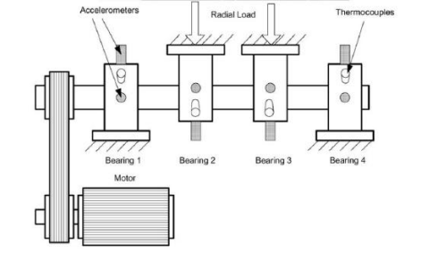
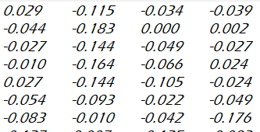
Vibration/Acceleration
Bearing 1
Bearing 2
Bearing 3
Bearing 4

Slide 11




Feature Extraction
Several signal-based statistical features has been extracted from the data :
Absolute mean :
2. Standard deviation :
3. Skewness : Faults can impact distribution symmetry and therefore increase the level of skewness.
4. Kurtosis : Developing faults can increase the number of outliers, and therefore increase the value of the kurtosis metric.

Slide 12
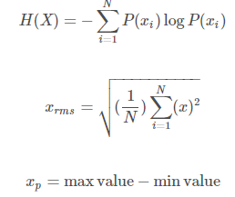




5. Entropy :
6. RMS :
7. Peak to Peak :
8. Crest factor : Faults often first show themselves in changes in the peakiness of a signal before they show in the energy represented by the signal root mean squared. The crest factor can provide an early warning for faults when they first develop
9. Clearance Factor : For rotating machinery, this feature is maximum for healthy bearings and goes on decreasing for defective ball, defective outer race, and defective inner race respectively. The clearance factor has the highest separation ability for defective inner race faults.
10. Shape Factor :
11. Impulse :

Slide 13
.
Dataset prepared based on experiment 1 which has data for in two different axis (X and Y)
Each bearing is termed as B1, B2, B3, B4
Dividing health status
To make the data ready for training a classifier we need to provide it with the health status labels based on the level of sensor data by specifying the correct date and time like
early
normal
suspect
failure.
This part depends on the project team how many labels they want to give.

Slide 14
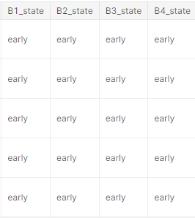
Dropped y axis columns because our test dataset has data in only X axis
Used state as target variable(we have to predict the state)
Classifiers used
K Neighbours Classifier
Support Vector Classifier
Gaussian Process Classifier
Decision Tree Classifier
RandomForestClassifier
MLP Classifier (ANN)
AdaBoost Classifier
Gaussian naive bayes classifier
Quadratic Discriminant Analysis
XGBoost Classifier
CatBoost Classifier
LGBM Classifier
NOTE : I arranged that bearing data 1,2,3 and 4 vertically (at first it was horizontally arranged)

Slide 15
Hyperparameter Tuning
Since accuracy score of the last 3 base model namely XGBoost, CatBoost, LGBM, are the highest ones, we will continue with one of them in further investigations
Parameters of the selected model will be tuned with optuna library
Typical values were given as interval of parameters
Finally used Xgboost classifier accuracy_score = 0.8423 → 0.8512
Fed experiment 2, 3 data as test data

Slide 16
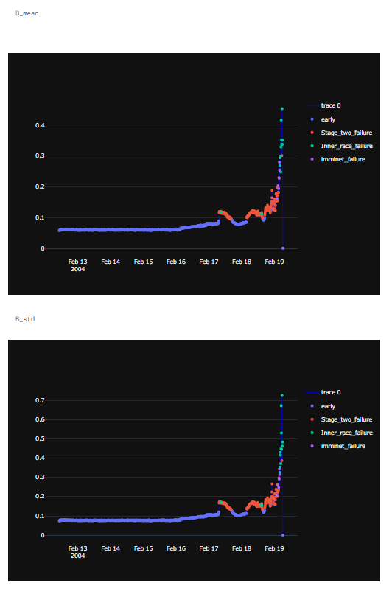
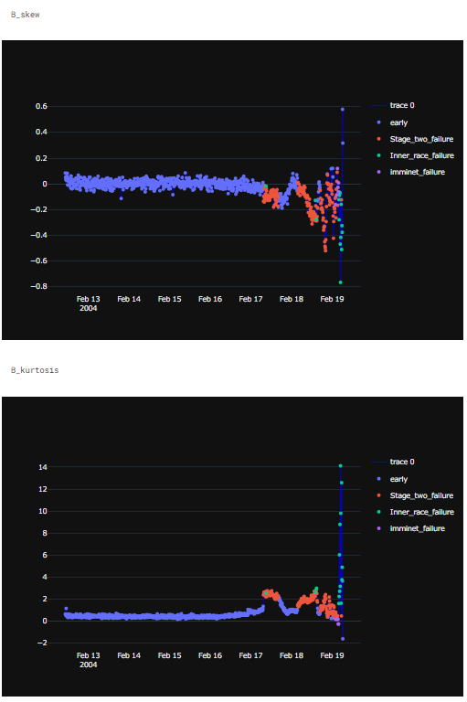
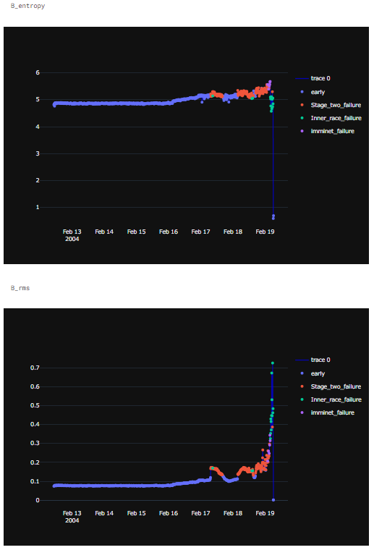
Results and Conclusion
Finally used Xgboost classifier accuracy_score = 0.8423 → 0.8512

Slide 17
Active damped boring bar system
Active damped Boring bar process experimental setup
Experimental
Data
Database
Experimental
Data
Fault Diagnosis Framework
Prognostics Framework
Health condition monitoring
And predictive maintenance Framework
Experimental process parameter Control Framework
Input

Slide 18
Summary
The whole case study work carried out here focused on two things that how well I can predict the failure and where is it is going to happen. This all work was done using Python programming language. I used some best available machine learning models and statistical parameters which have some roles to play in this physical processes. Then I chose the best models and parameters from them using hyperparameter tuning.
Future modifications that can be done :
Since I conducted all this fault diagnosis using a bearing data so if in future we get any boring data then the machine learning models must be trained and tuned based on boring data.
Some feature selection techniques can be induced in this framework for the better performance of the models.

Slide 19
Internship Experience
The second year of college is when I started learning more about machine learning. Being a mechanical Engineer, it was very interesting to study machine learning (anything except machines ) and it's applications in various fields of science and technology.I always wanted to do something related to machine learning and mechanical engineering.
I was delighted to see this Internship program and decided to join this program. I have spent three months of my time in doing Internship work in two of my favorite fields of science and technology. This internship taught me many new things about machine learning and how deep this ml can be used in mechanical engineering. Mentors and internship guides were very helpful and supportive during the internship. I learned many new things from them. This Internship has proven to be very beneficial for me and my career, and I am very glad I took part in it.

Slide 20
THANK YOU

