Slide 1


Introduction to Python
Week - 2
AIML
POST GRADUATE PROGRAM
ARTIFICIAL INTELLIGENCE & MACHINE LEARNING

Slide 2
Agenda
Pop Quiz
Data Visualization
Visualization - One variable
Visualization - Two variables
Visualization - Multiple variables

Slide 3
Pop Quiz
What is data visualization?
Why does data visualization help?
How to visualize numerical and categorical variables?
What is correlation?

Slide 4
Data Visualization
Data visualization is the process of translating data and metrics into charts, graphs and other visuals.
The resulting visual representation of data makes it easier to identify patterns, trends, and outliers hidden in the data, enabling us to gain better insights.
We can use different charts/plots to visualize different kinds of data
Each chart/plot helps us gain insights from a different perspective

Slide 5
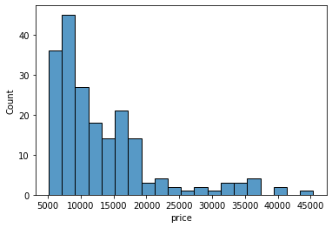
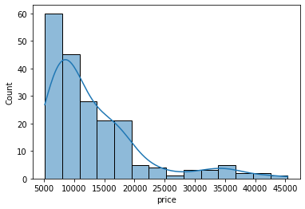
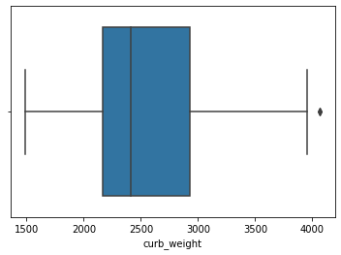
Visualization – One Variable
Plot | Type of Data | Usage | Example
Histogram | Numerical | Helps us understand data distribution by dividing it into bins and showing the number of observations in each bin via bars
Histogram with density curve | Numerical | Helps us understand data distribution by displaying a distribution curve on top of the histogram bars
Boxplot | Numerical | Helps us understand data distribution and skewness by displaying the data in the form of a box divided by quartiles

Slide 6
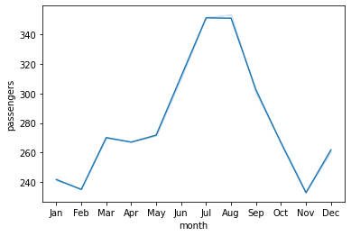
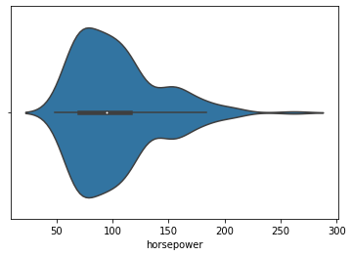
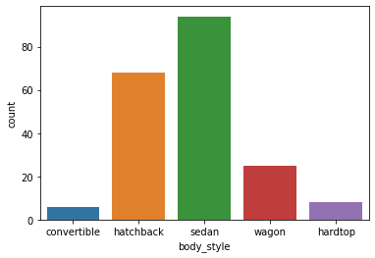
Visualization – One Variable
Plot | Type of Data | Usage | Example
Line Plot | Numerical | Helps us understand the trend or pattern in the data by displaying it as straight lines formed by connecting individual data points
Violin Plot | Numerical | Helps us understand data distribution by plotting a density curve symmetrically around a boxplot
Bar Graph | Categorical | Helps us understand data distribution by showing the counts of observations in each level (or group) using bars

Slide 7
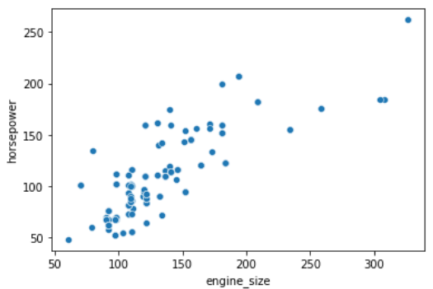
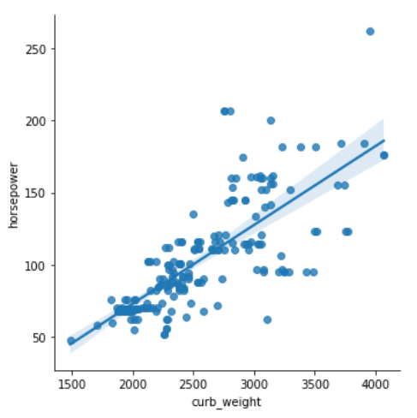
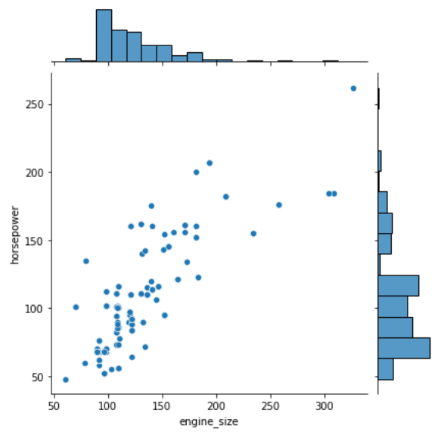
Visualization – Two Variable
Plot | Type of Data | Usage | Example
Scatter Plot | Numerical | Helps us understand potential relationship between two numerical variables
Implot | Numerical | Helps us understand and measure the relationship between the two variables quantitatively
Joint Plot | Numerical | Helps us understand the distribution and relationship between two numerical variables on the same plot.

Slide 8
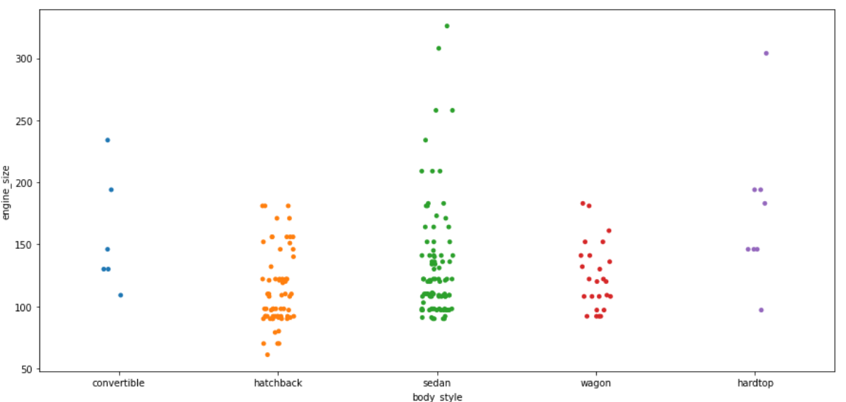
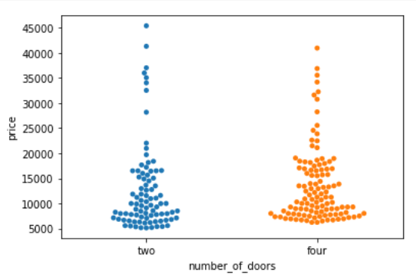
Visualization – Two Variable
Plot | Type of Data | Usage | Example
Strip Plot | Categorical | Helps us to visualize the distribution of a numerical variable wrt different categories of a categorical variable
Swarm Plot | Numerical | Helps us to visualize the distribution of a numerical variable wrt different categories of a categorical variable and avoids overlapping of data points

Slide 9
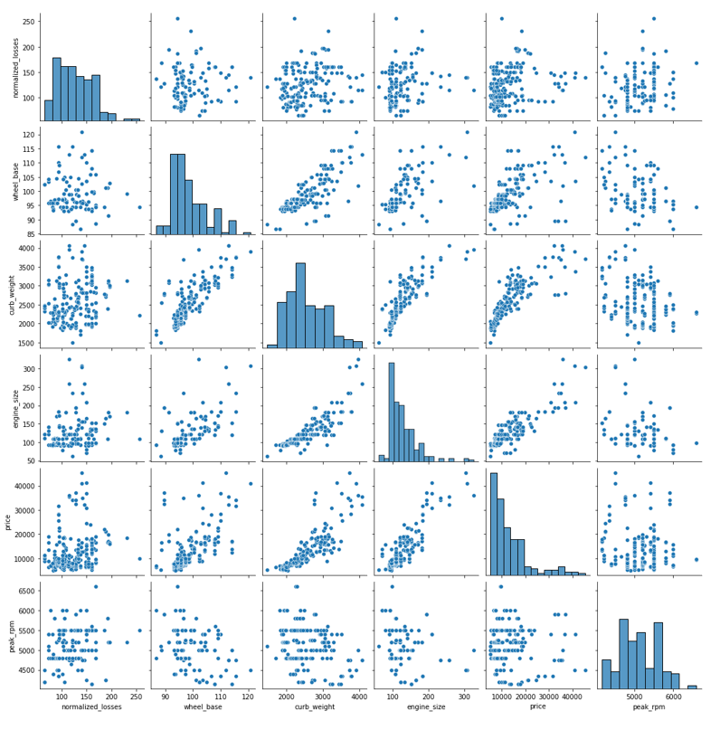
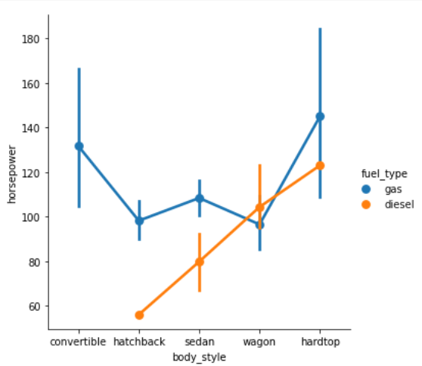
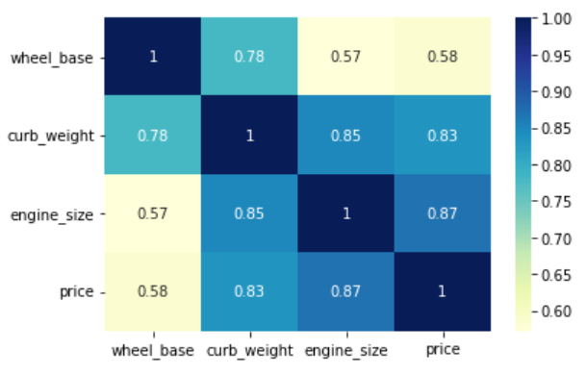
Visualization – Multiple Variable
Plot | Type of Data | Usage | Example
Pair Plot | Numerical | Helps us understand the relationship between two or more pairs of numerical variables
Cat Plot | Numerical | Helps us understand relationship between a numerical variable and one or more categorical variables
Heatmap | Numerical | Helps us understand the correlation between pairs of columns in the data

Slide 10




