Slide 1


Introduction to Neural Network - Week 2
AIML
POST GRADUATE PROGRAM
ARTIFICIAL INTELLIGENCE & MACHINE LEARNING

Slide 2
Brain Stormer
Q1. The fundamental unit of neural network in human body is
Brain
Necleus
Neuron
Axon
Q2. Artificial neural network is used for
Pattern Recognition
Classification
Regression
All of these

Slide 3
Learning Objectives
Activation functions, Loss function, Gradient Descent, Hyperparameter Tuning, Back propagation, Fully Connected layer
Case study
Questions

Slide 4
ACTIVATION FUNCTIONS

Slide 5
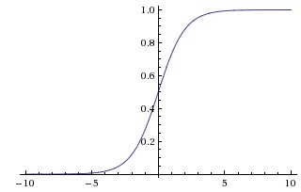
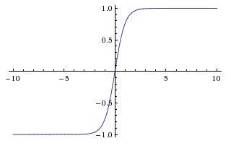
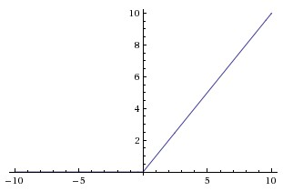
Types of Activation Functions
Sigmoid
Tanh
ReLU
Every activation function (or non-linearity) takes a single number and performs certain fixed mathematical operation on it.

Slide 6
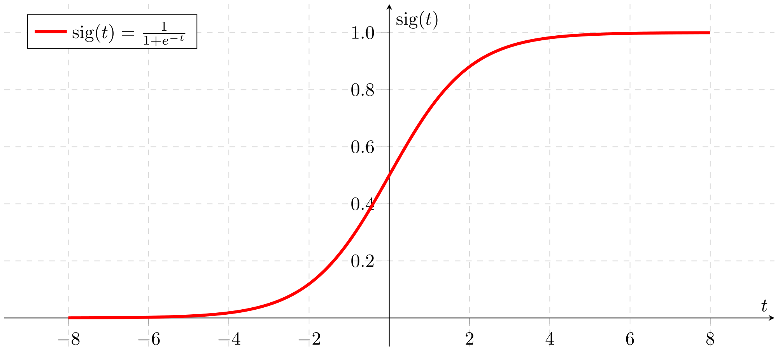
Sigmoid Functions
Activation function of form f(x) = 1 / 1 + exp(-x)
Ranges from 0-1
S-shaped curve
Historically popular
Interpretation as a saturating “firing rate” of a neuron
Drawbacks
Its output is not zero centered. Hence, make the gradient go too far in different directions
Vanishing Gradient Problem
Slow convergence
Image source: wikimedia

Slide 7
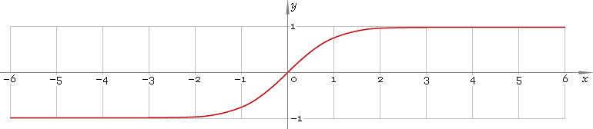
Tanh Function
Ranges between -1 to +1
Output is zero centered
Generally preferred over Sigmoid function
Drawbacks
Though optimisation is easier, it still suffers from the Vanishing Gradient Problem

Slide 8
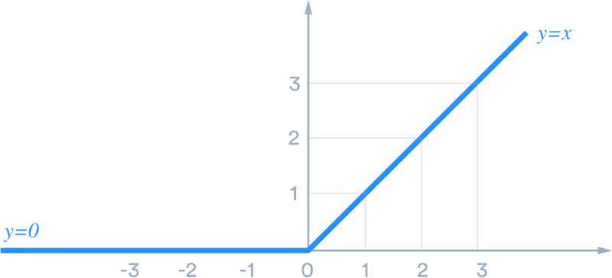
Relu Function
Very simple and efficient
Have 6x times better convergence than tanh and sigmoid function.
Very efficient in computation
Drawbacks
Output is not zero centered.
Should only be used within hidden layers of a NN model

Slide 9
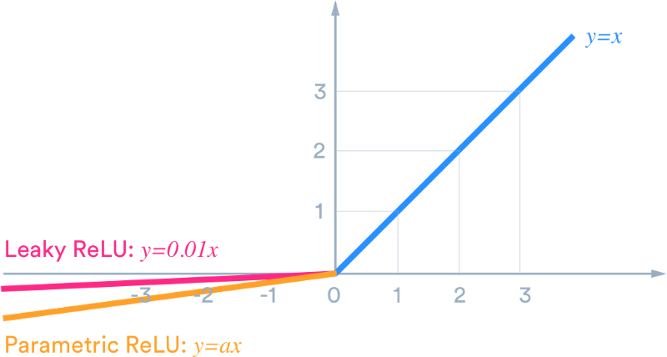
Leaky Relu Function
Leaky ReLU was introduced to overcome the problem of dying neurons.
Leaky ReLU introduces a small slope to keep the neurons alive
Does not saturate (in +region)

Slide 10
Softmax
Softmax function is a multinomial logistic classifier, i.e. it can handle multiple classes
Softmax typically the last layer of a neural network based classifier

Slide 11
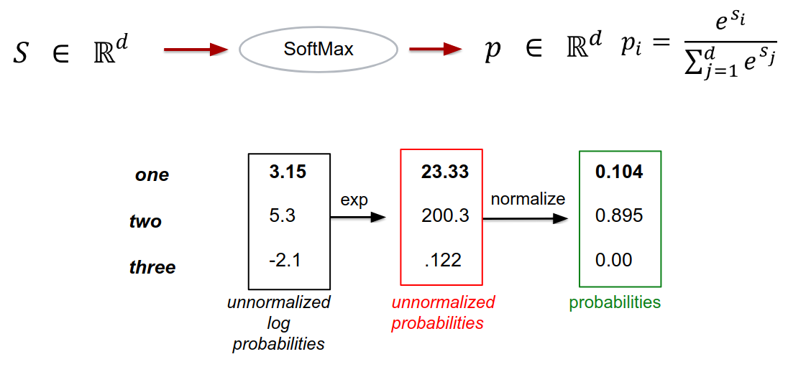
Softmax Contd..

Slide 12
Error and Loss Function
In most learning networks, error is calculated as the difference between the actual output and the predicted output.
The function that is used to compute this error is known as Loss Function.
Different loss functions will give different errors for the same prediction, and thus have a considerable effect on the performance of the model.
One of the most widely used loss function is mean square error, which calculates the square of difference between actual value and predicted value.
Different loss functions are used to deal with different type of tasks, i.e. regression and classification.
Text source: xpertup

Slide 13
CROSS-ENTROPY LOSS

Slide 14
Cross Entropy Loss
Cross-entropy loss (often called Log loss) quantifies our unhappiness for the predicted output based on its deviation from the desired output
Perfect prediction would have a loss of 0
With gradient descent, we try to reduce this (cross-entropy) loss for a classification problem

Slide 15
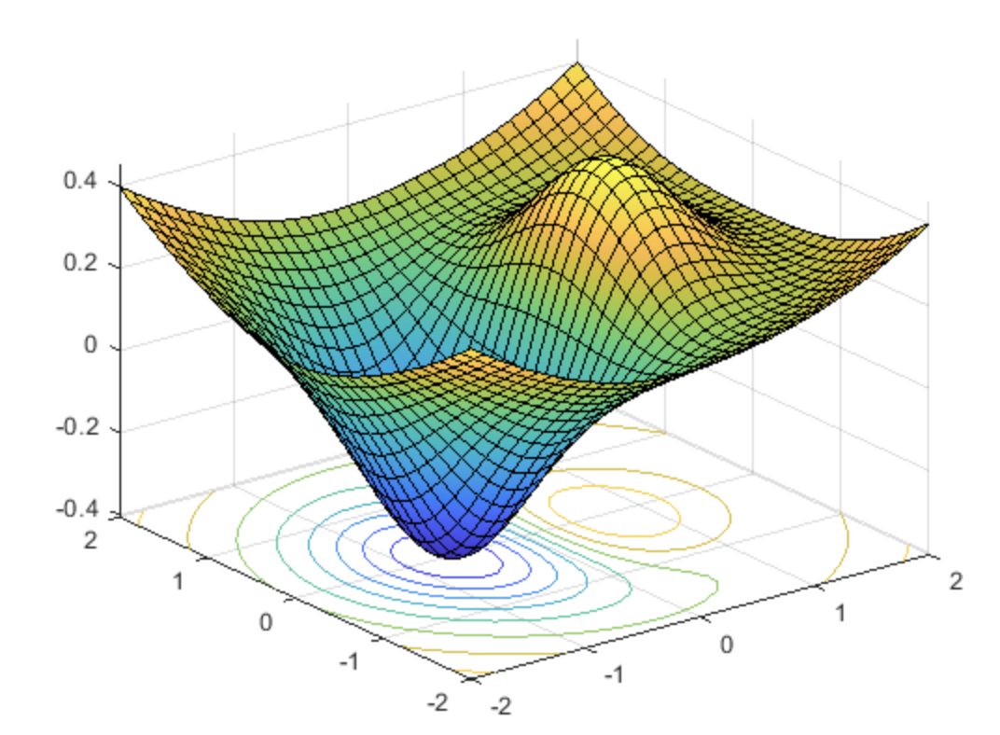
Optimization
The goal of optimization is to find
a set of weights that minimize the loss function
Image source: Mathworks

Slide 16
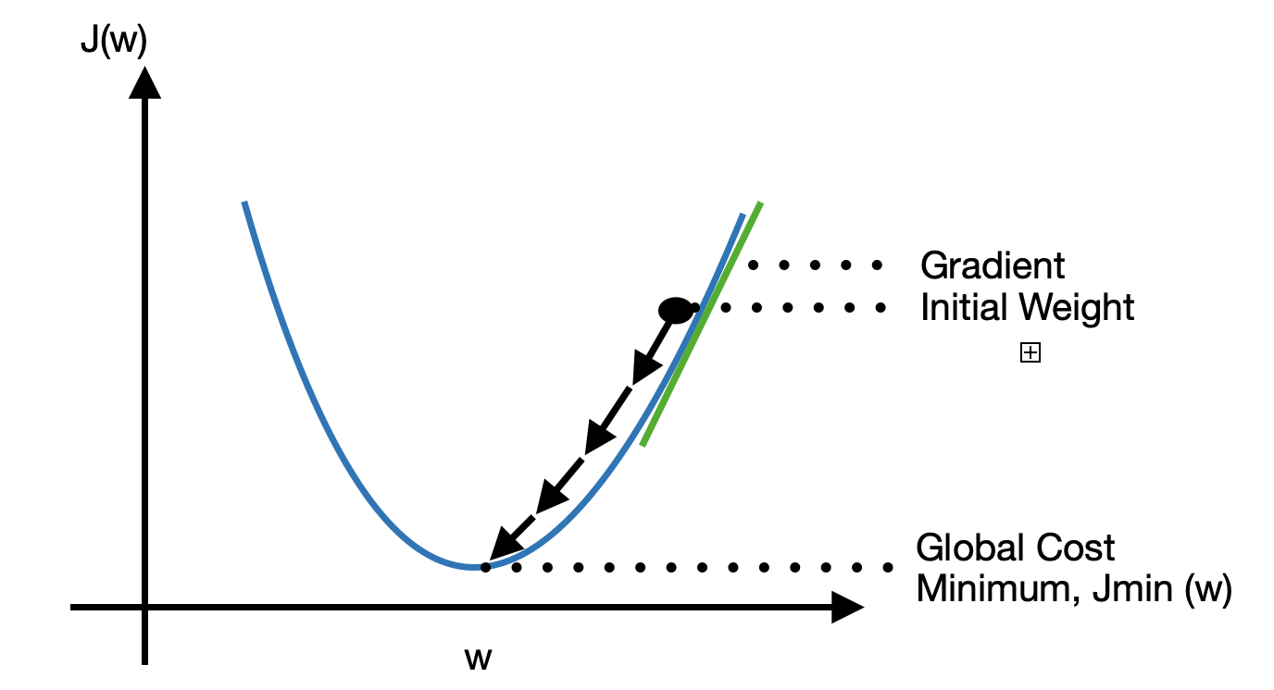
Gradient
Optimization functions usually calculate the gradient i.e. the partial derivative of loss function with respect to weights
The weights are modified in the opposite direction of the calculated gradient. This cycle is repeated until we reach the minima of loss function.
text source: xpertup

Slide 17
Gradient Descent
The procedure of repeatedly evaluating the gradient and then performing a parameter update is called Gradient Descent.
Image source: xpertup

Slide 18
Hyper parameter tuning in Neural Network
Similar to Hyper parameters in ML algorithms such as Decision tree, Random forest such as Max_Depth, Min_sample, Min_sample_leaf, max_leaf_node etc
The Hyperparameters in Neural Networks are
Type of activation function
Number of Hidden Layers and Neurons
Optimizers
Learning Rate
Batch Size
Epochs
Loss functions
Momentum

Slide 19
BACKWARD PROPAGATION

Slide 20
Backpropagation
Backpropagation allows us to calculate the gradient of the loss function with respect to each of the weights of the network
This enables every weight to be updated individually to gradually reduce the loss function over many training iterations.
Image source: webenergeek
Text source: Deepai

Slide 21
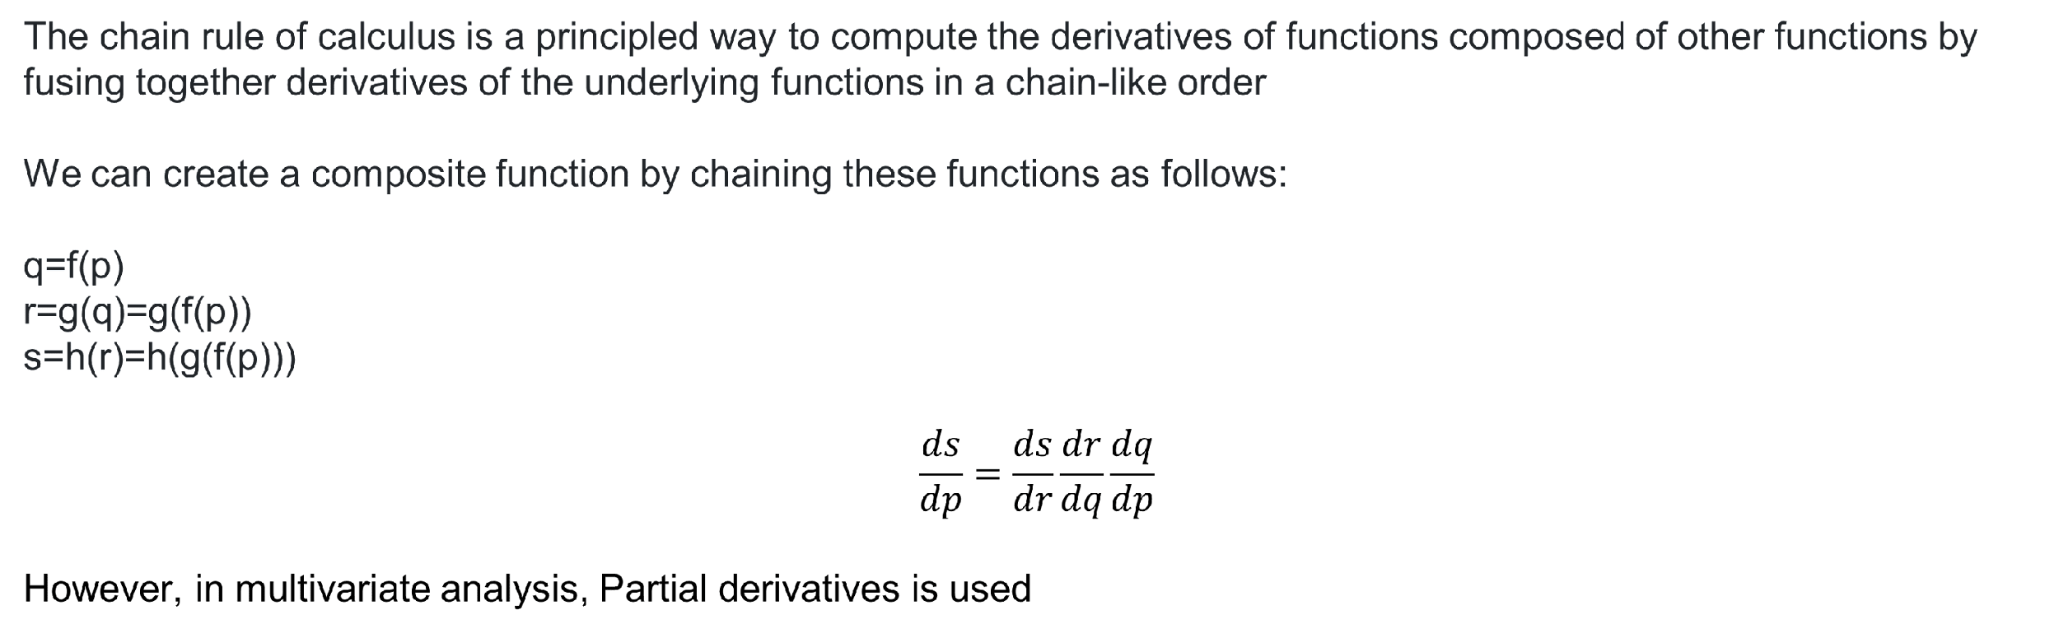
Chain Rule Recap

Slide 22

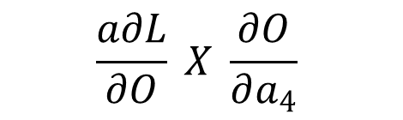
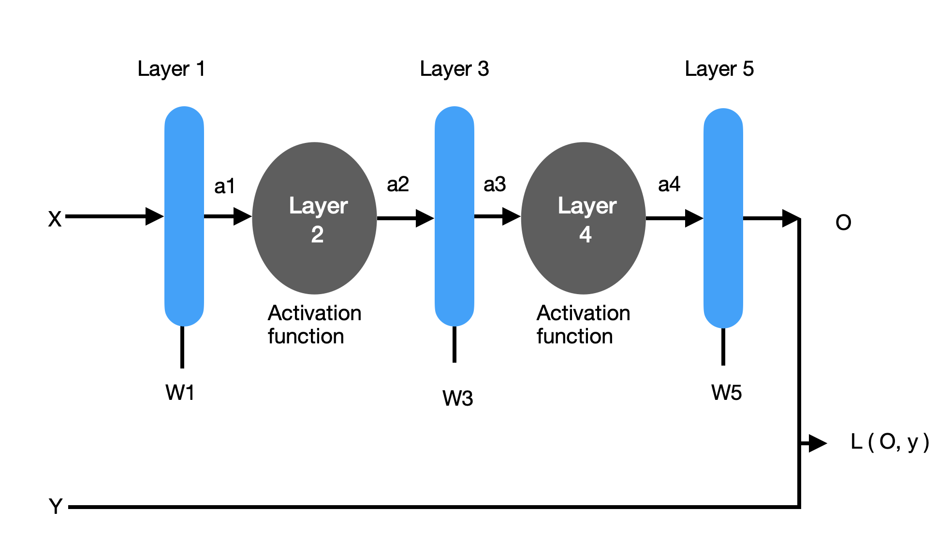
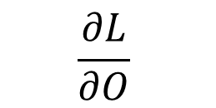
Back Prop

Slide 23
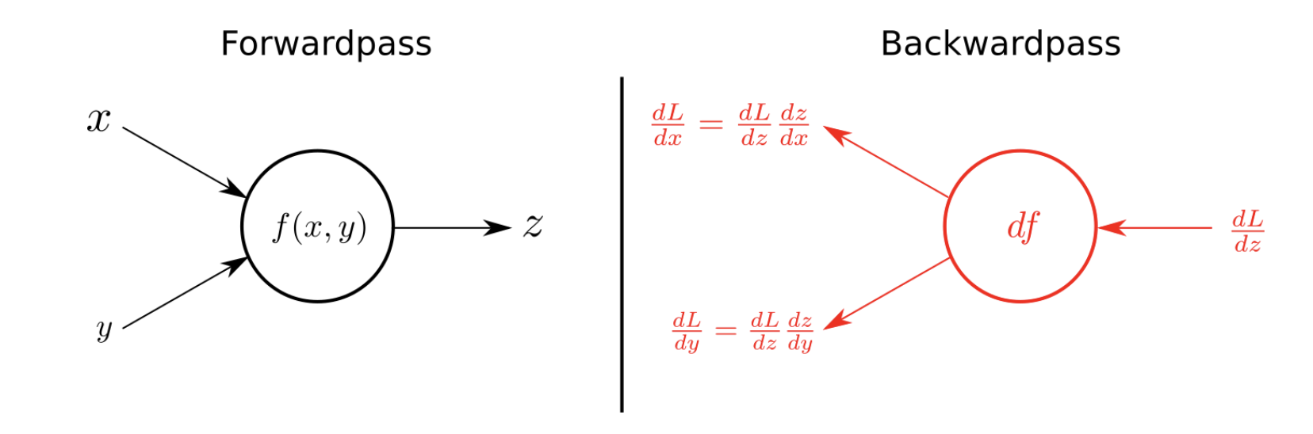
Summary – Forward Pass / Backward Pass

Slide 24
FULLY CONNECTED LAYER

Slide 25
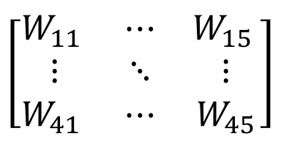
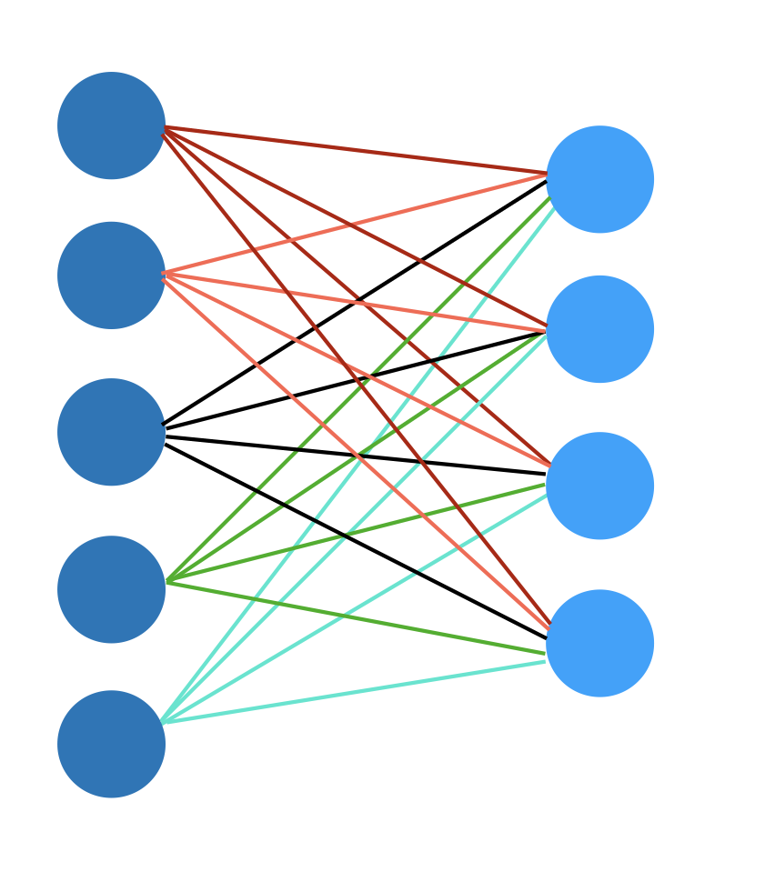


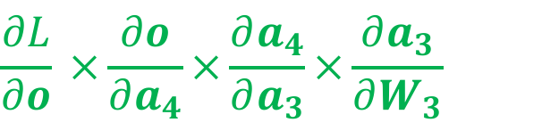
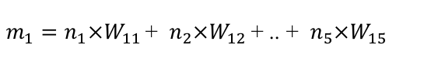

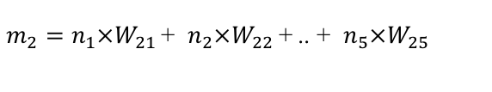
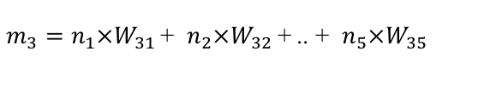
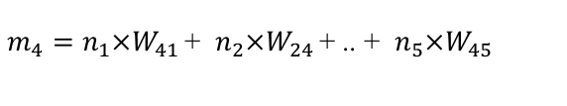


Fully Connected Layer

Slide 26
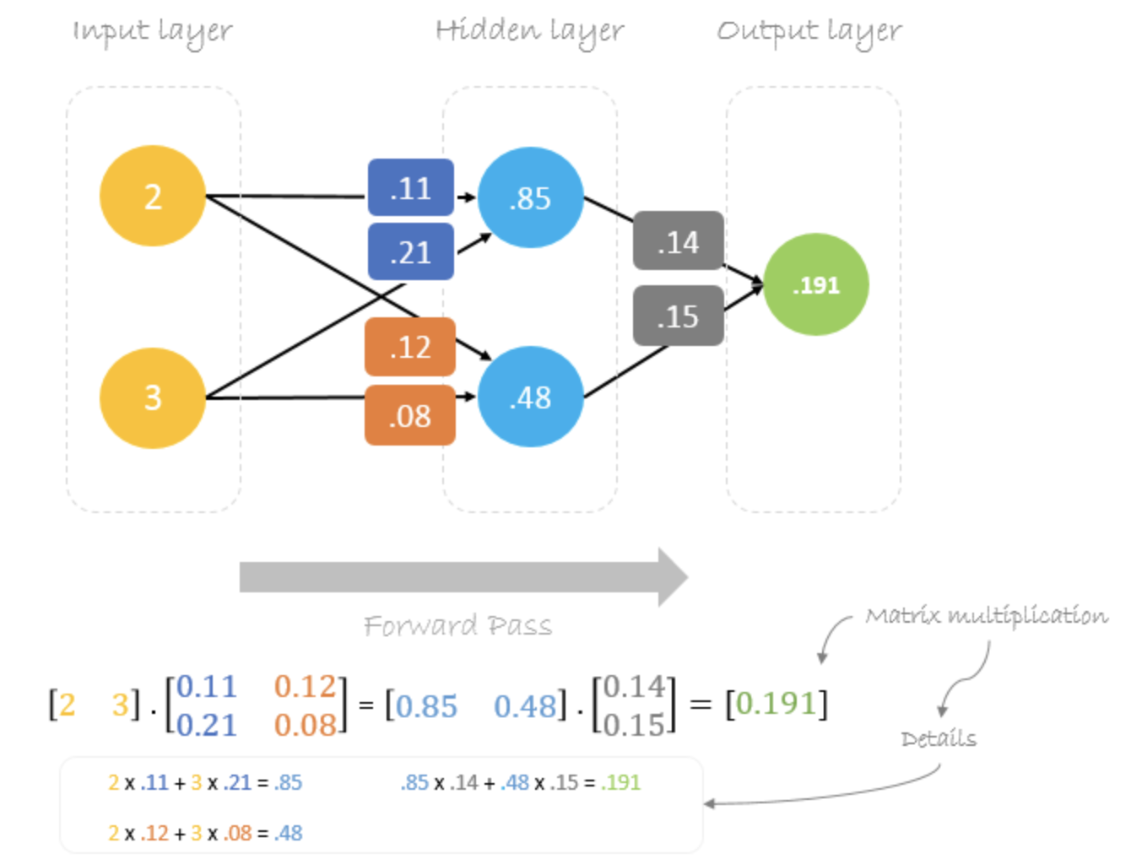
FC Layer – Forward Pass
Forward pass is basically a set of operations which transform network input into the output space.
During the inference stage neural network relies solely on the forward pass
Text Source: TowardsDataScience
Image source: hmkcode

Slide 27
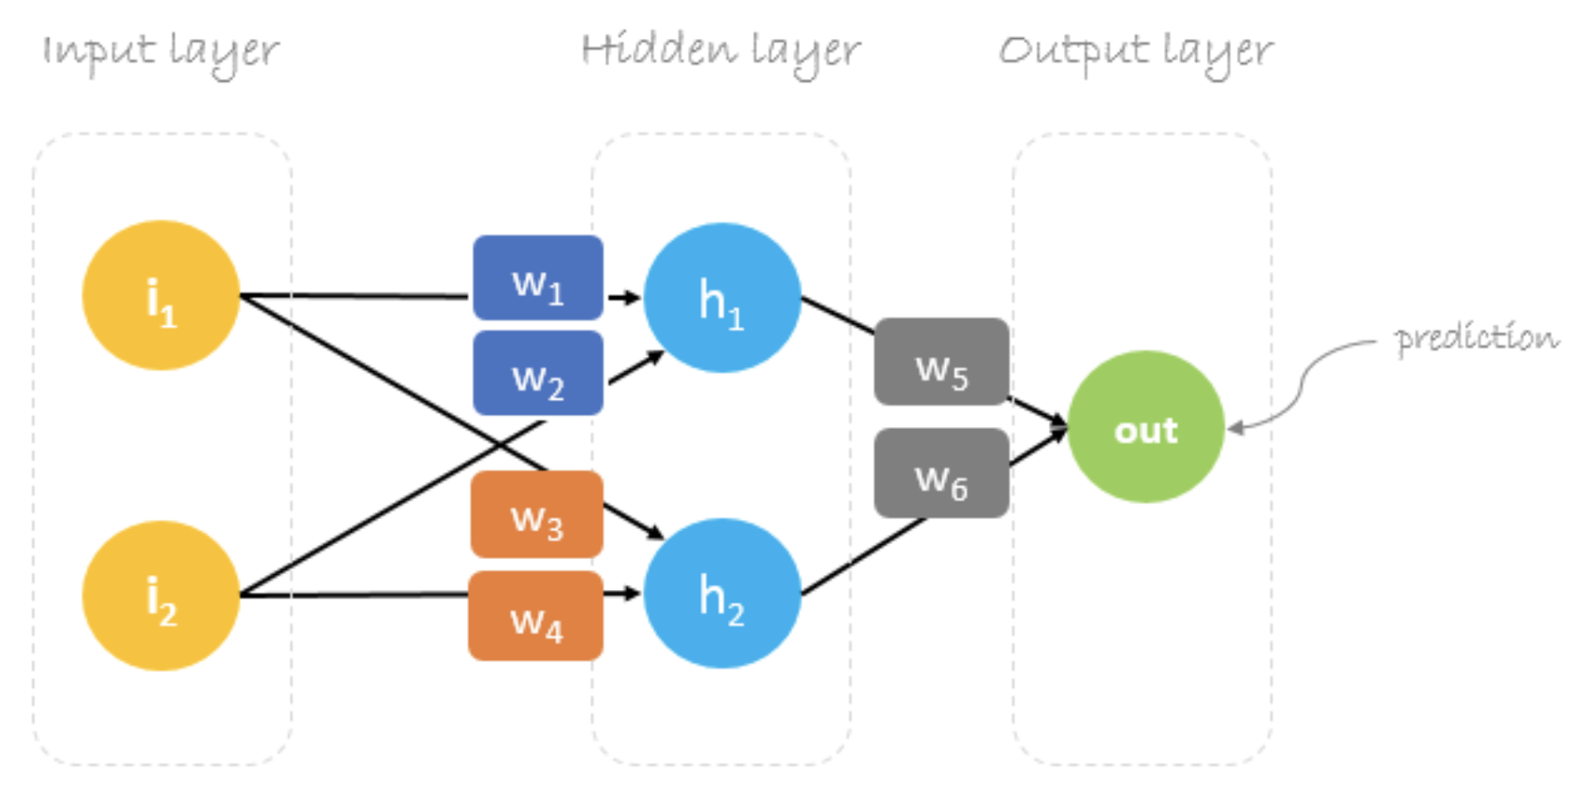
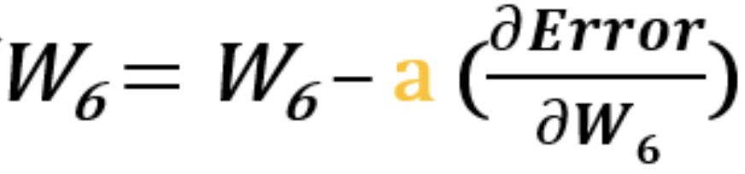
FC Layer – Backward Pass
Backpropagation is an algorithm which calculates error gradients with respect to each network variable (neuron weights and biases). Those gradients are later used in optimization algorithms, such as Gradient Descent, which updates them correspondingly. The process of weights and biases update is called Backward Pass.
text source: towardsdatascience

Slide 28
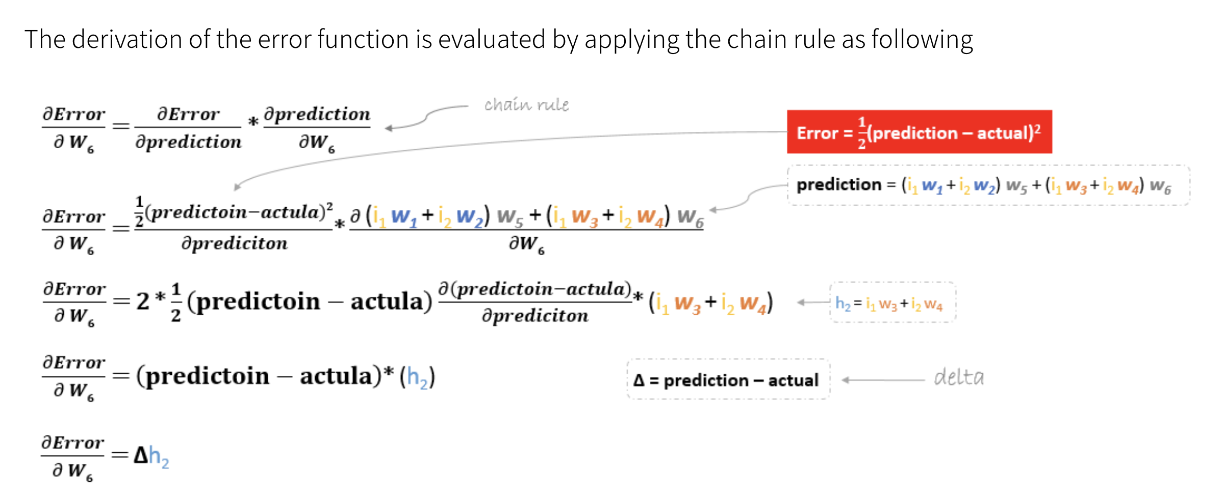
Image source: hmkcode

Slide 29
Thank you! :)
Questions are always welcome

