Slide 1


Introduction to Neural Network - Week 3
AIML
POST GRADUATE PROGRAM
ARTIFICIAL INTELLIGENCE & MACHINE LEARNING

Slide 2
Brain Stormer
Q1. Back Propagation is a learning technique that adjusts weights in neural network by propagating weight changes.
Forward from input to output
Backward from output to input
Forward from input to hidden layers
Backward from hidden layers to input
Q2. What is sigmoid as an activation function in neural network.
Answer-
A weighted sum of inputs is passed through an activation function and this output serves as an input to the next layer. When the activation function for a neuron is a sigmoid function it is a guarantee that the output of this unit will always be between 0 and 1.

Slide 3
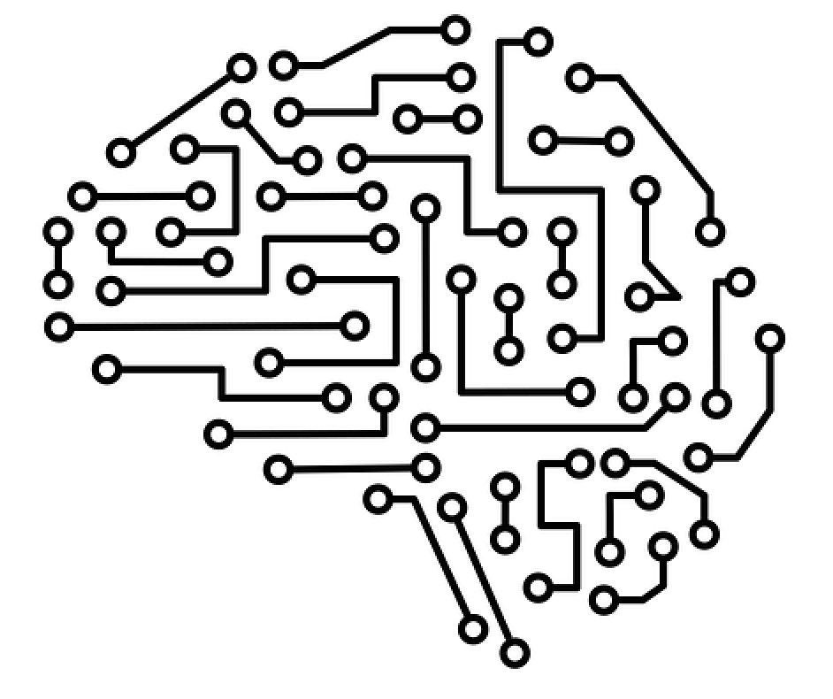
Week 3: Introduction to neural networks and deep learning

Slide 4
Learning Objective
Types of Optimizers
Weight initialization
Regularization
Drop out
Batch Normalization
Types of neural networks
Case study
Questions

Slide 5
Different types of optimizers
SGD with Momentum
This method computes gradient by exponentially weighted averages, hence it takes less time to converge compared to normal stochastic gradient descent
2. Adagrad ( Adaptive gradient algorithm )
Adagrad does not use momentum concept rather it utilizes different learning rates hence making it simpler than SGD with momentum
3. RMSProp (Root Mean Square Propagation )
RMS prop automatically adjusts the learning rate for each parameter
4. ADAM
ADAM proposes the characteristics of both SGD with Momentum and RMSprop
References
Paperspace, medium, Medium

Slide 6
Weight Initialization

Slide 7
Why Initialize Weights
The aim of weight initialization is to prevent layer activation outputs from exploding or vanishing during the course of a forward pass through a deep neural network. If either occurs, loss gradients will either be too large or too small to flow backwards beneficially, and the network will take longer to converge, if it is even able to do so at all.

Slide 8


What Happends When W=0 Init Is Used
Input Layer
Output Layer
Hidden Layer
The method of setting W=0 serves almost no purpose as it causes neurons to perform the same calculation in each iterations and produces same outputs. neurons will learn same features in each iterations.
This problem is known as network failing to break symmetry.
Text source = Medium

Slide 9
Initialization Techniques
Zero initialization
Random initialization
Xavier initialization
He initialization
Kaiming initialization
And many more

Slide 10
Regularization

Slide 11
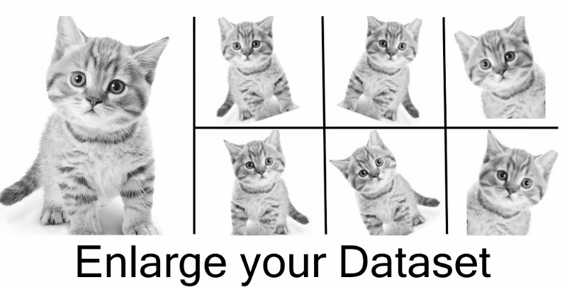
Data Augmentation
Data augmentation is a technique to artificially create new training data from existing training data.
Image data augmentation is perhaps the most well-known type of data augmentation and involves creating transformed versions of images in the training dataset that belong to the same class as the original image

Slide 12
Where We Should Do Data Augmentation
We may not have a big dataset, so create more data.
It helps in regularizing the network.

Slide 13



Data Augmentation Pipeline
Load image and label
“Dog”
Compute
loss
CNN
Transformimage

Slide 14
Data Augmentation Techniques
Horizontal flips
Rotation
Crop/scale
Color jitter
Other creative techniques
Random mix/combinations of :
translation (what about a pure ConvNet?)
Rotation
Stretching
Shearing
lens distortions

Slide 15
Dropout
Dropout is a regularization method that approximates training a large number of neural networks with different architectures in parallel.
During training, some number of layer outputs are randomly ignored or “dropped out.” This has the effect of making the layer look-like and be treated-like a layer with a different number of nodes and connectivity to the prior layer. In effect, each update to a layer during training is performed with a different “view” of the configured layer.

Slide 16
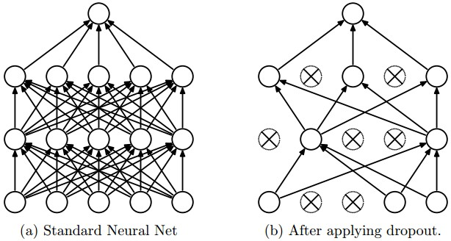
Dropout

Slide 17
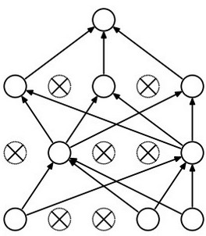
Dropout – How It Works
Forces the network to have a redundant representation.
has an ear
X
has a tail
is furry
X
cat
score
has claws
X
mischievous
look

Slide 18
Dropout
Another interpretation:
Dropout is training a large ensemble of models (that share parameters).
Each binary mask is one model, gets trained on only ~one batch.

Slide 19
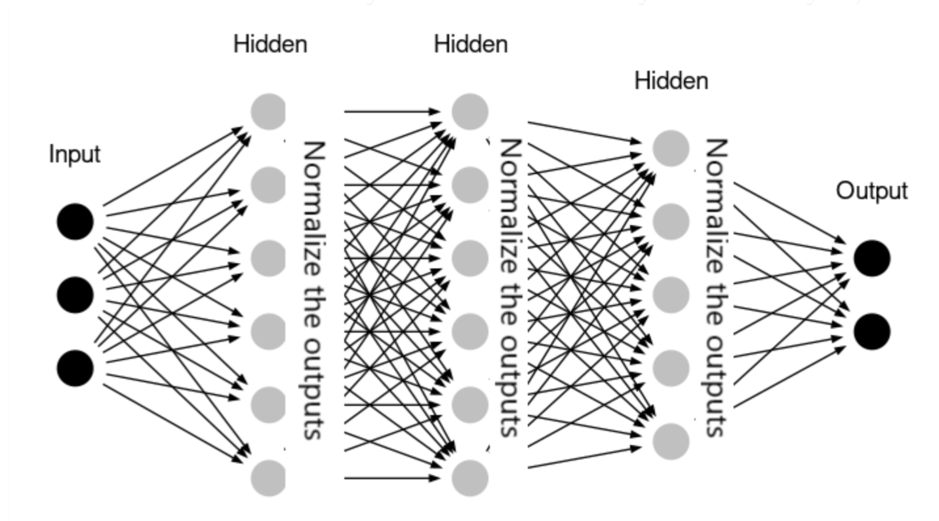
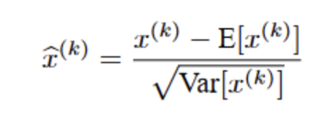
Batch Normalization
Due to this normalization “layers” between each fully connected layers, the range of input distribution of each layer stays the same, no matter the changes in the previous layer
Given x inputs from k-th neuron:
Normalization brings all the inputs centered around 0. This way, there is not much change in each layer input
Text and image source: Medium

Slide 20
Types of Neural Network
Feed Forward Neural Network
Convolutional Neural Network
Recurrent Neural Network
LSTM – Long Short-Term Memory
Sequence to Sequence Models

Slide 21

Thank you! :)
Questions are always welcome

