Slide 1
Unsupervised learning - Clustering

Slide 2
Learning Objectives
Introduction to Unsupervised learning
Types of clustering and distance calculation
Euclidean and Non Euclidean distance
K-means clustering
Elbow method
Visual analysis and Dynamic Clustering
Hands on exercise on K-means clustering
Case study
2

Slide 3
Introduction to Unsupervised learning
Unsupervised Learning is a class of Machine Learning techniques to find the patterns in data.
The data given to unsupervised algorithm are not labelled, which means only the input variables(X) are given with no corresponding output variables.
Unsupervised learning is the training an algorithm using information that is neither classified nor labelled.

Slide 4
What is unsupervised learning?
No defined dependent and independent variables.
Patterns in the data are used to identify / group similar observations

Slide 5
Clustering
Clustering is primarily an exploratory technique to discover hidden structures of the data, possibly as a prelude to more focused analysis or decision process
A way to decompose a data set into subsets with each subset representing a group with similar characteristics.
Group such that objects in the same group are more similar to each other in some sense than to objects of different groups.
The groups are known as clusters and each cluster gets distinct label called cluster ID, the centroid of cluster.

Slide 6
What is clustering?
task of grouping a set of objects in such a way that objects in the same group are more similar to each other than to those in other groups
Objective - to ensure that the distance between datapoints in a cluster is very low compared to the distance between 2 clusters.

Slide 7
Clustering distances
Manhattan distance
Euclidean distance
Chebyshev distance
General use case for all the three distance measures above:
Minkowski distance

Slide 8
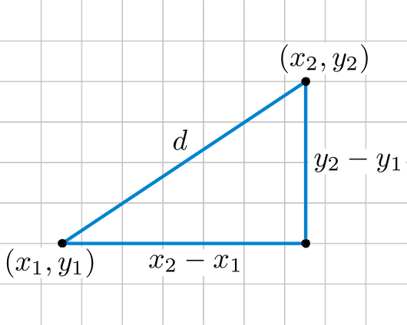
What is Euclidian distance?

Slide 9
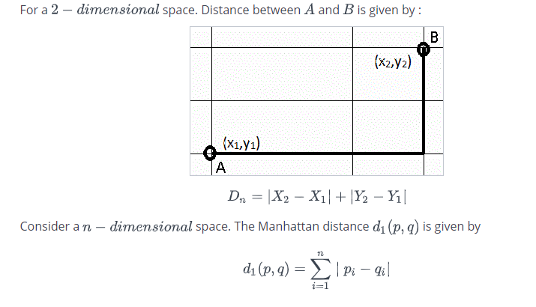
What is Manhattan distance?

Slide 10
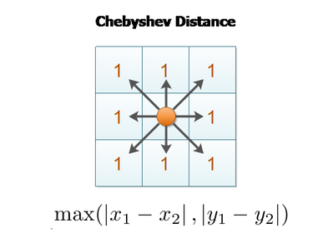
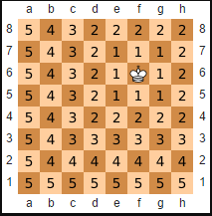
What is Manhattan distance?
The same can be extended for multiple dimensions

Slide 11
Types of clustering
Clustering
Connectivity based clustering
Centroid based Clustering
ex: Hierarchical clustering
ex: K Means clustering

Slide 12
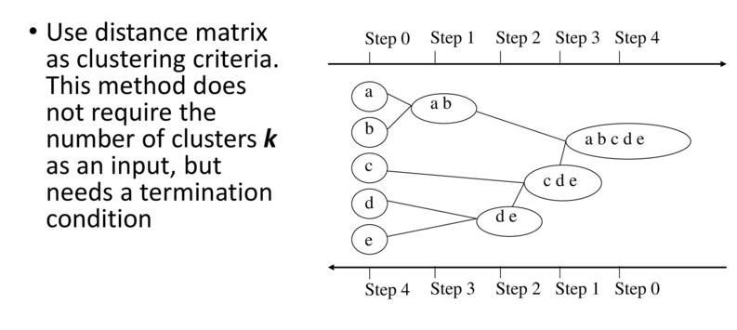
Connectivity based Clustering
Computational complexity: n(n-1)/2 where n denoted no of data points

Slide 13
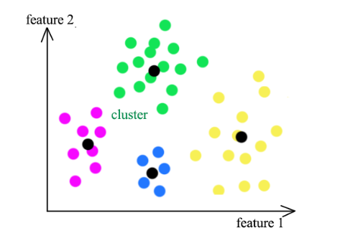
Centroid based Clustering

Slide 14
K-means clustering
K-means clusters data be separating data points into groups of equal variance.
It requires the number of clusters to be specified, hence the term “K” in its name
It divides the samples into K disjoint clusters.
The K-means algorithm chooses centroids that minimizes the inertia across all the clusters.

Slide 15
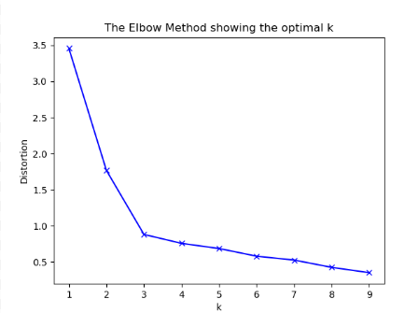
Elbow method
The elbow method runs k-means clustering on the dataset for a range of values for k (say from 1-10) and then for each value of k computes an average score for all clusters.

Slide 16
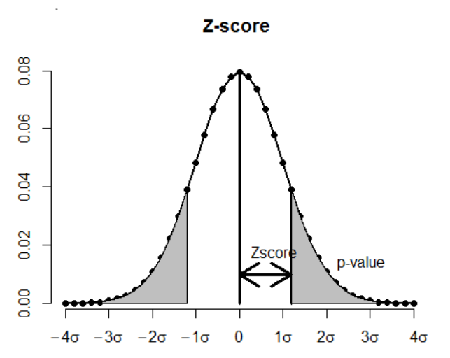
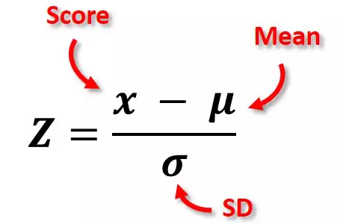
Scaling - Z score
It is important to normalize the data using either Z score or standard scaler before performing K means clustering
This ensure different attributes are of same standard values

Slide 17
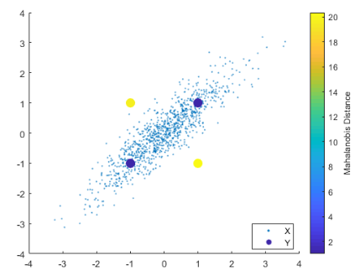
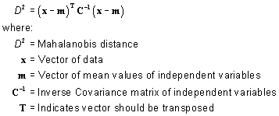
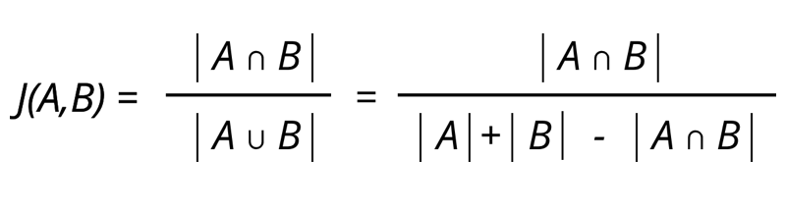
More distance measures
Mahalanobis distance
Jaccard distance

Slide 18
Applications of clustering
Image processing : used to cluster of pixels representing objects in each frame.
Medical: Patient attributes such as age, height, weight, systolic, etc. can identify naturally occurring clusters under various health conditions.
Customer segmentation: cluster customers on basis of frequency look for common attributes among high value customers.

Slide 19
Industry applications - clustering
Customer segmentation – buying patterns, income, spending behaviour, loyalty, customer lifetime value
Anomaly detection
Creating newsfeeds – cluster articles based on their similarity
Pattern detection in medical imaging for diagnostics

Slide 20
K means clustering
Simplest unsupervised learning algorithm
Classify a data set through a number of clusters fixed apriori.
The idea is to define k centroids, one for each cluster.
The centroids should be carefully placed, as far as possible from each other.
Each point is associated to a centroid and then centroids are re-calculated to minimize MSE.
Uses Euclidean distance
Advantages:
With large variables, k means is faster than other clustering algorithms.
Produces tighter clusters than hierarchical clustering.
Less impacted by outliers
Disadvantages:
Predicting the number of clusters is a tedious task.
Initial seeds have a strong impact on the final results
If the data has clusters ( in the original data) of different size and different density, the algorithm does not work well.

Slide 21
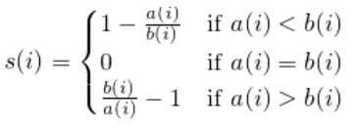
Silhouette coefficient
Silhouette coefficient is a measure of how similar a datapoint is to its own cluster compared to that of other clusters. It lies in the range of [-1,1]
+1 = The data point is far away from the neighboring cluster and close to its own
-1 = The data point is close to other neighbouring cluster than its own cluster
0 = The data point is at the boundary of the distance between the own and neighbouring cluster

Slide 22
Visual analysis for clustering
Visual analysis for clustering
Visual analysis of the attributes selected for the clustering may give an idea of the range of values that K should be evaluated in.
Identifying the attributes on which clusters are clearly demarcated and using them in incremental order to build the multi-dimensional clusters likely to give much better clusters than using all the attributes at one go.

Slide 23
Dynamic clustering
Clustering on correct attributes is the key to good clustering results.
We can also consider those attributes who’s value changes with time. For e.g. Age, income category, years of work experience etc.
We can use sequential k means clustering over time to track individual clusters.
Cluster size, new entries and exits one can analyse the impact of strategies designed based on earlier clustering analysis.

Slide 24
Hands on exercise on K-means clustering
Technical support data can often be a rich source of information on opportunities for improving customer experience. Let us analyse the tech support data and do some basic analysis on problem types, time to resolve the problem and channel of support that is most suitable.
Some important functions:
Importing libraries
import pandas as pd
import numpy as np
import matplotlib.pylab as plt
from sklearn.model_selection import train_test_split
from sklearn.cluster import KMeans
from scipy.stats import zscore

Slide 25
2. Group Data into similar clusters
for k in clusters:
model=KMeans(n_clusters=k)
model.fit(techSuppScaled)
prediction=model.predict(techSuppScaled)
meanDistortions.append(sum(np.min(cdist(techSuppScaled, model.cluster_centers_, 'euclidean'), axis=1)) / techSuppScaled.shape[0])
# Let us first start with K = 3
final_model=KMeans(3)
final_model.fit(techSuppScaled)
prediction=final_model.predict(techSuppScaled)

Slide 26
3. Analyze the distribution of the data among the two groups (K = 3). One of the most informative visual tool is boxplot.
#plt.cla()
techSuppClust = tech_supp_df.groupby(['GROUP'])
techSuppClust.mean()
techSuppScaled.boxplot(by='GROUP', layout = (2,4),figsize=(15,10))

Slide 27
Case Study
Objective
To determine if there is a relationship between higher levels of black and white thinking and higher levels of self-reported depression in psychiatric patients hospitalized for depression.Also apply K means clustering and assign groups for model prediction.
Context:
It is common for people who tend to think of their reality as a series of black and white events to suffer from depression.
For eg;," If your child isn't "brilliant" then he must be 'stupid.' If you're not 'fascinating' then you must be 'boring.'

Slide 28
Steps to follow:
Import all the necessary libraries
Get the data
Print the summary
Find optimal number of clusters
Create a new dataframe only for labels and convert it into categorical variable.
Convert the groupdataframe created by groupby back to dataframe.
Append the prediction with K=2
Make scatter plots, and based on the plot make inferences on group 0 and group 1

Slide 29
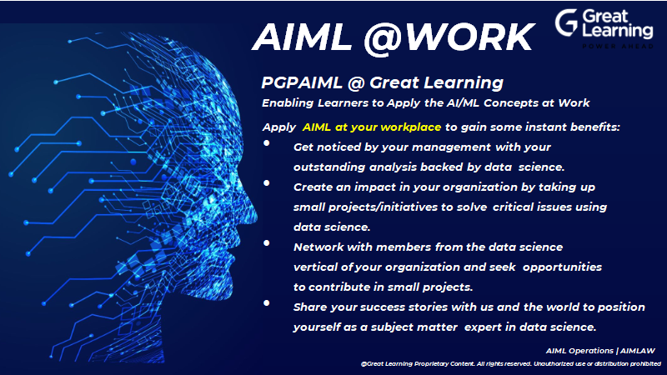

Slide 30


Questions?

