Slide 1


Introduction to Python
Week - 3
AIML
POST GRADUATE PROGRAM
ARTIFICIAL INTELLIGENCE & MACHINE LEARNING

Slide 2
Uber Case Study

Slide 3


Background
Uber Technologies, Inc. is an American multinational transportation network company based in San Francisco.
Ridesharing is a very volatile market and demand fluctuates wildly with time, place, weather, local events, etc.
It has operations in over 785 metropolitan areas worldwide with over 110 million users worldwide.
The key to being successful in this business is to be able to detect patterns in these fluctuations and cater to the demand at any given time.

Slide 4
Objective
To extract actionable insights from the data that we have collected over the past 6 months to optimize resources and identify area of growth and improvement.
We will be majorly focusing on these problems -
Variables that influence the pickups
Factors that affect pickups the most and the respective reasons
Ways to capitalize the fluctuating demand

Slide 5
Data Information
The data contains the details for the Uber rides across various boroughs (subdivisions) of New York City at an hourly level and attributes associated with weather conditions at that time.
Variable | Description
pickup_dt | Date and time of the pick up
borough | NYC's borough
pickups | Number of pickups for the period (hourly)
spd | Wind speed in miles/hour
vsb | Visibility in miles to nearest tenth
temp | Temperature in Fahrenheit
dewp | Dew point in Fahrenheit
slp | Sea level pressure
pcp01 | 1-hour liquid precipitation
pcp06 | 6-hour liquid precipitation
pcp24 | 24-hour liquid precipitation
sd | Snow depth in inches
hday | Being a holiday (Y) or not (N)
Observations | Variables | Duration
29101 | 13 | 6 months
Note:
The time period for the data is from January to June for the year 2015
The date column has been splitted into month, year and time of the day separately for the analysis
There are some missing values in the borough column that has been replaced with a new label named ‘Unknown’ in the analysis
The missing values in the temperature column have been imputed with the mean temperature of the month of January for the Brooklyn borough

Slide 6
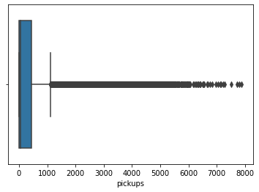
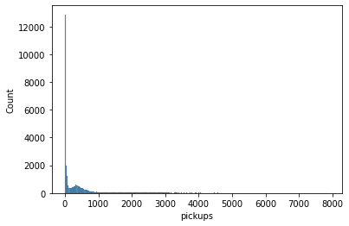
EDA – Number of Pickups
In this data, there are variables like temperature, wind speed, dew point, number of pickups etc. that affects the ride sharing business.
Let us first explore some of the variables and how they are distributed
Observations:
The distribution of hourly pickups is highly right skewed
There are a lot of outliers in this variable
While most hourly pickups are at lower end, we have observations where hourly pickups went as high as 8000

Slide 7
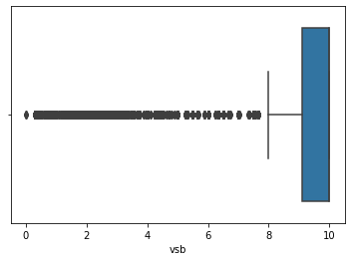
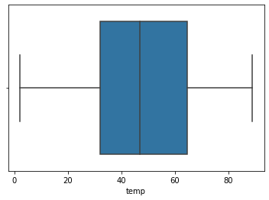
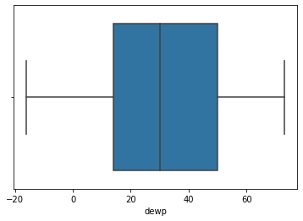
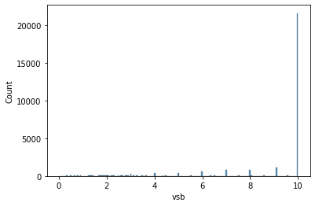
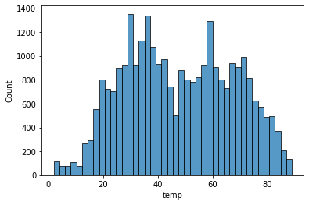
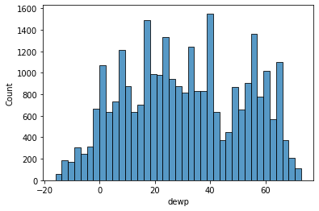
EDA – Visibility, Temperature & Dew Point
Visibility
Temperature
Dew point
Both the mean and median are high indicating that the visibility is good on most days
There are however outliers towards the left, indicating that visibility is extremely low on some days
Temperature does not have any outliers
50% of the temperature values are less than 45F (~7 degree celsius), indicating cold weather conditions
The distribution is similar to that of temperature. It suggests possible correlation between the two variables
Dew point is an indication of humidity, which is correlated with temperature

Slide 8
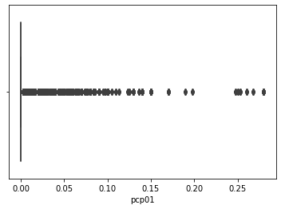
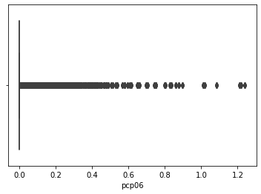
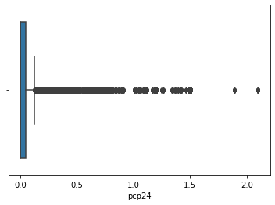
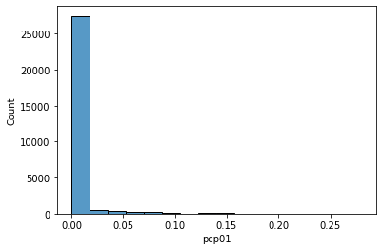
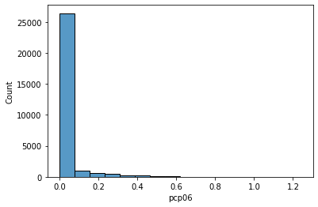
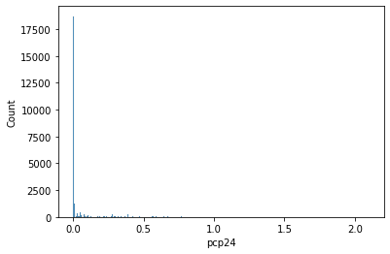
EDA – Univariate Analysis
1 hour liquid precipitation
6 hour liquid precipitation
24 hour liquid precipitation
Observations:
It rains on relatively fewer days in New York
Most of the days are dry
The outliers occur when it rains heavily

Slide 9
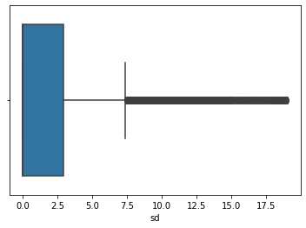
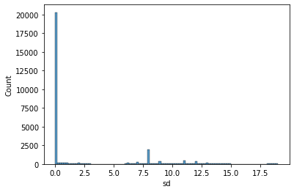
EDA – Snow Depth
Snow depth
Observations:
We observe that there is a snowfall in the time period that we are analysing.
There are outliers in this data.
We will have to see how snowfall affects pickups. We know that very few people are likely to get out if it is snowing heavily, so our pickups will decrease when it snows.

Slide 10
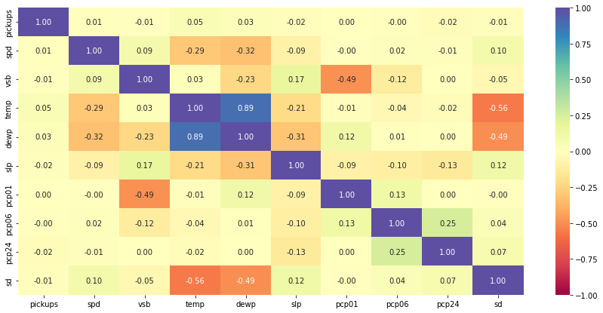
EDA – Correlation Matrix
Correlation matrix
Observations:
Temperature shows a high correlation with dew point
Visibility is negatively correlated with precipitation. If the rains are high during the hour, visibility is low.
Snow depth is also negatively correlated with temperature.
Wind speed and sea level pressure is negatively correlated with temperature. As the temperature increases, wind speeds decrease and so does sea level pressure.
There does not seem to be a strong relationship between number of pickups and weather stats.

Slide 11
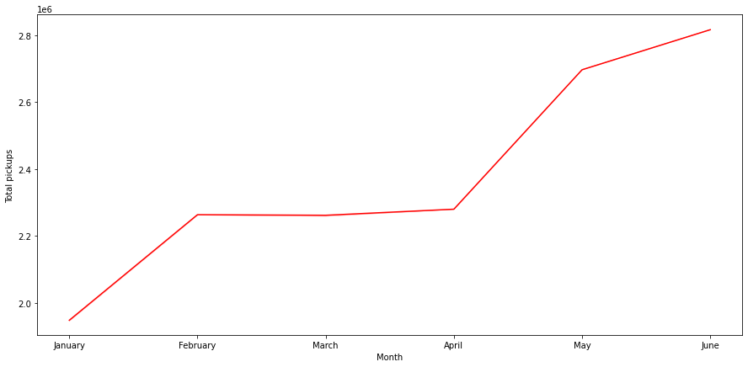
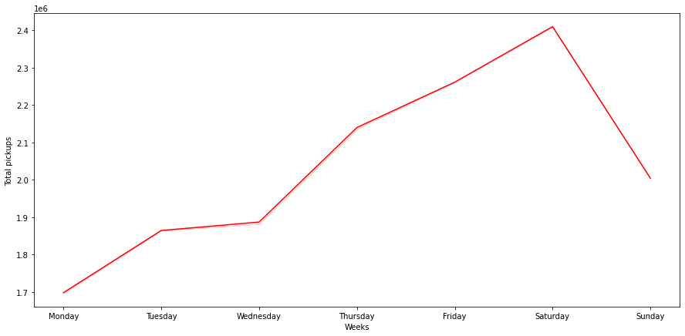
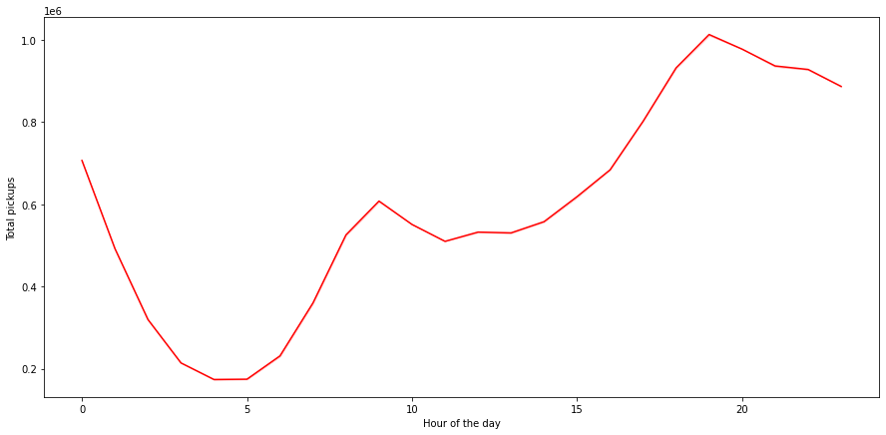
EDA – Total Pickups
Total Pickups per month
Total pickups per weekday
Total pickups per hours of the day
Observations:
There is clear increasing trend in monthly bookings
Bookings in June are almost 2.8 times than that that of Jan
Observations:
Pickups gradually increase as the week progresses and starts dropping down after saturday.
Demand is usually low at the beginning of the week
Observations:
Bookings peak around the 19th and 20th hour of the day, which can be attributed to people leaving their workplaces

Slide 12
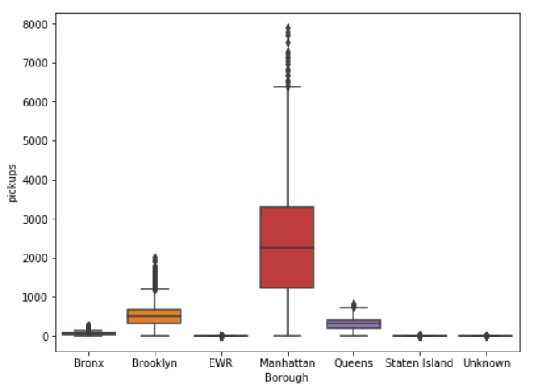
EDA – Pickups Across Borough
Observations:
There is a clear difference in ridership across the different boroughs.
Manhattan has the highest no. of bookings
Brooklyn and Queens are distant followers
EWR, Unknown and Staten Island have very low bookings. The demand is so small that probably it can be covered by the drop-offs of the inbound trips from other areas.
Pickups across borough

Slide 13
Conclusions
Uber cabs are most popular in the Manhattan area of New York.
Weather conditions do not have much impact on the number of Uber pickups.
The demand for Ubers has been increasing steadily over the months (Jan to June).
The rate of pickups is higher on the weekends as compared to weekdays.
It is encouraging to see that New Yorkers trust Uber taxi services when they step out to enjoy their evenings.
People use Uber for regular office commutes. The demand steadily increases from 6AM to 10AM in the morning, then declines a little and starts picking up at 12PM. The demand peaks at 7-8 PM at night.
We need to further investigate the low demand for Ubers on Mondays.

Slide 14
Recommendations
Manhattan is the most mature market for Uber. Brooklyn, Queens and Bronx show a lot of potential.
There has been a gradual increase in Uber rides over the last few months and we need to keep up the momentum.
Riderships are high at peak office commute hours on weekdays and during late evenings on Saturday. Cab availability must be ensured during these times.
The demand for cabs is highest during saturday nights. Cab availability must be ensured during this time of the week.
We need to procure data for fleet size availability to get a better understanding of demand-supply status and build a machine learning model to accurately predict pickups per hour, to optimise the cab fleet in respective areas.
We need to procure more data on price and build a model that can predict optimal pricing.

Slide 15




