Slide 1
Make A Copy Of This Deck And Update The Red Ink Based On Your Notebook Results

Slide 2

Instructor Kick-off
Analyze A/B Test Results
© 2019 Udacity. All rights reserved.

Slide 3
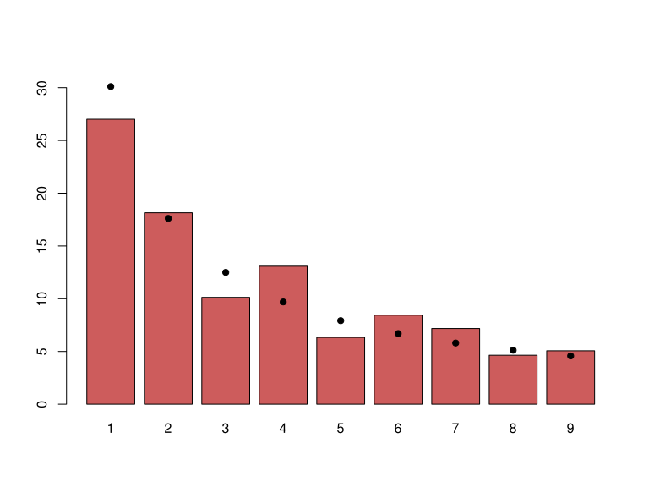
How Was The Experiment Implemented?​
Total Variant Visitors: [The number of variant visitors]
Total Control Participants:​ [The number of control visitors]
​
[Update the Below Chart With Your Chart of Where Users Are From]

Slide 4
Conversion Rates
 | U.S. | U.K. | CA
Control | Your Values Here | Your Values Here | Your Values Here
Treatment | Your Values Here | Your Values Here | Your Values Here
Executive Summary: [What do these probabilities suggest in how the `Treatment` or `Country` are associated with conversion rates?]

Slide 5
Experiment Results
Treatment Conversion Rate: [Treatment Conversion Rate]
Control Conversion Rate:​ [Control Conversion Rate]
Delta in Treatment vs. Control Conversion Rate:​ [Difference in Rates]
p-value:​ [p-value]
Conclusion:​ [Conclusion - what does the above suggest in terms of treatment and control - do you have statistically significant evidence of a difference?]

Slide 6
Country Results
Conclusion:​ [Are there differences in conversion rates between countries?]

