Slide 1
HTML
Fresher Learning Program
January, 2012
Notes:
© 2006 Capgemini - All rights reserved

Slide 2
Objectives of Java-basic
Purpose:
  Basic understanding of HTML and CSS
Product:
  To be able to design good looking a web page using HTML & CSS
  Understanding of various elements of HTML
  Understanding of xHTML
Process:
  Theory Sessions along with hands on assignments
  A review at the end of the session and a Quiz.
© 2012 Capgemini - All rights reserved
Notes:
Ver 1.0 © 2006 Capgemini - All rights reserved

Slide 3
Table of Contents
  Introduction to HTML
  What is XHTML
  Basic Idea
  Basic Structure - Tags, Attributes, and Elements
  Page Titles
  Paragraphs, Line Breaks
  Headings
  Lists
  Links
  Images
  Tables
  Forms
  Form Elements
  Accessible Forms
  Span and Div
  Meta Tags
  Helpful Hints
  W3 Validation
© 2012 Capgemini - All rights reserved
Notes:
Ver 1.0 © 2006 Capgemini - All rights reserved

Slide 4
Introduction to HTML
  HTML stands for Hyper Text Markup Language
  An HTML file is a text file containing small markup tags
    - ( <h1> Introduction </h1> )
  The markup tags tell the Web browser how to display the page
    - Appearance
    - Layout
    - Content
  An HTML file must have an htm or html file extension
  An HTML file can be created using a simple text editor
  HTML is straightforward, but finicky
© 2012 Capgemini - All rights reserved

Slide 5
What is XHTML?
  XHTML is a stricter and cleaner version of HTML.
  XHTML stands for EXtensible HyperText Markup Language
  XHTML is a W3C Recommendation
Differences between HTML & XHTML:
  XHTML elements must be properly nested
  XHTML elements must always be closed
  XHTML elements must be in lowercase
  XHTML documents must have one root element
  Attribute names must be in lower case
  Attribute values must be quoted
© 2012 Capgemini - All rights reserved

Slide 6
The Basic Idea
User views
HTML file in
a browser
HTML author
creates or edits
HTML file
.htm or .html
HTML author
puts file on the
server and makes
it public
© 2012 Capgemini - All rights reserved

Slide 7

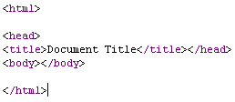
HTML-Basic structure
<!DOCTYPE HTML PUBLIC "-//W3C//DTD HTML 4.01 Transitional//EN">
Document structure
Example
  DOCTYPE
    HTML DTD
  HEAD
    Title
  BODY
    Attribute and Values
© 2012 Capgemini - All rights reserved

Slide 8
Basic Structure - Tags, Attributes, and Elements
<!DOCTYPE html PUBLIC "-//W3C//DTD XHTML 1.0
Strict//EN" "http://www.w3.org/TR/xhtml1/DTD/xhtml1-strict.dtd">
<html>
<body>
This is my first web page
</body>
</html>
Tags
Attributes
Elements
  The basic structure of an HTML document includes tags, which surround content and apply meaning to it.
  <html> is the opening tag that kicks things off and tells the browser that everything between that and the </html> closing tag is an HTML document.
  Tags can also have attributes, which are extra bits of information.
  Attributes appear inside the opening tag and their value is always inside quotation marks.
  They look something like
  <tag attribute="value“> Kanbay
  </tag>.
  Tags tend not to do much more than mark the beginning and end of an element.
  Elements are the bits that make up web pages. You would say, for example, that everything that is in-between and includes the <body> and </body> tags is the body element.
  As another example, whereas '<title>' and '</title>' are tags,
  '<title>Rumple Stiltskin</title>' is a title element.
© 2012 Capgemini - All rights reserved

Slide 9
Page Titles
  <html>
  <head>
  <title>My first web page</title>
  </head>
  <body>
  This is my first web page
  </body>
  </html>
  We have added two new elements here, that start with the head tag and the title tag (and see how both of these close).
  "My first web page" will appear on the title bar of the window.
  If you were to add this page to your 'favourites' you would see that the title is also used there.
© 2012 Capgemini - All rights reserved

Slide 10
Paragraphs, Line Breaks
  The p tag is for paragraph.
  If you want text to appear on different lines, you need to explicitly state that.
  The <br /> tag is for line break.
  The <br> tag is used when you want to end a line, but don't want to start a new paragraph. The <br> tag forces a line break wherever you place it.
  <p>This is my first web page</p>
  <p>How exciting</p>
  This is my first web page<br />
  How exciting
© 2012 Capgemini - All rights reserved

Slide 11
Headings
  Headings are defined with the <h1> to <h6> tags.
  <h1> defines the largest heading. <h6> defines the smallest heading.
  <html>
  <head>
  <title>My first web page</title>
  </head>
  <body>
  <h1>My first web page</h1>
  <h2>What this is</h2>
  <p>A simple page put together using HTML</p>
  <h2>Why this is</h2>
  <p>To learn HTML</p>
  </body>
  </html>
  Note that the h1 tag is only used once - it is supposed to be the main heading of the page and shouldn't be used multiple times.
  h2 to h6 however, can be used as often as you desire, but they should always be used in order, as they were intended.
  For example, an h4 should be a sub-heading of an h3, which should be a sub-heading of an h2.
© 2012 Capgemini - All rights reserved

Slide 12
Lists
  HTML supports ordered, unordered and definition lists.
  Unordered Lists
  An unordered list is a list of items. The list items are marked with bullets (typically small black circles).
  An unordered list starts with the <ul> tag. Each list item starts with the <li> tag.
  Ordered Lists
  An ordered list is also a list of items. The list items are marked with numbers.
  An ordered list starts with the <ol> tag. Each list item starts with the <li> tag.
<ul>
  <li>Coffee</li>
  <li>Milk</li>
</ul>
Coffee
Milk
<ol>
  <li>Coffee</li>
  <li>Milk</li>
</ol>
Coffee
Milk
© 2012 Capgemini - All rights reserved

Slide 13
Definition Lists
  where there is a list of terms and descriptions (such as a glossary), a definition list should be used.
  The dl definition lists have a dt element, which is the definition term, followed by a dd element which is a definition description.
  <h1>Some random glossary thing</h1>
  <dl>
  <dt>HTML</dt>
  <dd>Abbreviation for HyperText Markup Language - a language used to make web pages.</dd>
  <dt>Dog</dt>
  <dd>Any carnivorous animal belonging to the family Canidae.</dd>
  <dd>The domesticated sub-species of the family Canidae, Canis lupus familiaris.</dd>
  </dl>
© 2012 Capgemini - All rights reserved

Slide 14
Links
  HTML uses a hyperlink to link to another document on the Web.
The Anchor Tag and the Href Attribute
  <a href="http://www.w3schools.com/">Visit W3Schools!</a>
The Target Attribute
With the target attribute, you can define where the linked document will be opened.
  <a href="http://www.w3schools.com/" target="_blank">Visit W3Schools!</a>
The Anchor Tag and the Name Attribute
The name attribute is used to create a named anchor.
  <a name="tips">Useful Tips Section</a>
To link directly to the "tips" section, add a # sign and the name of the anchor to the end of a URL, like this:
  <a href="http://www.w3schools.com/html_links.asp#tips"> Jump to the Useful Tips Section</a>
  <a href="#tips">Jump to the Useful Tips Section</a>
© 2012 Capgemini - All rights reserved

Slide 15
Images
  In XHTML, images are defined with the <img> tag.
  The <img> tag is empty, which means that it contains attributes only and it has no closing tag.
  To display an image on a page, you need to use the src attribute. Src stands for "source". The value of the src attribute is the URL of the image you want to display on your page.
  <img src="boat.gif" alt="Big Boat" width="157" height="70" />
  The alt attribute is used to define an "alternate text" for an image.
  The "alt" attribute tells the reader what he or she is missing on a page if the browser can't load images.
  It’s a good practice to include the “alt” attribute for each image. (W3C Validation)
© 2012 Capgemini - All rights reserved

Slide 16

Tables
  The correct use for tables is to do exactly what you would expect a table to do - to structure tabular data.
  The <table> tag defines the table.
  The <tr> tag defines a table row.
  The <td> tag defines a data cell. These must be enclosed in <tr> tags, as shown above.
  <table border="1">
  <tr>
  <td>row 1, cell 1</td>
  <td>row 1, cell 2</td>
  </tr>
  <tr>
  <td>row 2, cell 1</td>
  <td>row 2, cell 2</td>
  </tr>
  </table>
© 2012 Capgemini - All rights reserved

Slide 17

Headings in a Table Tables Contd…
  th is a header cell.
  As with the td tag, these tags must be enclosed in tr tags.
  <table border="1">
  <tr>
  <th>Heading</th>
  <th>Another Heading</th>
  </tr>
  <tr>
  <td>row 1, cell 1</td>
  <td>row 1, cell 2</td>
  </tr>
  <tr>
  <td>row 2, cell 1</td>
  <td>row 2, cell 2</td>
  </tr>
  </table>
© 2012 Capgemini - All rights reserved

Slide 18
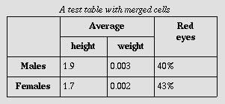
Summary and Caption Tables Contd…
  A brief and easy accessibility consideration is to always apply a summary and caption to the table.
  A summary can be applied to a table using the summary attribute in the opening table tag. This won't be displayed, but can aid in a non-visual representation of a table.
  <table summary=“Breif summary about the table goes here..">
  <caption>List of Employees</caption>
  ...
  ...
  </table
© 2012 Capgemini - All rights reserved

Slide 19

Headers, footers Tables Contd…
  thead, tfoot and tbody allow you to separate the table into header, footer and body.
  <table>
  <thead>
  <tr>
  <th>Header 1</th> <th>Header 2</th
  </tr>
  </thead>
  <tfoot>
  <tr>
  <td>Footer 1</td> <td>Footer 2</td>
  </tr>
  </tfoot>
  <tbody>
  <tr>
  <td>Cell 1</td> <td>Cell 2</td>
  </tr>
  ...
  </tbody>
  </table>
© 2012 Capgemini - All rights reserved

Slide 20
Forms
  HTML Forms are used to select different kinds of user input.
  A <FORM> tag usually contains the following attributes.
  ACTION - Specifies the location of a program to process the results of the form.
  METHOD - get / post - Specifies the method used to submit the form results. Get for search forms and forms where results need to be retrieved. Post for feedback forms and forms where results need to be sent.
  NAME - Name that can identify the form (E.g. in scripts).
  <form action="process.php" method="post“ name=“form1”>
  </form>
© 2012 Capgemini - All rights reserved

Slide 21
Form Elements - Input
  The input tag is the daddy of the form world. It can take ten forms, outlined below:
  <input type="text" /> is a standard textbox.
  <input type="password" /> is similar to the textbox, but the characters typed in by the user will be hidden.
  <input type="checkbox" /> is a checkbox, which can be toggled on and off by the user.
  <input type="radio" /> is similar to a checkbox, but the user can only select one radio button in a group.
  <input type="file" /> is an area that shows the files on your computer, like you see when you open or save a document in most programs, and is used to enable users to upload files.
© 2012 Capgemini - All rights reserved

Slide 22
Form Elements - Input
  <input type="submit" /> is a button that when selected will submit the form.
  <input type="image" /> is an image that will submit the coordinates of where the user clicked on it.
  <input type="button" /> is a button that will not do anything without extra code added.
  <input type="reset" /> is a button that when selected will reset the form fields to their default values.
  <input type="hidden" /> is a field that will not be displayed and is used to pass information such as the page name that the user is on or the email address that the form should be posted to.
© 2012 Capgemini - All rights reserved

Slide 23
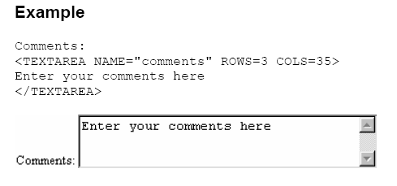
Form Elements - Textarea
  A textarea is, basically, a large textbox. It requires a rows and cols attribute.
© 2012 Capgemini - All rights reserved

Slide 24
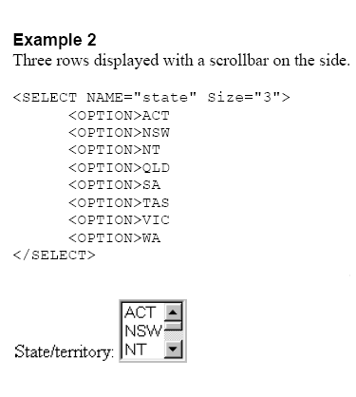
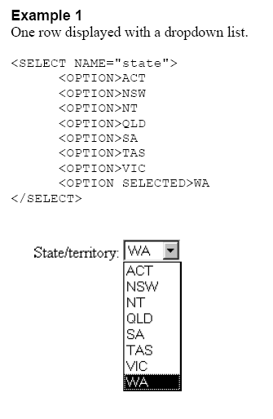
Form Elements - Select
  The select tag works with the option tag to make drop-down select boxes.
© 2012 Capgemini - All rights reserved

Slide 25
Accessible Forms
  Labels
  Each form field should have its own label. The label tag sorts this out, with a for attribute that associates it to a form element:
  <form>
  <label for="yourName">Your Name</label> <input type="text" name="yourName" id="yourName" />
  ...
  Field sets and legends
  You can group fields, for example name (first, last, middle, title etc.) or address (line 1, line 2, county, country, postal code, country etc.) using the fieldset tag.
  Within the field set, you can set a legend with the legend tag.
  <form action="somescript.php" >
  <fieldset>
  <legend>Name</legend>
  <p>First name <input type="text" name="firstName" /></p>
  <p>Last name <input type="text" name="lastName" /></p>
  </fieldset>
  ...
© 2012 Capgemini - All rights reserved

Slide 26
Span and Div
  HTML is all about applying meaning to content. Whereas most HTML tags apply meaning (p makes a paragraph, h1 makes a heading etc.)
  the span and div tags apply no meaning at all, but they are actually used quite extensively in conjunction with CSS.
  The difference between span and div is
    that a span element is in-line and usually used for a small chunk of in-line HTML
    whereas a div (division) element is block-line and used to group larger chunks of code.
  <div id="scissors">
  <p>This is <span class="paper">crazy</span></p>
  </div>
© 2012 Capgemini - All rights reserved

Slide 27
Meta Tags
  Meta tags don't do anything to the content, but they are used by the likes of search engines to catalogue information about the web page.
  <html>
  <head>
  <title>Title</title>
  <meta http-equiv="Content-Type" content="text/html; charset=UTF-8" />
  <meta name="description" content="This is my bloody exciting web page about air conditioners" />
  ...
© 2012 Capgemini - All rights reserved

Slide 28
Validate Your Markup
  W3C Markup Validation Service, a free service that checks Web documents in formats like HTML and XHTML for conformance to W3C Recommendations and other standards.
  Always validate your page.
  http://validator.w3.org/
© 2012 Capgemini - All rights reserved

Slide 29
Cascading Style Sheets (CSS)
  Style sheets - Usage
  Style sheets - How to add ?
    Inline Styles: Using Style attribute with some html tag
    as <H2 STYLE = "COLOR:RED“ >
    Embedded Style Sheets : Using <STYLE> tag within <Head> part of html
    Linked Style sheets: Using link tag and a separate .css file
    as <LINK REL="STYLESHEET" HREF="Examle.css">
© 2012 Capgemini - All rights reserved

Slide 30
Editors and Browsers
  Different Text Editors
        FrontPage
        Dreamweaver
        EditPlus
  Various Browsers
        Internet Explorer
        Firefox
        Safari (Macintosh)
        Google Chrome
© 2012 Capgemini - All rights reserved

Slide 31
Helpful Hints
Preview all web pages prior to uploading to the server.
Keep things simple. Too many gizmos make the page unattractive.
Keep it small. avoid large graphics and pages that extend beyond the screen.
Keep it up-to-date. Nothing is worse than a page with dead links and outdated information.
Use a consistent style. Use style sheets (.css).
Validate - Validate your markups as per w3C standards
Organize - Develop a system of organizing your web pages, using sub-directories as appropriate, e.g.,
Main web page in
root directory
index.html
Teaching
subdirectory
Research
subdirectory
Service/Personal
subdirectory
© 2012 Capgemini - All rights reserved

Slide 32
Recap (Keywords)
Table
tr td
head
div
CSS
H1
body
© 2012 Capgemini - All rights reserved
Notes:
You may ask participants to explain these key words
© 2006 Capgemini - All rights reserved

Slide 33
Thank You For Your Time
Notes:
© 2006 Capgemini - All rights reserved

