Slide 1
Team Details
Team Name-
Tech Thalaivas
Institute-
Govt. Engineering College ,Ajmer
Team Members-
Rajat Shri Shrimal
Kshitij Abhay
Mukul Dhaka
Manpreet Singh

Slide 2
Problem Statement:
Reducing phishing attacks in online/mobile wallets and net banking:
Phishing attacks are becoming common. A common man is sometimes duped of hard earned saving due to phishing attacks. Especially, senior citizens and villagers are more vulnerable. They are targeted for their net banking/online wallet PIN and passwords. The developer should design a system to solve this problem. This problem is not only technology specific, but also focus will have to be put on User Experience (UX) and User Interface (UI) design. Solutions should keep in mind the targetable user category, who are not technically savvy.

Slide 3
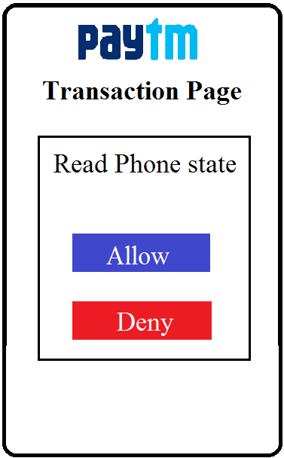
Solution:
Login Verification :
Pre existing features (Password and OTP)
Transaction Verification :
  Read phone state (Solution of OTP).
To increase its functionality : “ TRUSTED CONTACTS ”
Feature to provide unique Id to each verified customer
For Trusted Devices: “E-Tag”
E-Tag for own PC/Laptop.
To stay away from fraud link : ” Browser Extension ”
It will block links having URL and html code
similar to actual paytm web pages.
Notes:
Statistics are are taken from expandedramblings.com

Slide 4
Technology Stack
The functionality will be implemented using-
  Development Environment - Android Studio
  Application- Java for Android and Swift for IOS
  Java script
  CSS
  HTML
  Chrome Extension - json

Slide 5
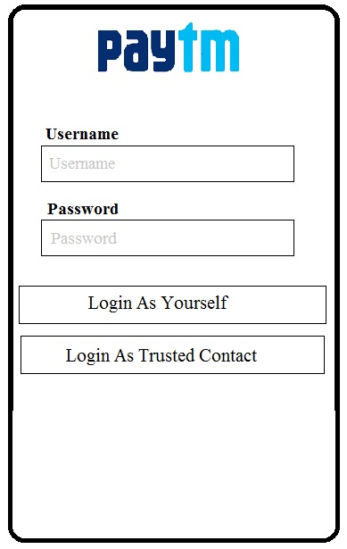
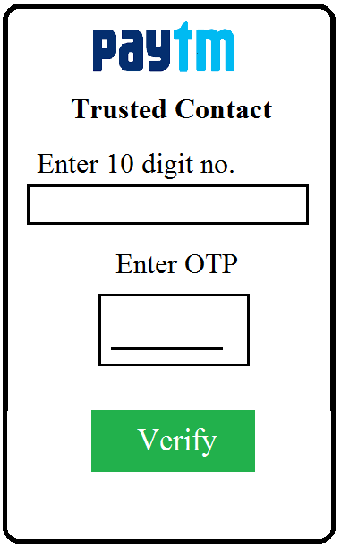
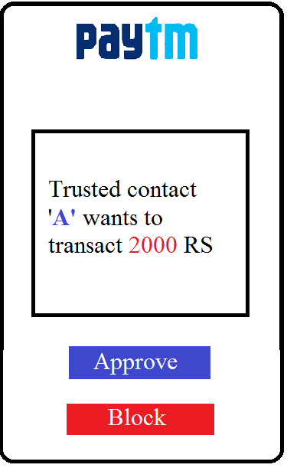
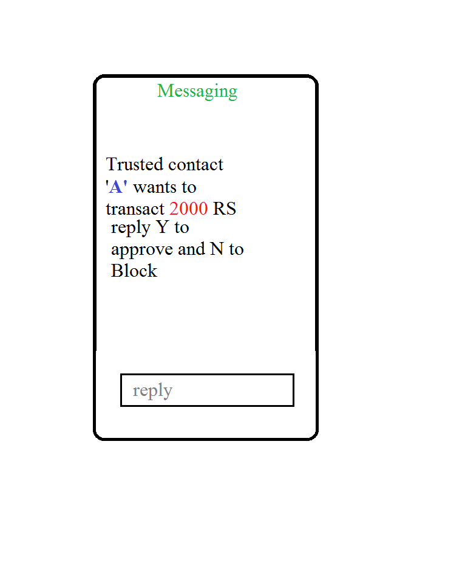
OR
Login Procedure
Transaction Verification

Slide 6
