Slide 1

Bank Loan Dashboard
Rajat Tandulkar
© All rights reserved by Fireblaze Technologies Pvt. Ltd.

Slide 2



Problem Statement
Why we need a bank-loan dashboard:
Loan dashboards ensure efficient tracking of metrics.
They provide real-time insights for better decisions.
Dashboards enhance transparency and streamline complex data.
© All rights reserved by Fireblaze Technologies Pvt. Ltd.

Slide 3
Problem Statement and About the Data
Make detailed loan report dashboard in Power BI .
Analyze key metrics like total applications, amounts, and trends.
Assess good vs bad loan ratios and risks.
Optimize decision-making with actionable loan insights.
There are 24 columns namely loan_amount , purpose, loan_status , installment , int_rate , term and total_payment , etc.
Each column has 38577 rows.
© All rights reserved by Fireblaze Technologies Pvt. Ltd.

Slide 4
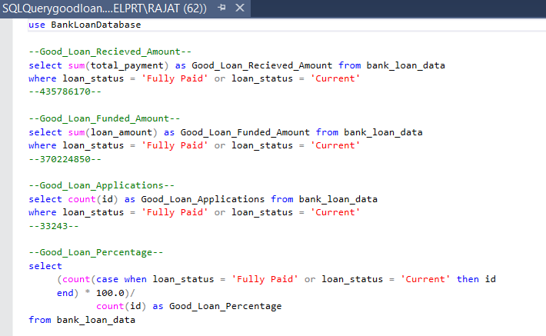
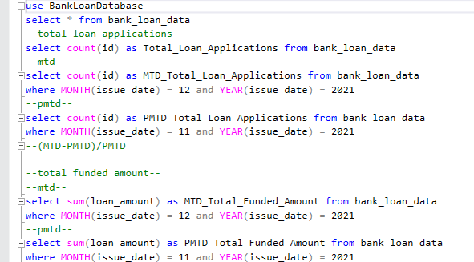
Proposed Solution
© All rights reserved by Fireblaze Technologies Pvt. Ltd.

Slide 5
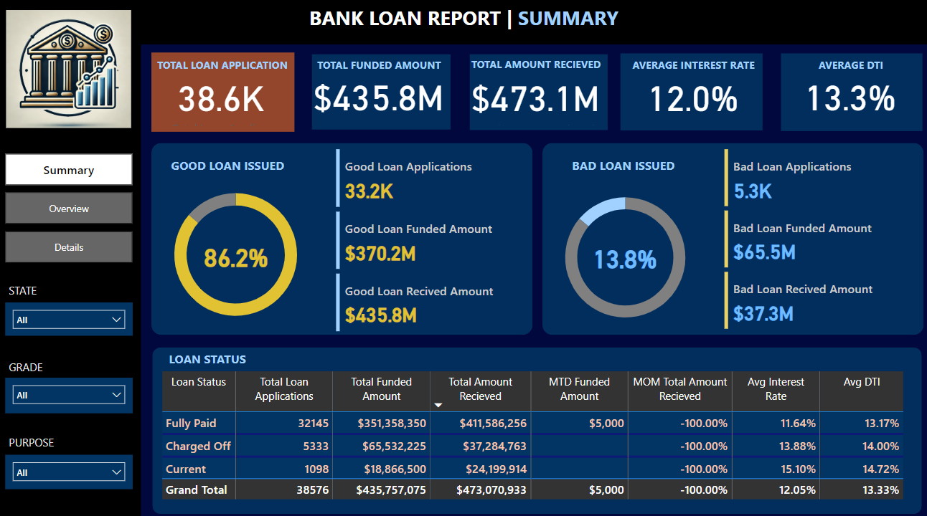
Proposed Solution
© All rights reserved by Fireblaze Technologies Pvt. Ltd.

Slide 6
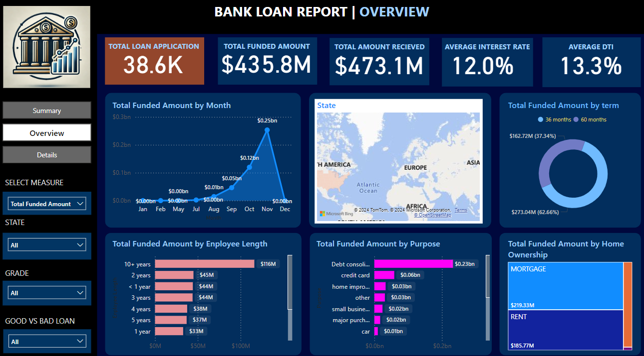
Proposed Solution
© All rights reserved by Fireblaze Technologies Pvt. Ltd.

Slide 7
Conclusion
The dashboard was successfully created in Power BI.
Data Analysis was performed to get detailed insights about the loan, kpi’s like Total Loan Applications, Total Funded Amount, Total Amount Received, Average Interest Rate, Avg DTI.
employees and their account and other details from the database.
© All rights reserved by Fireblaze Technologies Pvt. Ltd.

Slide 8
Future Scope
This model can be utilized for larger databases and is suitable for real-time applications in the future.
Additional columns can be incorporated into this model, including savings account details, fixed deposit (FD) details, credit card details.
© All rights reserved by Fireblaze Technologies Pvt. Ltd.

Slide 9
Thank You!

