Slide 1
PARTITIONAL ALGORITHMS
RAJAT TOMAR
UID: 229039

Slide 2
OVERVIEW
CLUSTERING
PARTITIONAL ALGORITHMS
VARIOUS PARTITIONAL ALGORITHMS
PRO AND CONS OF EACH
IMPLEMENTATION OF THE CODE

Slide 3
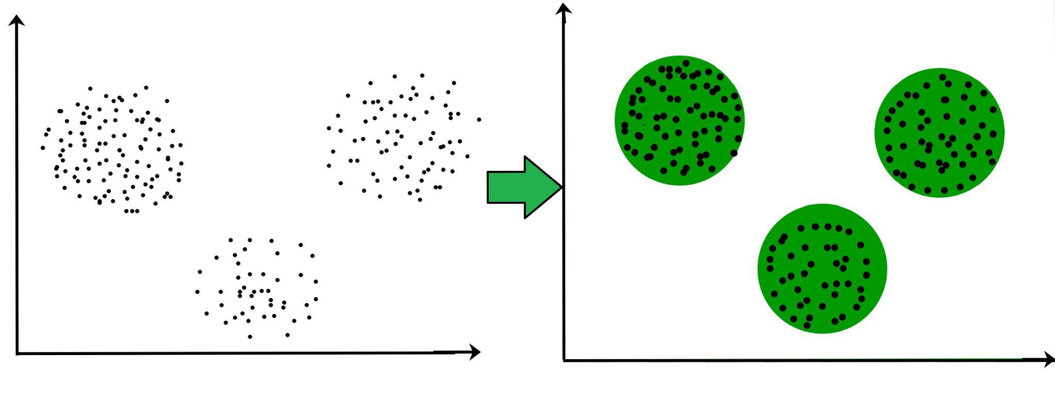
CLUSTERING
The Process of Clustering is Classification of the objects which are similar among them, and organizing of data into groups.
The Techniques of Clustering are among the Unsupervised Learning Methods.

Slide 4
Unsupervised Learning Method
An unsupervised learning method is a method in which we draw references from datasets consisting of input data without labeled responses.
Generally, it is used as a process to find meaningful structure, explanatory underlying processes, generative features, and groupings inherent in a set of examples.

Slide 5
Basic features of Clustering Vs Classification
• The (best) number of clusters is not known.
• There may not be any a priori knowledge concerning the clusters.
• Cluster results are dynamic.

Slide 6
Partitional Algorithms
The Partitional Algorithms separate similar objects to the clusters.
These Algorithms are successful to determine Centre Based Cluster.
The Partitional Algorithms divide n objects into Clusters by using k Parameter.
example K-means, CLARANS (Clustering Large Applications based upon Randomized Search), etc.

Slide 7
K means
First, we initialize k points, called means or cluster centroids, randomly.
We categorize each item to its closest mean and we update the mean’s coordinates, which are the averages of the items categorized in that cluster so far.
We repeat the process for a given number of iterations and at the end, we have our clusters.
The time complexity of K-means is O (tkn) where t is the number of iterations.
http://shabal.in/visuals/kmeans/2.html

Slide 8
PAM ( PARTITIONING AROUND MEDOIDS)
Randomly select k points from the data( k is the number of clusters to be formed). These k points would act as our initial medoids.
The distances between the medoid points and the non-medoid points are calculated, and each point is assigned to the cluster of its nearest medoid.
Calculate the cost as the total sum of the distances(also called dissimilarities) of the data points from the assigned medoid.
Swap one medoid point with a non-medoid point(from the same cluster as the medoid point) and recalculate the cost.
If the calculated cost with the new medoid point is more than the previous cost, we undo the swap, and the algorithm converges else; we repeat step 4

Slide 9
Advantages of K-Means
Relatively easy to implement.
Scales to large data sets.
K-Means returns clusters which can be easily interpreted and even visualized

Slide 10
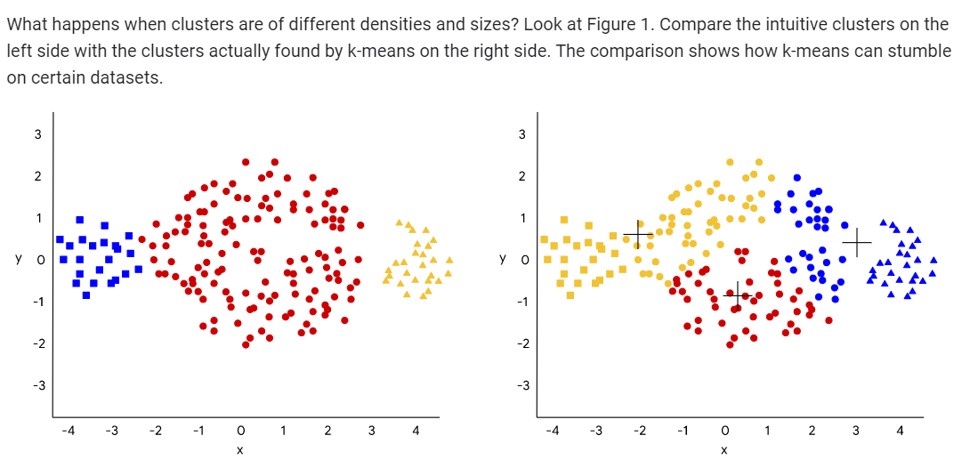
Disadvantages

Slide 11
Disadvantages
K-Means does not work on categorical data because the mean must be defined on the attribute type.
Only convex-shaped clusters are found.
It also does not handle outliers well.

Slide 12
Advantages Of PAM
Using a medoid is an approach that handles outliers well
It is simple to understand and easy to implement.
K-Medoid Algorithm converges in a fixed number of steps.
PAM is less sensitive to outliers than other partitioning algorithms.

Slide 13
Disadvantages of PAM
The total complexity per iteration is n(n - k)2
PAM does not scale well to large datasets because of its computational complexity.
It may obtain different results for different runs on the same dataset because the first k medoids are chosen randomly.
The main disadvantage of K-Medoid algorithms is that it is not suitable for clustering non-spherical (arbitrarily shaped) groups of objects.

Slide 14
Thank You

