Slide 1

E-Commerce Sales Data Analysis
End-to-end analysis using Excel, MySQL, and Power BI — turning raw data into business insights.

Slide 2
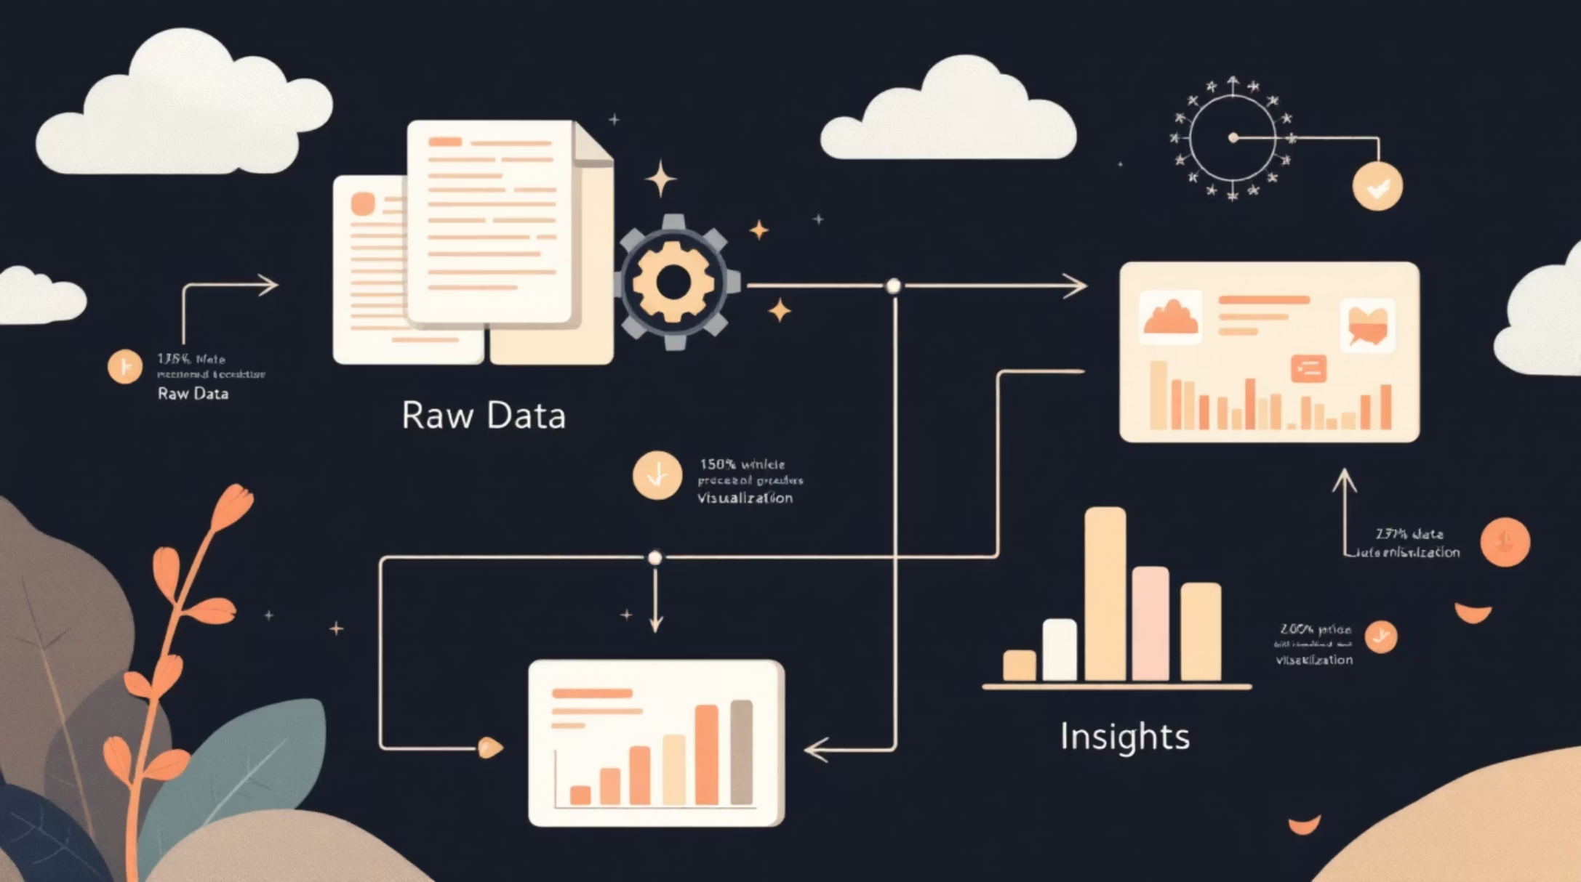
Project Overview
The Goal
Convert raw e-commerce sales data into meaningful business insights through:
Structured data cleaning
SQL-based analysis
Interactive dashboard reporting

Slide 3

Data Cleaning & Preparation
EXCEL
Deduplication
Removed duplicates & null values
Standardization
TRIM, UPPER, LOWER, PROPER functions
Data Types
Corrected Date, Numeric formats
Pivot Analysis
Region, Category, Product breakdowns

Slide 4


MYSQL
SQL Business Analysis
Total Sales
Category Profit
Aggregate sales and profit overview
Assess profitability by category
Region Analysis
Top & Bottom
Compare performance across regions
Identify best and worst products
Structured queries uncovered performance patterns across regions, categories, and products.

Slide 5
Product Performance Queries
Top Performers
Loss Makers
Top 5 products by sales
Top 5 brands by revenue
Top 3 cities by sales
Products above average sales
Bottom 5 loss-making products
Products below average profit
Discount impact on margins
Average sales per product

Slide 6

Power BI Dashboard
POWER BI
Cleaned MySQL data imported into Power BI. DAX measures built for Total Sales, Total Profit, Avg. Delivery Days, and Order Count.

Slide 7
Dashboard Features
KPI Cards
Bar Charts
At-a-glance metrics
Product & regional performance
Regional Comparison
Dynamic Slicers
Side-by-side region visuals
Interactive filtering

Slide 8
Key Business Insights
Revenue Concentration
Discount Danger
A few products generate the majority of total revenue
High discounts significantly reduce profit margins
Regional Gaps
Loss Sub-categories
Certain regions significantly outperform others
Some sub-categories consistently generate losses

Slide 9

Recommendations
01
Optimize Discounts
Revise discount strategies to protect margins
02
Focus on High-Margin Products
Prioritize top-performing SKUs and brands
03
Review Underperformers
Audit loss-making sub-categories
04
Invest in Top Regions
Double down on high-performing markets

Slide 10


Future Enhancements
Next Steps
Predictive analytics integration
Customer segmentation modeling
This project demonstrates a complete Excel → MySQL → Power BI analytics pipeline ready for real-world business decisions.

