Slide 1
Hospital - Diagnostic Laboratory
Data Exchange System
Date : 26-10-2026
Sem : FALL SEMESTER – 2026
Subject : ADVANCED PYTHON PROGRAMMING
A REST API–Based Hospital–Laboratory Data Exchange System
Hospital Management Portal
Diagnostic Laboratory Portal
by
RAJAVEL MURUGAN S – 23MID0018
KISHORI KAMALI M – 23MIC0055

Slide 2



Two Independent Websites
1. Hospital Website
2. Diagnostic Laboratory Website
Purpose: Manage patients and create diagnostic test requests.
Purpose: Receive test requests, process tests, and return results.
Main Functions:
Main Functions:
User login and authentication
Patient registration and management
Create diagnostic test requests
Create and send diagnostic test requests using REST API
Send test requests to the Laboratory using REST API
Retrieve laboratory results using REST API
Store and display test results
Doctor can review the final report
Laboratory staff login
Receive test requests through REST APIValidate request data
Process diagnostic tests
Enter test measurements
Evaluate results using reference ranges
Submit completed test results using REST API
Send completed results to the Hospital using REST API

Slide 3


Communication
Hospital Portal → REST API → Laboratory Portal → REST API → Hospital Portal
The two websites are independent systems with separate databases. REST API acts as the communication layer between the two systems.

Slide 4
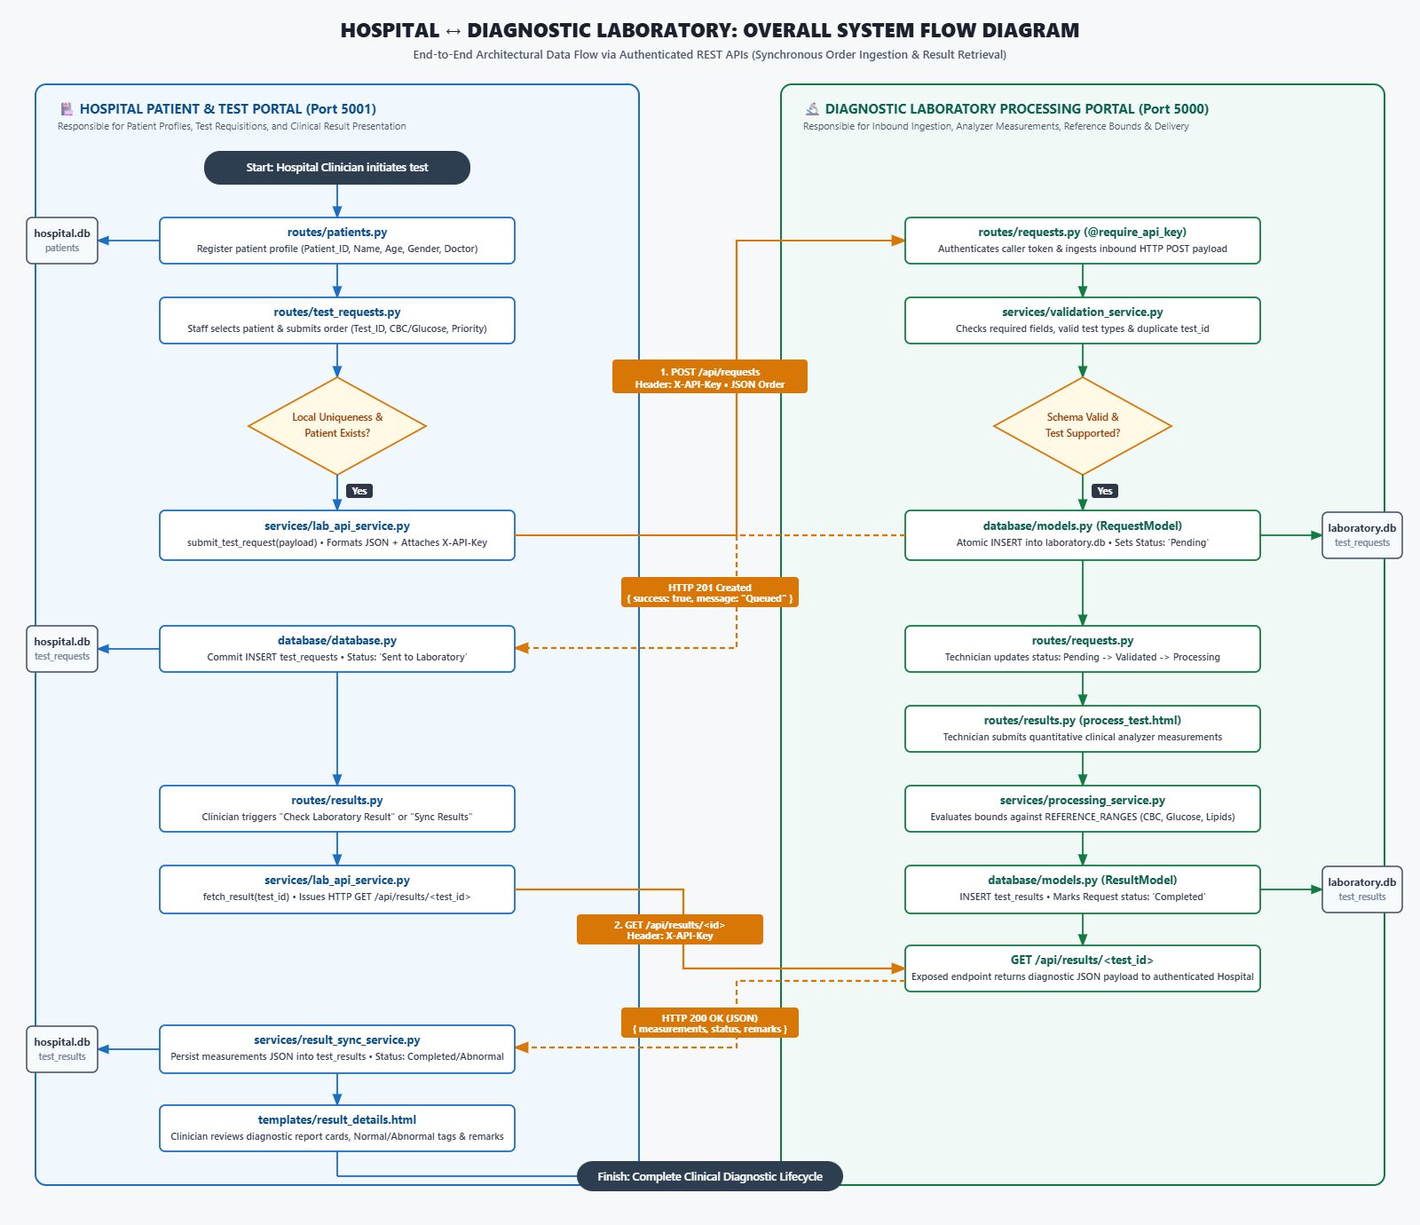
OVERALL FLOWCHART

Slide 5
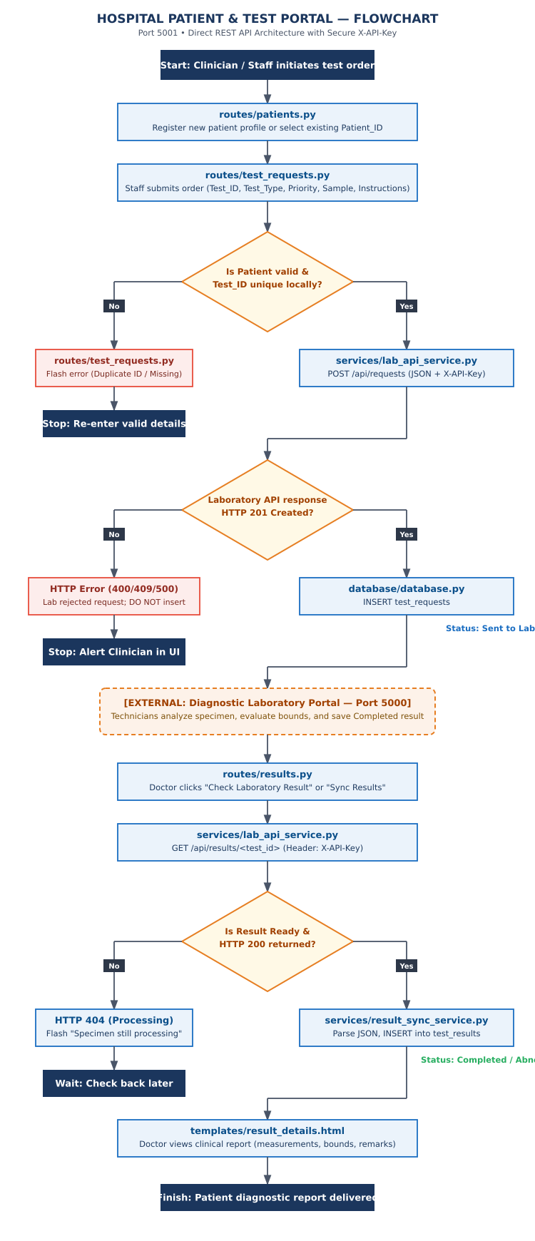
HOSPITAL WORKFLOW

Slide 6
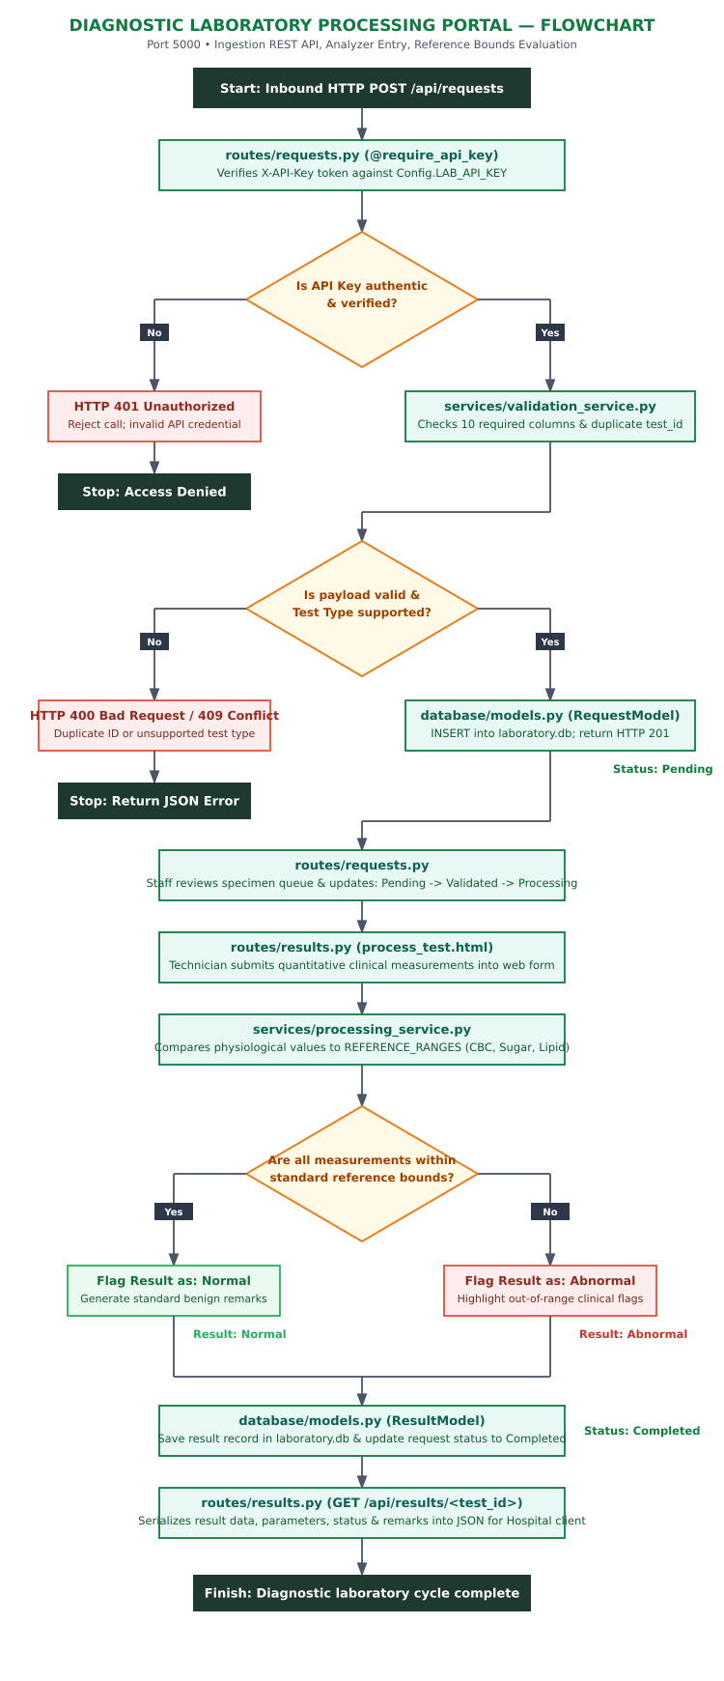
LABORATORY WORKFLOW

