Slide 1
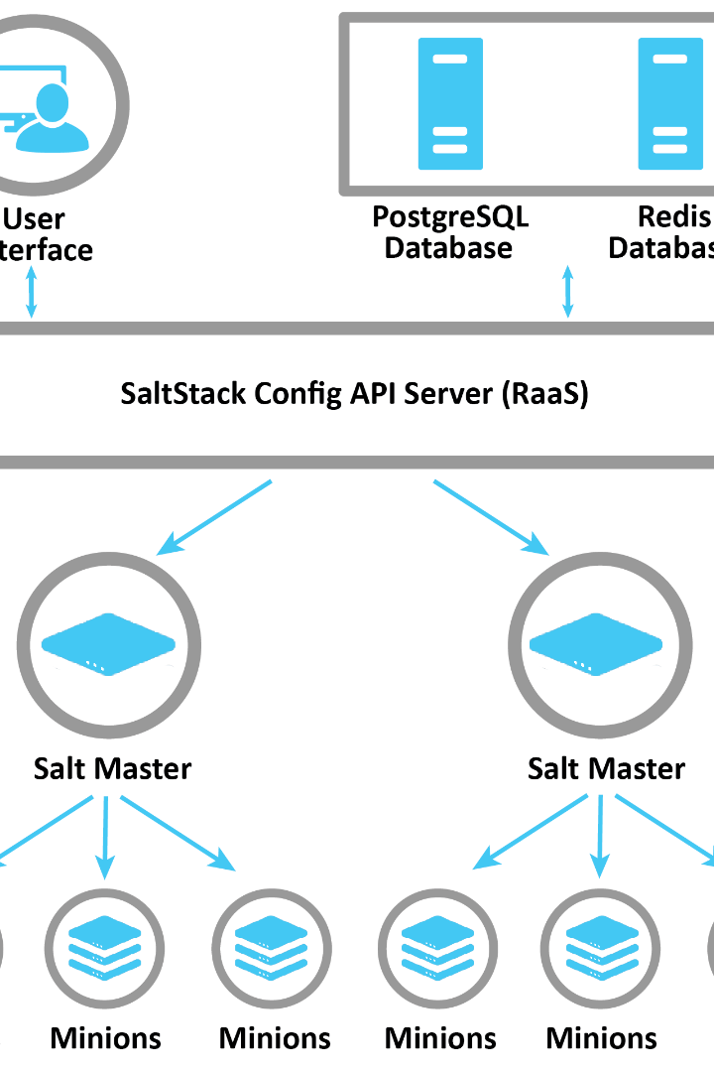

Configuring Saltstack: Configuring Firewall, Configuring Salt Minion
Learn all about configuring Saltstack with this comprehensive guide. From configuring firewalls to setting up Salt Minions, we cover it all!
ek
by Charanjit Singh

Slide 2

Overview of Saltstack
Saltstack is a powerful automation and orchestration tool that can help you manage your infrastructure at scale. It uses a client-server architecture and can manage thousands of servers with ease. With Saltstack, you can configure, deploy and manage your entire infrastructure using code.

Slide 3

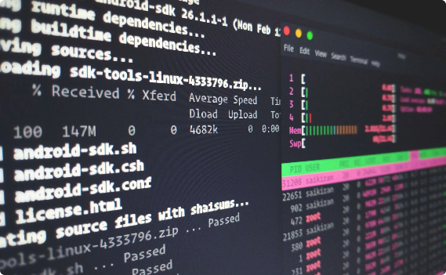

Configuring Salt Master
Server Setup
Terminal Setup
Key Exchange
Before we begin, we need to set up a Salt Master server. This server will act as the central point of control for all your Salt Minions. Make sure to choose a powerful server, as the Salt Master will need to handle a lot of traffic.
We also need to set up our terminal to communicate with the Salt Master. This involves installing the Saltstack CLI and configuring it to connect to your Salt Master.
Once the Salt Master and CLI are set up, we need to perform a key exchange to establish trust between the two. This is a one-time process and ensures that only authorized Salt Minions can communicate with the Salt Master.

Slide 4
Configuring Firewall
Understanding the Firewall
The Most Used Firewall Table
Configuring Firewall Rules
A firewall is a network security system that monitors and controls incoming and outgoing network traffic based on predetermined security rules. It acts as a barrier between your network and external networks to prevent unauthorized access.
The most commonly used firewall table in Linux is iptables. It is a powerful command-line tool that allows you to control network traffic and create complex rules based on various criteria such as source and destination IP address, protocol, and port number.
To configure the firewall, we need to create a set of rules that define what traffic is allowed and what traffic is blocked. These rules should be based on your specific needs and should strike a balance between security and functionality.

Slide 5


Configuring Salt Minion
Setting Up Salt Minion
Configuring Salt Minion ID
A Salt Minion is a client that runs on your managed servers. It communicates with the Salt Master to receive instructions and execute them. To set up a Salt Minion, you need to install the Saltstack package on your server and configure it to connect to your Salt Master.
Each Salt Minion is identified by a unique ID that is used by the Salt Master to communicate with it. By default, the Salt Minion's hostname is used as its ID, but you can also specify a custom ID if you prefer.

Slide 6

Conclusion
Configuring Saltstack can be a complex process, but with the right tools and knowledge, it can be done efficiently and effectively. By following the steps outlined in this presentation, you will be able to set up your Saltstack infrastructure with ease and benefit from the many advantages it provides.

