Slide 1
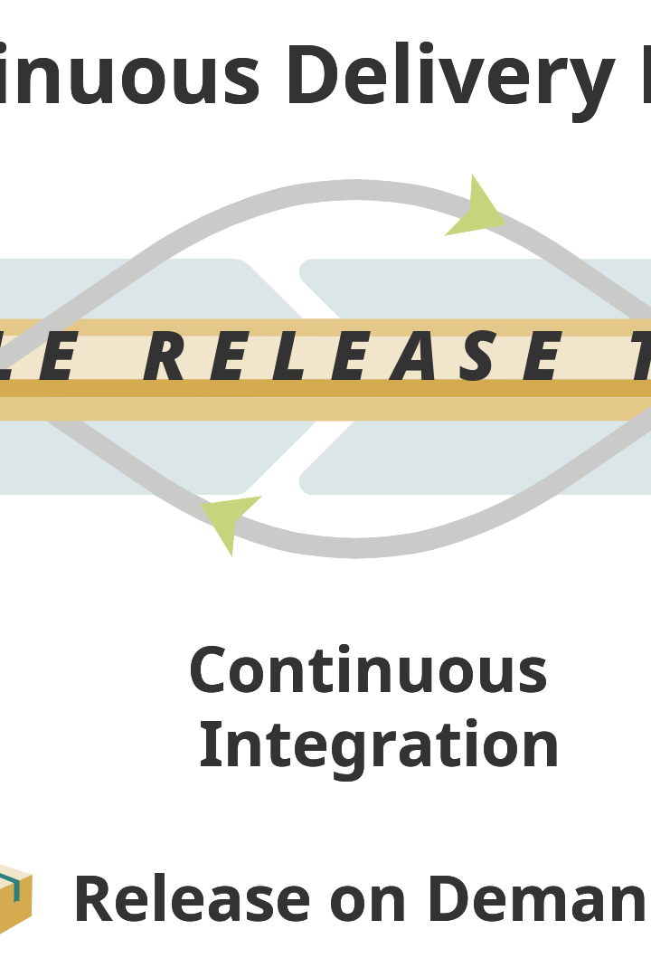

Continuous Delivery Pipeline with Jenkins
Learn how to streamline software delivery using Jenkins. Continuous delivery makes deployments faster, safer, and more automated.
by Charanjit Singh

Slide 2
What is Continuous Delivery Pipeline?
Think of Continuous Delivery Pipeline as a factory assembly line for software development. The pipeline automates software builds, testing, and deployment in a repeatable way.
Benefits
Tools
Challenges
Improved collaboration, faster feedback loops, and higher quality software.
Jenkins, Docker, Kubernetes, Git, and more.
Complex setup, more infrastructure required, and increased testing complexity.

Slide 3
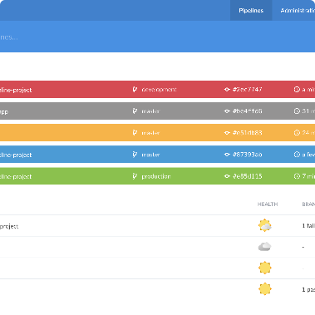
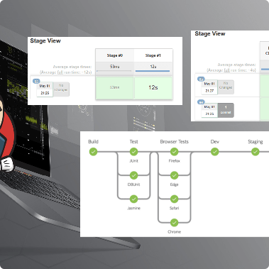
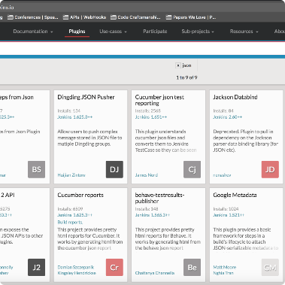
The Beauty of Jenkins
Jenkins is an open-source automation tool that helps build, test, and deploy software. It's versatile and easy to use even for complex Continuous Delivery Pipeline setups.
Dashboard
Pipeline
Plugins
Jenkins' intuitive dashboard keeps track of your builds and tests in one place.
The pipeline gives you a visual view of your software delivery process. Easily monitor and manage each step of the pipeline.
Jenkins has a huge library of plugins. Easily extend the functionality to fit your needs.

Slide 4
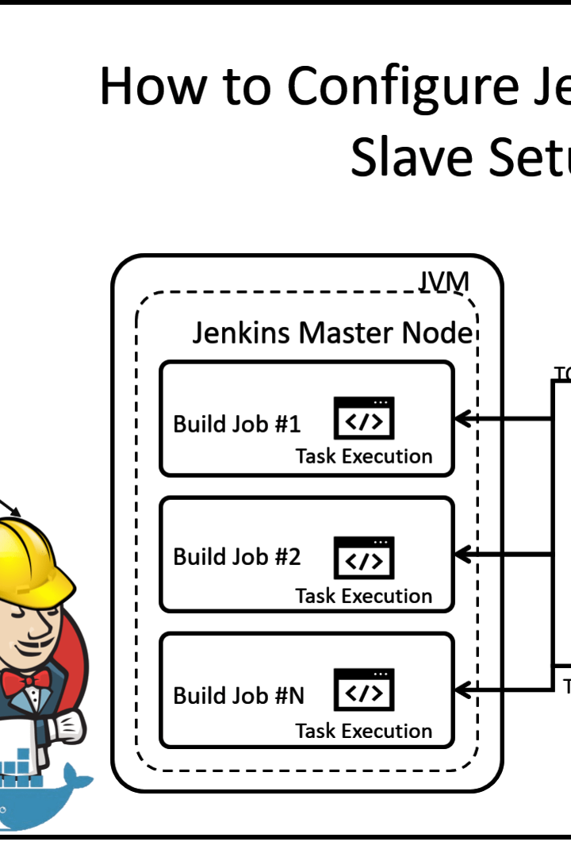
Setting Up Jenkins for Continuous Delivery Pipeline
Setting up Jenkins can seem daunting, but once it's done, your software development team can reap the benefits of Continuous Delivery Pipeline. Follow these steps:
Install Java & Jenkins.
Configure plugins.
Create a Jenkinsfile for building, testing, and deploying.
Configure automated testing.

Slide 5
Creating Jenkinsfile
Jenkinsfile is a script that defines the pipeline's building, testing, and deployment stages. It lives in your source code repository and automates your Continuous Delivery Pipeline.
1
2
3
Stage 1: Build
Stage 2: Test
Stage 3: Deploy
Compiles the app, packages it, and creates a Docker image.
Runs unit tests, integration tests and other types of automated testing.
Pushes the artifact to a container registry and deploys to a target environment.

Slide 6
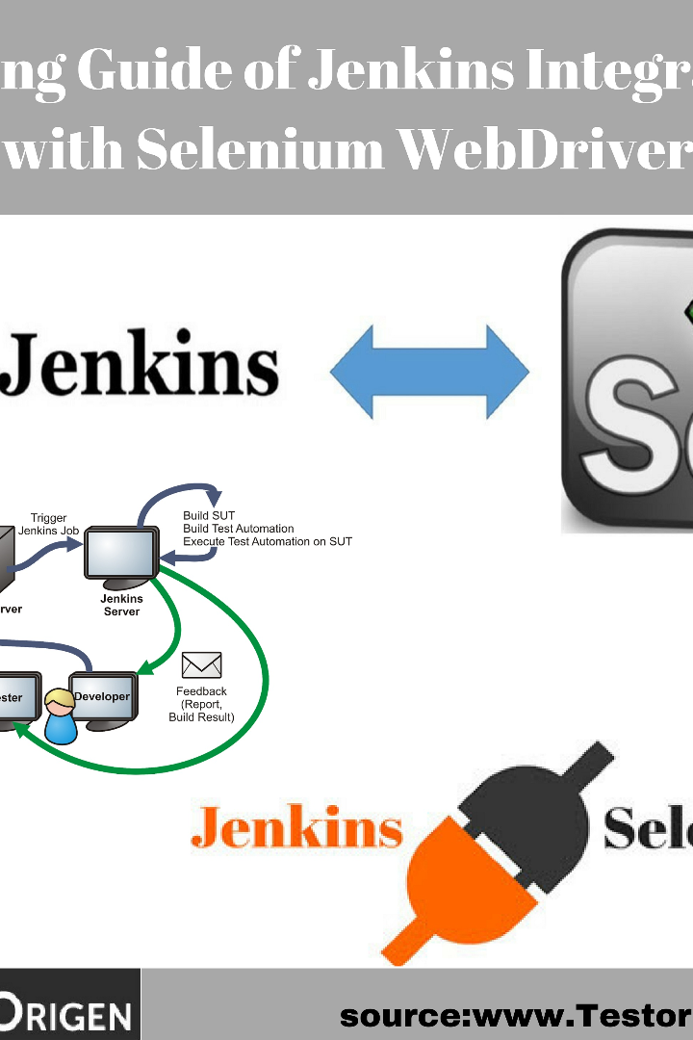
Adding Automated Tests to Pipeline
Automated testing is crucial in Continuous Delivery Pipeline. It improves code quality, catches bugs early, and reduces the risk of shipping bad code. Jenkins supports automated testing out of the box. Add these tests to your pipeline:
1
Unit testing
2
Integration testing
Tests a single piece of code like a function or class in isolation. Quick to run and valuable for detecting regressions.
Tests how different pieces of code interact with each other. Identifies issues in the interactions between different components.
3
Acceptance testing
Tests the entire application end-to-end. Ensures the app behaves as expected from the user's perspective.

Slide 7
Monitoring and Improving Pipeline Performance
Continuous Delivery Pipeline is a living organism that requires monitoring and care. By continuously measuring and analyzing pipeline performance, you can improve its efficiency and reliability:
Tools
Metrics to track
Continuous Improvement
Jenkins Health Advisor plugin
Build duration and frequency
Regular reviews of pipeline performance
Prometheus and Grafana for monitoring and alerting
Test coverage
Error rates
Optimizing and automating steps where possible
Adapting pipeline to fit new requirements

Slide 8
Conclusion and Future Outlook
Continuous Delivery Pipeline with Jenkins is a key enabler for modern software development practices. It can improve your team's collaboration, quality, and productivity. The future looks bright for Jenkins as it continues to evolve and integrate with new technologies.
Challenges
Benefits
Takeaways
Complex setup, increased testing complexity
Faster feedback loops, higher quality software.
Break down software delivery into small batches. Automate as much as possible. Continuously monitor and improve pipeline performance.

