Slide 1

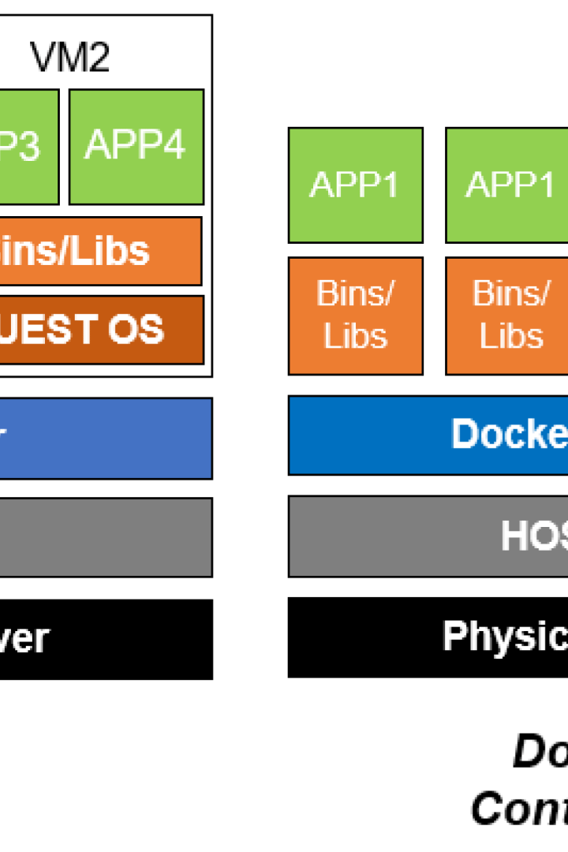
Docker Containers: The Future of Modern Computing
Docker containers offer a streamlined and efficient way to package, deploy, and run software applications. In this presentation, we'll explore the basics of containerization, the differences between Docker and traditional virtualization, and the benefits and use cases of Docker.
CS
by Charanjit Singh

Slide 2
What are Docker Containers?
Structure
A Docker container has its own file system, networking, and process environment, but shares the host machine's kernel.
1
2
3
Definition
Advantages
A lightweight, standalone executable package that contains everything needed to run an application, including code, libraries, system tools, and runtime.
Portability, scalability, and consistency across different environments, from local development to production servers.

Slide 3
Containerization Basics
Containers vs. VMs
Isolation Mechanisms
Container Orchestration
Containers provide OS-level virtualization, while VMs emulate full hardware and allow multiple OS instances on a single machine.
Namespaces, control groups, and layered file system images allow containers to be isolated from each other and from the host OS.
Tools like Kubernetes and Docker Swarm automate the deployment, scaling, and management of containerized applications.

Slide 4
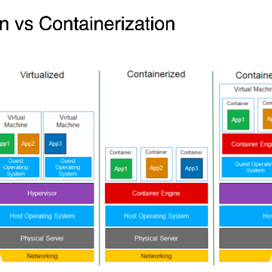
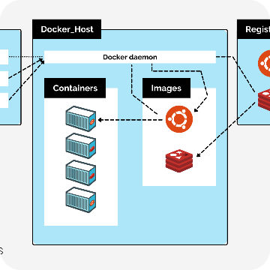
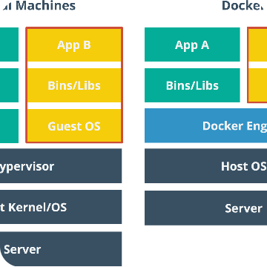
Docker vs. Traditional Virtualization
Resource Usage
Architecture
Performance
Containers use fewer resources than VMs, as they share the same kernel and can reuse libraries and dependencies.
Containers are a modular, microservices-friendly approach to application architecture, while VMs are a monolithic, all-in-one solution.
Containers have better performance than VMs, thanks to their lightweight design and lower overhead.

Slide 5
Benefits of Docker
Portability
Efficiency
Flexibility
Containers can be moved easily across different machines and cloud platforms, ensuring consistent environments for development and deployment.
Containers consume fewer resources and start up faster than VMs, allowing for better resource utilization and faster time-to-market.
Containers can run on any host OS that supports Docker, allowing for multi-platform compatibility and simplified cross-team collaboration.

Slide 6
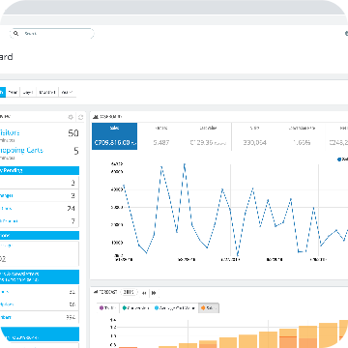
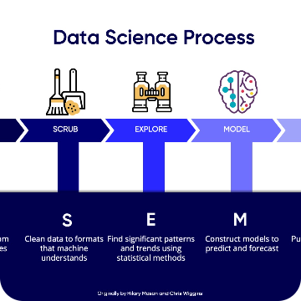
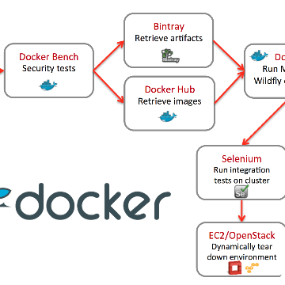
Use Cases for Docker
E-commerce
Data Science
DevOps
Docker can help streamline the deployment and scaling of web applications and microservices, improving uptime and reducing costs.
Docker can provide a consistent and reproducible environment for sharing and collaborating on data science projects, reducing the risk of errors and inconsistencies.
Docker can help automate and speed up the deployment and testing of applications, improving collaboration and reducing cycle times.

Slide 7

Getting Started with Docker
1
Installation
2
Command Line Usage
Install Docker on your machine or server following the official documentation for your OS or cloud provider.
Use basic Docker commands to manage containers, images, volumes, and networks.
3
Dockerfile Creation
Create a Dockerfile that defines your application, dependencies, and runtime environment, and build a container image from it.

Slide 8
Conclusion
Summary
Future
Resources
Docker containers offer a modern, efficient, and flexible way to package and deploy software applications.
As DevOps and cloud computing continue to evolve, Docker is likely to become even more ubiquitous and powerful.
Check out the Docker website and community forums for more information on how to learn, use, and contribute to Docker.

