Slide 1
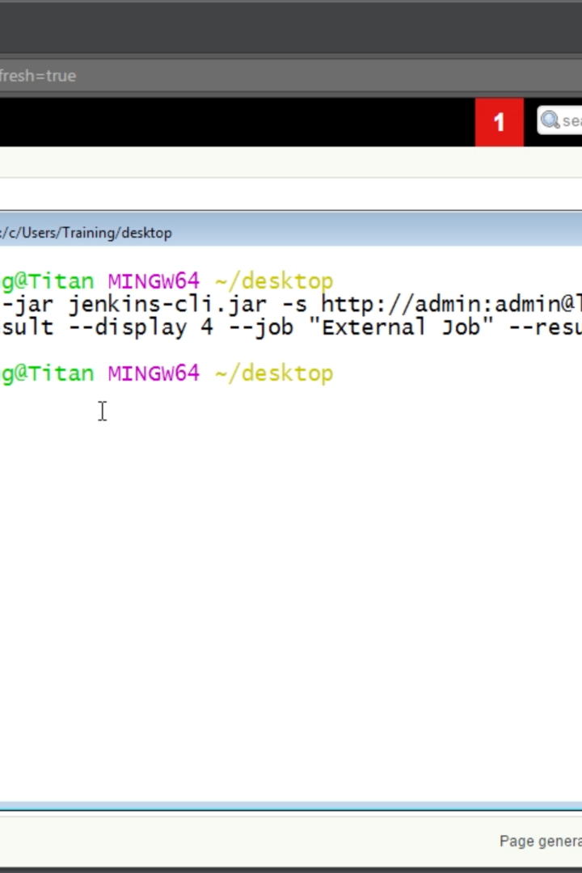

How to Use the Command Line Interface for Jenkins
Learn how to work smarter, not harder with Jenkins by mastering its command line interface. From basic commands to pipeline integration, we've got you covered.
by Charanjit Singh

Slide 2
Introduction to CLI for Jenkins
Jenkins CLI allows you to manage your Jenkins jobs from the terminal without accessing the Jenkins web UI. It's fast, powerful, and saves time. CLI provides a wide range of functionality including triggering a build, listing jobs and nodes, and more.
Fast and Powerful 🏎️
Automation at Scale 🔪
Easy Integration 🧩
Get things done faster by using CLI to manage your Jenkins jobs from the terminal without accessing the web UI.
Take advantage of the full spectrum of Jenkins features, such as triggers, builds, and pipelines.
Build and automate workflows with Jenkins CLI by easily integrating with other tools and APIs.

Slide 3
Basic CLI Commands for Jenkins
1
2
3
4
Install Jenkins CLI
List Jobs
Create a Job
Build a Job
Jenkins CLI can easily be installed on your machine either through a package manager or downloading the .jar file
Use the `list-jobs` command to see a list of all jobs on the Jenkins server.
Use the `create-job` command to create a new job by specifying a name and the XML configuration
Use the `build` command to build a job and provide any required parameters

Slide 4
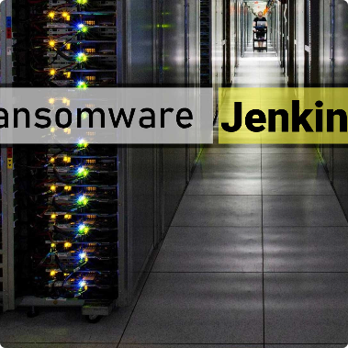
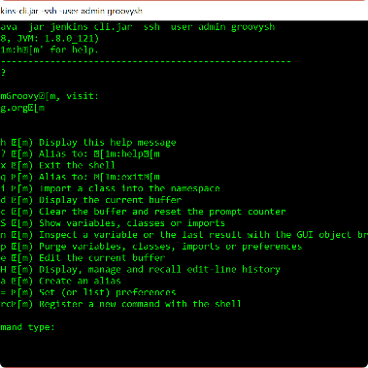
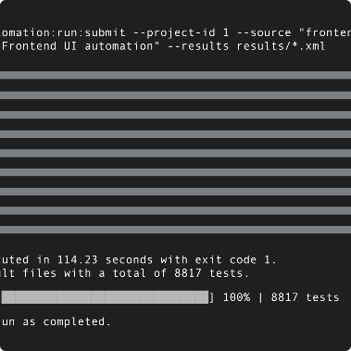
How to Install and Configure the Jenkins CLI
Installing and configuring Jenkins CLI is a straightforward process. All you need is a supported operating system and a running Jenkins server. Once you have the server up and running, you can download the CLI jar file and use SSH to connect to the server.
Requirements
Installation
Testing
To install and configure Jenkins CLI, you'll need a supported operating system and a running Jenkins server.
Download the Jenkins CLI JAR file and use SSH to connect to the Jenkins server.
You can test your CLI installation by running a simple command like `help`.

Slide 5

CLI Usage for Managing Jenkins Jobs
Jenkins CLI makes it easy to manage your jobs from the command line interface. You can create and delete jobs, build jobs, and manage parameters all from the terminal. This is particularly useful if you want to automate job creation and management.
1
Build Jobs
2
Create Jobs
3
Delete Jobs
Use the `build` command to build jobs and provide any required parameters.
Use the `create-job` command to create a new job by specifying a name and the XML configuration
Use the `delete-job` command to delete a job by name.

Slide 6
Integrating CLI with Jenkins Pipeline
Jenkins pipeline is a powerful way to automate your workflows and processes. You can also use the CLI to interact with your Jenkins pipeline. With the CLI, you can set up and run pipelines from the command line, trigger and stop builds, and more. You can also create and manage stage parameters via the CLI.
Setup Pipeline
Run Pipeline
Stop Pipeline
Use the `create-pipeline` command to create a pipeline by specifying the pipeline name and the Jenkins file.
Use the `build-with-parameters` command to start a pipeline build with any required parameters specified via the CLI.
Use the `stop-builds` command to stop a running pipeline.

Slide 7
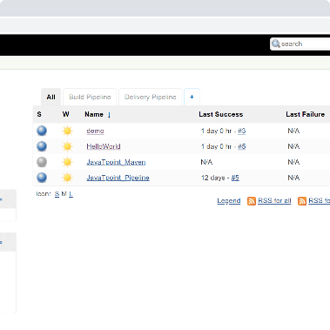
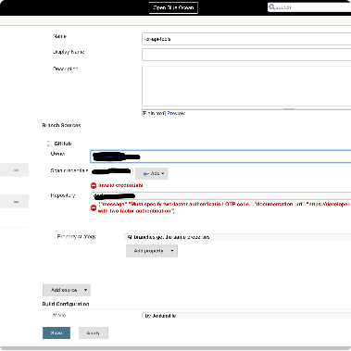
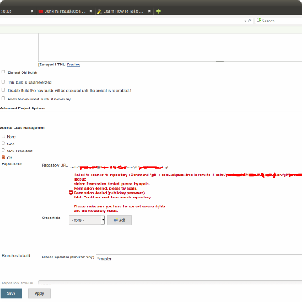
Best Practices for Using CLI with Jenkins
Using the Jenkins CLI comes with its own set of best practices that you should follow to ensure that everything runs smoothly. These include creating backups, using authentication, and using SSH to connect to the Jenkins server where possible.
Backups
Authentication
SSH Access
Regularly create backups of your Jenkins instance to protect your data.
Use authentication and encryption to secure your CLI communications.
Use SSH access to connect to your Jenkins instance where possible.

Slide 8

Conclusion and Q&A Session
The Jenkins CLI is a powerful tool that can save you time and make you more efficient. By mastering the CLI, you can automate job management, create and run pipelines, and more. Thank you for attending our presentation, now let's dive into some Q&A!

