Slide 1


Install Git on Ubuntu
Welcome to this tutorial on installing Git on Ubuntu. Whether you're an experienced developer or just starting with Git, this guide will help you get up and running in no time.
by charan jeet

Slide 2
Prerequisites
Ubuntu version
Terminal access
Internet connection
You'll need an Ubuntu machine running at least version 12.04 LTS.
You'll need a command line terminal to run Git commands.
You'll need an active internet connection to download and install Git.

Slide 3
Step-By-Step Installation Guide
Configure Git
Configure your name and email address by running the commands 'git config --global user.name "Your Name"' and 'git config --global user.email "youremail@example.com"'.
Install Git
Run the command 'sudo apt-get install git' to install Git on your Ubuntu machine.
1
2
3
4
Update system
Check installation
Using the terminal, run the command 'sudo apt-get update' to update the system package list.
Run the command 'git --version' to verify that Git has been installed successfully.

Slide 4


Verifying Git Installation and Version Check
Check Git Installation
Version Check
To verify that Git is installed on your system, run the command 'git' on the terminal.
To check what version of Git is installed on your system, run the command 'git --version' on the terminal.

Slide 5
Configuring Git After Installation
Set your name
Set your email
Show configuration
Run the command 'git config --global user.name "Your Name"' to set your name.
Run the command 'git config --global user.email "youremail@example.com"' to set your email.
Run the command 'git config --list' to see your current Git configuration.

Slide 6
Common Git Commands and Their Usage
1
git clone
Clone a repository into a new directory.
2
git add
Add file contents to the index.
3
git commit
Record changes to the repository.
4
git push
Update remote refs along with associated objects.

Slide 7
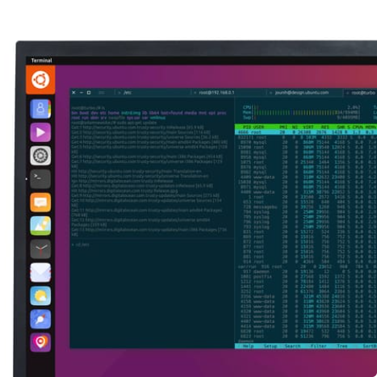

Conclusion
Get started with Git today!
Thanks for reading!
Now that you have successfully installed Git on Ubuntu, start using it to manage your projects and collaborate with others.
We hope this guide has been helpful. Happy coding!

