Slide 1


Install Git on Windows
Learn to install Git with ease. Git is a powerful tool that can help you manage your code and simplify collaborations with other developers. This guide will walk you through the steps to download and install Git on your Windows computer.
by charan jeet

Slide 2

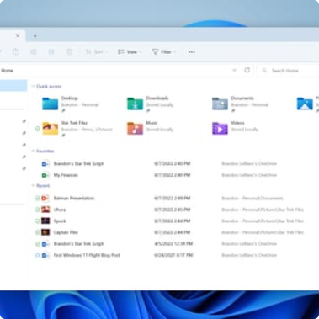
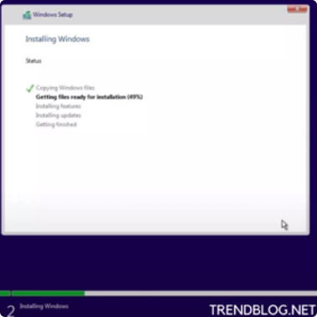
Download Git for Windows
Download the installer
Locate the download
Run the installer
Head to the official Git website and download the installer for Windows. Choose the 64-bit or 32-bit version depending on your system.
Once you have downloaded the Git installer, find it in your downloads folder or wherever you saved it on your computer.
Double-click on the Git installer to run it. You may need to allow it to make changes to your computer.

Slide 3
Choose Installation Options
Choose components
Set up PATH environment
Choose HTTPS transport backend
Select the components you want to install. The default options should work for most users. However, you can customize the installation to include only what you need.
Choose how you want Git to be added to your PATH environment variable. Select the recommended option, which adds Git to the system PATH.
Choose the HTTPS backend for Git. Select the recommended option, which uses the OpenSSL library.
Configure line ending conversions
Choose how you want Git to handle line endings. Select the recommended option, which converts Windows-style line endings to Unix-style line endings.

Slide 4
Configure Git
1
Set your username and email
Use the following commands to set your Git username and email: git config --global user.name "your-username" and git config --global user.email "your-email".
2
Set your default text editor
You can set your default text editor for Git with the following command: git config --global core.editor "your-editor".
3
Check your settings
You can check your Git settings anytime using the git config --list command.

Slide 5
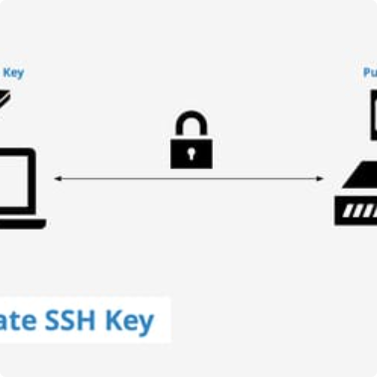
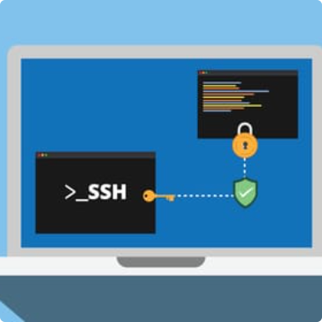

Set up SSH keys
Generate SSH keys
Add your public key to GitHub
Test your SSH connection
Use the following command to generate SSH keys: ssh-keygen -t ed25519 -C "your-email".
Copy your public key to the clipboard using the following command: clip < ~/.ssh/id_ed25519.pub. Go to your GitHub account settings and add your public SSH key.
Test your SSH connection with GitHub using the following command: ssh -T git@github.com. You should see a message that says "Hi username! You've successfully authenticated"

Slide 6

Test Git Installation
1
Open the Git Bash terminal
2
Type git --version
Click on "Git Bash" on your Windows Start menu to open Git's command-line interface.
This will check your Git version and make sure it is installed correctly.
3
Create a test repository
4
Add a file and commit changes
Use the following command to create a test repository: git init my-repo. This will create a new directory called "my-repo" with a hidden .git folder inside it.
Add a file to your test repository with the following command: echo "hello world" > my-repo/test.txt. Then commit your changes with the following commands: cd my-repo and git add test.txt and git commit -m "Initial commit".

Slide 7



Conclusion
You have successfully installed Git on your Windows computer! Now you can use Git to manage your code and collaborate with other developers.

