Slide 1


Installing Saltstack: Installation of Salt on Linux
Learn to install and configure Saltstack on Linux in this comprehensive guide.
ek
by Charanjit Singh

Slide 2
Introduction to Saltstack
Saltstack is a powerful automation tool used for provisioning and configuration management. Learn how it can help streamline your IT operations.
Remote Execution
Idempotency
Flexible Configuration
Run commands on multiple servers with ease.
Ensure servers are configured the way you want them, even if you run the same configuration multiple times.
Choose between declarative and imperative configuration management, or a hybrid approach.

Slide 3

Pre-requisites for Saltstack Installation
Before you can install Saltstack, you need to make sure you have the following:
1
Linux Server
2
Python
You'll need a server running Linux with root or sudo-level access.
Saltstack is written in Python, so you'll need a version of Python installed.
3
Internet Access
You'll need to be able to download the Saltstack installation package and any dependencies.

Slide 4

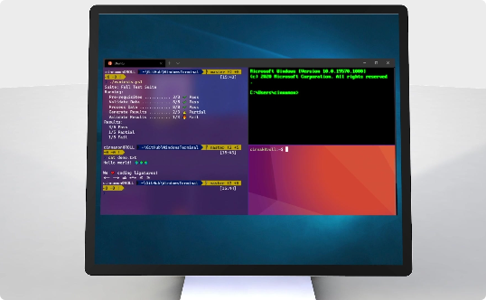

Downloading Saltstack Installation Package
Download the latest stable release of Saltstack on the official website or using your package manager.
Website
Package Manager
Progress Tracker
Download the installation instructions and package from the Saltstack website.
Use your package manager to download Saltstack and its dependencies.
The download typically takes a few seconds to complete and there's a progress bar to track it.

Slide 5
Installing Saltstack using Package Manager
Follow these steps to install Saltstack :
Install
Install the package by running a simple command in your terminal.
1
2
3
Find the Package
Verify the Installation
Use your package manager to locate the Saltstack package.
Ensure that Saltstack is up and running by executing a few commands.

Slide 6
Configuring Saltstack Master and Minion
Configuring Saltstack is a key step in using it. Learn how to configure the master and minion using YAML configuration files for optimal performance and security.
Master Configuration
Minion Configuration
Set up the master configuration file with the correct settings.
Configure the minion settings to allow for secure communication with the master.
Test Minion Connection
Set Target and Run Commands
Verify that the minion is correctly connected to the master.
Run commands on the minion by specifying the target and then the command.

Slide 7
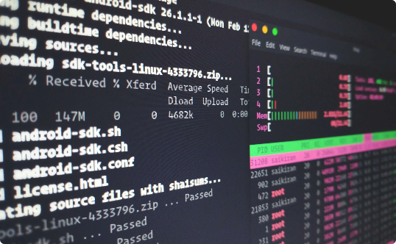

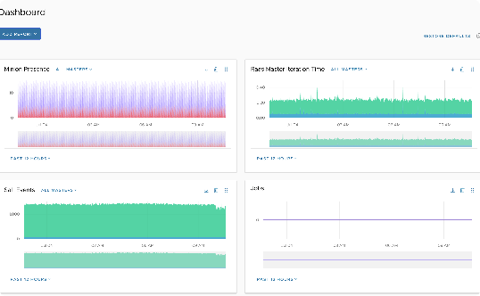
Running Salt Commands
Learn how to use Salt commands to perform a variety of system administration tasks.
Salt CLI
System Administration Tasks
Saltstack Web Interface
Use the Salt command line interface to run commands on multiple servers at once.
Complete tasks such as installing packages or updating the system.
The Salt dashboard provides a graphically visual way to manage your Salt infrastructure.

Slide 8



Conclusion and Tips for Troubleshooting Saltstack Installation
1
Conclusion
You've now learned how to install, configure and use Saltstack for system administration tasks.
2
Troubleshooting
If you experience errors, try restarting the Salt Master and Minion services and reviewing the log files.
3
Tips
Always check the configuration files for errors and use Salt pillars to store sensitive data.
Always Back Up Your Systems
Look Before You Leap
Ask for Help
Make sure to back up your systems correctly before running task automation routines.
Always assess the potential risk and be prepared for any possible challenges that may come along.
Never hesitate to seek help from a professional if you get stuck or need assistance.

