Slide 1


Introduction to Continuous Integration
Learn how continuous integration can help reduce errors, improve efficiency, and build better software. Discover the key concepts and tools needed to implement this practice successfully.
by charan jeet

Slide 2

What is Continuous Integration?
1
Integration
2
Automation
Continuous Integration is the practice of frequently and automatically integrating code changes into a shared repository. It ensures that changes made by multiple developers do not conflict with each other.
CI relies heavily on automation and automated tests to catch issues early in the development process. Code changes are constantly tested, built, and deployed to catch problems before they become bigger and costlier.
3
Collaboration
CI encourages collaboration among team members by providing fast feedback loops and transparency into code changes. It also promotes consistent coding practices and standards.

Slide 3

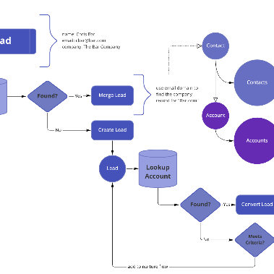

The Benefits of CI
Teamwork
Workflow
Quality
CI facilitates better collaboration between developers, testers, and operations, creating a better sense of team unity and shared responsibility.
CI streamlines the workflow between code development, testing, and deployment, making it faster and more efficient.
CI helps improve software quality by catching issues early in the development cycle, reducing the risk of bugs and defects in the final product.

Slide 4
How CI Works
Feedback
Build and test
CI provides immediate feedback to developers and identifies issues early in the development process, reducing the time and effort required to fix errors.
A CI server automatically pulls the code, builds it, and runs automated tests to detect issues.
1
2
3
4
Code changes
Deploy
Developers make changes to the code and push them to the source control repository.
If the tests pass, the new code is automatically deployed to production, making it available to users.

Slide 5
CI Tools and Frameworks
Jenkins
Travis CI
CircleCI
An open-source automation server that supports continuous integration and continuous delivery.
A cloud-based CI tool that integrates with GitHub and Bitbucket to provide automated testing and deployment for web and mobile apps.
A modern continuous integration and deployment platform with a focus on speed and scalability.

Slide 6


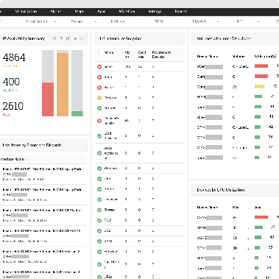
Best Practices of CI
Automation
Collaboration
Monitoring
Automate as many tasks as possible, including testing, building, and deployment.
Encourage open communication and collaboration among team members to foster a sense of shared ownership and responsibility.
Establish a monitoring system to track changes in performance and coverage, and to determine whether automated tests are successful.

Slide 7
Challenges of CI
1
Legacy code
Legacy code may not be designed for automated testing, making it challenging to integrate with CI.
Siloed teams
2
Teams that are not used to working together may not be as open to collaboration, making it harder to adopt CI practices.
3
Complexity
Large, complex systems can be challenging to integrate and test, requiring careful planning and execution.

Slide 8
Conclusion and Next Steps
Try it out
Continuous Improvement
Learn from the experts
Start by setting up a simple CI pipeline to build and test your code automatically.
Remember that CI is an ongoing process that requires continuous attention and improvement.
Seek advice from experienced developers and read up on best practices to learn how to optimize your CI pipeline.

