Slide 1
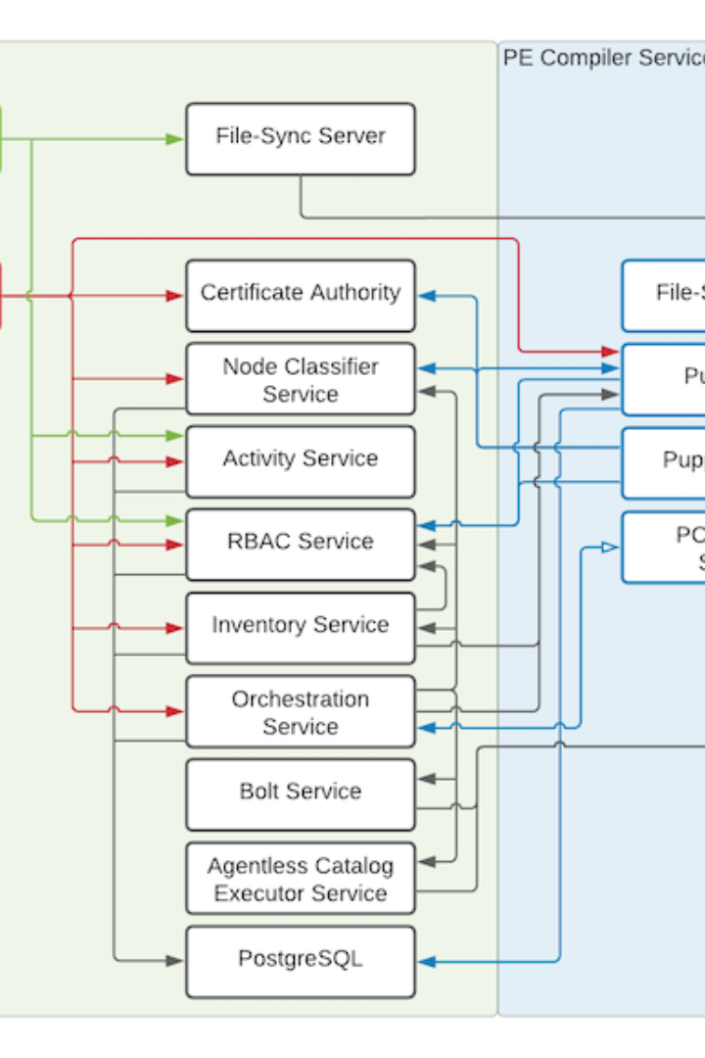
Introduction to PUPPET: Puppet Architecture
Discover how Puppet helps manage infrastructure as code, automating the delivery and operation of software. In this presentation, we'll explore Puppet architecture.
ek
by Charanjit Singh

Slide 2
Puppet Overview
Infrastructure as Code
Declarative Configuration Management
Open Source and Enterprise Versions
Puppet allows you to define infrastructure as code, so you can test, validate and deploy changes faster and with more confidence.
With Puppet, you declare the desired state of your infrastructure, and Puppet ensures that the current state matches it.
Both the open-source and enterprise versions of Puppet are available, depending on your organization's needs and resources.

Slide 3
Puppet Architecture
Master-Slave Architecture
The Puppet master stores all the configuration data and manifests used by each agent to ensure that each node is configured consistently.
1
2
3
Agents
Resource Abstraction Layer
All nodes that Puppet manages have an agent installed on them, which communicates with the master and applies the configuration.
Used by Puppet to interact with the system being managed, the Resource Abstraction Layer presents a set of abstractions so that Puppet can manage different operating systems and devices in a unified way.

Slide 4
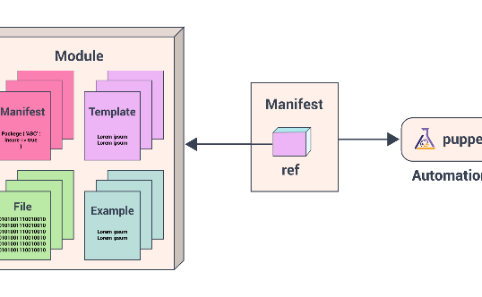
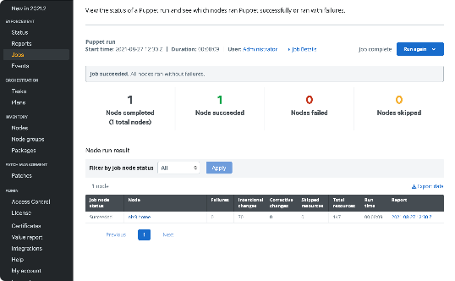
Puppet Modules
Module Structure
Puppet Forge
Testing Modules
A Puppet module is a collection of manifests, files, and other necessary components organized in a specific directory structure. This structure ensures that the module is portable, reusable and shareable.
Puppet modules can be downloaded from, and contributed to, a shared repository called the Puppet Forge, which makes it easier to share and reuse code and collaborate within the Puppet community.
Testing Puppet modules is standard practice, it helps you ensure that the modules you create work correctly and are error-free. Puppet provides testing and validation infrastructure to help ensure that modules work correctly.

Slide 5

Puppet Language - DSL
1
Declarative Language
2
Expressive Language
Puppet's Domain-Specific Language is declarative, allowing you to specify what you want to achieve without concerning yourself with how.
Puppet DSL is designed to be expressive and concise, making it easy to read and understand.
3
Resource Types
Resource type is the atomic element of Puppet's DSL. Puppet's DSL is flexible and allows you to create custom resource types as necessary.

Slide 6
Manifests - Building Block of Configuration
Resource Declaration
Allows you to declare a specific resource type and its attributes to manage the configuration of your infrastructure.
Classes
Classes group related resources into a single reusable unit. They simplify the definition and management of complex configurations.
Defined Types
Defined types allow you to create a resource type that represents a combination of other resource types. They can be shared within and across modules, and provide a way to model more complex configurations.

Slide 7
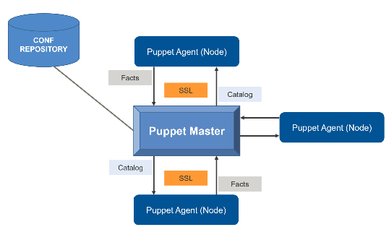
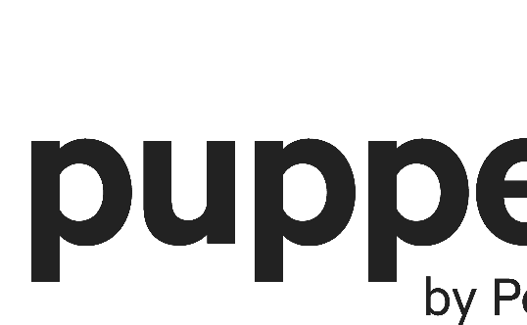
Master-Slave Architecture
Puppet Master Node
Puppet Agent Nodes
Puppet Certificates
The Puppet Master is responsible for compiling the configuration, delivering it to the agent nodes, and monitoring the infrastructure's state.
Agent nodes are responsible for applying the configuration sent from the master to ensure that the infrastructure is correctly configured according to the defined state.
With Puppet, communication between the master and the node is secure - trusted certificates secure all communication between them, ensuring that only authorized agents can request configuration from the master.

Slide 8
Resource Abstraction Layer
Extending Resources
The Resource Abstraction Layer is extensible, so you can create custom behaviors that don't exist in the base layer.
1
2
3
Abstracting Resources
Interactive Resources
The Resource Abstraction Layer abstracts the underlying operating system or APIs, allowing resources from different systems to appear the same.
Puppet's Resource Abstraction Layer also allows you to manage interactive resources such as file systems or services that are running on hosts.

