Slide 1
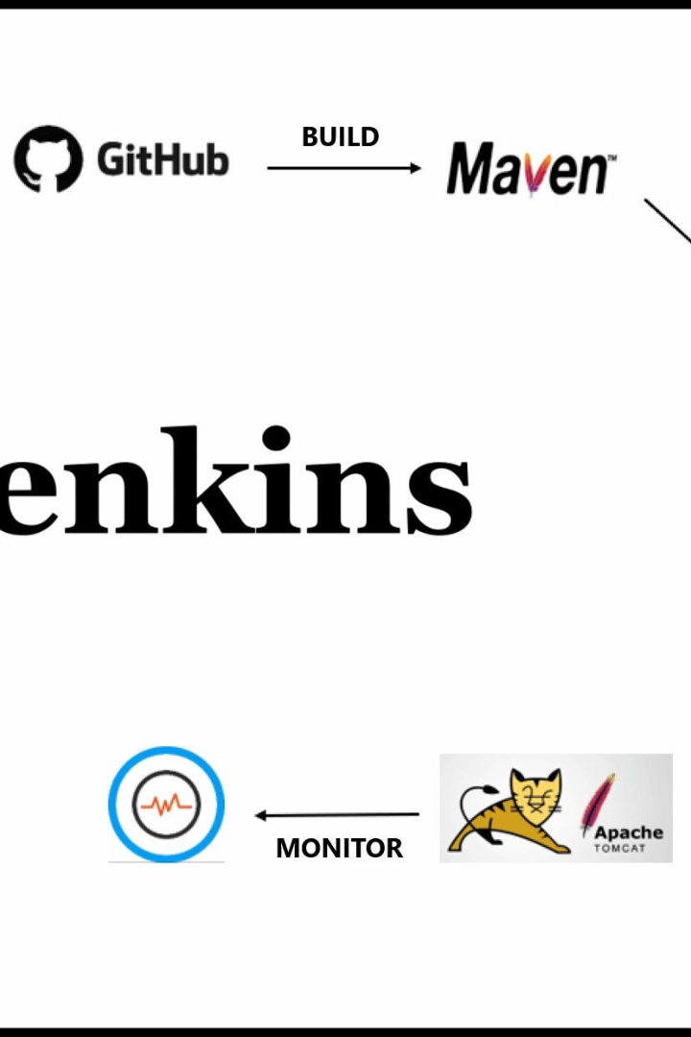

Managing Build Dependencies with Jenkins
Efficiently managing build dependencies is crucial for timely and effective software development. Learn how Jenkins can streamline the process.
by Charanjit Singh

Slide 2

What are Build Dependencies?
1
Definition
2
Types
3
Importance
Build dependencies are any software components that are required for an application to be successfully built and deployed.
There are two types of build dependencies: external dependencies, which are third-party libraries or frameworks, and internal dependencies, which are modules or packages that form part of the application.
Managing build dependencies is critical for avoiding conflicts between dependencies and ensuring that the application can be built and tested reliably.

Slide 3
The Benefits of Managing Build Dependencies
Reduced build times
Better documentation
Improved collaboration
By eliminating redundant builds across different modules, build times can reduce significantly, and boosting your development speed.
Organizing dependency information provides greater visibility into the project and can help with maintaining documentation.
Properly managing dependencies promotes greater teamwork and collaboration among developers.

Slide 4

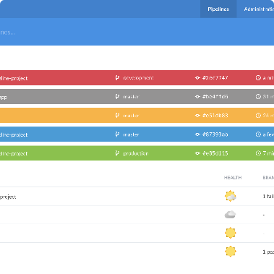
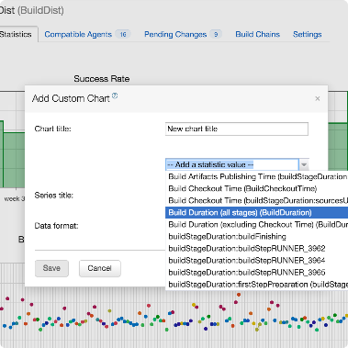
Jenkins Overview
CI/CD Pipeline
User Interface
History
Jenkins is an open-source automation platform that supports continuous integration and continuous deployment (CI/CD) practices.
The Jenkins user interface (UI) makes it easy to configure and automate software build and deployment pipelines.
Jenkins has a rich history in the CI/CD world, with strong community support and an extensive library of plugins and integrations.

Slide 5
Using Jenkins for Managing Build Dependencies
1
Version Control Integration
Jenkins enables integration with various version control systems, including Git, GitHub, and BitBucket, to manage project dependencies in a fast and efficient manner.
Continuous Integration and Deployment
2
Jenkins allows for automated build and deployment pipelines with pre-configured and customized build tasks and workflows, making it easier to manage project dependencies.
3
Testing and Validation Automation
With Jenkins, you can also integrate various testing tools and frameworks, ensuring a streamlined testing and validation process for all the project dependencies.

Slide 6
Best Practices for Jenkins Dependency Management
Use a Single Pipeline
Ensure Stable Builds
Use Robust Testing and Validation
Use a single pipeline to manage the interdependent builds. This ensures streamlined dependencies and provides greater visibility into the overall process.
The builds should always be maintained in a stable and validated state, with uncompromised quality.
Integrate testing frameworks to ensure that projects are rigorously tested throughout the build process. Always validate dependencies before deploying.
Follow a Consistent Release Process
Adopt a consistent release management process to ensure all dependencies are tested and officially released as part of the process.

Slide 7
Common Pitfalls of Dependency Management
No Clear Ownership
Dependency Conflicts
Outdated Dependencies
The lack of clear ownership can cause mismanagement and create confusion in dependencies, resulting in broken builds or security vulnerabilities.
Unresolved dependency conflicts can cause serious problems in the build process, making it critical to manage dependencies effectively.
Staying up-to-date with security releases and dependencies is essential for ensuring application security and preventing breaches.

Slide 8

Q&A and Discussion with Audience
Engage with our experts and peers on dependency management and Jenkins. Share your thoughts and experiences with the community.

