Slide 1


Mastering Master and Minion
A beginner's guide to configuring a Salt Master and Minion and running commands on a remote host securely. Learn how to streamline your system administration with Salt.
ek
By Charanjit Singh

Slide 2
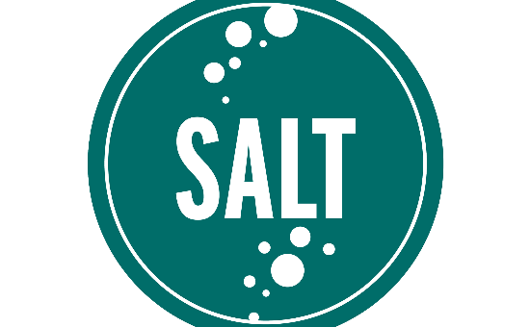
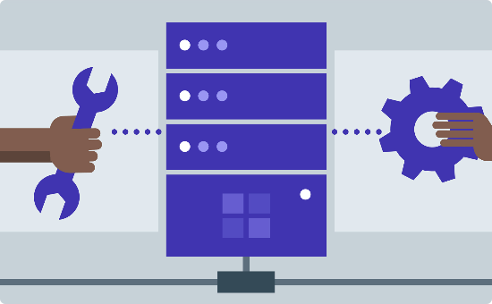

What is Salt?
Salt is a configuration management tool that automates tasks like provisioning, templates, and deployment to save time for system administrators.
Why Use Salt?
How Salt Works
Automating Schedules
Salt is more secure and much faster than traditional methods because it uses a custom protocol called ZeroMQ to manage communication.
Salt uses a client-server architecture. The client, called a minion, sends requests to the server, called a master, which then distributes instructions to all minions attached to the Salt network.
Salt can automate tasks that need to be run at a particular frequency, like backups or updates. Its scheduling system creates a predictable workflow by specifying when the task should run based on parameters like date, time, or event trigger.

Slide 3
Accepting Minion Keys
The first action taken with a new minion is its key must be accepted by the master. Attend to key management before running commands on a minion. You can accept the keys one at a time with a command in the Salt Master, or you can use Salt-Cloud which automatically deploy minion keys to the master when it starts.
Manual Acceptance
Automatic Acceptance
Revocation of Keys
Accept the minion key by entering the command: `sudo salt-key -a `
To automatically accept the minion key, edit the master configuration file: `auto_accept: True`
If a minion’s key is compromised, it can be revoked with: `sudo salt-key -d `

Slide 4
Running Commands on Minion
Use the `salt` command to pass basic Salt command and run various functions on the minion. You can distribute this command to a single minion or the minion network. Commands can be made or modified based on states, executions, or modules based on the particular needs of the environment or the task at hand.
Bulk Commands
Salt can execute the same command or script in all minions by entering the following command: `sudo salt '*' `
1
2
3
Single Command
Module Execution
Use the following command to execute a single command: `sudo salt `
To execute Salt modules, enter this command: `sudo salt . `

Slide 5
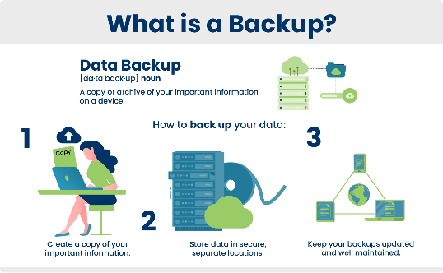


Examples of Commands to Run on Minion
Here are a few examples of how to utilize Salt for common system administration tasks:
Back Up Data
Unbricking the Laptop
Maintenance
Command: `sudo salt cmd.run ‘tar –cvf /home/backups/.tar.gz `
Command: `sudo salt cmd.run ‘rm /data/system/settings.db’`
Command: `sudo salt '*' cmd.run ‘yum -y update’`

Slide 6

Troubleshooting
These are some commonly encountered issues:
1
Key Not Accepted
2
Minions Not Responding
To solve this, check if any duplicates are connected to the Salt-Master or wait until the transmission completes. Logging may provide you with more details.
Ensure the minion is connected to the right network, firewall allows Salt traffic, and the keys accepted by the Salt Master.
3
Command Fails
Correct the minion’s IP address, command syntax errors, or missing modules.

Slide 7
Conclusion
Salt is an all-in-one automation solution for system administrators who want to streamline their workloads and minimize errors. Use this toolset to manage your system's configurations easily and efficiently, so your team can focus on more important, strategic tasks.
Learn More
Contact Us
Visit the Salt official website to discover more about Salt’s modules, products, plugins, and meet people from the community.
You can contact us for support and advice on how to integrate Salt into your workflow.

