Slide 1


Puppet Installation
Learn how to install and configure Puppet, an open-source configuration management tool designed to automate infrastructure tasks and improve efficiency.
ek
by Charanjit Singh

Slide 2

Overview of Puppet
1
What is Puppet?
2
Why use Puppet?
3
How does Puppet work?
Puppet is a configuration management tool that automates repetitive tasks, improves consistency, and streamlines infrastructure management.
Puppet allows for faster and more reliable deployment, provides a unified system for managing infrastructure, and reduces risk by enforcing policy compliance.
Puppet uses a master-agent architecture, where one server acts as the master and manages a group of clients, or agents, located on various nodes within the infrastructure.

Slide 3
System Requirements
Operating System:
Memory:
Puppet can be installed on a variety of operating systems, including Windows, Linux, and macOS.
A minimum of 4 GB of RAM is recommended.
Storage:
Network Connectivity:
A minimum of 10 GB of free hard drive space is recommended.
Puppet requires IP connectivity between the master and agent nodes.

Slide 4
Installing Puppet on Linux
Install Puppet
Install the puppet agent package.
1
2
3
Add Puppet Repository
Configure Puppet
Add the puppet repository to your system.
Edit the puppet configuration files to configure the puppet agent server.

Slide 5
Installing Puppet on Windows
1
Download Puppet Agent
Download the puppet agent msi package from the Puppet website.
2
Install Puppet Agent
Run the msi package to install Puppet Agent on Windows.
3
Configure Puppet
Edit the puppet configuration files to configure the puppet agent server.
4
Verify Installation
Verify the installation using the puppet agent command.

Slide 6
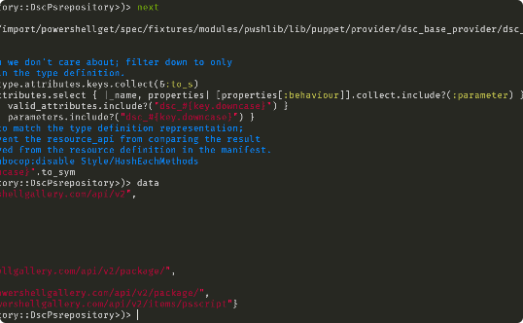
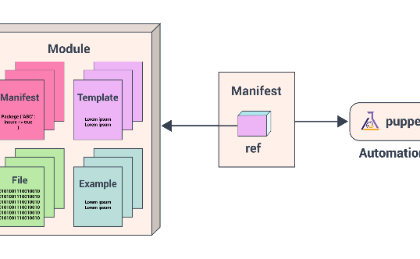

Configuring Puppet
Manifests
Modules
Facts
Manifests are files that describe the desired state of the infrastructure. Puppet uses these manifests to make configuration changes.
Modules are pre-built code that can be used to manage common tasks or applications.
Facts are details about the nodes in your environment, such as the operating system, hardware information, and IP addresses.

Slide 7
Verifying Puppet Installation
Check Puppet Agent Status
Run a Test Configuration
Check the Logs
Use the command line to check the status of the puppet agent.
Apply a small test configuration to verify that Puppet is functioning correctly.
Check the Puppet logs for errors or warnings.

Slide 8

Next Steps
1
Create a Manifest
2
Install Modules
Create a manifest to define the desired state of your system.
Find and install pre-built modules that can be used to manage common tasks.
3
Use Puppet Bolt
Use Puppet Bolt to run one-off commands or scripts across your infrastructure.

