Slide 1
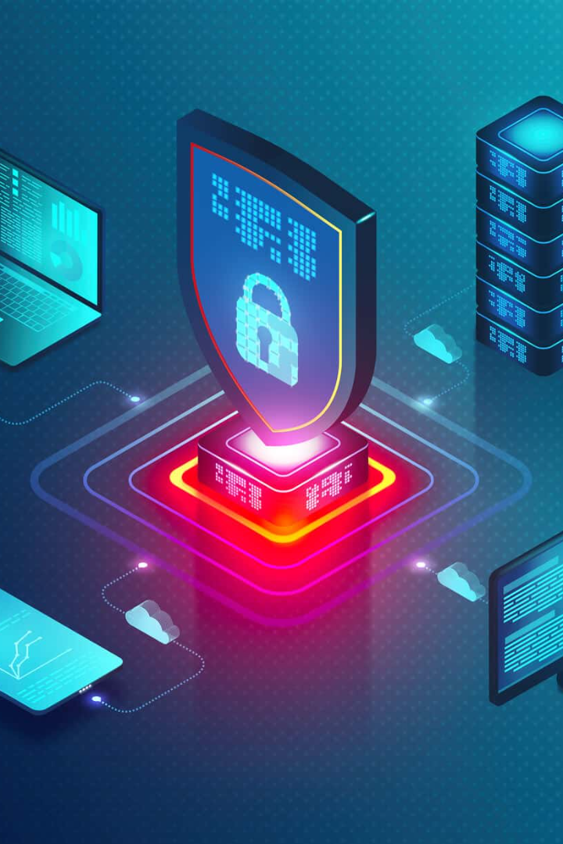
Security Aspects in the Build Process
As software development and deployment grow in complexity, protecting the build process has become a critical task. Here's what you need to know.
CS
by Charanjit Singh

Slide 2

Common Vulnerabilities in the Build Process
1
Outdated Dependencies 📦
2
Weak Access Control 🔑
Improper access control could result in an attacker being able to view or manipulate your build process, leading to critical data theft or system compromise.
Unpatched libraries can expose your build process to new and known vulnerabilities.
3
Misconfigured CI/CD 🚀
CI/CD configurations that fail to put security first can lead to easy exploitation of your build pipeline.

Slide 3
Technologies and Practices to Improve Build Process Security
DevSecOps
Secret Management
Static Analysis Tools
Integrating security into your DevOps process can help prevent vulnerabilities.
Use secret management solutions or store secrets offline to increase security.
Static analysis tools can identify and stop vulnerabilities at the earliest stage of the build process.

Slide 4
Impact of DevOps on Build Process Security
1
2
3
Traditional Approach
DevOps Approach
Future of Security
In the traditional model, security is a bolted-on feature, often leading to costly and time-consuming delays and rework.
In DevOps, security becomes a fundamental and integrated component of the development pipeline, leading to faster and more secure delivery.
DevOps is leading the way towards more secure software development, with continuous security integration and automation as key elements of modern build process security.

Slide 5
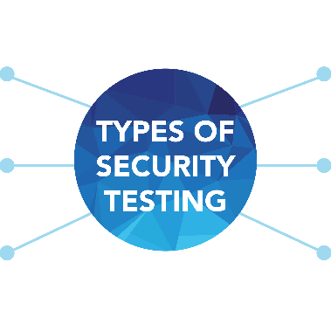
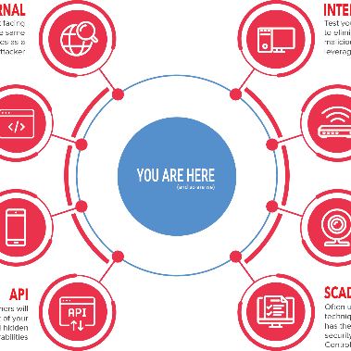

Integrating Security Testing into the Build Process
Security Unit Tests
Penetration Testing
Vulnerability Scanning
Security unit tests can detect security vulnerabilities early in the code.
Penetration testing simulates an attack on your application to identify vulnerabilities that may otherwise be overlooked.
Vulnerability scanning can discover vulnerabilities across your entire technology stack

Slide 6
Best Practices for Secure Build Process Management
Standardize Tools 🛠️
Monitor Activity 🕵️‍♂️
Automate Safely 🤖
Use consistent toolchains and ensure there is security-focused configuration across all instances.
Implement runtime monitoring to detect unauthorized activity and report abnormal behavior.
When automating steps within the build process, ensure a comprehensive security review has taken place first.
Enforce Access Control 💂
Ensure that only authenticated and authorized users can access the build system.

Slide 7
Conclusion and Key Takeaways
1
Build Process Security Is Critical
The build process is a prime target for attackers, and securing it can prevent serious damage to a company.
2
DevSecOps Is the Way Forward
Integrating security into DevOps workflows can improve security and lead to faster delivery.
3
Continuous Testing Is Essential
Continuous security testing allows teams to perform early intervention and remediation of vulnerabilities, reducing risk.

