Slide 1
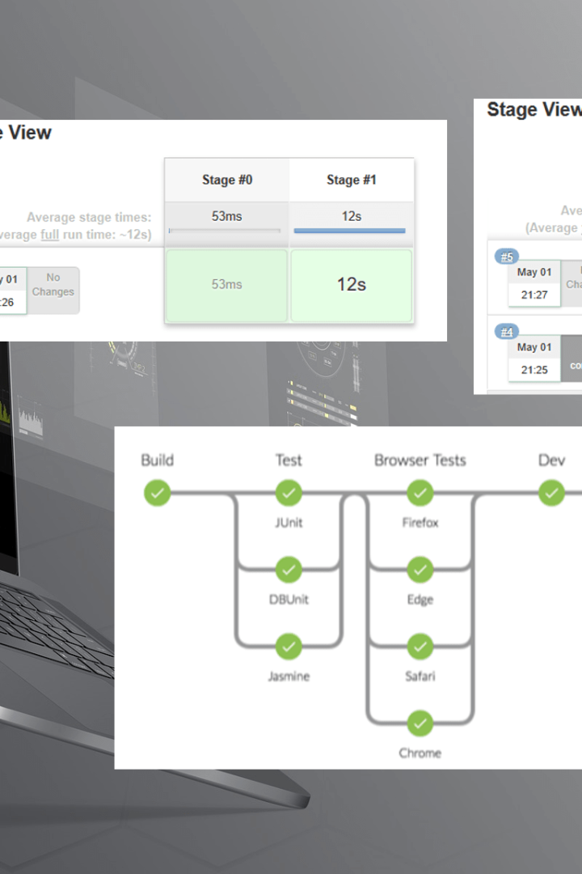
Setting up Delivery Pipelines in Jenkins
Learn how to set up and maintain delivery pipelines in Jenkins. Delivery pipelines help automate the software delivery process, from building to deployment.
CS
by Charanjit Singh

Slide 2

Introduction to Jenkins & Delivery Pipelines
Jenkins is an open-source automation tool that helps automate parts of the software delivery process. A delivery pipeline is a set of steps that code goes through to become a deployable artifact. Installing plugins and creating jobs can help automate this process.

Slide 3

Benefits of Using Delivery Pipelines
1
Increased Efficiency 🚀
2
Enhanced Quality 🔍
3
Reduced Costs 💸
Delivery pipelines integrate multiple tools and automate the acceptance testing process, leading to faster build times and reduced manual intervention.
Automating the pipeline allows for the creation of consistent builds, resulting in higher software quality.
Automation of tests and builds reduces errors and the amount of human intervention required, thereby reducing costs.

Slide 4
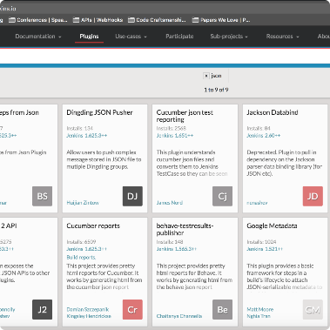
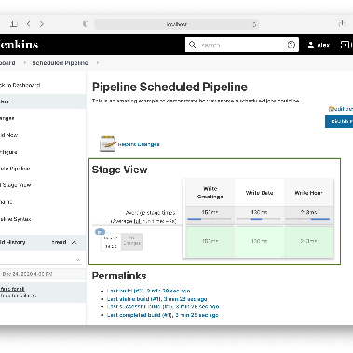
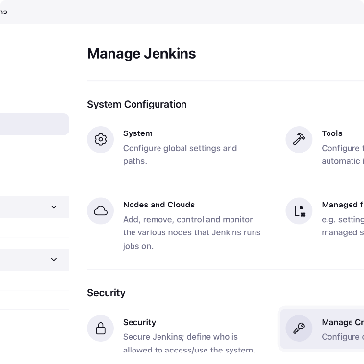
Setting up the Jenkins Environment
Installing Plugins
Creating Jobs
Adding Credentials
Install necessary plugins, including those for pipeline and testing.
Create a job for the pipeline, configure the SCM, and add appropriate credentials.
Add credentials for secure access to code repositories and deployment environments.

Slide 5
Creating a Simple Delivery Pipeline
Stage 1 - Checkout
Stage 2 - Build
Stage 3 - Deploy
The pipeline checks out the code and moves to the next stage.
The code is compiled, unit tests are run, and the artifact is archived.
The artifact is deployed to a test environment, and unit tests are run.

Slide 6
Adding Build Stages to the Pipeline
Artifact Repository
Deploy the artifact to an artifact repository like Nexus or Artifactory for versioning and organization.
1
2
3
Static Analysis
Integration Testing
Run static code analysis tools like Checkstyle or Sonarqube to detect faulty code.
Create a test environment and run integration tests on the artifact.

Slide 7
Integrating Testing into the Pipeline
Unit Testing 🧪
Integration Testing ✅
Acceptance Testing 🚀
Integrate unit tests into the pipeline to prevent errors early in the process.
Create a testing environment and run integration tests to ensure that individual components are functioning correctly.
Create an acceptance testing environment for end-to-end tests that ensure the full product is working correctly and can be deployed.
Load/Stress Testing ⚙️
Use tools like Gatling or JMeter to simulate traffic and ensure that the product can handle the expected load.

Slide 8
Best Practices for Maintaining Delivery Pipelines
1
Use Version Control 💾
Use version control for pipeline scripts and pipeline code. Store them in a repository like Git.
Monitor and Analyze 🔍
2
Monitor pipeline performance and analyze failures to improve the pipeline and fix problems quickly.
3
Regular Updates 🔄
Update the pipeline regularly to ensure compatibility with new versions of tools and changes in the code.

