Slide 1


The Final Artefact with Jenkins
Welcome to our presentation on Jenkins and how to use it with the Final Artefact in the software development process.
by Charanjit Singh

Slide 2
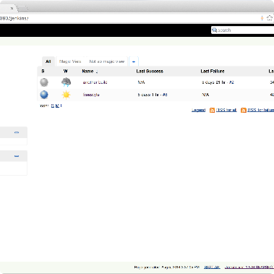
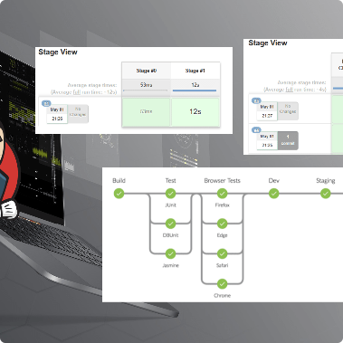
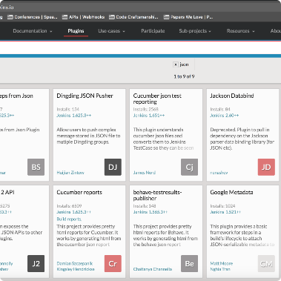
What is Jenkins?
Overview
Working Process
Plugin Integration
Jenkins is an open-source platform that helps automate software development processes and enables continuous integration and continuous delivery (CI/CD).
It works by automatically building, testing, and deploying code changes, providing immediate feedback in case of any issues.
Jenkins is also highly configurable and has an extensive range of plugins that can be used to customize it further for various software development requirements.

Slide 3
Setting Up the Jenkins Environment
Installation Guide
Configuring Jenkins
Security Measures
The installation process for Jenkins is straightforward, and various guides are available online based on your operating system.
Once installed, configure Jenkins to suit your project requirements, including adding plugins and setting up agents for remote deployment.
It's essential to set up proper security measures for your Jenkins environment, such as user authentication, role-based access control, and secure communication.

Slide 4
The Final Artefact
Benefits
Having the Final Artefact streamlines the software delivery process as it provides a single source of truth, eliminates manual errors, and simplifies audits.
1
2
3
Introduction
Usage
The Final Artefact is the complete and executable artifact that encompasses the source code, build artifacts, and deployment artifacts.
The Final Artefact is used repeatedly throughout the software development process, from local builds, to shared testing environments, to release production.

Slide 5
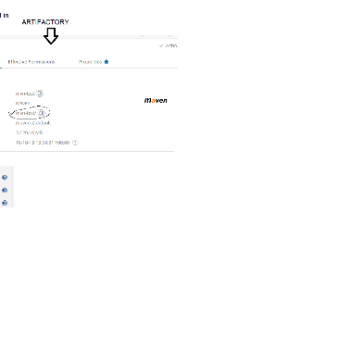

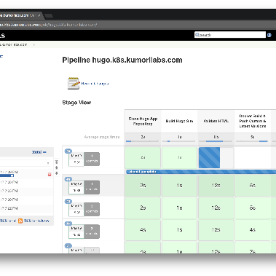
Jenkins Integration with the Final Artefact
Build Artifacts
Artifact Storage
Artifact Deployment
Jenkins can build, test, package and deploy the Final Artefact through its extensive pipeline and plugin integration.
Jenkins can store the Final Artefact safely and securely and keep track of its versioning, making it highly accessible and improvable.
Jenkins can also handle the deployment of the Final Artefact to the different environments, ensuring a smooth delivery process.

Slide 6

Benefits of using Jenkins
1
Streamlined Development Process
2
Continual Feedback
Jenkins provides real-time feedback and notifications on code errors and anomalies, facilitating swift issue resolution.
Jenkins automates the software development process, minimizing errors, boosting reliability and efficiency.
3
Flexibility and Customization
Jenkins can be tailored to meet specific project requirements, making it highly adaptable to changing development needs.

Slide 7
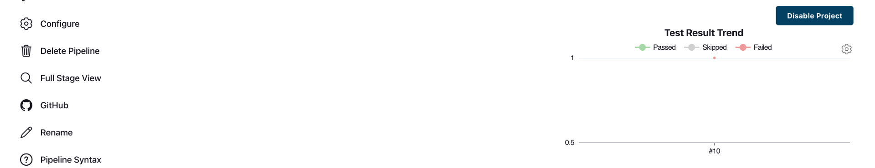
Demo of Jenkins Integration with the Final Artefact
Let's take a look at how Jenkins integrates with the Final Artefact, streamlining our software development process for better and faster results.

Slide 8
Conclusion
Final Artefact Benefits
Jenkins Advantages
Single source of truth
Continuous feedback on code changes
Automated error-free builds
Integration with various plugins and tools
Improved auditing
Flexibility and customizability
In conclusion, Jenkins is a powerful tool that can significantly enhance the software development process, and its integration with the Final Artefact streamlines software delivery while providing valuable benefits to developers and businesses alike.

