Slide 1
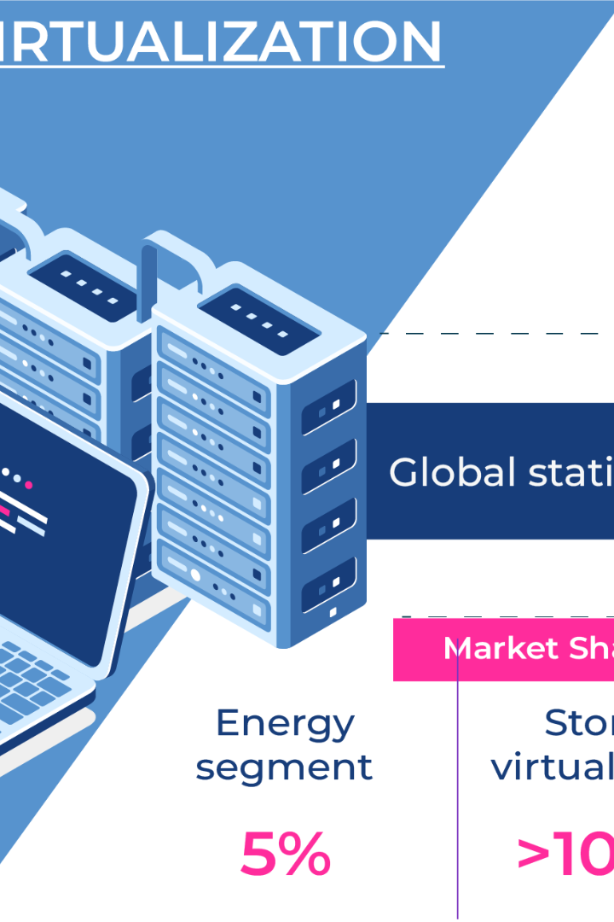
Virtualization: Empowering Your Infrastructure
Dive into the world of virtualization, learn its advantages, and discover the different types of virtualization.
CS
by Charanjit Singh

Slide 2
Efficient Resource Management with Virtualization
Optimal Use of Resources
Reduced Energy Consumption
Flexibility and Scalability
Virtualization helps to utilize hardware resources efficiently, cutting down on underutilization and hardware costs.
Virtualization lets you change the size of resources allocated to a VM dynamically, without disrupting the guest operating system.
With server consolidation, the need for fewer servers leads to reduced energy consumption in the data center.
Increased Reliability
Fault isolation and high availability significantly improve your infrastructure's reliability to minimize downtime.

Slide 3
The Different Types of Virtualization
1
Full Virtualization
This type of virtualization allows multiple guest operating systems to run on a single host operating system without any modification of the guest OS.
2
Emulation Virtualization
The host systems emulate hardware to operate the guest OS. It is slower than full virtualization due to the hardware emulation process.
3
Paravirtualization
Paravirtualization requires modifications to both the guest and host operating systems for communication to take place through a hypervisor.
4
Operating System-Level Virtualization
Operating System-Level Virt allows for multiple virtualized OS instances to run on the same host operating system, typically sharing the same kernel.

Slide 4
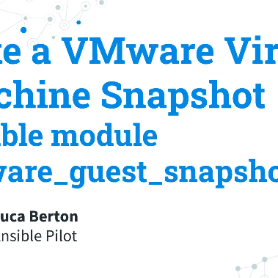
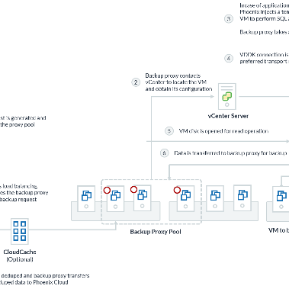
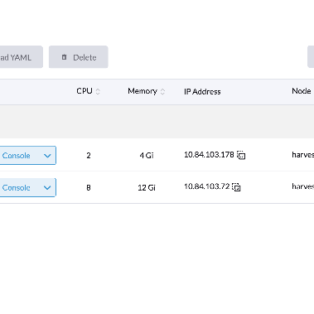
Take Control of Your Virtualized Infrastructure
Virtual Machine Snapshots
Virtual Machine Backup
Virtual Machine Live Migration
Create snapshots of your VM at a specific point in time and save them for later use, making it easy to revert to a previous state in case of problems.
Back up your VMs to avoid the loss of critical data to ensure business continuity even in the wake of hardware failures.
Move your VM to another host with live migration without stopping the guest OS, decreasing downtime and improving reliability.

Slide 5
VMM: Your Gateway to Virtualization
Virtual Machine Manager (VMM) is a powerful tool that lets you configure, deploy, and manage VMs on your infrastructure.
Easily Manage Hyper-V Environments
Customizable Templates
Centralized Management
VMM offers templates that you can customize for maximum automation and leverage for all your VMs.
With VMM, you can see all the VMs deployed in your infrastructure, and manage individually or all at once.
Use VMM to manage all Hyper-V tasks, from creation and migration to Virtual Fibre Channel and more in a single console.

Slide 6

The Importance of Hypervisors
1
Intermediary Layer
2
Allocating Resources
The Hypervisor is the intermediary layer between the hardware and virtualization software and is responsible for managing virtual machines.
With the help of a Hypervisor, you can allocate resources such as memory, disk I/O, and CPU usage to a VM on the fly without any interruption.
3
Maximize Hardware Utilization
The flexibility of hypervisor maximizes hardware utilization, providing significant cost savings for your organization.

Slide 7



Conclusion
Virtualization helps to simplify IT infrastructure by optimizing resource utilization, reducing energy consumption, and providing flexibility and scalability to the enterprise.

