Slide 1
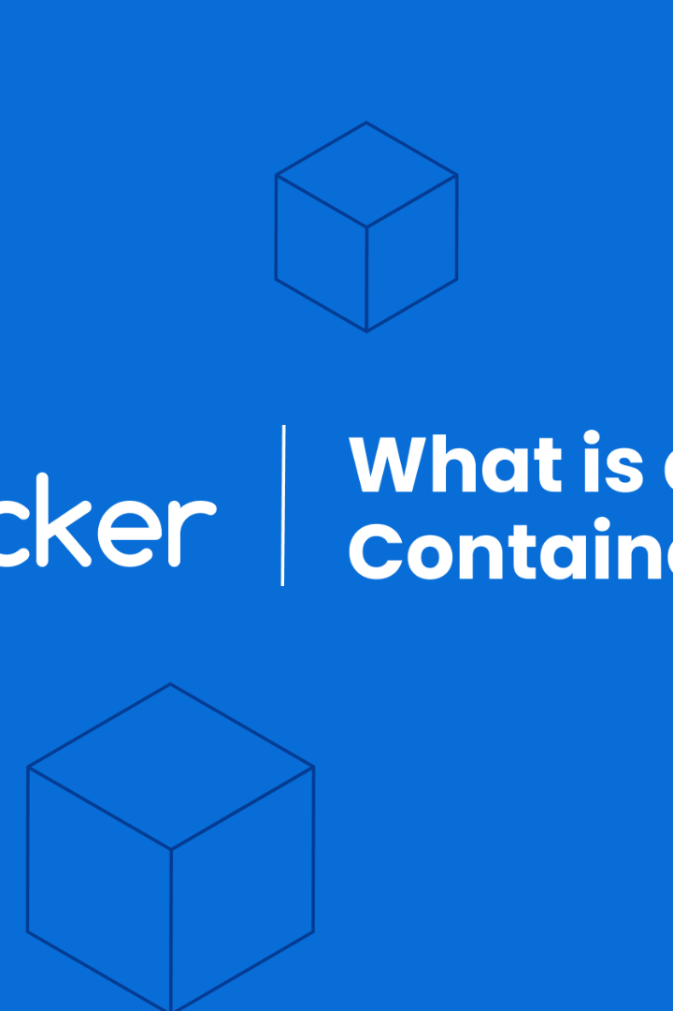

Working with Docker Toolbox & Kitematic
Welcome to our presentation on Docker Toolbox and Kitematic. We'll cover installation, basic commands, containerization, and demos. Get ready to boost your development workflow.
ek
by Charanjit Singh

Slide 2
Docker Toolbox 101
What is Docker Toolbox?
Installation & Setup
Basic Docker Commands
It's an easy-to-use installer package that installs Docker on Mac and Windows.
Download and install the Docker Toolbox, create a VM and run 'docker run hello-world' command to verify the installation.
Use 'docker ps', 'docker images', and other commands to manage your containers and images.

Slide 3
Building Images with Dockerfiles
1
Dockerfile
Build an image using Dockerfile, which contains instructions for the build process.
2
Building Images
Use the 'docker build' command to build images with Dockerfiles.
3
Managing Images
Use 'docker images', 'docker tag', and 'docker push' commands to manage your images.

Slide 4
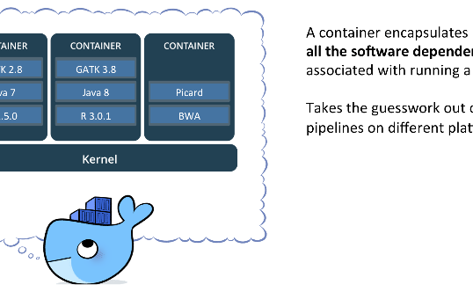
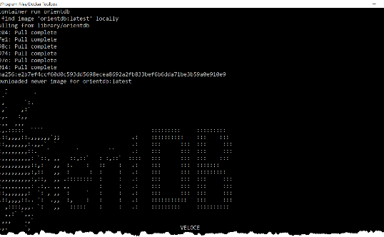
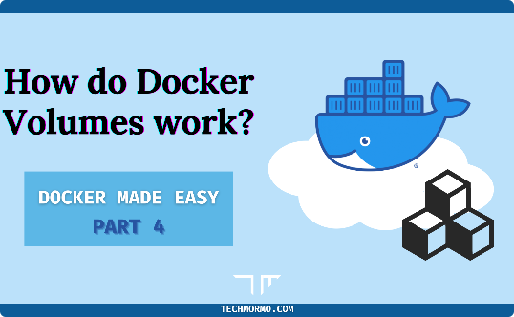
Working with Containers
Containerization
Container Operations
Volumes
A container is an isolated environment that runs your application with everything it needs, without interfering with your system environment or other containers.
Use 'docker run', 'docker stop', and other commands to manage your containers.
Volumes provide persistent data storage for containers and allow sharing data between containers.

Slide 5
Kitematic: A GUI for Docker Management
1
Introduction
Kitematic is a user-friendly GUI for Docker that simplifies command-line operations.
Key Features
2
It offers an easier Docker experience with a web UI, one-click install of images and containers, and easier management.
3
Demo
Now let's dive into a demo to show how Kitematic works and simplifies complex Docker tasks.

Slide 6

Application Deployment with Docker
1
Benefits
2
Workflow
Use containers to deploy applications quickly and easily with an increased degree of flexibility, scalability, and portability.
Developers can create Dockerfiles, testers can simulate environments with Docker, and DevOps can use Docker to deploy the app to the cloud or on-premises.

Slide 7
Conclusion: Docker and the Future
Advantages
Uses
Portability
DevOps Automation
Scalability
Microservices and Monoliths
Isolation & Security
Cloud-native App Development

Slide 8
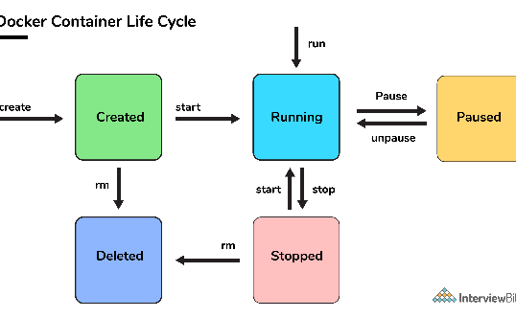
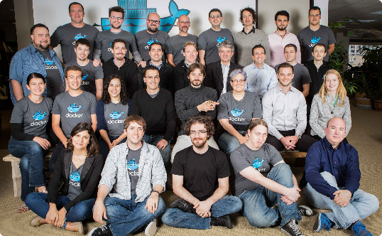
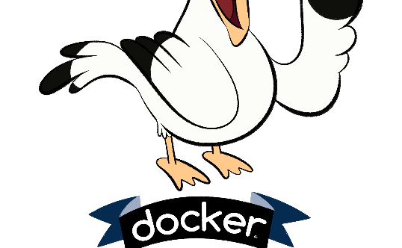
Q&A
Ask us Anything
The Docker Team
Join the Community
Got a question about Docker? We're happy to help!
Meet our team of Docker experts and learn more about our work.
Connect with other Docker enthusiasts and stay up to date on the latest developments in the Docker ecosystem.

