Slide 1
TechBuddy.
Rohan Vasudev Ginde-(002646835)
Kruthi Shankar Hegde-(002618976)
Sheetal Pujari-(002619620)
Rajavi Shah-(002727823)

Slide 2
Why TechBuddy?
A social media platform that caters specifically for Developers who want to learn, explore, connect and grow with other techies!

Slide 3
Main Features
Blog - Developers can write blogs
Challenges- Developers can challenge other developers and solve the challenges as well!
Analytics- Statistics related to Developer Activity
Future Scope : Solve quiz and upgrade developer level!

Slide 4
Blog feature @TechBuddy
Question: What you can do as developer on TechBuddy
Answer: You can add post, comment , reply , like posts!!!

Slide 5
Challenges Feature @TechBuddy
Question: What is the challenge feature about?????
Answer: You can add a challenge of your own and wait till other developers solve it for you!

Slide 6
Analytics feature @techbuddy
Question: Can TechBuddy help me know how popular I am ?
Answer: Yes! Analytics feature is meant to provide statistical and performance data. It also allows you to understand how popular your posts are on the website!

Slide 7










Tech stack used?

Slide 8
Screenshots

Slide 9
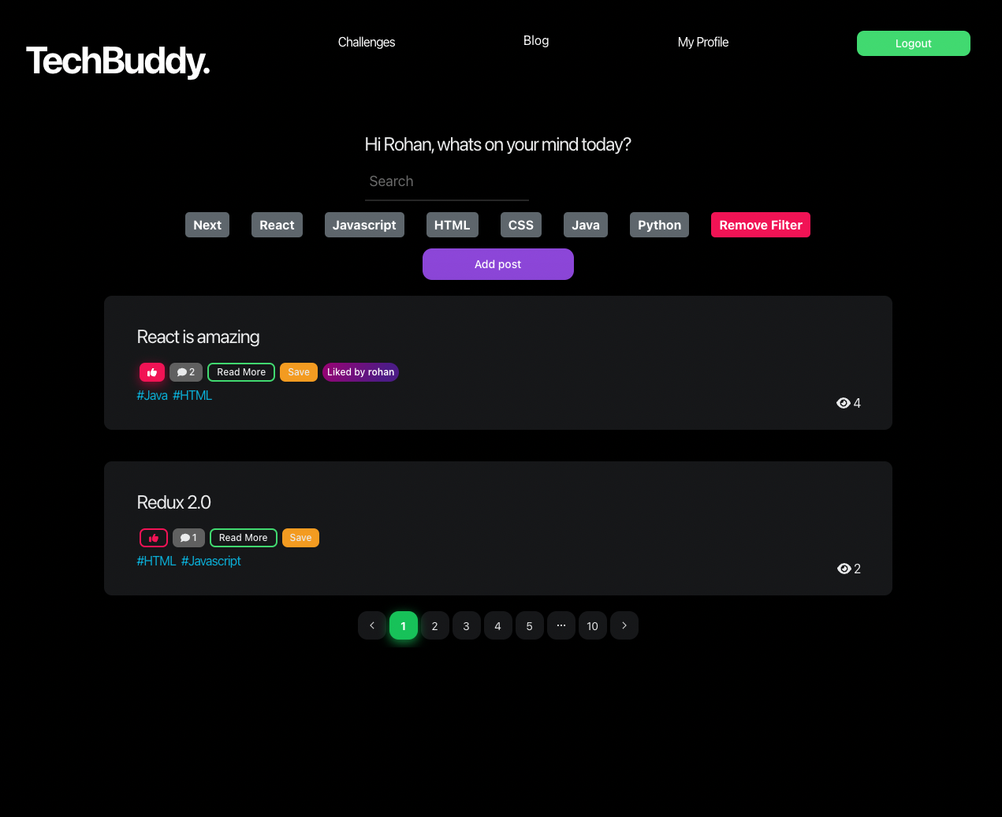
Blog

Slide 10
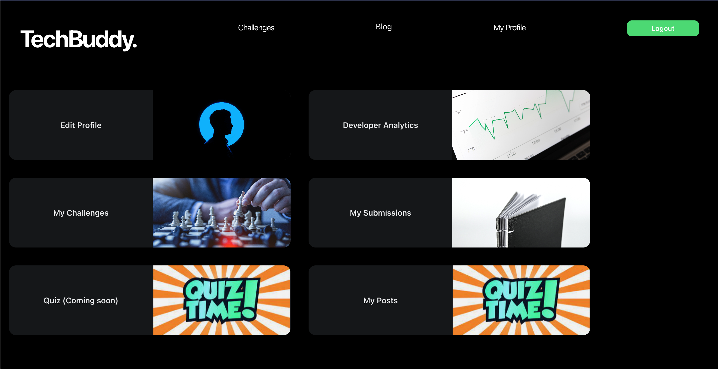
My Profile

Slide 11
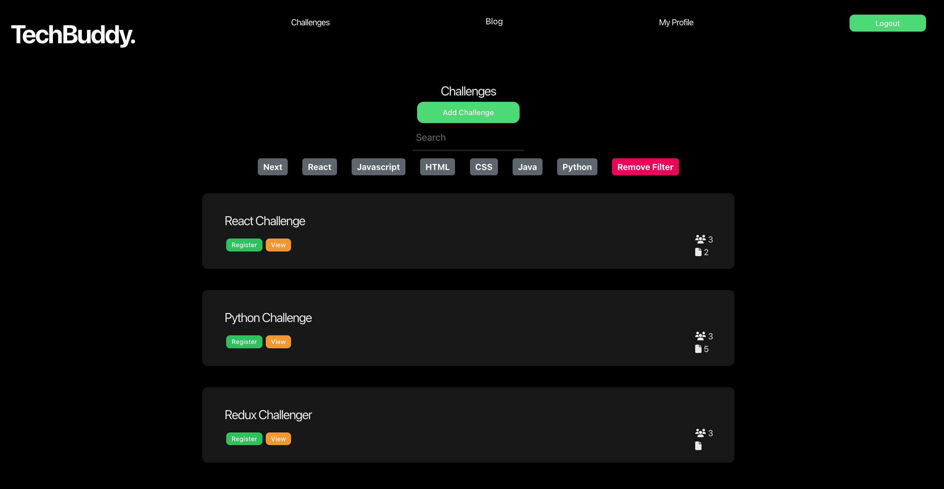
Challenges

Slide 12
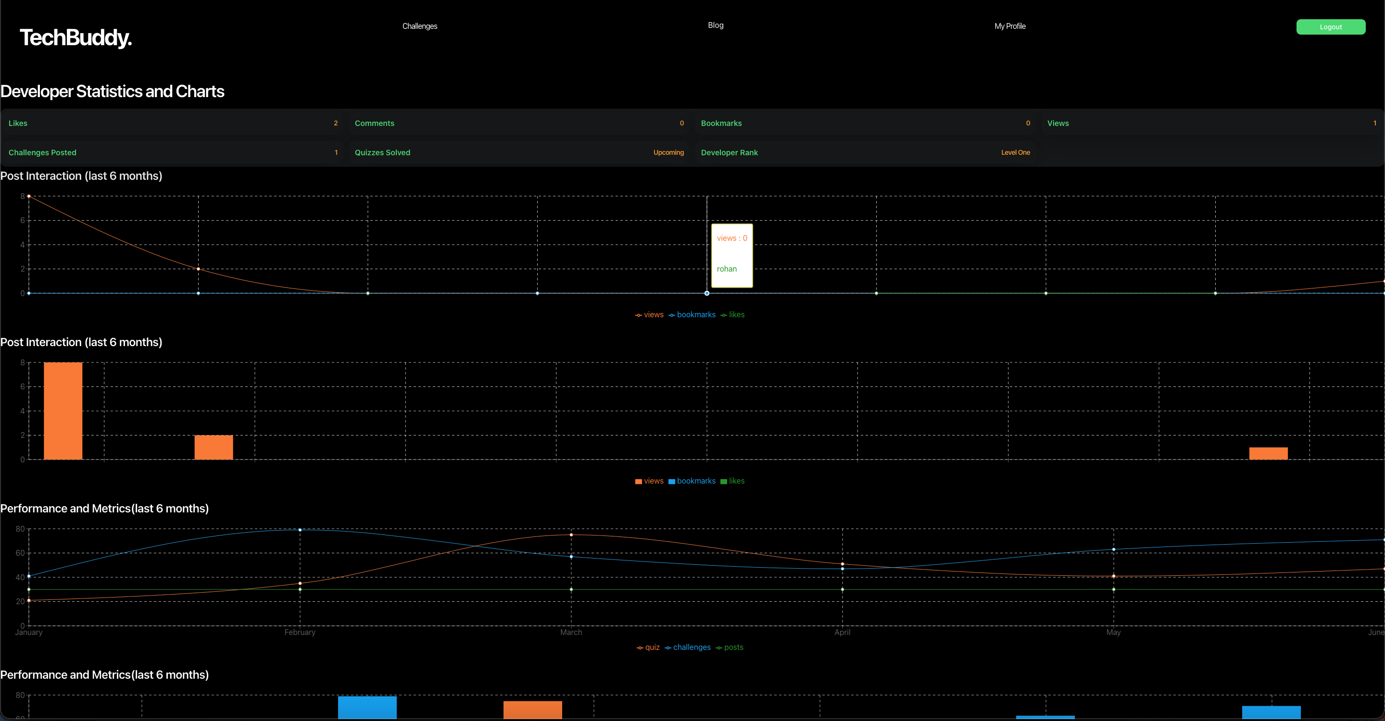
Developer Analytics

Slide 13
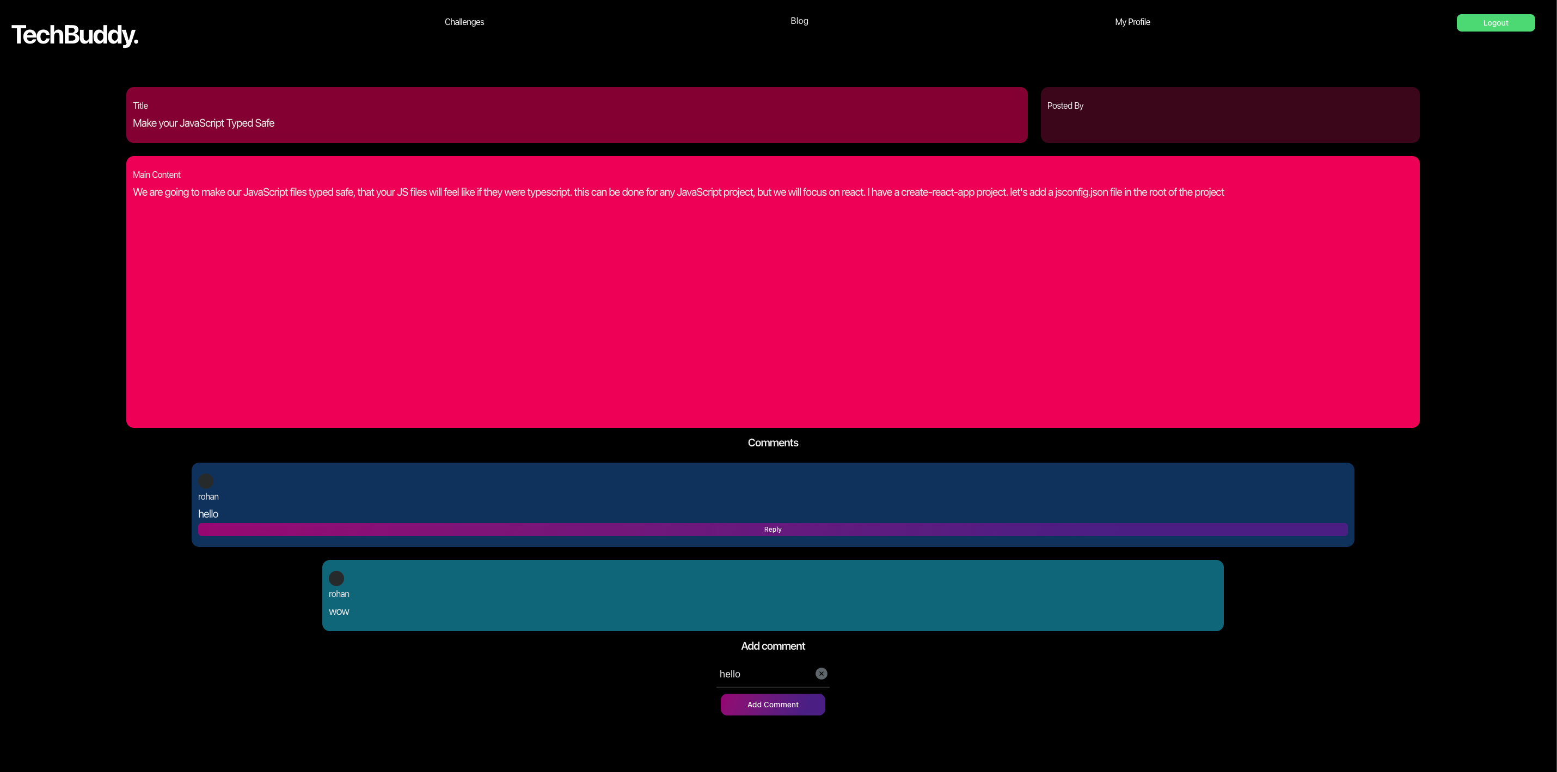
Inside Post and Comment feature

