Slide 1
USER INTEREST ANALYSIS IN TWITTER
BY
Pirasad T
Rajendra Kumar VM

Slide 2
Problem domain
To identify the user interest we try to categorize Tweets of a user based on the domain i.e sports,politics,movies,literature etc..
Tweets are basically short messages with max size of 140 characters.
Twitter is one of the most popular microblogging service where user can send and read short character messages called tweets
Twitter has raw data which has to be classified for better understanding.

Slide 3
Solution
We use Twitter API for extracting tweets of specific user using OAuth authorization. The API returns a JSON object as its response.
We have to train the data set which generally involves the text pre processing and profile binding
Interest analyzer process the tweets using SVM classifier and from which the word cloud can be generated

Slide 4
Twitter API
We can get various user information such as tweets, friends list and followers list.
A user’s Tweets can be retrieved using both the REST and the Streaming API.
Any application which needs to access the tweets of a user must first create a sample application for which secret token is provided, which can be further used for accessing the tweets.

Slide 5
Training set
To summarise the info about the list of tweets in data frame
Data frame consists of favorite count,time created,retweet count
From this we get the text field only along with the URL
Data matrix generation

Slide 6
Pseudo code
matrix <- create_matrix(total[,1], language="english",
removeStopwords=T, removeNumbers=T,stemWords=T, toLower=T,
removePunctuation=T, removeSparseTerms=0.998)
mat <- as.matrix(matrix)
interestedArea <- function(user_name) {
result_table <- get_result_table(user_name)
list <- result_table[c(1,2,3,4,5),]
list <- list[,1]
as.data.frame(list)
}

Slide 7
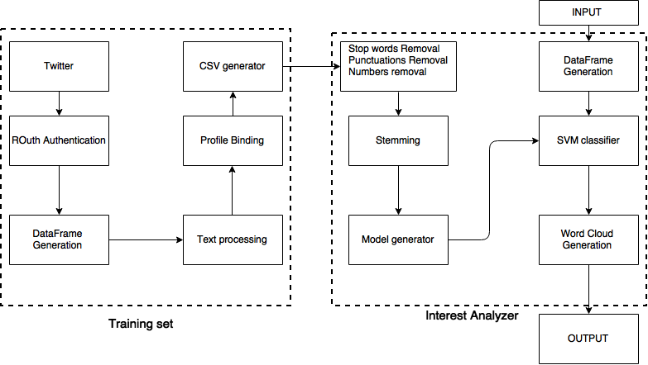
Block diagram

Slide 8
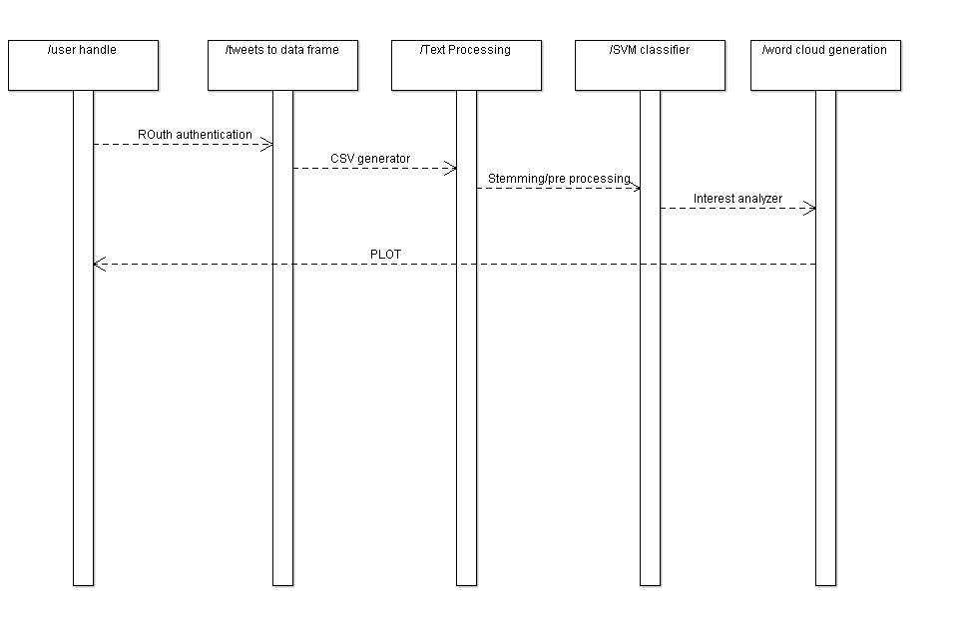
Sequence diagram

Slide 9
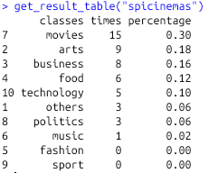
Output

Slide 10
Svm classifier
In machine learning, support vector machines are supervised learning models with associated learning algorithms that analyze data and recognize patterns, used for classification and regression analysis.
It is used to train the data set and map them to a particular category in which the tweets fall upon.

Slide 11
Tweet processing
Stop word removal – in this process we remove the question words i.e which,what,when,where etc.. And also the,is,at,on
Number removal is used to remove the numbers from tweet
Stemming-it is the process done to get root words
Ex : if cooking is used in a word,then it is processed to get cook
Removal of ing,ly etc..

Slide 12
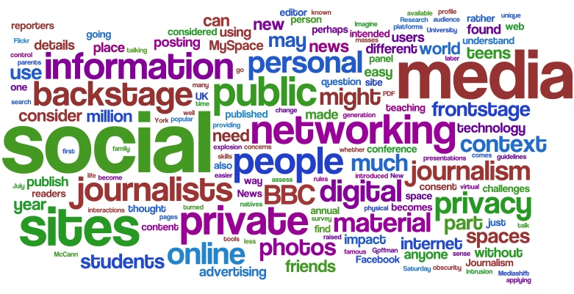
Word cloud
It is an image composed of words used in a particular text or subject, in which the size of each word indicates its frequency or importance.
Thus the tweets processed is mapped on to word cloud based upon the frequencies of words used by the user

Slide 13
Conclusion
With the help of our project one can categorize Twitter-user whether he/she is talking about movies or politics and can find the personalities often mentioned in the tweets.
After categorizing the tweets we try to plot the categorized domains in form of pie chart
Each user can be given a pie chart and the domain with highest tweets can be termed as the interest of user in twitter

Slide 14
Reference Papers
Inferring User Interests in the Twitter Social Network Parantapa Bhattacharya IIT Kharagpur, India ,MPI-SWS, Germany,Muhammad Bilal Zafar,MPI-SWS, Germany,Niloy Ganguly,IIT Kharagpur, India RecSys’14, October 6–10, 2014, Foster City, Silicon Valley, CA, USA.
Discovering Users’ Topics of Interest on Twitter: A First Look, Matthew Michelson and Sofus A. Macskassy, AND’10, October 26, 2010, Toronto, Ontario, Canada.

