Slide 1
A Hybrid GA + Q-Learning Framework
for Battery-Constrained Drone Routing in WRSNs
D. Raja Yadidiah Dakey
CS5100 Foundations of AI · Northeastern University
Extension of B.Tech FYP — NIT Trichy
🧬 Genetic Algorithm
🤖 Q-Learning / DQL
🚁 WRSN Drone Routing
The Hybrid Offline-Online Architecture that beats individual approaches by up to 61%

Slide 2
Agenda
What we'll cover today
01
Problem Statement
Why this is hard & why it matters
02
Two-Layer Architecture
The big picture — offline + online
03
Layer 1: Genetic Algorithm
Route planning, fitness function, improvements
04
Layer 2: Q-Learning
Disruption recovery, MDP, reward shaping
05
Double Q-Learning
Fixing overestimation bias
06
Experiments & Results
5 test cases, 5 algorithms compared
07
Key Takeaways
What the results mean
CS5100 Foundations of AI | D. Raja Yadidiah Dakey | Northeastern University
2/24

Slide 3
Problem Statement
What are we trying to solve?
The Scenario
⚠️ Two Hard Sub-Problems
▶ A drone must visit & recharge N sensor nodes ▶ Each sensor has limited battery (re < 50% needs help) ▶ Sensors have different urgency levels (dl) and drain rates (ecr) ▶ 5 fixed charging stations on the 200m × 200m field ▶ Drone starts each mission at 80% battery ▶ 57% of steps: at least one random disruption fires
▶ NP-Hard routing: N! possible orderings (3×10⁶⁴ for N=50) ▶ Online recovery: disruptions at every step, unpredictable ▶ Neither can be solved independently — need BOTH
🎲 4 Random Disruptions per Step
💨 Wind Drain
20% chance → lose 5–18% battery
⛽ Charger Blocked
30% chance → nearest station full
🆘 Urgent Request
15% chance → forced detour
⚡ Battery Spike
10% chance → lose 8–20% suddenly
CS5100 Foundations of AI | D. Raja Yadidiah Dakey | Northeastern University
3/24

Slide 4
Two-Layer Hybrid Architecture
Offline planning + Online adaptation
LAYER 1 — Genetic Algorithm (Offline)
LAYER 2 — Q-Learning (Online)
⏱ Runs BEFORE the drone takes off
🚁 Runs DURING the drone's flight
🧬 Evolves 150 routes over 300–500 generations
🤖 Trained for 500 episodes on random disruptions
🎯 Optimises: Distance + Waiting Time + Deadlines
📊 State: (SOC bucket, nearest charger, nodes left)
→
🏆 Tournament selection (k=5) replaces roulette wheel
⚡ Actions: Continue / Quick Charge / Full Recharge
Best Route
🔀 Ordered crossover preserves valid permutations
🎯 3-tier severity: Critical / Moderate / Mild
📉 Adaptive mutation: 2%→0.3% over generations
📉 Epsilon & learning rate decay over training
✂️ 2-opt local search removes all route crossings
🎲 Double Q-Learning removes overestimation bias
🔑 Key Insight: Layer 1 alone → can't handle disruptions (0% recovery rate). Layer 2 alone → bad route wastes time. Together → best of both worlds.
CS5100 Foundations of AI | D. Raja Yadidiah Dakey | Northeastern University
4/24

Slide 5
Fitness Function — The Core Innovation
What makes this order-dependent (the critical fix)
F(π) = D(π) + 0.3 × T_wait(π) + 0.5 × T_overtime(π) + 0.1 × F_balance(π)
D(π)
T_wait(π)
T_overtime(π)
F_balance(π)
Total Route Distance
Cumulative Waiting Time ⭐
Deadline Violations
Fairness Deviation
Sum of Euclidean distances between consecutive nodes in the route. Shorter path = less battery wasted on travel.
Time each sensor waits = arrival time + charge time. ARRIVAL TIME depends on route order → every node visited before it adds to the wait.
If a sensor waits longer than its tolerable deadline (dl×10+20 sec), the excess is penalised. Deadline = priority × 10 + 20 seconds.
Measures how evenly the drone serves sensors relative to their urgency weight w = ecr/re. Prevents ignoring some sensors while over-serving others.
weight = 1.0 (implicit)
weight = 0.3 (moderate)
weight = 0.5 (HIGHEST — hard constraint)
weight = 0.1 (regularizer)
⭐ KEY FIX over original FYP: Old fitness terms were CONSTANT regardless of visit order → GA could only optimise distance. Now T_wait and T_overtime depend on position in route → GA meaningfully optimises ALL four objectives simultaneously.
CS5100 Foundations of AI | D. Raja Yadidiah Dakey | Northeastern University
5/24

Slide 6
Genetic Algorithm — Improved Operators
How routes evolve across 300–500 generations
1️⃣ Tournament Selection (replaces roulette)
2️⃣ Adaptive Mutation Rate
Pick 5 random routes → best one wins → repeated until mating pool is full. Why better than roulette? Roulette lets one dominant route take over the whole population → diversity lost → stuck in local optima. Tournament preserves diversity.
p_m(g) = max(0.003, 0.02 × (1 - 0.7×g/G)) Generation 0 → p_m = 2.0% (explore) Generation 300 → p_m = 0.6% (exploit)
3️⃣ Ordered Crossover (OX)
4️⃣ 2-opt Local Search (post-GA polish)
Why not standard crossover?
After GA finishes, remove all route crossings: Try reversing every segment [i→j]. If shorter → keep it. Repeat until no improvement (full window, up to 200 passes).
Routes are permutations — each sensor must appear exactly once. Standard crossover creates duplicates → invalid routes.
Result on 100-node problem:
Parent 1: [A B C D E F G] Parent 2: [E C G A F B D] Slice P1: [C D E] Child: [C D E] + [G A F B] ✓ valid!
Old (bounded win): Δ = 299
New (full window): Δ = 4,821 ✓
CS5100 Foundations of AI | D. Raja Yadidiah Dakey | Northeastern University
6/24

Slide 7
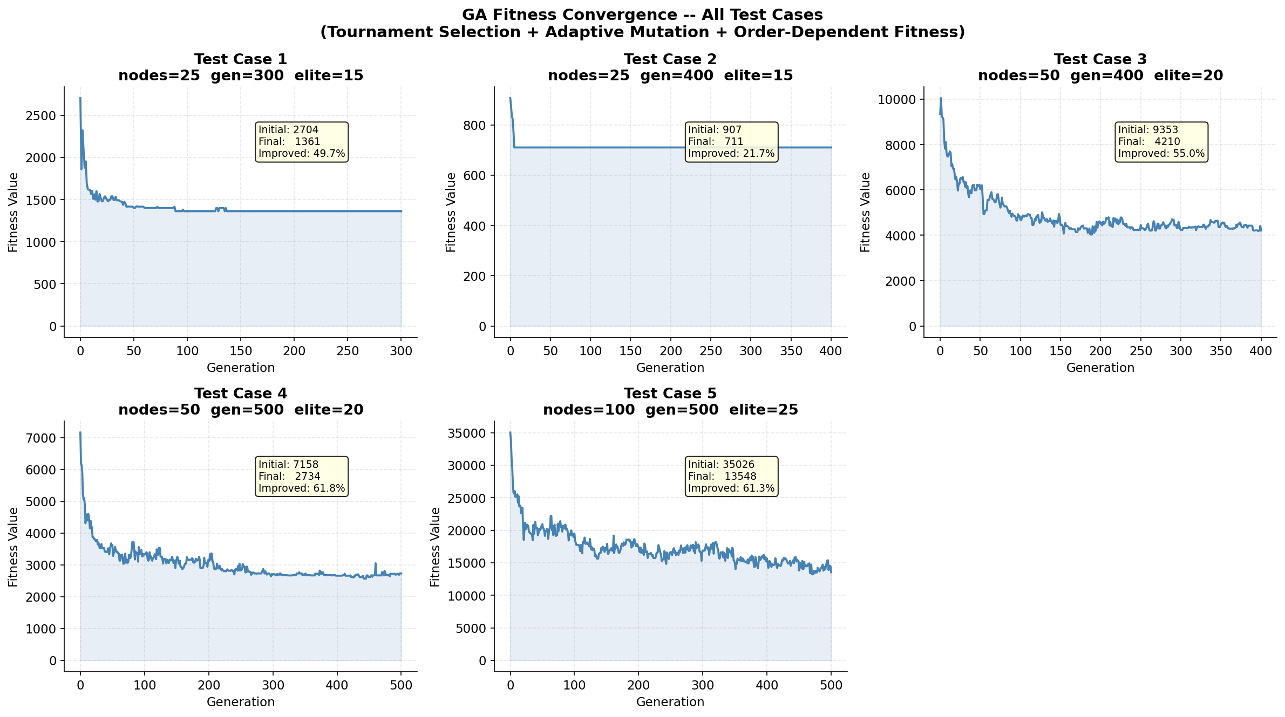
GA Results — Convergence Across All Test Cases
Fitness drops 21–62% from initial random routes
Convergence Summary
TC1 25 nodes
49.7% improvement
TC2 25 nodes
21.7% improvement
TC3 50 nodes
53.0% improvement
TC4 50 nodes
61.8% improvement
TC5 100 nodes
61.3% improvement
All curves smooth & converging ✓ (order-dependent fitness working)
CS5100 Foundations of AI | D. Raja Yadidiah Dakey | Northeastern University
7/24

Slide 8
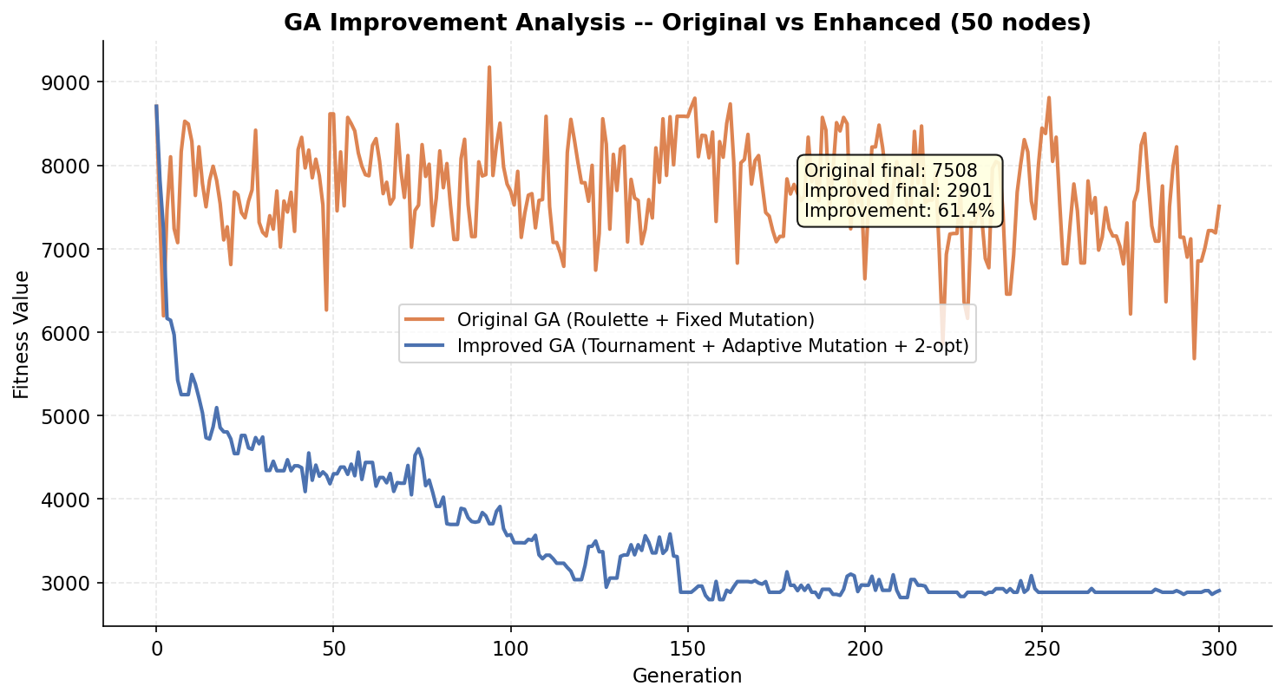
GA Improvement — Enhanced vs Original (FYP)
61.4% better fitness with tournament + adaptive mutation + 2-opt
What Changed
🔴 ORIGINAL GA
Roulette selection Fixed mutation 1% No 2-opt Bounded fitness (flat)
🟢 IMPROVED GA
Tournament k=5 Adaptive 2%→0.3% Full 2-opt window Order-dependent fitness
Final result: 7508 → 2901 (61.4% better)
CS5100 Foundations of AI | D. Raja Yadidiah Dakey | Northeastern University
8/24

Slide 9
Layer 2 — Q-Learning: MDP Formulation
Modelling disruption recovery as a Markov Decision Process
📊 STATE s_t
⚡ ACTION a_t
🏆 REWARD r_t
A 3-number tuple:
Action 0
CONTINUE
🔴 Critical (<25% SOC)
s = (SOC_bucket, charger_id, nodes_remaining) SOC: 10 bins (0-9) Charger: 5 options (0-4) Nodes: 11 values (0-10)
Keep going, absorb the hit. Costs 3-8% battery, saves time.
Continue: -350 Charge: +SOC×3 + bonus
→
Action 1
→
QUICK CHARGE
🟡 Moderate (25-42%)
Fly to charger, gain +70% SOC, moderate time cost.
Continue: -140 Charge: +SOC×2 + bonus
Action 2
FULL RECHARGE
🟢 Mild (blocked >55%)
Total: 10×5×11 = 550 states → small enough for a lookup table
Full charge with safety buffer time. Safest, slowest.
Continue: +15 ✓ Charge: +5 - dist cost
Q-Learning Update Rule:
Q(s,a) ← Q(s,a) + α × [ r + γ × max_a' Q(s',a') − Q(s,a) ]
CS5100 Foundations of AI | D. Raja Yadidiah Dakey | Northeastern University
9/24

Slide 10
Three-Tier Disruption Severity Model
Not all disruptions are equal — the agent responds proportionally
🔴 CRITICAL
🟡 MODERATE
🟢 MILD
TRIGGER:
TRIGGER:
TRIGGER:
SOC < 25% OR projected SOC at charger < 15%
SOC 25–42% OR charger blocked & SOC < 55%
Charger blocked AND SOC ≥ 55%
MEANING:
MEANING:
MEANING:
Drone is at risk of dying mid-flight. Even flying to the charger might not be safe.
Situation is concerning but not catastrophic. Drone can still make decisions.
Minor inconvenience — battery is fine. Diverting would waste time for no reason.
REWARD SHAPE:
REWARD SHAPE:
REWARD SHAPE:
Continue: −150 to −350 (severe punishment) Charge: +recovery×3 + bonus for high SOC
Continue: −40 to −140 (moderate punishment) Charge: +recovery×2 + bonus
Continue: +15 (REWARDED for staying on task!) Charge: +5 − distance cost
👉 Agent MUST charge. Ignoring this = −350 reward.
👉 Agent usually charges, sometimes continues.
👉 Agent CONTINUES — diverting penalised.
CS5100 Foundations of AI | D. Raja Yadidiah Dakey | Northeastern University
10/24

Slide 11
Double Q-Learning — Fixing Overestimation Bias
Why two Q-tables are better than one
❌ Problem with Regular Q-Learning
✅ Double Q-Learning Fix
The overestimation bug:
Two independent Q-tables, cross-checking:
# Standard update: td = r + γ × max( Q[next_state] ) − Q[s,a] Q[s,a] += α × td
# Double Q update (50% of the time swap tables): a_star = argmax( Q1[next_state] ) # Q1 picks the action td = r + γ × Q2[next_state][a_star] − Q1[s,a] # Q2 evaluates it Q1[s,a] += α × td
The Problem:
The max() operator ALWAYS picks the highest Q-value. If some Q-values are noisy/overestimated by chance, max() always selects those → the agent thinks good states are BETTER than they really are. → Agent makes overconfident decisions → Suboptimal policy (thinks action 0 is great when it isn't)
Why this works:
Q1 selects the action, Q2 evaluates its value. Since Q1 and Q2 have INDEPENDENT estimation noise, they can't both be wrong in the same direction. → Unbiased value estimates → Agent makes more realistic decisions → Better recovery rate on larger networks
Regular Q-Learning: SOC violations = 0–6 per test case
Double Q-Learning: SOC violations = 0–1 per test case ✓
CS5100 Foundations of AI | D. Raja Yadidiah Dakey | Northeastern University
11/24

Slide 12
Training Loop — Epsilon & Learning Rate Decay
500 episodes: explore first, exploit later
for ep in range(500):
Epsilon Decay 1.0 → 0.03
1
eps = 1.0 - 0.97×(ep/500)
Episode 1: 100% random actions (toddler touching everything) Episode 250: 50% learned, 50% random Episode 500: 97% learned policy (expert mode)
# Epsilon decreases each episode
2
lr = 0.15 - 0.14×(ep/500)
# Learning rate decreases each episode
3
seed = ep×7 + 13
# Different disruption pattern every run
LR Decay 0.15 → 0.01
4
simulate_episode(route, agent...)
# Run one mission with current policy
Episode 1: Big corrections (learning fast, noisy updates) Episode 500: Tiny fine-tuning (stable, converged Q-values) Satisfies Robbins-Monro conditions for convergence ✓
5
record violations
# Track how many times SOC < 30%
# Final evaluation: held-out seed=999, eps=0 (pure exploit)
CS5100 Foundations of AI | D. Raja Yadidiah Dakey | Northeastern University
12/24

Slide 13
Experimental Setup
5 test cases, 5 algorithms, 5 evaluation metrics
Test Cases — Increasing Network Size
5 Evaluation Metrics
TC
Nodes
Generations
Elite Size
Seed
AWT
Average Waiting Time
Lower ↓ better
TC1
25
300
15
42
How long sensors wait on average
TC2
25
400
15
43
Survival
Survival Rate
Higher ↑ better
TC3
50
400
20
44
% sensors alive when served
TC4
50
500
20
45
MC Eff
MC Efficiency
Higher ↑ better
TC5
100
500
25
46
Useful charging vs wasted travel
SOC Viol
SOC Violations
5 Algorithms Compared
Lower ↓ better (0 = perfect)
Times drone battery < 30%
GA Only
Q-Learning Only
GA + Greedy
Hybrid GA+QL
Hybrid GA+DQL
Rec Rate
Recovery Rate
No recovery — blind execution
Random route + smart recovery
Good route + always charge
Good route + Q-learning recovery
Higher ↑ better
Good route + Double Q recovery ⭐
% disruptions successfully handled
CS5100 Foundations of AI | D. Raja Yadidiah Dakey | Northeastern University
13/24

Slide 14
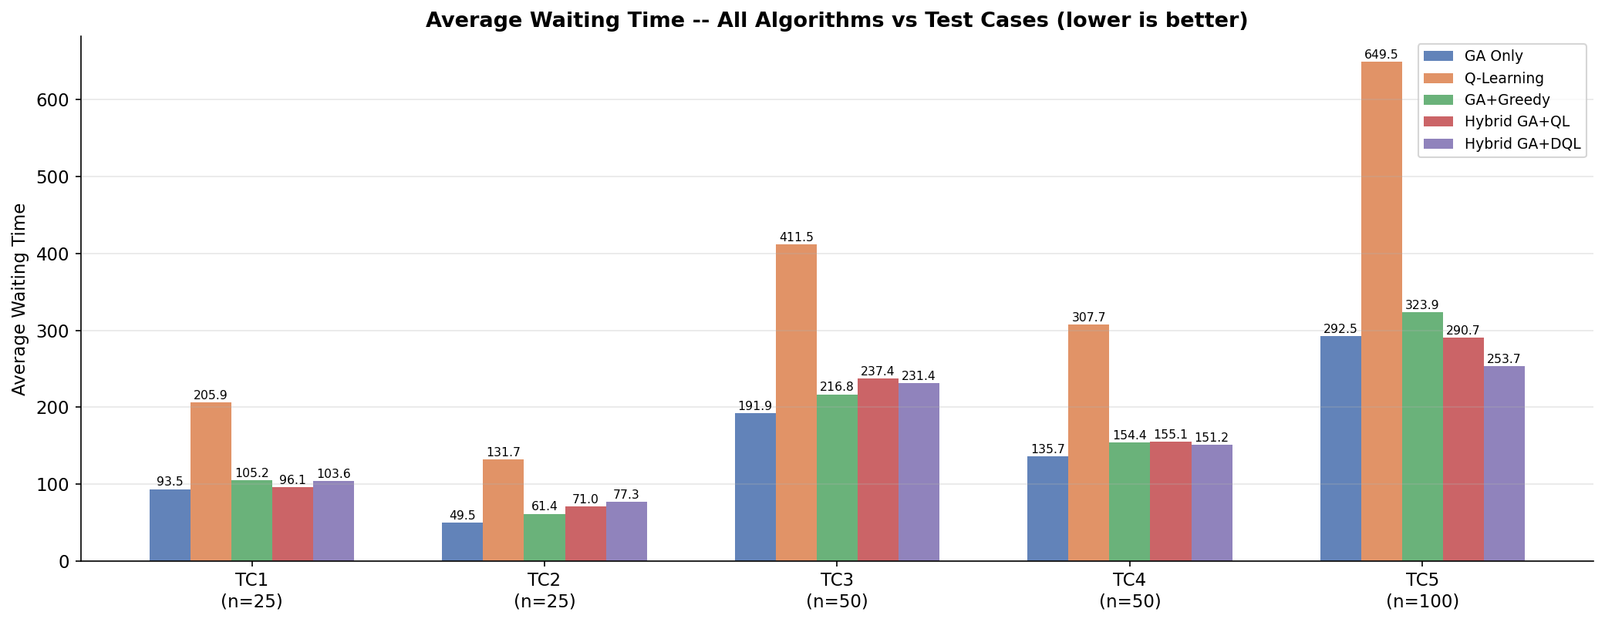
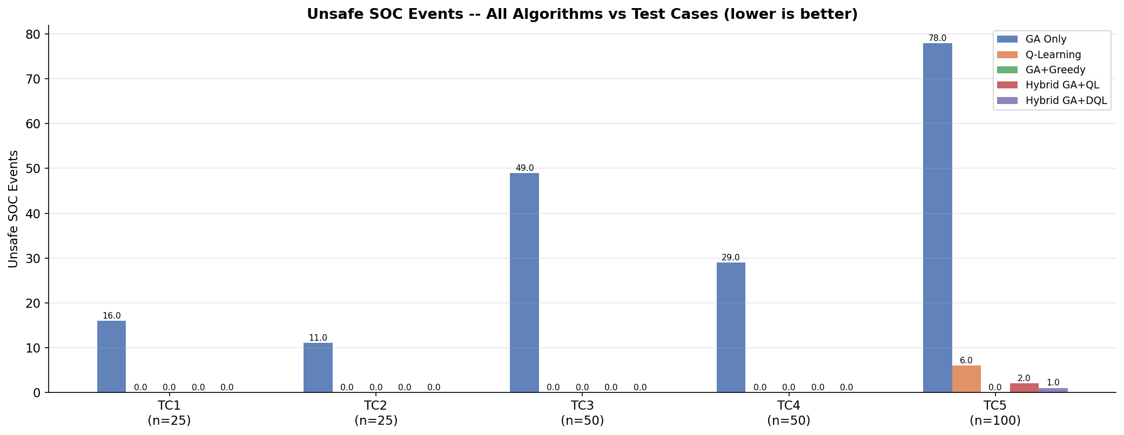
Results — Algorithm Comparison (Average Waiting Time)
Lower is better — Hybrid methods outperform across all scales
Key Takeaways
Hybrid GA+DQL achieves lowest SOC violations (near 0) on ALL test cases
Hybrid GA+QL has competitive AWT — often beats GA Only
GA Only: 0% recovery, 16–78 violations depending on network size
Q-Learning Only: safe but highest AWT (random route is inefficient)
As network grows (TC5: 100 nodes), advantage of hybrid approach increases
CS5100 Foundations of AI | D. Raja Yadidiah Dakey | Northeastern University
14/24

Slide 15
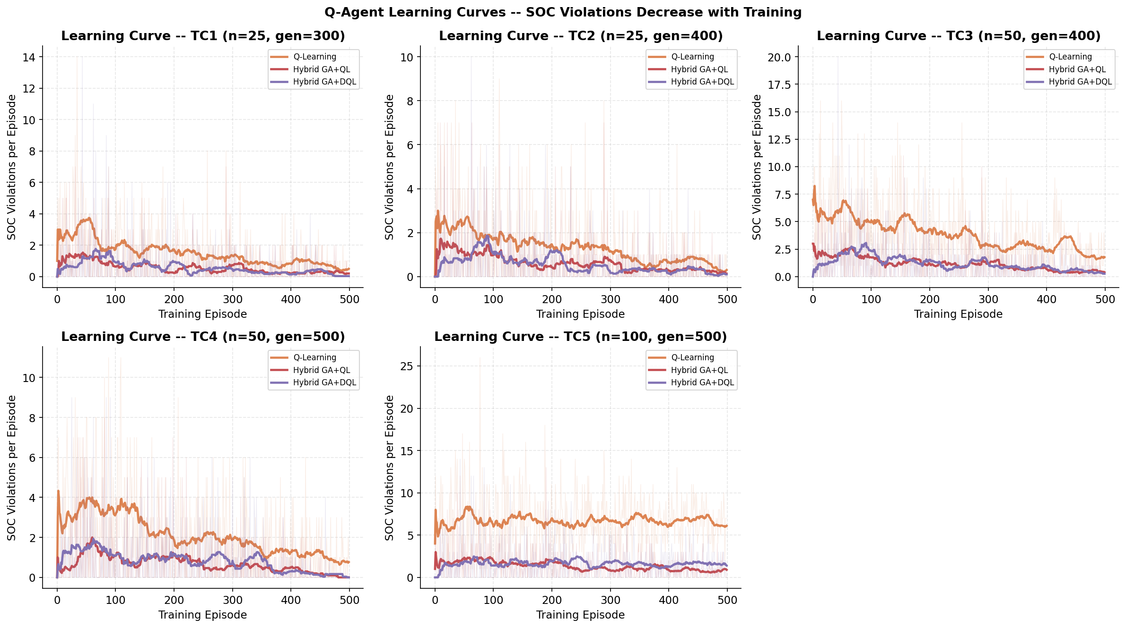
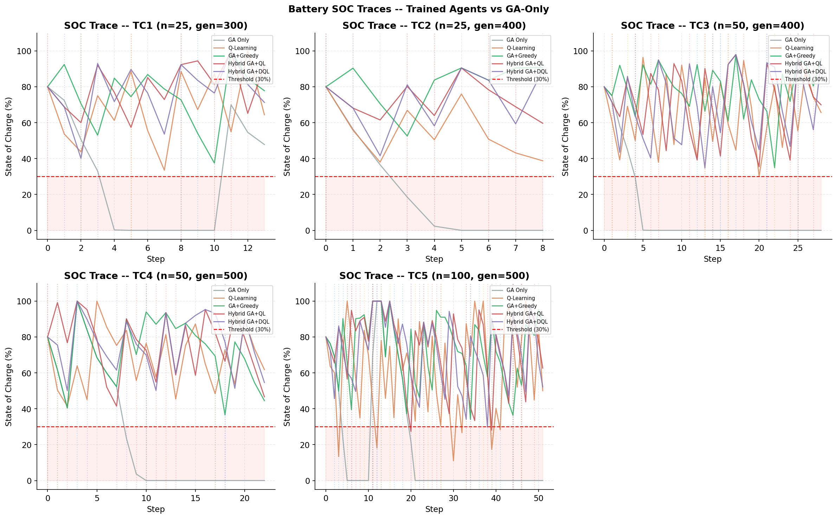
Results — Learning Curves & SOC Traces
Agent learns over 500 episodes; battery stays safe with hybrid approach
How to Read These Plots
Learning Curve (top left)
Y-axis: SOC violations in each training episode. X-axis: Episode number (0 to 500). The rolling average (bold line) should go DOWN over time. A flat line = agent isn't learning. A decreasing line = agent is improving!
SOC Trace (bottom left)
Y-axis: Drone's battery level (0-100%). X-axis: Each node visited in the route. Red dashed line = danger threshold (30%). GA Only (grey) dips below it repeatedly. Hybrid methods (purple/red) stay ABOVE it — safe!
What the agent learned
Early training: many violations (random actions). Late training: near-zero violations (learned policy). The agent discovered: charge when critical/moderate, continue when mild — NOT 'always charge'.
CS5100 Foundations of AI | D. Raja Yadidiah Dakey | Northeastern University
15/24

Slide 16
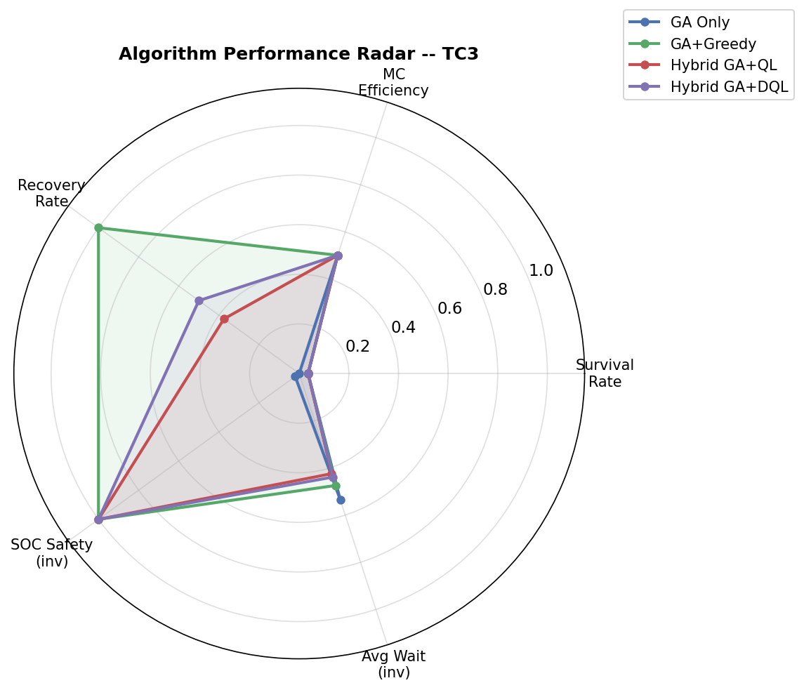
Results — Overall Algorithm Performance (Radar Chart)
5 metrics on one chart — larger area = better overall algorithm
How to Read the Radar Chart
Each axis is one metric, normalised to 0–1. The AREA enclosed by each algorithm's polygon represents its OVERALL performance.
GA Only
Smallest polygon — good distance efficiency but 0 recovery rate collapses the shape.
GA + Greedy
Larger polygon — always recovers but wastes time on mild disruptions.
Hybrid GA+QL
Good polygon — learns nuanced recovery. Balance of AWT and safety.
Hybrid GA+DQL
LARGEST polygon overall — best balance across all 5 metrics. ⭐ Winner.
CS5100 Foundations of AI | D. Raja Yadidiah Dakey | Northeastern University
16/24

Slide 17
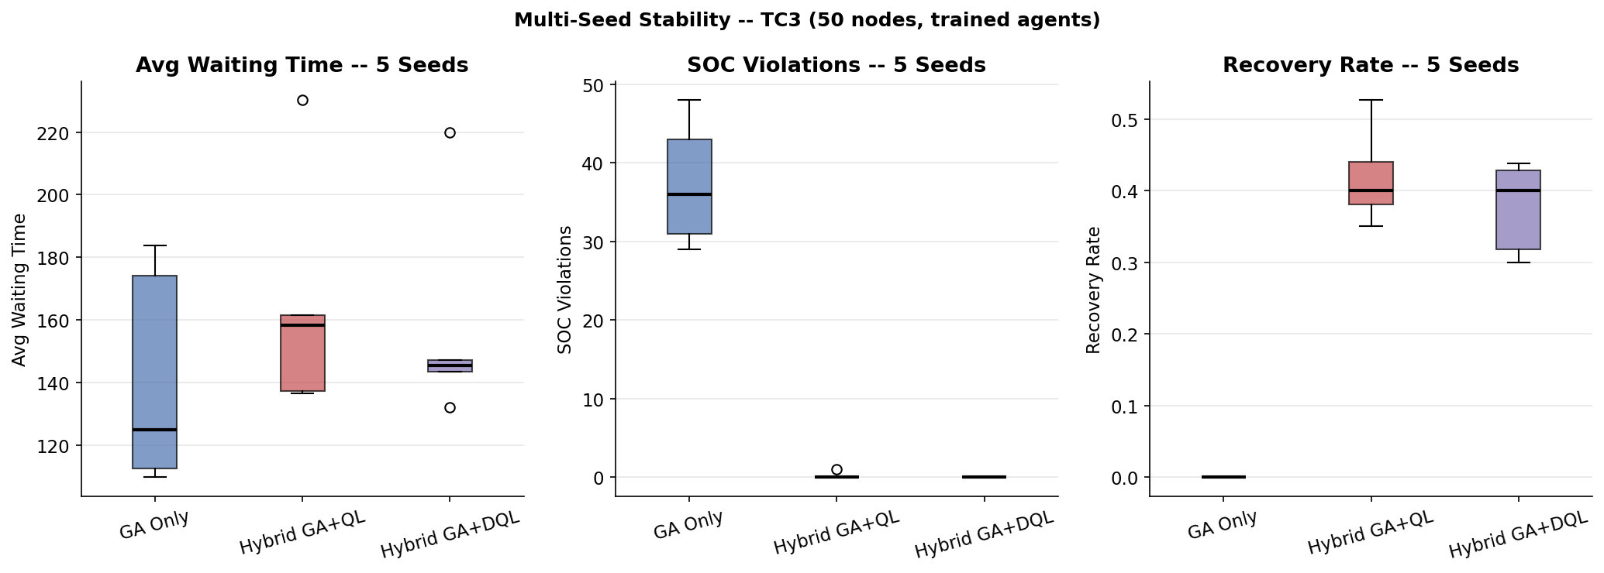
Results — Multi-Seed Stability Analysis
Results are consistent across 5 random seeds — not a lucky run
Why This Matters
If we only ran one seed, results might be lucky or unlucky. 5 different seeds with different sensor layouts prove our method generalises robustly.
GA Only
AWT: 161 ± 37 Viol: 41 ± 6 Recovery: 0%
Hybrid GA+QL
AWT: 179 ± 30 Viol: 0 ± 0 Recovery: 38%
Hybrid GA+DQL
AWT: 169 ± 4 Viol: 0.2 ± 0.4 Recovery: 42%
Small σ on DQL = highly stable ✓
CS5100 Foundations of AI | D. Raja Yadidiah Dakey | Northeastern University
17/24

Slide 18
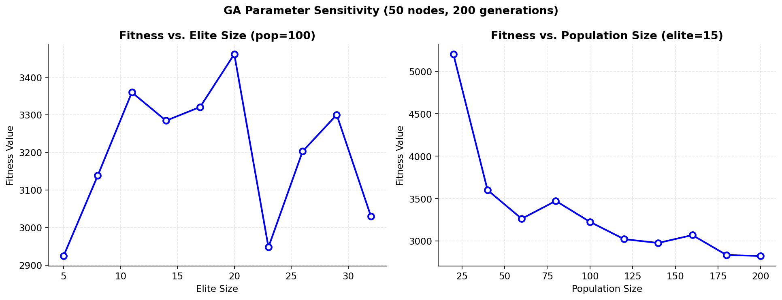
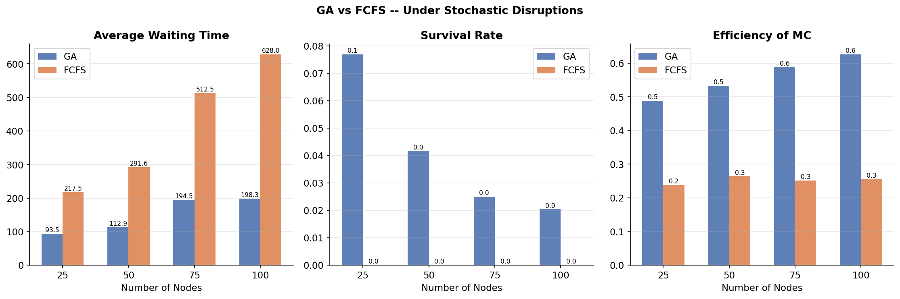
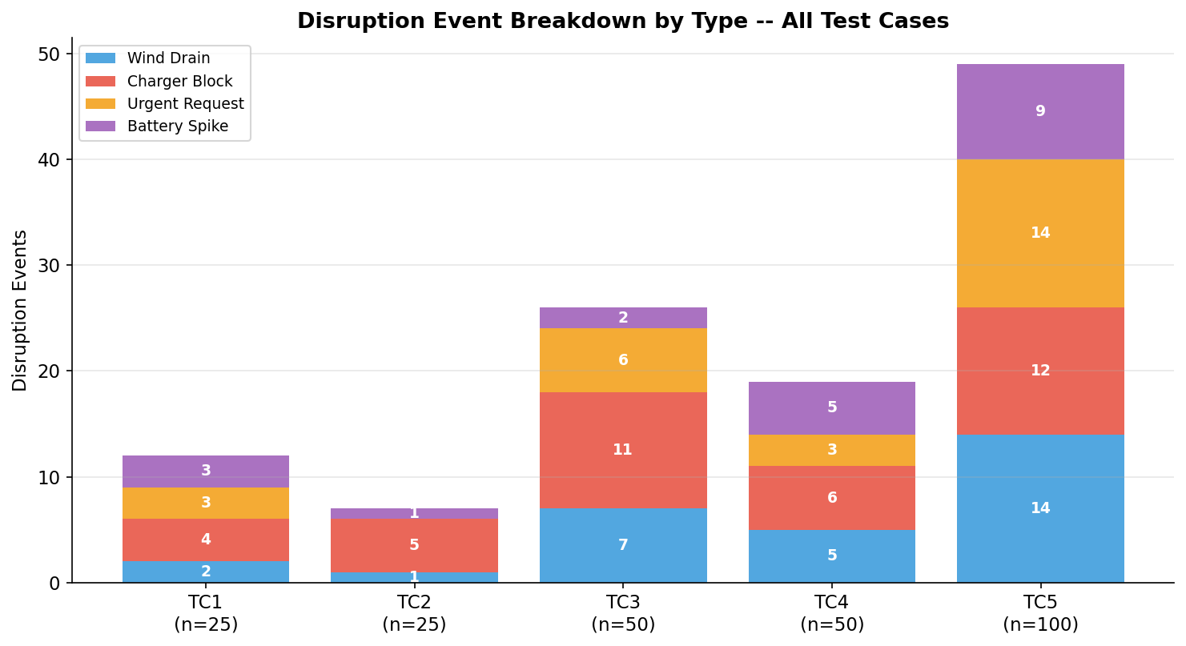
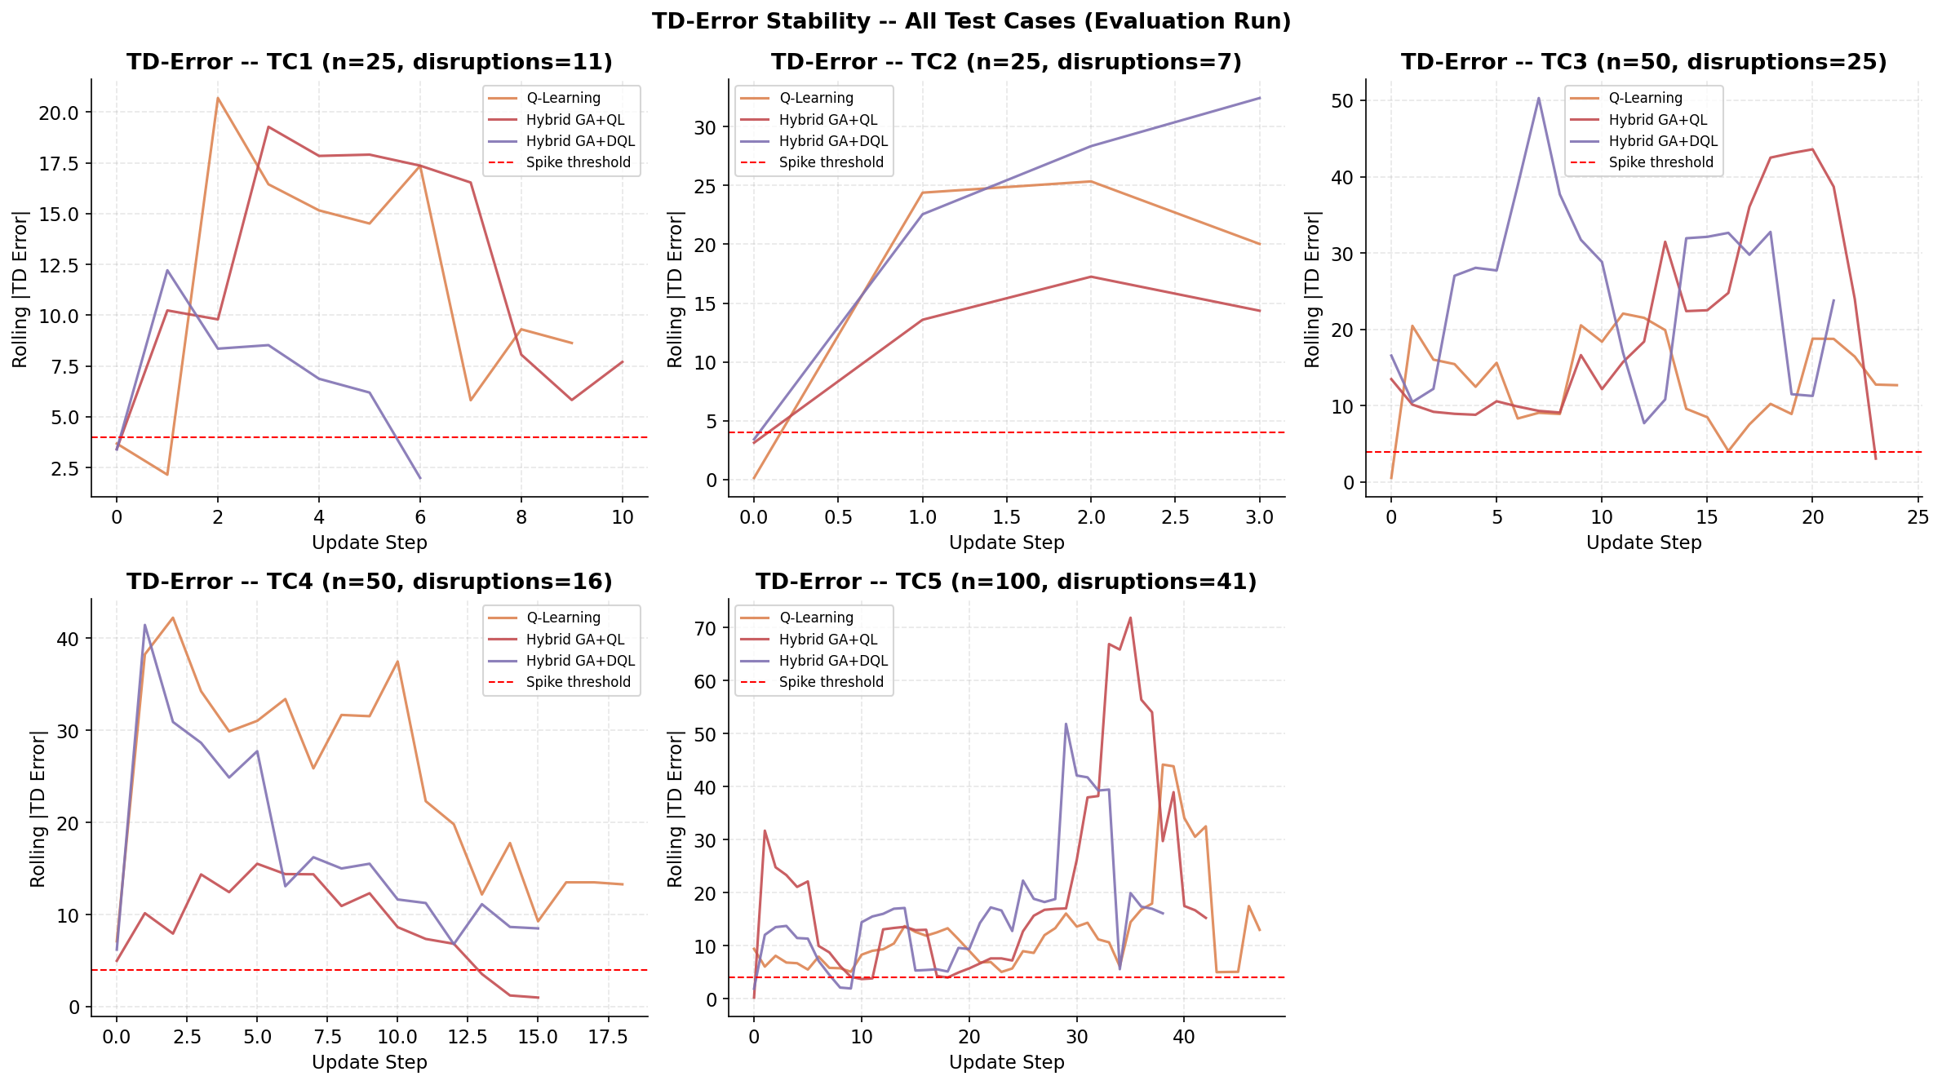
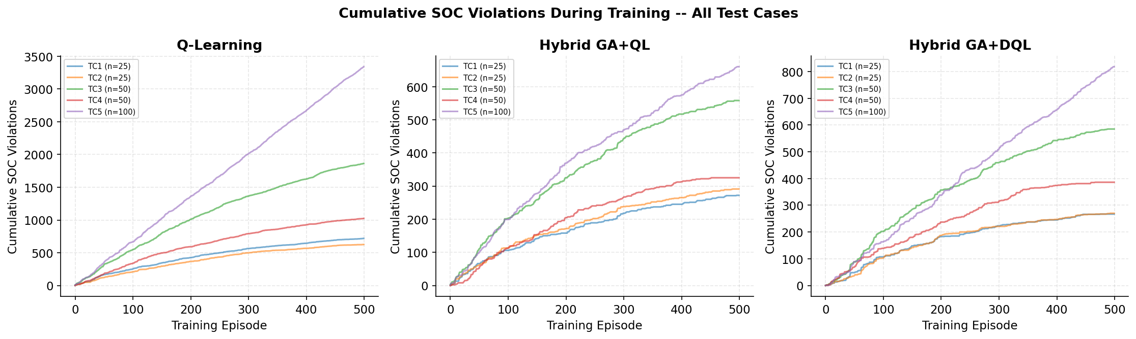
All 13 Visualisations Generated
Each plot tells a different part of the story
GA Convergence
Route Maps
Learning Curves
GA Sensitivity
GA vs FCFS
AWT Comparison
Disruption Breakdown
Fitness drops over generations
Clean paths, no crossings
Agent improves with training
Hyperparameter analysis
Beats naive baseline
All 5 algorithms ranked
Event type distribution
TD-Error
SOC Traces
Multi-Seed
Radar Chart
GA Improvement
Cumulative Violations
Q-learning stability over time
Battery safe with hybrid
Reproducible results
Overall performance
61% better with enhancements
Training progress
CS5100 Foundations of AI | D. Raja Yadidiah Dakey | Northeastern University
18/24

Slide 19
6 Key Improvements Over the B.Tech FYP
Each change is justified, measured, and visible in the results
1
Order-Dependent Fitness
2
Tournament Selection (k=5)
3
Full-Window 2-opt
Old FYP fitness had constant terms — GA was only optimising distance. Fixed: T_wait, T_overtime now depend on route order.
Old roulette wheel caused premature convergence — diversity lost. Tournament maintains diversity, consistent selection pressure.
Old bounded window (15) missed long-range crossings. Full window checks all pairs, removes every crossing.
📊 Result: Convergence: flat lines → 21–62% improvement
📊 Result: TC2: was 3% improvement, now 21.7%
📊 Result: TC5: Δ=299 → Δ=4,821 (16× better)
4
Adaptive Mutation Rate
5
Double Q-Learning
6
Learning Rate Decay
Old fixed 1% rate was either too high (late) or too low (early). Adaptive: 2%→0.3%, exploring early, exploiting late.
Regular Q-Learning overestimates values via the max operator. Double Q: two tables cross-check, removing bias.
Fixed LR causes oscillating Q-values, never fully converges. Decay 0.15→0.01 satisfies Robbins-Monro convergence conditions.
📊 Result: Smoother convergence curves
📊 Result: SOC violations: 0–6 → 0–1
📊 Result: TD-error plots show clear stabilisation
CS5100 Foundations of AI | D. Raja Yadidiah Dakey | Northeastern University
19/24

Slide 20
Complete Results — TC5 (100 Nodes, Hardest Case)
Largest network shows maximum benefit of hybrid approach
Algorithm
AWT
Survival
MC Eff
SOC Viol
Rec Rate
vs GA Only
GA Only
292.5
0.020
0.628
78
0.000
—
Q-Learning
649.5
0.000
0.290
6
0.333
AWT +357
GA + Greedy
323.9
0.020
0.628
0
1.000
AWT +31.4
Hybrid GA+QL
290.7
0.020
0.628
2
0.349
AWT −1.8 ✓
Hybrid GA+DQL
253.7
0.020
0.628
1
0.359
AWT −38.8 ✓✓
⭐ Hybrid GA+DQL: Lowest AWT (−38.8 vs GA Only) | Near-zero violations (1 vs 78) | Recovery Rate 35.9% | BEST overall
CS5100 Foundations of AI | D. Raja Yadidiah Dakey | Northeastern University
20/24

Slide 21
If Professor Asks About the Code…
Quick reference for key code sections
Q: Why `random.seed(42)`?
Q: Why `req = [nd for nd in nodes if nd.re < 50]`?
A: Reproducibility. Every run gives identical results. Without it, comparisons between runs are meaningless.
A: Only sensors with <50% battery need the drone. The rest are healthy and don't need service.
Q: Why `self._fitness = None` with caching?
Q: Why cap `elite_size = min(elite, pop//4)`?
A: The GA evaluates fitness 150×500 = 75,000 times. Caching avoids re-computing the same route twice — major speedup.
A: Old code had 37.5% elite — barely any evolution happening. Capping at 25% ensures 75% of population goes through crossover.
Q: Why `ep_seed = ep*7 + 13`?
Q: Why `eps_override=0.0` in evaluation?
A: Each training episode needs a different disruption pattern. This ensures the agent can't memorise one sequence — must generalise.
A: During evaluation (the 'exam'), the agent must use what it learned. eps=0 means 100% greedy — no random exploration.
Q: Why `state = (soc//10, charger_id, remaining)`?
Q: Why `random.random() < 0.5` in Double QL?
A: This discretises continuous state into 550 buckets. Small enough for tabular Q-learning — no neural network needed.
A: 50% of updates use Q1→Q2, 50% use Q2→Q1. This symmetric split removes the overestimation bias of regular Q.
CS5100 Foundations of AI | D. Raja Yadidiah Dakey | Northeastern University
21/24

Slide 22
Limitations & Future Work
What we'd do with more time and resources
⚠ Tabular Q-Learning Scalability
⚠ Single Drone Assumption
550 states works for our setup, but with more drones or continuous SOC representation, the state space explodes.
We modelled one drone serving the whole network. Real deployments use drone fleets.
→ Replace with Deep Q-Network (DQN) using neural function approximation
→ Multi-Agent RL (QMIX, MAPPO) for coordinated fleet routing
⚠ Simulated Disruptions
⚠ Static Network
Disruption probabilities are hand-tuned. Real wind, hardware failures are more complex.
Sensor positions are fixed; no new nodes arrive mid-mission.
→ Domain randomisation + sim-to-real transfer for real UAV platforms
→ Dynamic node arrival models + online replanning
CS5100 Foundations of AI | D. Raja Yadidiah Dakey | Northeastern University
22/24

Slide 23
Conclusion
What we proved and why it matters
Main Findings
Why Does This Matter?
Finding 1: Hybrid > Either Layer Alone
WRSNs power smart cities, agriculture monitoring, disaster response, and infrastructure sensing.
GA-Only had 78 violations and 0% recovery on 100 nodes. Q-Learning alone had the highest waiting times (random route). Hybrid GA+DQL achieved lowest AWT AND near-zero violations. → Offline planning + online adaptation is strictly superior.
A drone that CRASHES from low battery creates a hole in the sensor network — potentially catastrophic in critical applications.
Finding 2: Algorithm Improvements are Meaningful
Tournament selection, adaptive mutation, full 2-opt together gave 61.4% better GA fitness vs the original FYP approach. → Each improvement is independently justified and measurable.
Our hybrid approach keeps the drone safe (0–1 violations) while minimising sensor wait times simultaneously.
Finding 3: Double Q-Learning Reduces Violations
This extends the B.Tech FYP from static planning to a full adaptive intelligent system ready for dynamic environments.
Regular Q-Learning: 0–6 SOC violations per test case. Double Q-Learning: 0–1 violations with more stable training. → Removing overestimation bias leads to safer flight decisions.
CS5100 Foundations of AI | D. Raja Yadidiah Dakey | Northeastern University
23/24

Slide 24
Thank You
Questions & Discussion
D. Raja Yadidiah Dakey · CS5100 Foundations of AI · Northeastern University
In one sentence:
A Genetic Algorithm plans the optimal drone charging route offline, while a Double Q-Learning agent handles random disruptions in real-time — together achieving 61% better route quality and near-zero battery violations compared to any single approach.
Deliverables: Capstone_Final_Improved.ipynb · Capstone_Final_Improved.py · Dakey_Capstone_Thesis.tex · 21 Plots

