Slide 1
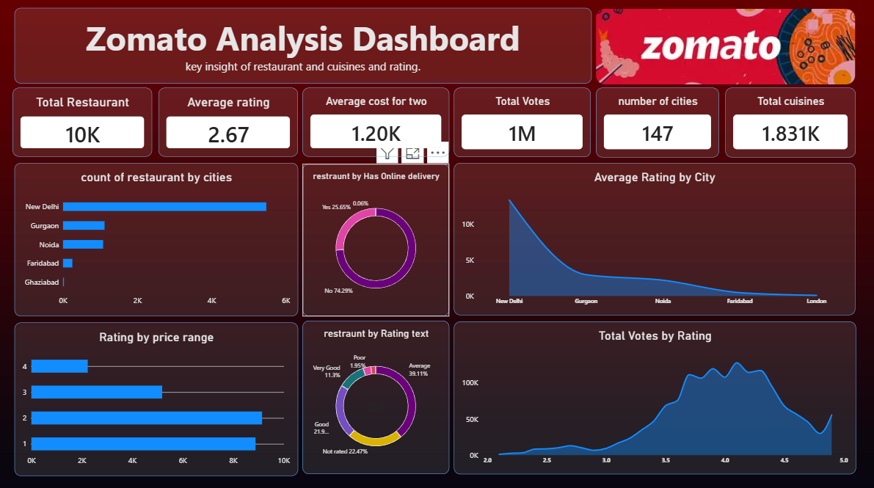
ZOMATO ANALYSIS
Restaurant performance • ratings • customer engagement
Dashboard overview and key findings

Slide 2
Dashboard at a Glance
A snapshot of restaurant listings, customer ratings and activity
Total restaurants
Average rating
Average cost for two
10K
2.67
1.20K
Total votes
Cities covered
Cuisine entries
1M
147
1.831K
What this dashboard helps answer
Where are restaurant listings concentrated?
How do ratings, delivery availability and votes vary?
What patterns can guide restaurant-market decisions?
02 / 08

Slide 3
Restaurant Distribution by City
The visible dashboard shows New Delhi leading the selected cities
Count of restaurants by city
Key observations
New Delhi has the largest restaurant count in the displayed comparison.
Gurgaon and Noida form the next tier.
Faridabad and Ghaziabad contribute a much smaller share.
A city-wise view can help compare market concentration.
03 / 08

Slide 4
Online Delivery Availability
A majority of listed restaurants in the dashboard are marked as not offering online delivery
Delivery status (as shown)
Interpretation
About 74.29% are shown as not offering online delivery.
About 25.65% are shown as offering online delivery.
Delivery availability may affect convenience and customer reach.
Restaurants can use this split to review their digital service strategy.
04 / 08

Slide 5
Ratings and Price Range
The dashboard compares rating levels across price ranges
Rating by price range (dashboard view)
Reading the chart
The displayed bars are longest for rating levels 1 and 2.
The count falls for ratings 3 and 4 in this view.
Use the rating breakdown alongside price to identify areas for improvement.
The source image does not provide a detailed data table, so chart values here are illustrative.
05 / 08

Slide 6
Customer Rating Categories
Text labels provide a quick view of how ratings are classified
Rating text distribution
What stands out?
“Average” is the largest displayed category at about 39.11%.
“Not rated” represents roughly 22.47% of entries.
“Good” accounts for about 21.9%, while “Very Good” is around 11.32%.
The “Poor” category is comparatively small at about 1.95%.
06 / 08

Slide 7
Votes by Rating
Votes indicate customer engagement across the rating scale
Total votes by rating
Engagement insights
Vote volume rises notably around ratings in the mid-to-high 3s and 4s.
The visible chart peaks around the rating-4 region.
Lower vote counts appear at the low end of the rating scale.
More votes can make a rating more informative, but votes alone do not prove quality.
07 / 08

Slide 8
Key Takeaways & Conclusion
A concise summary of the Zomato dashboard
Market coverage
The dashboard summarizes around 10K restaurants across 147 cities.
Suggested next steps
Compare ratings city by city.
Explore rating patterns by cuisine and cost.
Check delivery availability against votes and ratings.
Validate all illustrative values with the underlying dataset before formal reporting.
Customer feedback
The average rating shown is 2.67, so rating improvement may be a useful focus.
Digital service
Online delivery is available for a smaller share than the no-delivery group in the displayed split.
Engagement
About 1M total votes are shown, giving a broad view of customer activity.
Thank you
Prepared from the supplied Zomato Analysis Dashboard screenshot
08 / 08

