Slide 1
BondVoyage
A Travel Booking Management System
Presented by: Raj Kumar Jain
BCA Final Year

Slide 2
Project Briefing
BondVoyage
Project Briefing
Tools & Technology
ER Diagram
DFD Level - 0
Objective:
- To develop a secure, scalable platform for travel booking and tour management.
Problem Statement:
- Traditional systems lack real-time capacity checks, leading to overbooking.
Solution:
- Users: Easily search & booking history.
- Admins: 'Command Center' dashboard for revenue & inventory.
DFD Level - 1
DFD Level - 2

Slide 3
Tools & Technologies
BondVoyage
Project Briefing
Tools & Technology
ER Diagram
DFD Level - 0
Backend:
- Python & Django (Core Logic)
- PostgreSQL (Database)
Frontend:
- Bootstrap (Responsive UI)
- HTML / CSS
Tools:
- Visual Studio Code Editor
- Git & GitHub (Version Control)
DFD Level - 1
DFD Level - 2

Slide 4
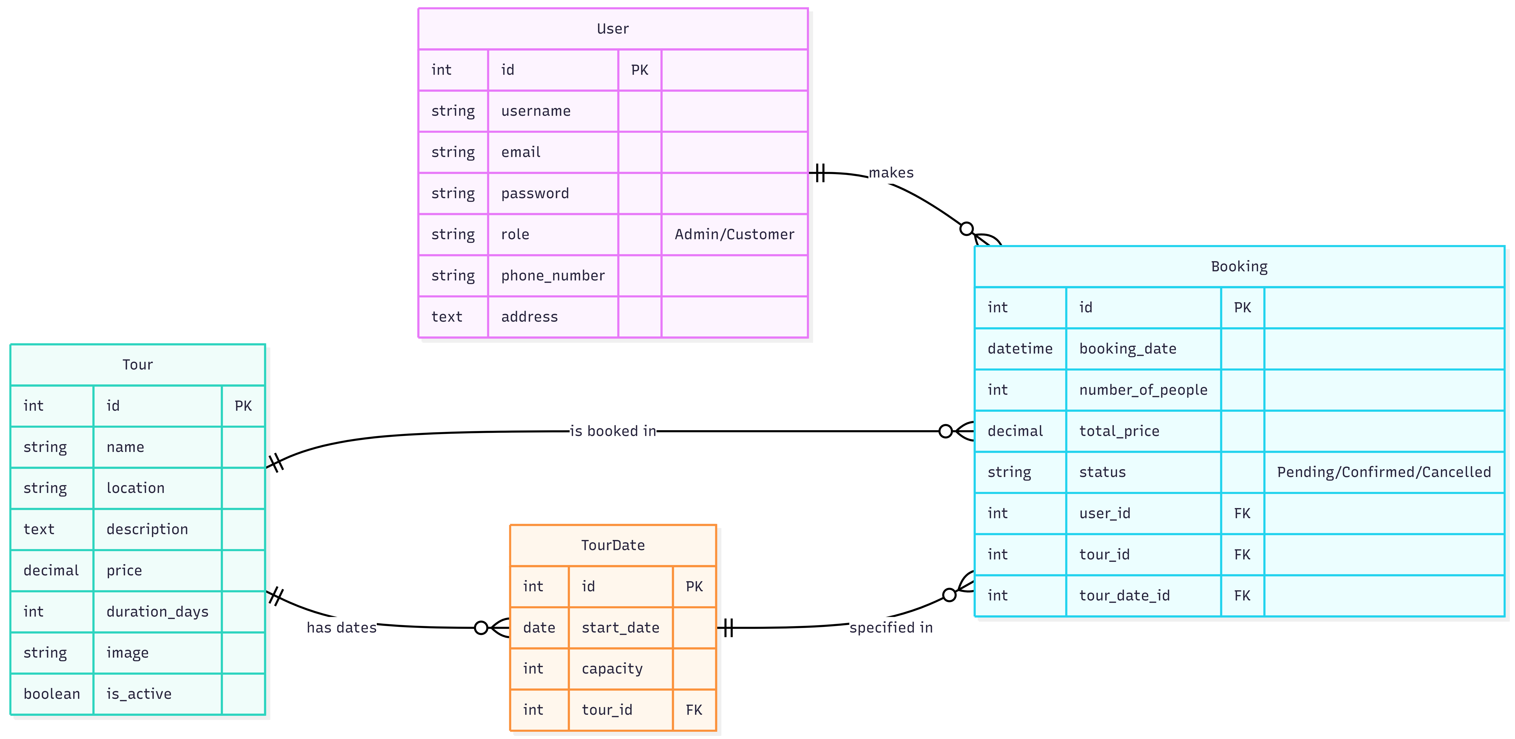
Entity-Relationship (E-R) Diagram
BondVoyage
Project Briefing
Tools & Technology
ER Diagram
Key Entities:
- User (Admin/Customer roles)
- Tour (Package details)
- TourDate (Capacity management)
- Booking (Links Users to Tours)
DFD Level - 0
DFD Level - 1
DFD Level - 2

Slide 5
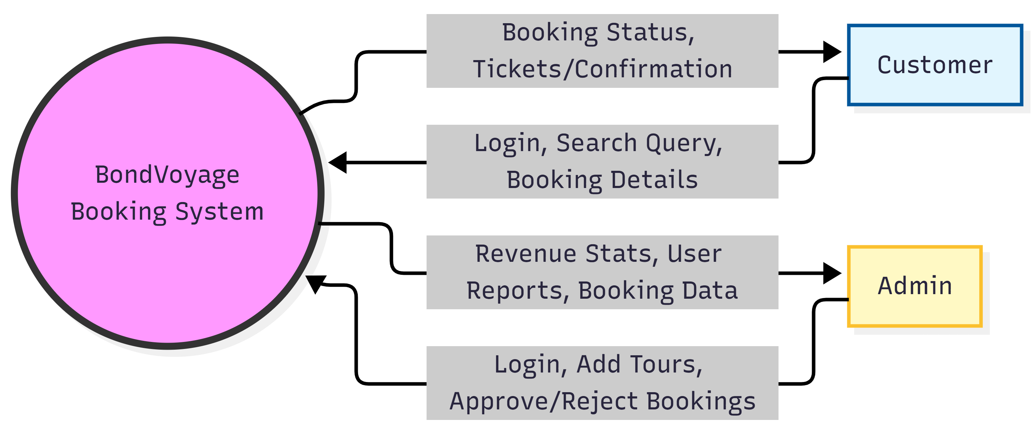
Data Flow Diagram (DFD)
BondVoyage
Project Briefing
Tools & Technology
ER Diagram
DFD Level - 0
Data Flow:
1. Users input search & booking requests.
2. System validates capacity & calculates price.
3. Admin manages inventory & approvals.
4. System outputs tickets & revenue analytics.
DFD Level - 1
DFD Level - 2

Slide 6
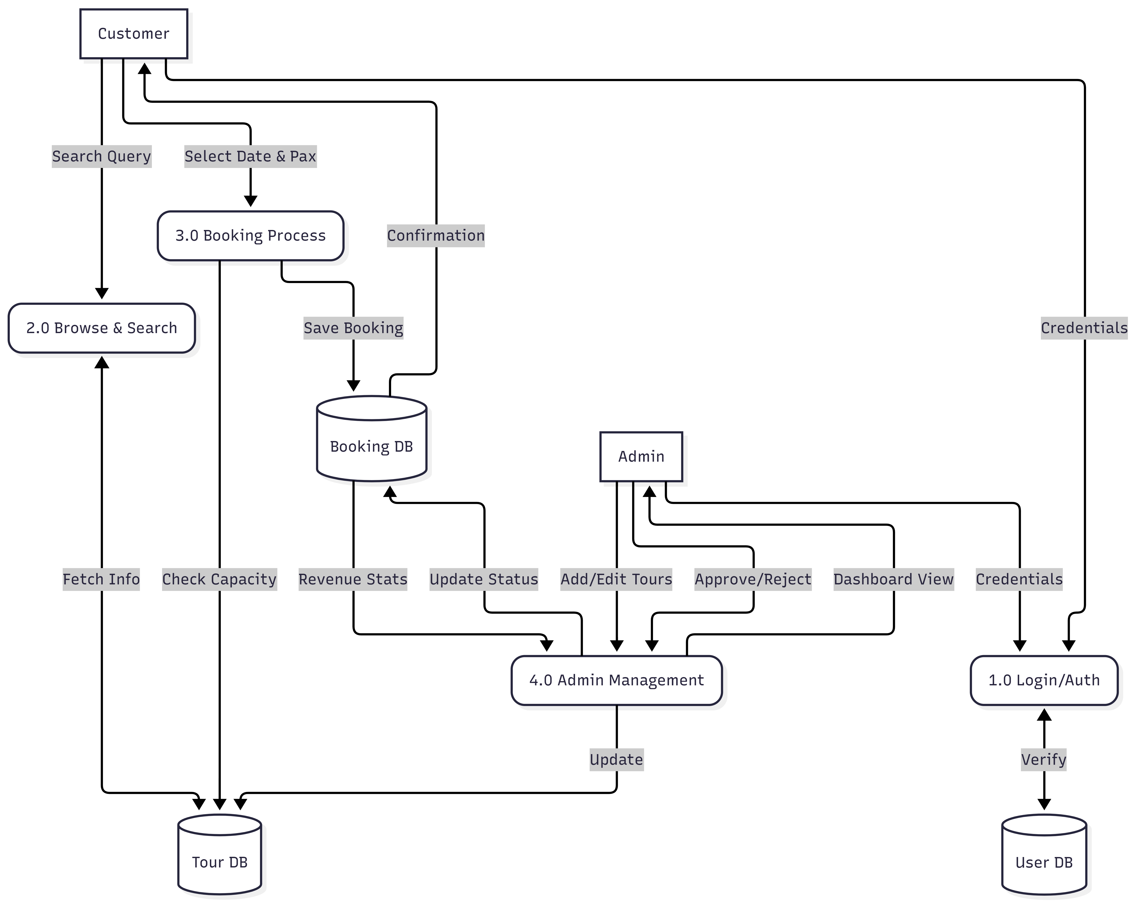
DFD - Level 1
BondVoyage
Project Briefing
Tools & Technology
ER Diagram
DFD Level - 0
DFD Level - 1
DFD Level - 2

Slide 7
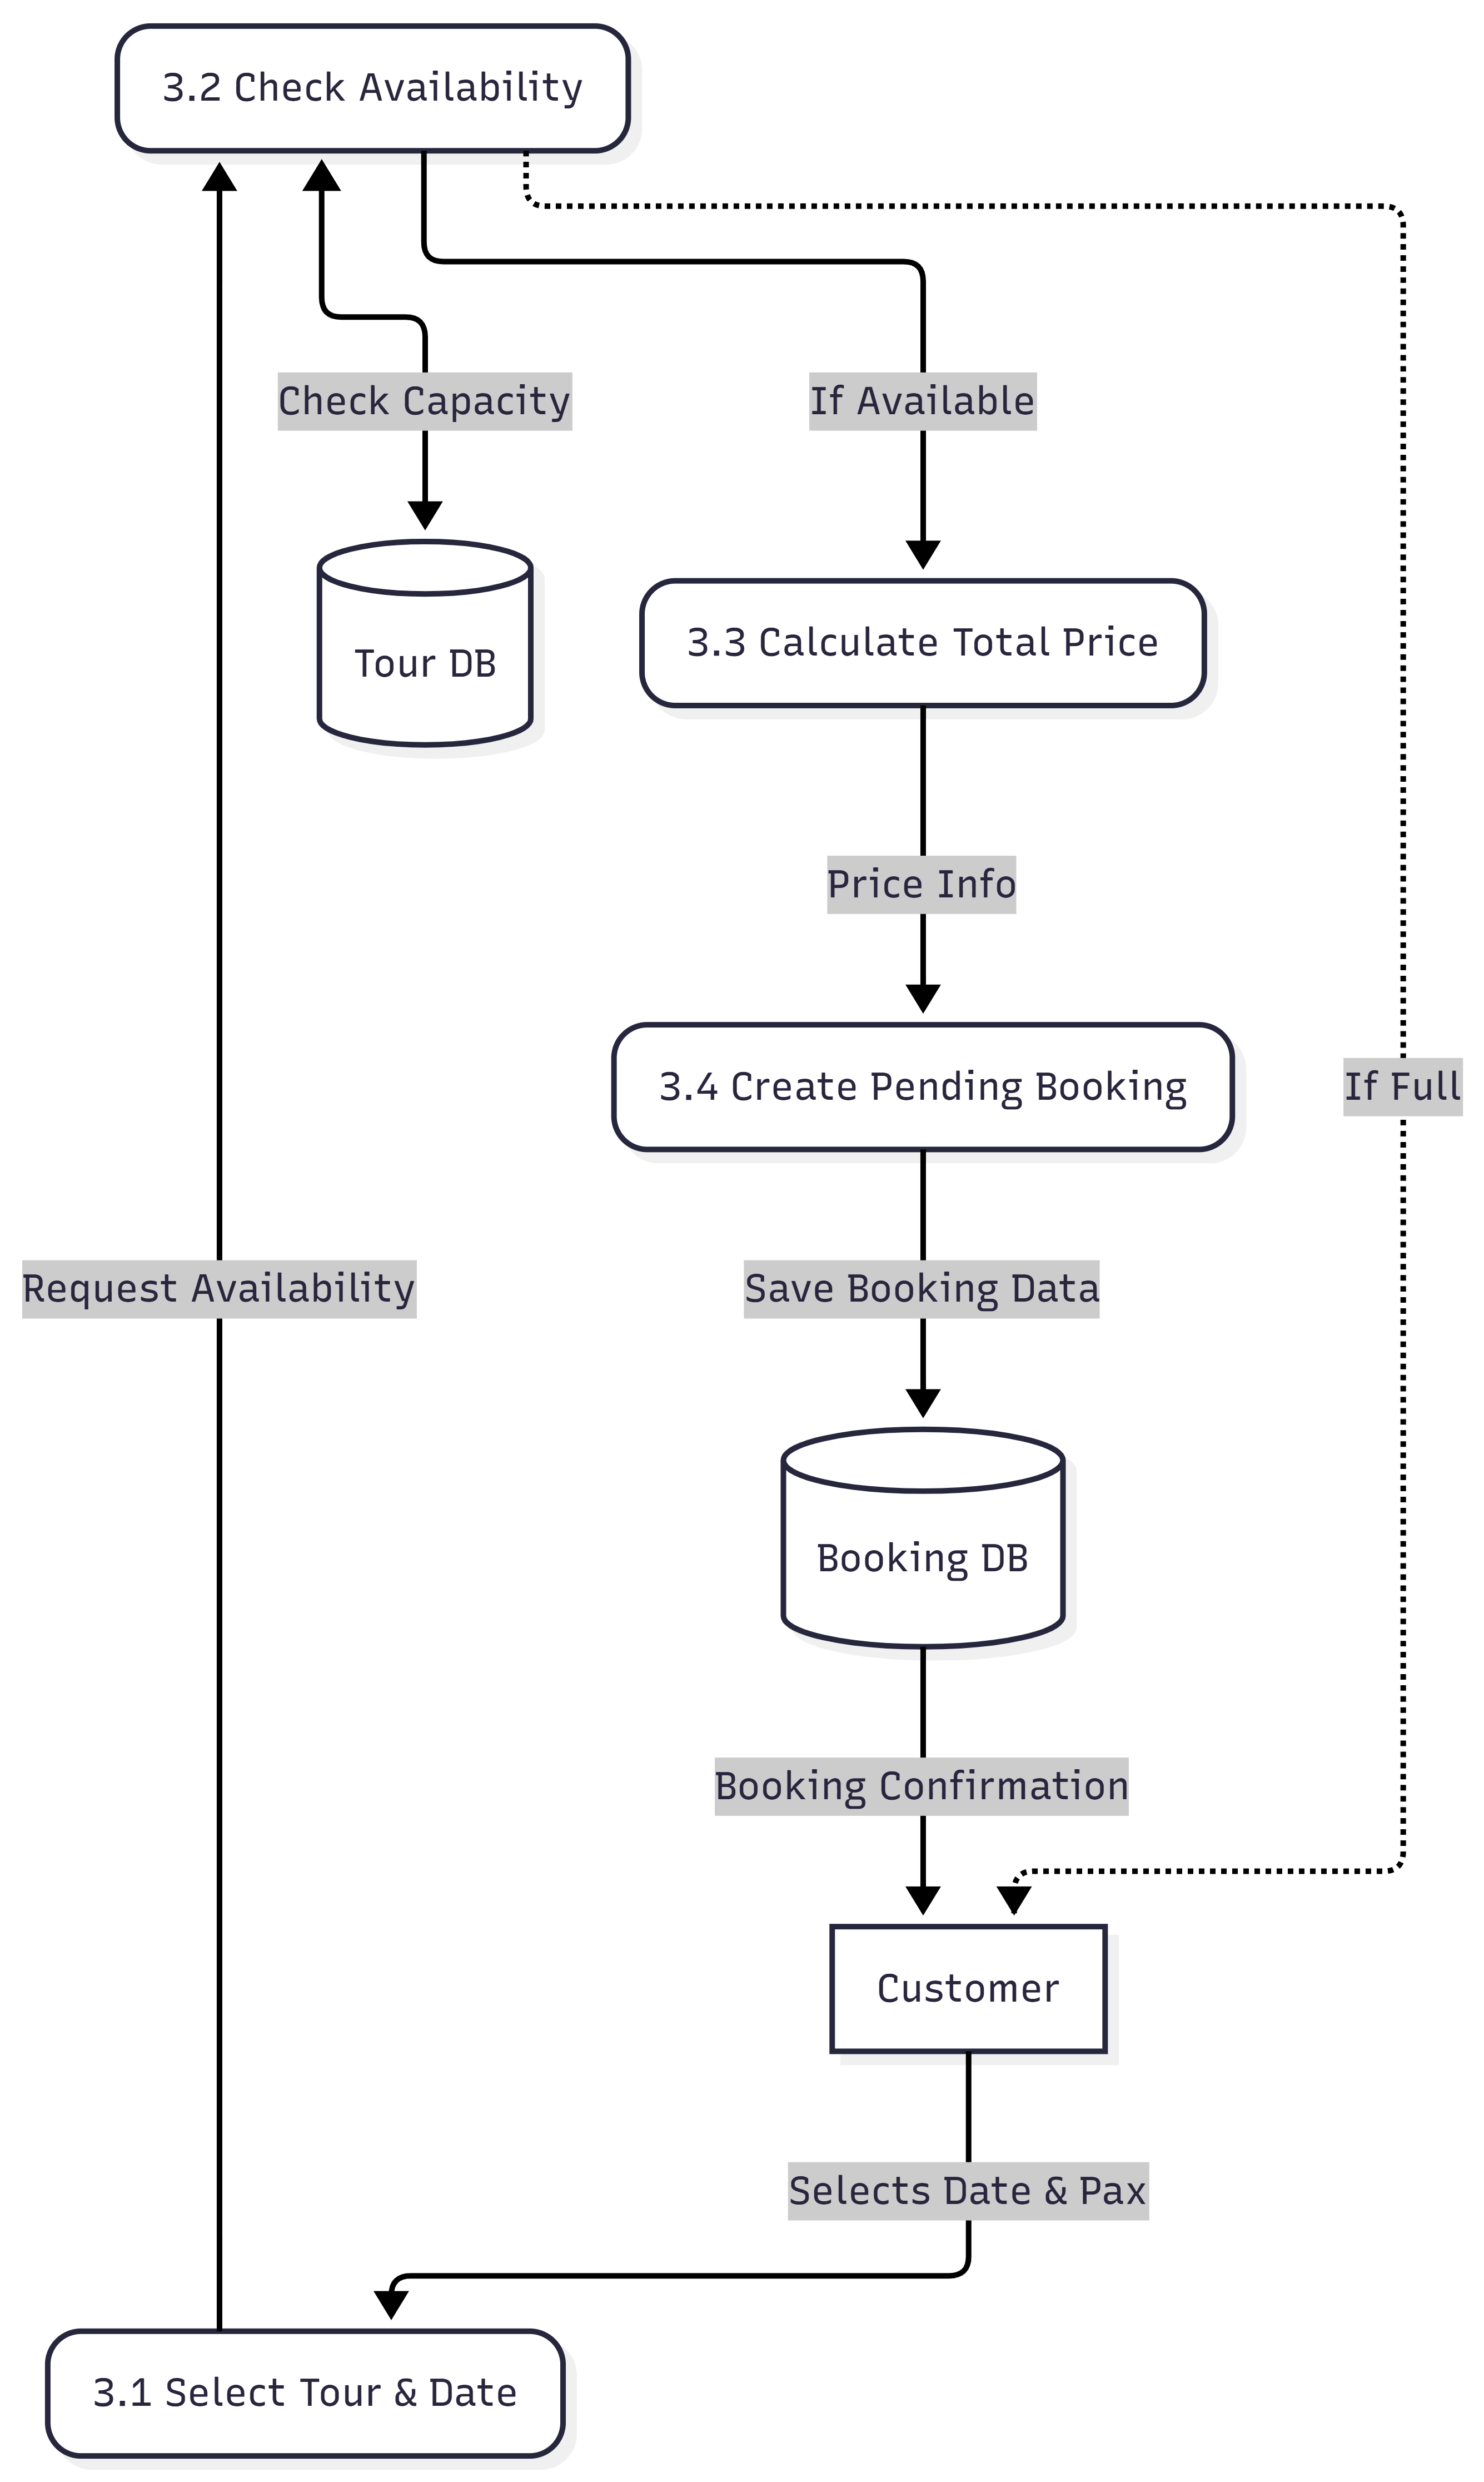
DFD - Level 2
BondVoyage
Project Briefing
Tools & Technology
ER Diagram
DFD Level - 0
DFD Level - 1
DFD Level - 2

Slide 8
Thank You!
GitHub Repo:
https://github.com/rajbafna_111/bondvoyage

