Slide 1

NextHikes IT Solutions
Bike Sharing Demand: A Data-Driven Analysis
Optimizing Operations through Weather and Time Insights
Presented by: Raj Bajaj

Slide 2
Project Objectives :
Goal: To analyze how environmental factors (weather) and factors (time/holidays) influence bike rental behavior.
Business Value:
Predict peak demand to ensure bike availability.
Optimize maintenance schedules.
Improve marketing ROI by targeting high-demand weather m conditions.

Slide 3
Data Methodology:
Data Integration:
Merged three distinct datasets using the instant key via Power Query/VLOOKUP.
Data Cleaning:
Handled missing values and removed duplicates.
Standardized date and numerical formats.mm…/.
Feature Engineering:
Created new categories: mmmmmmmmmmmm..
week_name, heat (Temperature bins), and weather.

Slide 4
Dashboard:
Visual Highlights: Hourly trends, Weekday vs. Weekend volume, and Weather impact.
Interactivity: Integrated Slicers (Season/Holiday) for dynamic filtering.
Key Benefit: Allows to shift from static reports to real-time exploration.

Slide 5
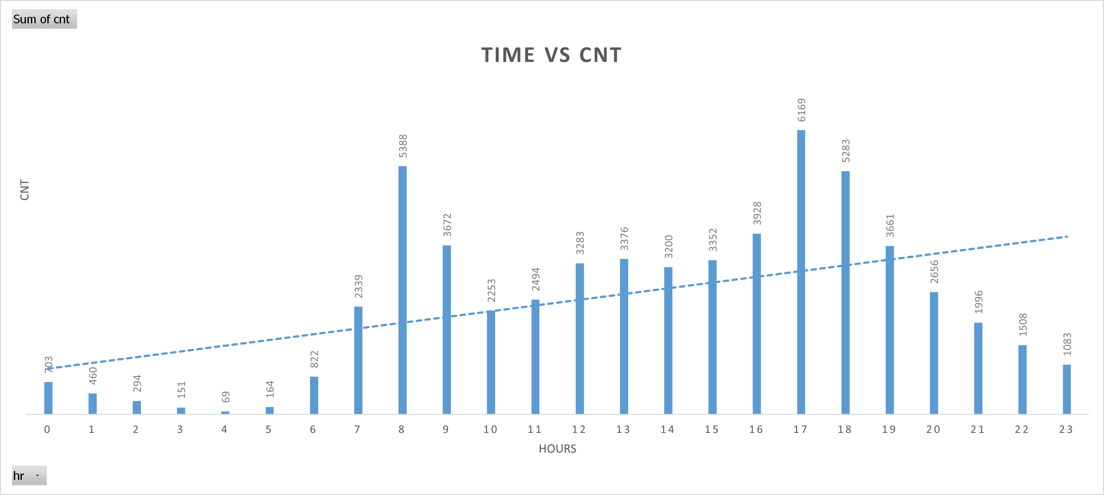
Key Finding – Time
Peak Hours: 8:00 AM and 5:00 PM
The Mid-Day Lull: Demand drops by 20% between 10:00 AM and 2:00 PM.
Recommendation: Schedule bike re-balancing and minor repairs during the mid-day lull to ensure maximum fleet availability for the evening peak.

Slide 6
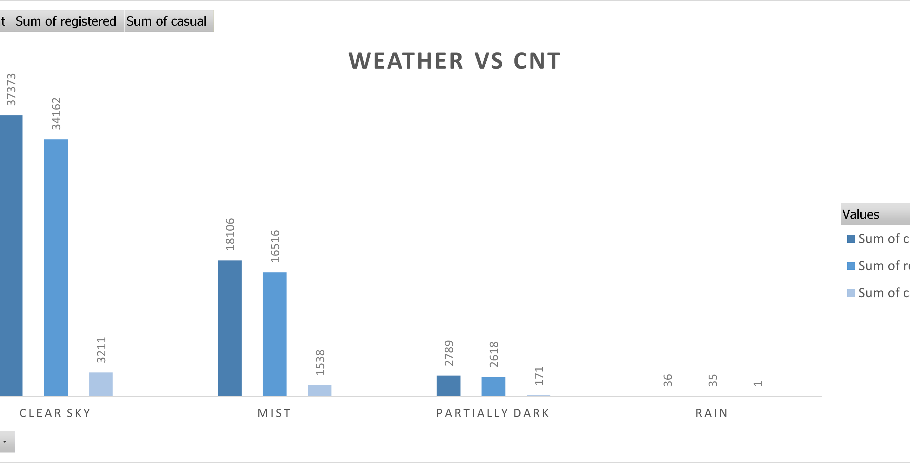
Weather Impact – Humidity vs. Temperature
Humidity: The primary deterrent (Correlation: -0.23). Rentals drop significantly when humidity exceeds 60%.
Temperature: A steady positive driver (Correlation: +0.23).
Insight: "Clear Sky" days see 40% more rentals than "Misty/Rainy" days.

Slide 7
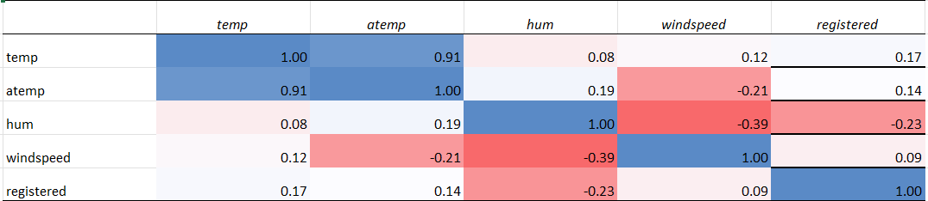
Statistical Analysis & Correlation
Method: Used CORREL, STDEV, and SUMIF functions to quantify relationships.
Redundancy Check: High correlation between temp and atemp (0.91) suggests we only need one for predictive modeling.

Slide 8
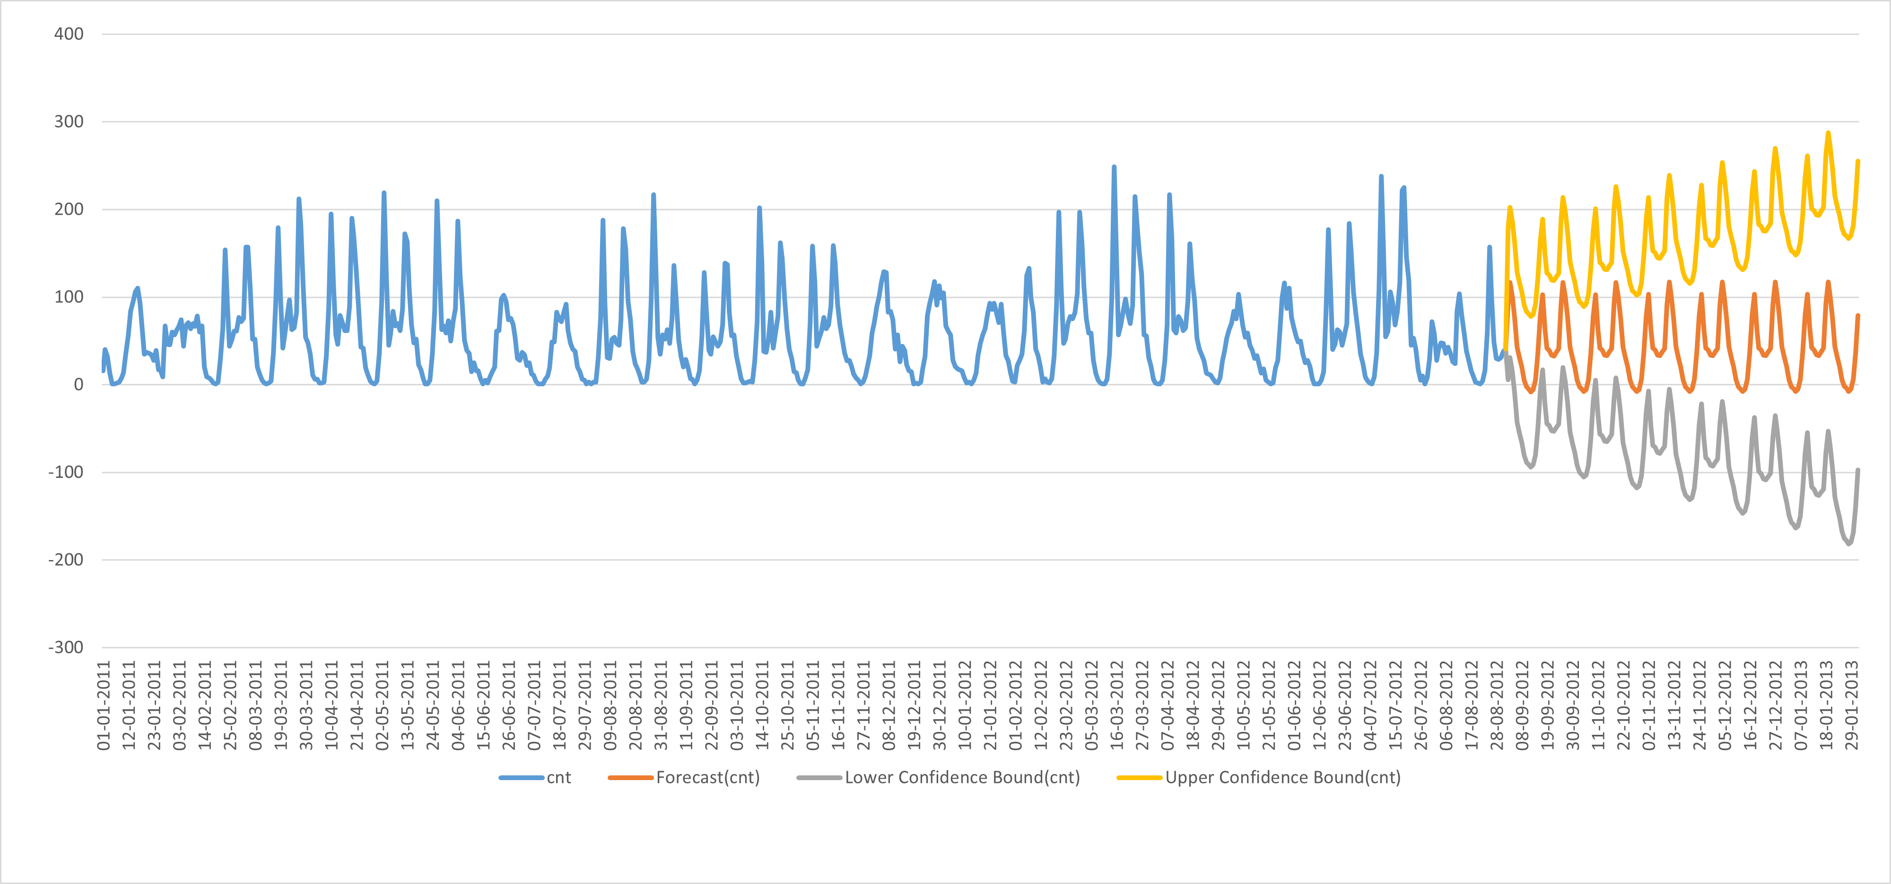
AI-Powered Forecasting
Model: Exponential Smoothing (ETS) via Excel’s Forecast Sheet.
Outcome: Predicted a 15% growth trend for the upcoming period.

Slide 9
Strategic Business Recommendations
Staffing: Increase fleet redistribution staff at 4:30 PM to handle the 5:00 PM peak.
Marketing: Launch "Low Humidity" promotions to drive rentals during comfortable riding weather.
Dynamic Pricing: Test small discounts during "Misty" weather to encourage usage among casual riders.

Slide 10
Thank you!

