Slide 1

NextHikes IT Solutions
Building a Basic GUI Calculator
Developing a Graphical User Interface using Python
Presented by: Raj Bajaj

Slide 2
Project Introduction :
Objective: To transition from a simple command-line script to a reusable, visual Graphical User Interface (GUI) application.
Goal: Create a functional calculator that handles basic arithmetic.
Core Focus: Enhancing presentation and reusability of Python code.

Slide 3
Technologies Used :
Python: The core programming language used for logic.
Tkinter Library: The basic GUI toolkit for Python used to build the window and buttons.
Visual Studio Code (VS Code): The Integrated Development Environment (IDE) used for writing and debugging the script.
GitHub: Used for version control and hosting the project repository

Slide 4
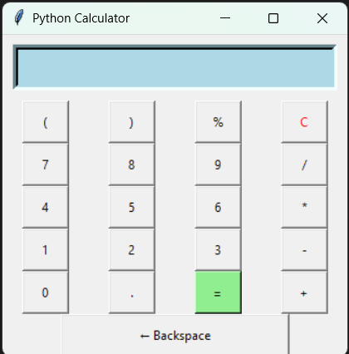
Essential Features :
Equation Display Area: A screen to exhibit mathematical expressions and results.
Interactive Buttons: Clickable numerical values (0-9) and mathematical operators.
Core Math Functionality: Support for Addition, Subtraction, Multiplication, and Division.
Utility Functions: A Clear (C) button to reset the display and an Equals (=) button to execute calculations.

Slide 5
Project Logic :
GUI Construction: The layout is managed using the grid() system to organize buttons in rows and columns.
Event Handling: Each button is linked to a function that captures user input.
Evaluation: The Python eval() function is used to process the string from the display and return a mathematical result.
Error Handling: Implementation of try-except blocks to prevent the app from crashing on invalid inputs.

Slide 6
Conclusion & GitHub Link:
Learning Outcome: Successfully developed a functional Python GUI application.
GitHub Repository: https://github.com/rajbajaj12022006-pixel/Project_2_NHIS.git

