Slide 1



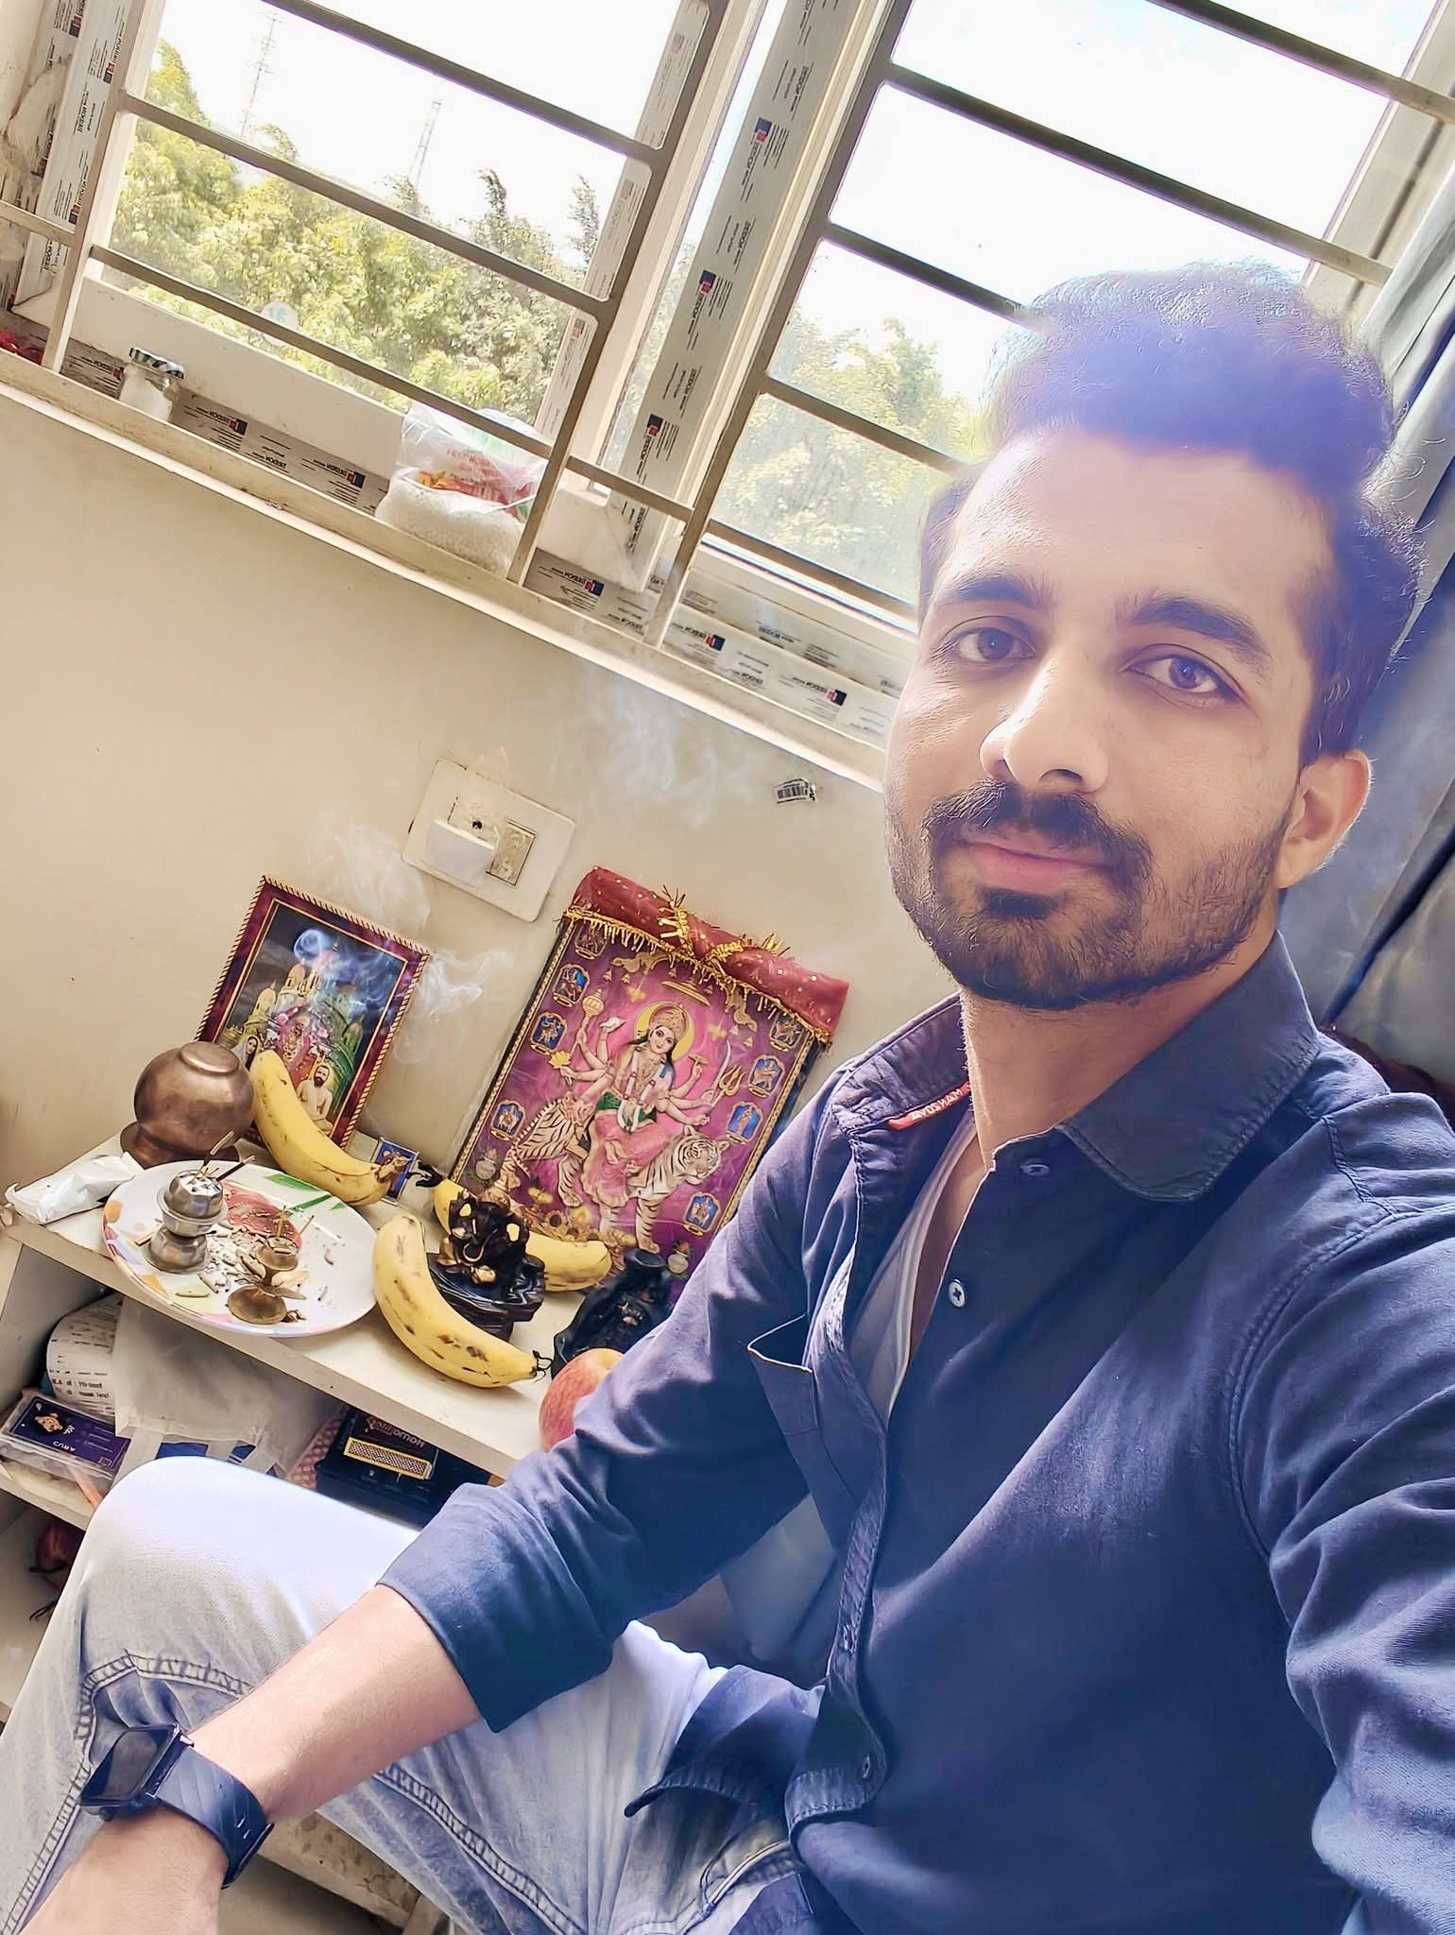

Consultant
Profile
Experience
Worked on JAVA based Technology.
Having Experience in implementation of oAuth2(Swagger).
Familiarity with Git or similar versioning systems.
Developed Web Applications using Apache Web Server.
Deploy the Project on Server using Putty.
Experience with REST Web Services, JSON.
Having Experience in Junit / Mockito unit test cases.
Basic Knowledge in Azure Cloud, Docker, Kubernetes.
Experience in Jira tool.
Having Experience in Spring + Hibernate and Sonar Lint (Locally) And Javadoc.
Have work experience in Support Application like Maximo, Ticketing tools etc.
Ability to handle a team of developers.
Have work experience of Analysis, Design & Use case analysis.
Coding as per as requirement.
Having Experience in Spring Boot Caching (Use of Cacheable annotation)
Worked on Aws Poc (pushing Json data into stream using aws using Firehose)
By using JD-GUI, we can check object is created or not inside jar file.
Having Experience for merging code while pull requests in GitHub.
Worked on Json Schema to Java (POJO)
Capgemini, Bangalore. Consultant
July 2025 – till now
Cognizant , Kolkata. Associate
June 2022 - July 2025
Project Name – EDM (Encounter Data Manager)
Client Name – TRIZETTO
Description: Designed and developed a healthcare microservice application to manage, validate, and submit encounter data in compliance with CMS guidelines. The project was built as part of the TriZetto product suite to streamline provider-to-payer data exchange.
Developed RESTful APIs using Spring Boot for ingesting and processing healthcare encounter data.
Implemented Spring Data JPA to handle relational data storage and complex queries with MySQL.
Integrated robust data validation, logging, and error-handling mechanisms to support HIPAA compliance.
Containerized the application using Docker for environment consistency and easier deployment.
Implemented CI/CD pipeline using GitHub Actions, automating build, test, and deployment processes.
Collaborated via GitHub for source control and pull request-based code reviews.
Accenture, Kolkata, Application Developer Analyst
Apr 2021 – June 2022
Project Name – Mondelez Fenix Federation
Project Description: Fenix Federation establishes a federated network of transport and logistics actors across Europe, enabling sharing of information and services. All the Platforms which are part of the federated network has to develop a Fenix Connector to interact with the Federation and also with other platforms to reach out to its resources. Mondelez is one of the Platform. Responsibilities: Developed API’s using Spring Boot, Developed the Maven Project and Build. Worked on Junit/Mockito unit test cases and Analyze the Sonar Lint issues.
Raj Kumar
Software Engineer
Competencies
Java Version: Java 1.7, Java 1.8, Java 11
Programming Language: Core Java, Spring Boot, Hibernate, JUnit, Swagger, Docker, Collection, Jsp-Servlet, JDBC, JSTL, SQL, HQL, JPA, Web Services-API, Spring Mvc, Thyme leaf, JWT, Eureka Server, Kafka
Cloud Services: Azure Cloud, Jira, AWS
Comm & Msg System: Rest API, Kafka
Dev ops : Jenkins, Docker, Kubernetes, Concourse
Architecture: Microservice, Monolithic
Database Technologies: MySQL, MS SQL, PostgreSQL
Configuration Tool : Maven, Bitbucket, GitHub, Git, Log4J.
Design Tools: STAR UML, IO Draw and RSA.
Servers : Tomcat
Education
BE, Computer Science Engineer and Engineering ,
RGPV, Bhopal, MP, India.

