Slide 1
MLOPS Assignment 1 Bimal 10/23/25
Comparing Data Versioning Tools
lakeFS vs Weight and Biases
Impact of Differential Privacy on model Accuracy/Metrics
Applying privacy techniques ensures sensitive data remains protected in machine learning workflows at the cost of accuracy.

Slide 2
Comparing Data Versioning Tools

Slide 3
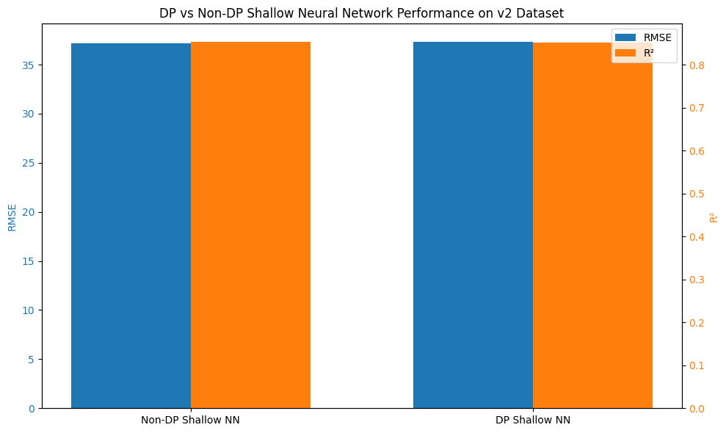
Impact of Differential Privacy on model Accuracy/Metrics
The DP model introduces noise during training to protect individual data points. Despite this, the performance degradation is minimal:
RMSE increased by only 0.14 units.
R² dropped by just 0.0011.
This shows that the DP model maintains strong predictive power while offering privacy guarantees.
Both models perform very well. The non-DP model is slightly more accurate, but the DP model is nearly as good and provides privacy protection. If privacy is a concern (e.g., sensitive athlete data), the DP model is a highly viable choice with minimal trade-off in accuracy.
An ε of 10.81 indicates weaker privacy guarantees than typical DP applications (which usually target ε between 1-8). However, since our v2 dataset contains no sensitive personal information (e.g., names, addresses), this higher privacy budget is acceptable for our use case.

