Slide 1
Prostate Cancer Classification
- Bharat Nagaraju

Slide 2
Problem Statement
Prostate gland magnetic resonance imaging (MRI) data available from SPIE-AAPM-NCI Prostate MR Gleason Grade Group Challenge (Prostrate X2)
112 Subjects – Training ; 70 Test Subjects
CG and PZ – are not easily identifiable in Biopsy. Hence, we need a better approach

Slide 3
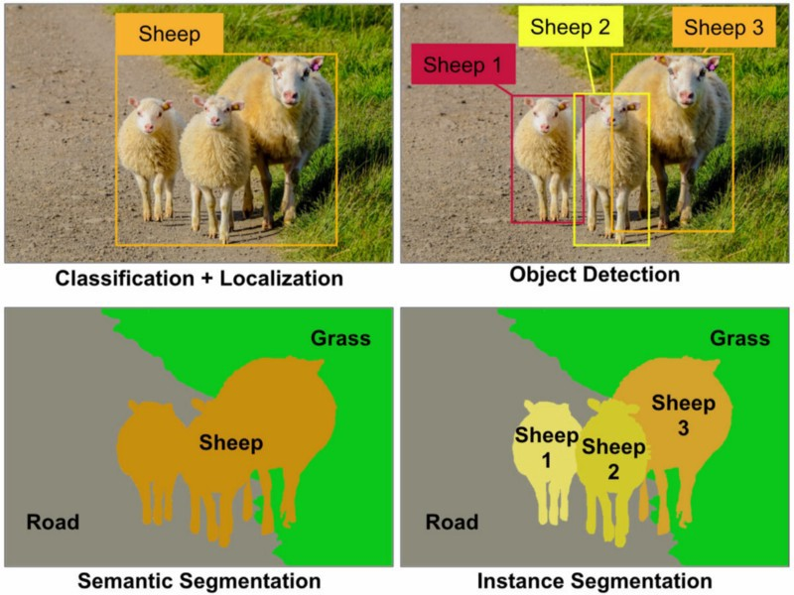
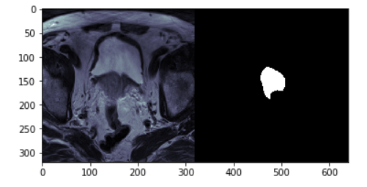
Segmentation & Classification

Slide 4
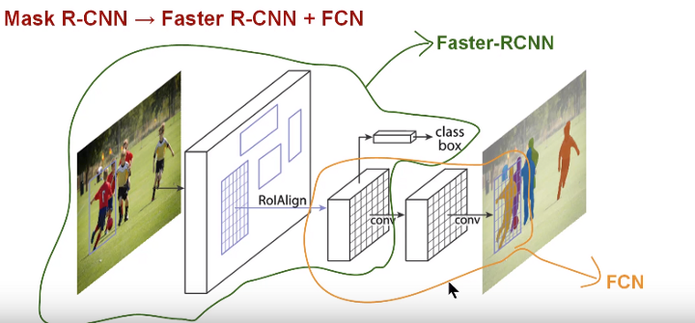
Existing system
Mask-RCNN, CNNs & 3D CNNs model overfits easily without image augmentation.
Resource Utilization is quite high & not scalable
AutoEncoders + tSNE. Low True Positive accuracy for Cancer cases
Few U-Net & 3D U-Net serve as benchmark (90+ or – 4%)

Slide 5
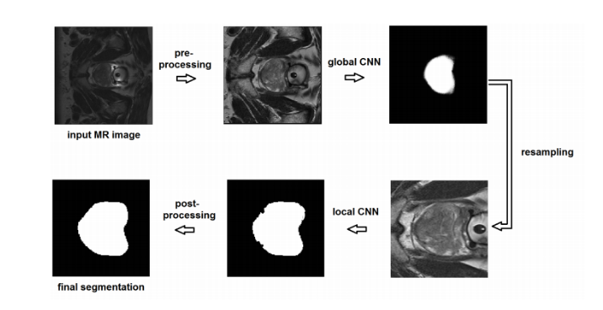
Existing system - Baseline
CNN & State of Art CNN Sequence Models

Slide 6
Proposed system
Auto-Encoders , it is a deep-learning framework based on FCNs.
Auto Encoders has below advantages
Computationally efficient
Trained end-to-end

Slide 7
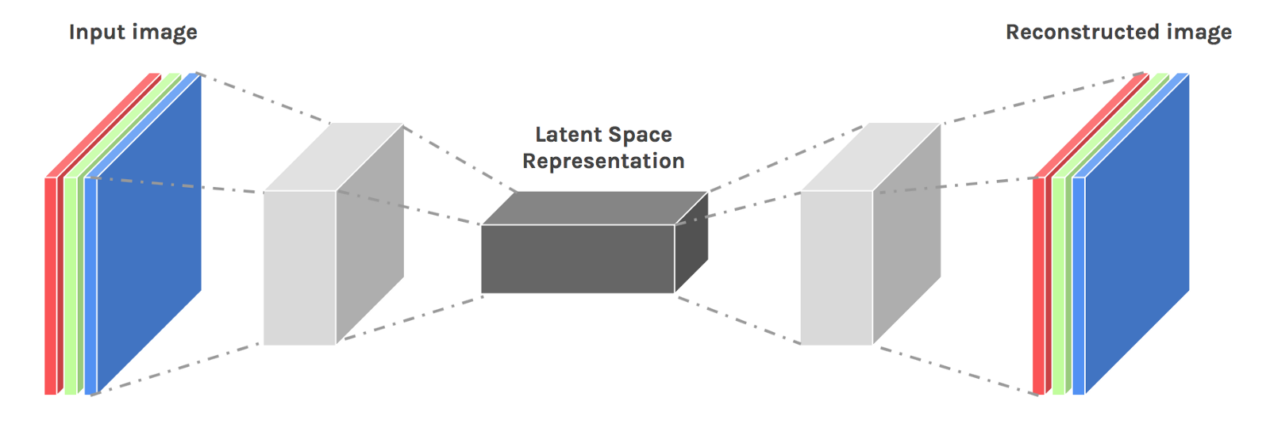
Proposed system
Convolutional Autoencoder are autoencoders that use CNNs in their encoder/decoder parts.
Convolutional Autoencoder is an autoencoder, a network that tries to encode its input into another space (usually a smaller space) and then decode it to its original value.
Based on the type of input, you can use different types of networks for encoder and decoder. For example, if your input is Bag Of Word Vector, you’ll probably use a Fully Connected network; if your input is a time series, you’ll probably use a recurrent neural network (RNN); and if your input is image, you’ll probably use a Convolutional Neural Network (CNN).

Slide 8
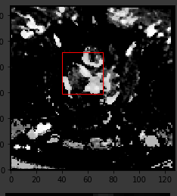
Pre processing
Conversion of Dicom / Mhd files to nifty & Resampling for uniform voxel spacing according to findings in EDA
Equalize Image histogram, Rotate Image, Rescale Intensities, Extract Patch
Cancer cases are oversampled by adding 4 rotations (45, 90, 180, 270) to the dataset since the cancer cases are imbalanced by 1/3 ratio
A Typical 32x32 resized patch appears as shown on the right

Slide 9
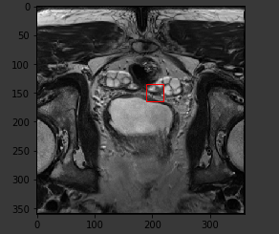
Modelling
Data for 4 Channels – ADC, T2, Ktrans, Bval are retained and processed separately without combining them. Hence , Different models for different channels
Based on Gleason grade, Cancer Images are marked as Clinically Significant or not
Clinically Significant Cancers are Marked

Slide 10

Network Architecture

Slide 11
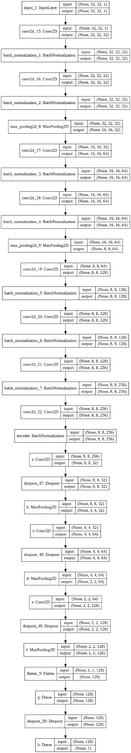
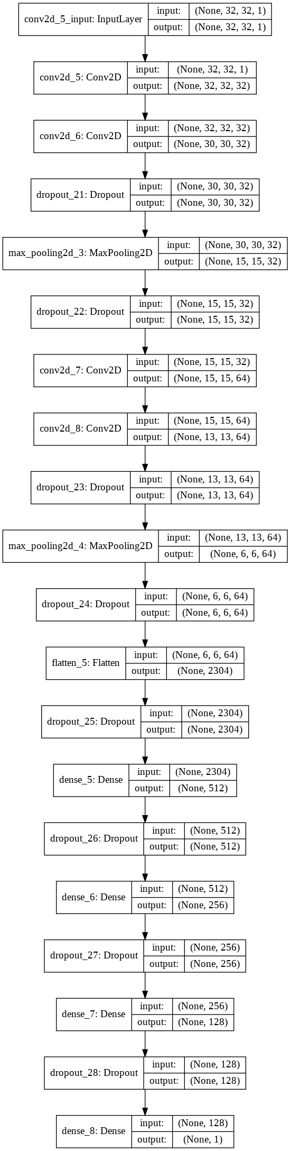

Slide 12
Training & Cross-Validation
Besides rotation, scaling and gray value augmentation, we apply a smooth dense deformation field on both data and ground truth labels as part of pre-processing.
K-Fold Cross Validated (K=5) for different channel models
Hardware – Tesla K80 24 gig (Colab)

Slide 13
Experiments
Playing around with Hyper Parameters
- Image Size – 32,64,128
Iterations – 1000,5000,7000,10000
max_scans: 32,16, 8
With and Without BN
Batch Size, BN, Weights, Learning rate
Models – Compared with Baseline CNN Sequence / Stacked Model

Slide 14
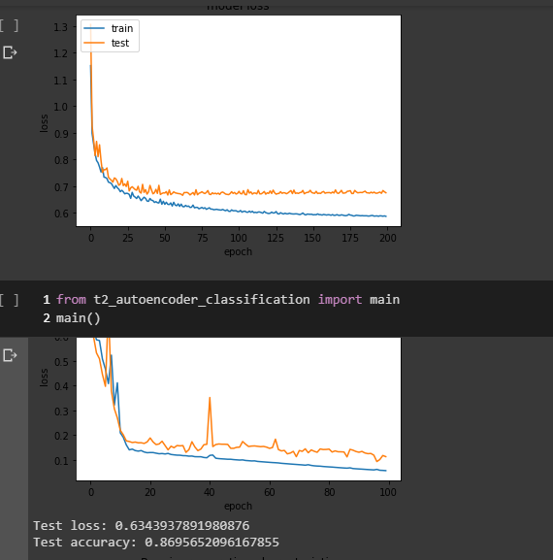
Results

Slide 15
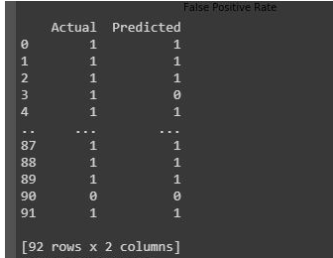
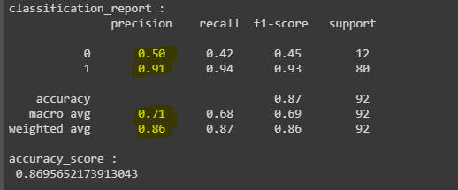
Results Continued

Slide 16
Limitations and Improvements
Although, Its an end to end model – The model can perform better by
Reduce False Negatives
The model can also be enhanced to identify the mask / target location of the cancer

Slide 17
Progress
Draft Paper is ready
Screenshots of Successful run is available
Compared with State of Art Benchmarks
Tune the network for better performance

Slide 18
Thank You
References:
https://medium.com/@SeoJaeDuk/achieved-post-a-novel-deep-learning-based-method-for-prostate-segmentation-in-t2-weighted-229cec073758
https://towardsdatascience.com/autoencoders-are-essential-in-deep-neural-nets-f0365b2d1d7c
https://arxiv.org/abs/1901.09462
https://openreview.net/pdf?id=Syoj0k2iG
https://www.sciencedirect.com/science/article/pii/S2352914819302588
https://github.com/alexhamiltonRN/ProstateX
https://wiki.cancerimagingarchive.net/display/Public/SPIE-AAPM-NCI+PROSTATEx+Challenges#715aea9571044e3e8577f712808173e8
https://arxiv.org/ftp/arxiv/papers/1904/1904.02575.pdf
https://meetshah1995.github.io/semantic-segmentation/deep-learning/pytorch/visdom/2017/06/01/semantic-segmentation-over-the-years.html
https://towardsdatascience.com/semantic-segmentation-popular-architectures-dff0a75f39d0
https://towardsdatascience.com/semantic-segmentation-of-aerial-images-using-deep-learning-90fdf4ad780
https://towardsdatascience.com/u-net-b229b32b4a71

