Slide 1
Windows Registry Change Monitoring System
Host-Based Intrusion Detection (HIDS) for Persistence
Created by: Raj Bharti

Slide 2
Project Objective
Problem: Malware often hides in the Windows Registry (Auto-Start keys) to survive system reboots (Persistence).
Goal: Develop a monitoring tool to detect unauthorized changes to critical Registry keys.
Scope: Real-time monitoring of HKCU\...\CurrentVersion\Run keys using Python.

Slide 3
Technical Implementation
Language: Python 3.x (using 'winreg' library).
Method: Integrity Checking (Baseline vs. Current State).
Key Function: Periodic polling (every 3s) to detect new values.
Output: Immediate console alerts and persistent logging.

Slide 4
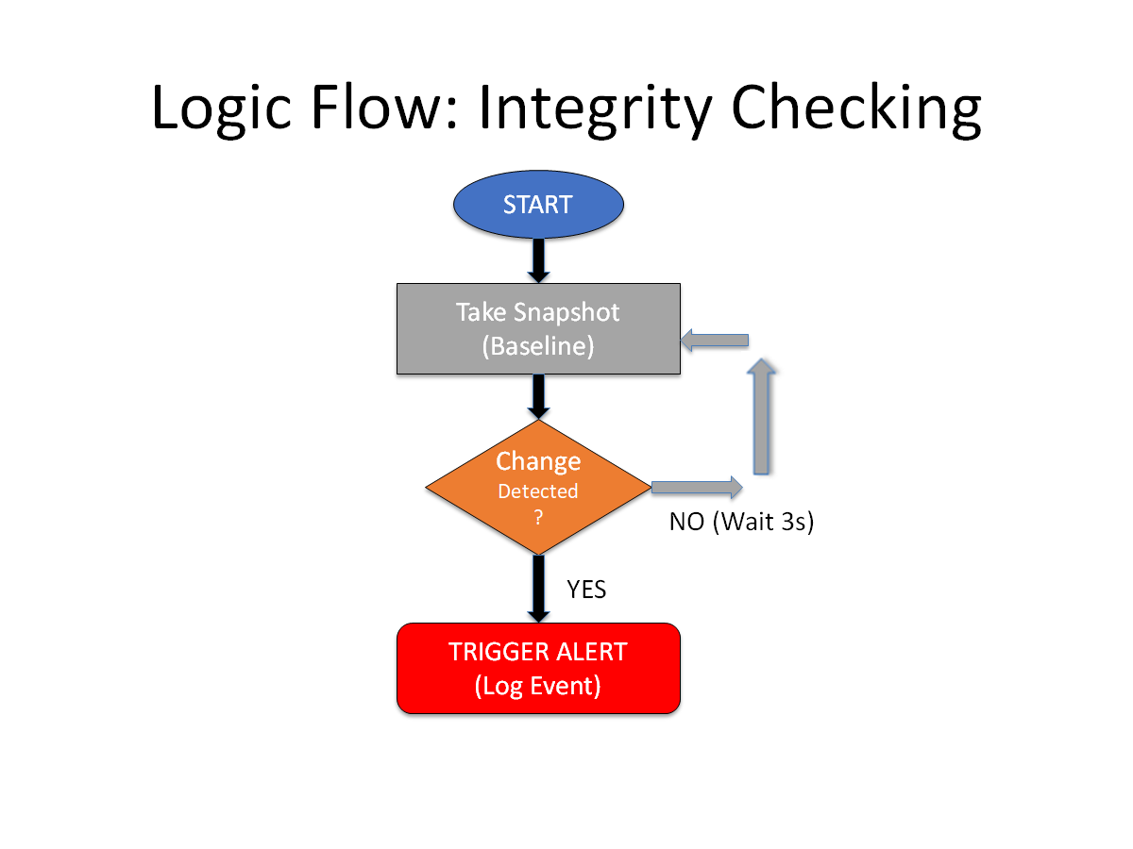
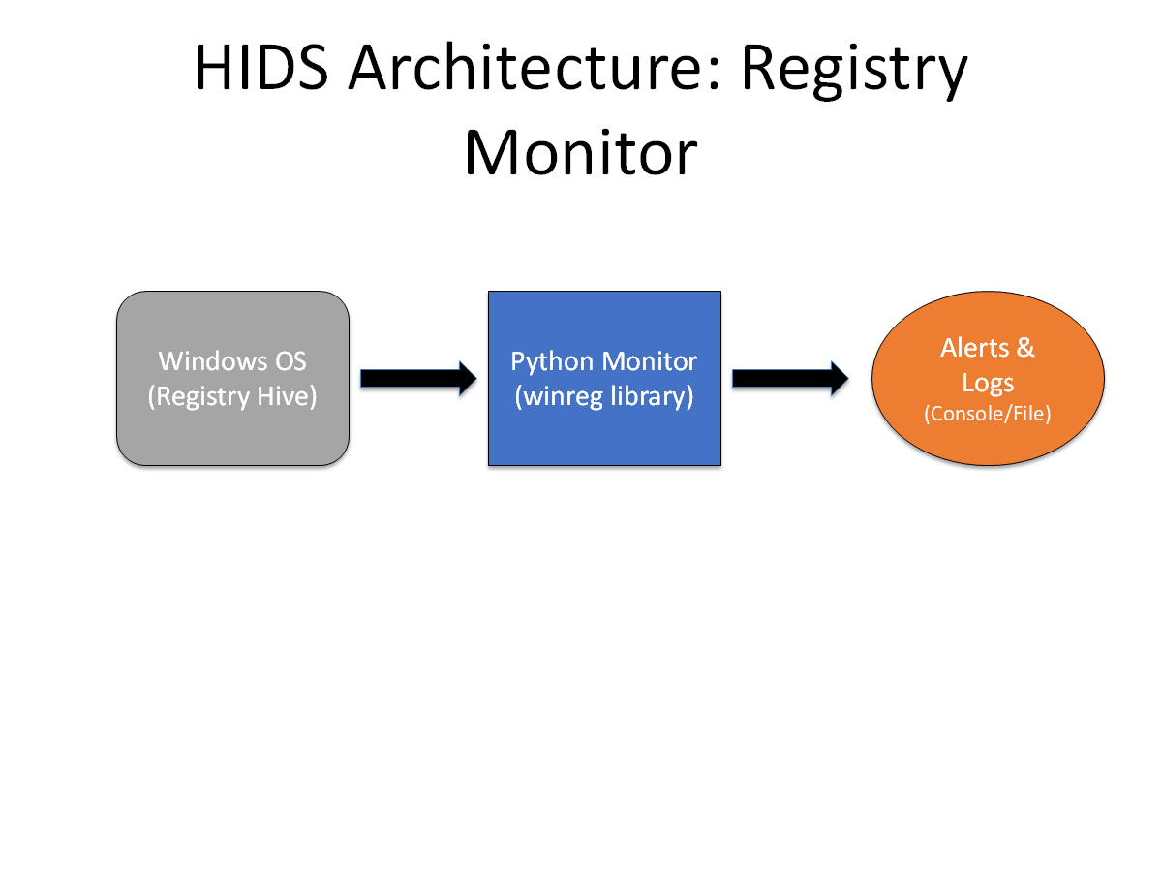
System Design
1. 2.

Slide 5
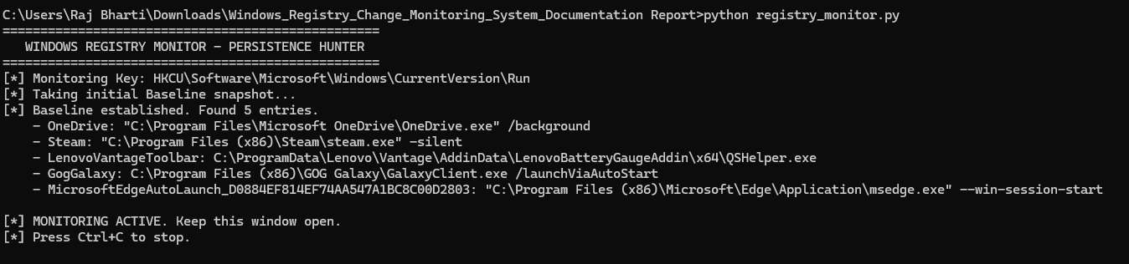
Proof of Concept
Scenario A: Establishing Baseline
Scenario B: Detecting 'TEST_MALWARE'

Slide 6
Conclusion & Impact
Outcome: Successfully built a HIDS that detects Registry persistence.
Key Feature: Instant detection of unauthorized autostart programs.
Security Impact: Reduces 'Dwell Time' of malware by alerting admins immediately.
Future Improvements: Integrate with Windows Event Logs or email alerts.

